Slide 1

The Concert of Europe 1815 - 1914
AP European History – Mr. Ott

Slide 2
The Concert of Europe
The Concert of Europe was established to primarily prevent one nation from taking a major action in international affairs without consulting other nations first.
Created in response to the French Revolution and Napoleon's rule.
It's goal was to maintain European peace, prevent further French aggression, and uphold balance of power unto Russia's military might, which posed a possible military threat.

Slide 3
The French Revolution
The French Revolution was a primary contributor to the creation of the Concert of Europe, as to prevent the spread of radicalism.

Slide 4
Creation of Concert
From the outbreak of the French Revolutionary Wars in 1792 to the exile of Napoleon I to Saint Helena in 1815, Europe had been almost constantly at war.
During this time, the military conquests of France had resulted in the spread of liberalism throughout much of the continent, resulting in many states adopting the Napoleonic code.
Largely as a reaction to the radicalism of the French Revolution, the victorious powers of the Napoleonic Wars resolved to suppress liberalism and nationalism.

Slide 5
Origins
The idea of a European federation had been brought up many times by other leaders, such as Gottfried Liebinz, and the 1st Baron of Granville.
The end product of the Congress of Vienna, and combined effort of the Holy/Quadruple Alliance, though mainly on the Quadruple Alliance's part.

Slide 6
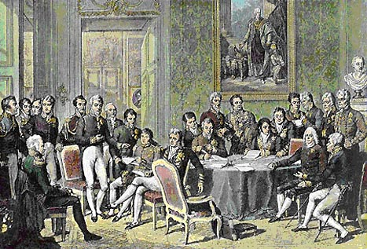
The Congress of Vienna
- To restrict wars of aggression by France: France had been an aggressive force in Europe since Louis XIV.
- That a balance of power must be maintained: It was felt that an equality of force among disparate European powers would create enough uncertainty that rulers would not be inclined to risk the use of aggressive force. It would make it more difficult for one nation to dominate Europe.
- A system of rewards and punishments for past deeds must be in place: This would discourage European powers from future aggrandizement. (Not to mention the fact that it would reward the current participants in the Congress.)
- Countries must be ruled by legitimate governments.
Before the Concert of Europe, the Congress of Vienna provided the base ideas for the Concert of Europe's main tenets.

Slide 7
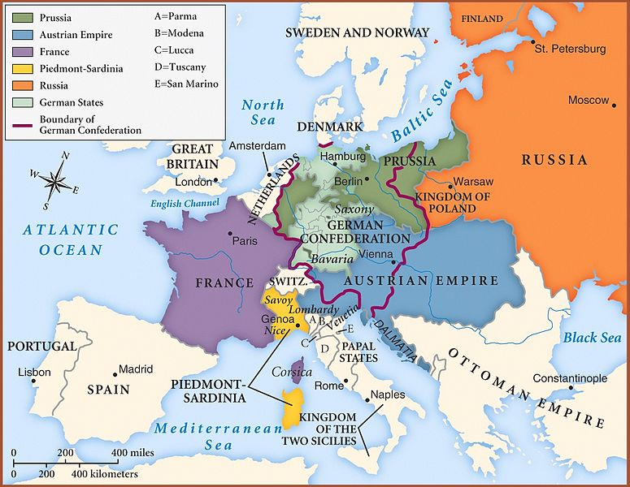
National boundaries of Europe set by the Congress of Vienna, 1814.

Slide 8
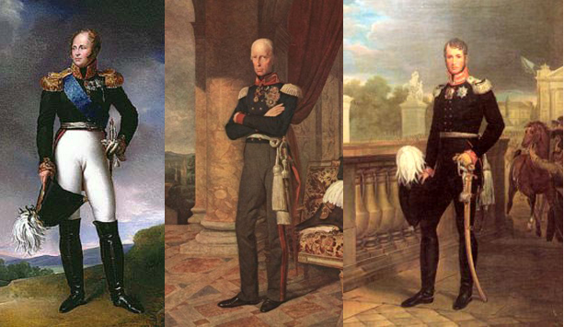
Factions
The Holy Alliance;
Alexander I, Tsar of Russia, believed that he had been appointed by God to destroy Napoleon. After the Napoleonic Wars he felt that the best hope for peace in Europe was to create an alliance where the states participating would swear to abide by Christian principles. Prussia and Austria joined with Russia in this alliance.
Austria, Prussia, and Russia pictured from left to right.
Franz I, Friedrich Wilhelm III and Alexander I.

Slide 9
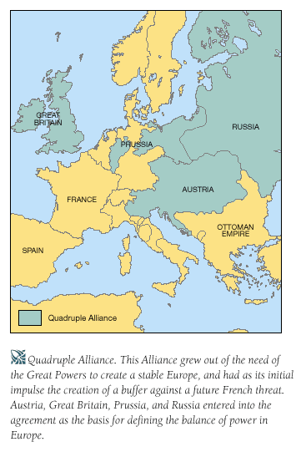
Factions
The Quadruple Alliance
In the wake of the Napoleonic Wars there was a mania for alliance building. The Quadruple Alliance was an effort to keep together the force that had finally destroyed Napoleon. The Quadruple Alliance included Great Britain, Russia, Austria, and Prussia. They agreed to meet periodically to resolve the problems of Europe. (France joined in 1818, making it the Quintuple Alliance.) Thus, congresses of Europe met until about 1822 when there was a falling out about the right of the alliance members to interfere in the politics of other states. Britain left, and the alliance withered away.

Slide 10
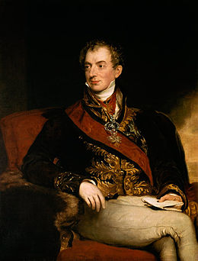
Prince von Metternich
The Concert of Europe was conducted by the Austrian Prince Metternich, hence the reason why the age of the Concert is commonly referred to as the age of Metternich.

Slide 11
The Congress System
In the years immediately after the Congress of Vienna and the Concert of Europe, the new congress system of mutual cooperation and consultation functioned well.
The first congress took place in 1818 at Aix-la-Chapelle in Germany near the border of Belgium.
The four major powers removed their troops from France, which paid war reparations, and readmitted France to good standing among the European nations.

Slide 12
Ideologies of Change
Liberalism
Economic liberalism (classical economics)
Laissez-faire
Support for representative government dominated by the classes and minimal government economy interference
Nationalism
Part of a community with common institutions, traditions, language, and customs
The community is called a “nation”
Nationalist ideology
Allied with liberalism

Slide 13
Congress System After effects
The Revolt of Latin America
When Bourbon Ferdinand VII of Spain came up on the throne after Napoleon's downfall, he promised to govern according his constitution, but ignored that after he came up. The European countries saw this as a reason to intervene with revolution on the verge.
Bourbon monarchy of Spain toppled
Latin American countries begin declaring independence
Simón Bolivar (1783-1830)
Liberated Venezuela in 1810
José de San Martín (1778-1850)
Protector of Peru

Slide 14
Aftermath
It was the first time since the middle ages that Europeans had made any significant strides toward unity and continental peace.
Though, war and revolution would occur during the remainder of the century but, theoretically it was a peaceful period, and the people of Europe were generally grateful for the time of growth, stability, and prosperity which followed.

Slide 15
Wars
Crimean War 1854–56 (Russia vs UK, France (2nd Republic), Ottoman Empire, Sardinia)
Italian War of Independence 1859 (France (2nd Republic) & Sardinia vs Austrian Empire)
Austro-Prussian War 1866 (German Confederation, Austrian Empire vs. Prussia, German Allies, and Italy)
Franco-Prussian War 1870–71 (France (2nd Republic) vs Prussia, Northern German Confederation)
German victory; Treaty of Frankfurt
Formation of the German Empire
Fall of the Second French Empire
Formation of the French Third Republic
German annexation of Alsace-Lorraine
The following wars can be deemed as important, as the Concert of Europe and beliefs of the Congress of Vienna were subjugated (subdued, defeated), as demands for revisions of the frontiers were rampant, later causing the Concert to unravel in the later 19th century.

Slide 16
Fall of the Concert
After an early period of success, the Concert began to weaken as the common goals of the Great Powers were gradually replaced by growing political and economic rivalries.
While the Congress System had a further significant achievement in the form of the Congress of Berlin (1878) which redrew the political map of the Balkans, the old balance of power had been irrevocably altered, and was replaced by a series of fluctuating alliances.
By the early 20th century, the Great Powers were organized into two opposing coalitions, and the First World War broke out.

Slide 17
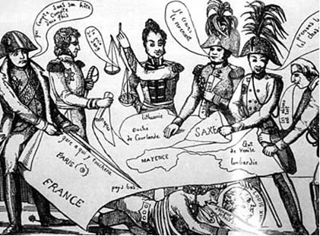
A political cartoon portrayal of the Concert of Europe.

