Slide 1
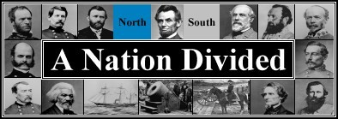
The Civil War
The American War between the North and the South
Aim: Who were the people and their effects of their actions?
Do Now: In your notebook, Name two (2) reasons for the Civil War?

Slide 2
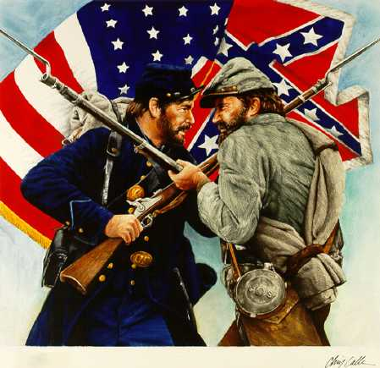
The American Civil War (1861 - 1865) was one of the most violent times in the History of the United States. More than 600,000 men gave their lives for their country in this war. More lives lost in one war than in all almost all wars and conflicts combined.

Slide 3
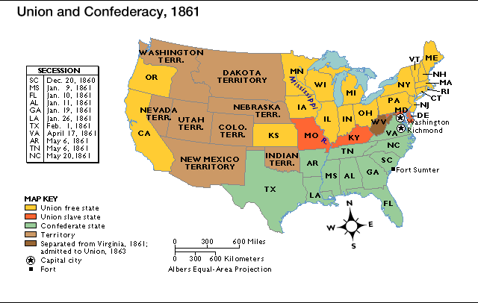

Slide 4
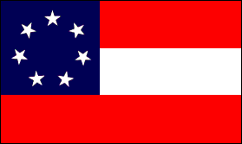
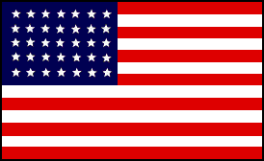
Two Nations? - 2 Flags
Confederate Flag U.S.A. Flag (1864)
Rebel - REB
YANKEE- YANK

Slide 5
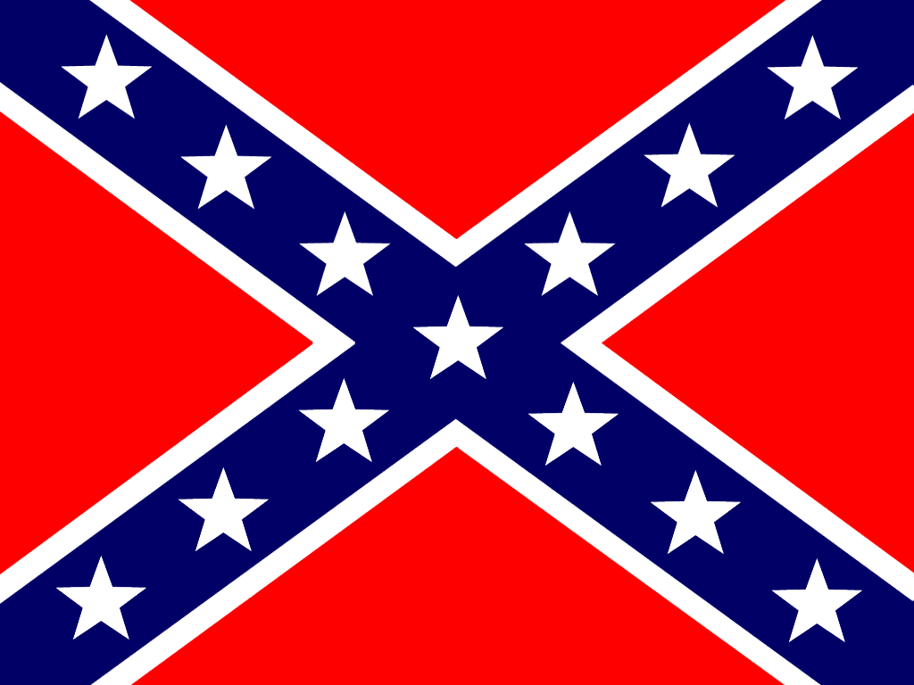
Confederate Battle Flag

Slide 6
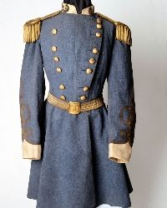
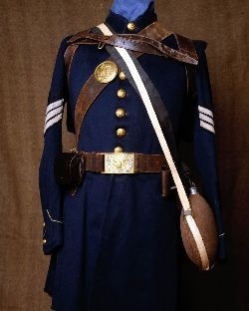
Confederate Uniform
(The South)
Union Uniform
(The North)

Slide 7
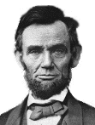
Abraham Lincoln
February 12, 1809 – April 15, 1865
Lawyer & Politician
Ran for Senate against Douglass & Lost 1858
Ran for President & Won
Elected 1860
Took Office – South Carolina Seceded from the Union
Civil War Starts 4/12/1861
Emancipation Proclamation 1863
South Surrenders April 1865
Assassinated by John Wilkes Booth April 15, 1865

Slide 8
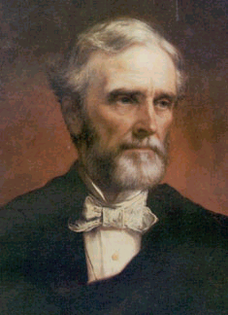
Jefferson Davis
President of Confederate States of America (C.S.A.)
Graduated from West Point
Colonel during the Mexican-American War
Secretary of War
Senator
President of the C.S.A.

Slide 9
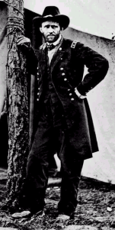
Ulysses S. Grant
West Point Military School
2nd Lieutenant Mexican-American War
Rejoined Army after North started losing battles
Hard and Stubborn Leader
Did not like to be defeated
Lincoln appointed him Leader of the whole Union Army

Slide 10
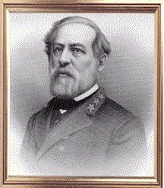
Robert E. Lee
West Point Military School
Colonel in the Army
From Virginia
Lincoln asked him to command the whole Union Army – Lee refused and fought for the South
Fierce Fighter
Helped soldiers win many battles in the beginning of war

Slide 11
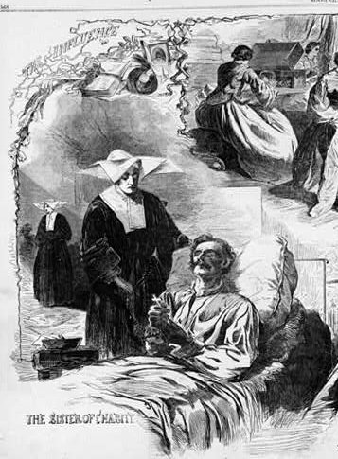
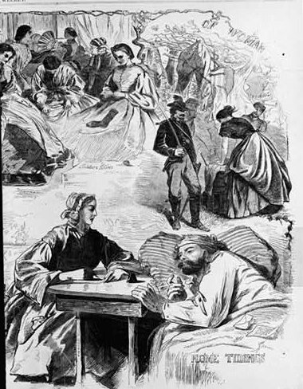
Women in the Civil War

Slide 12
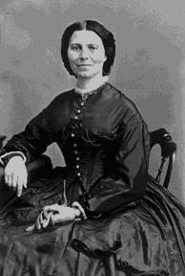
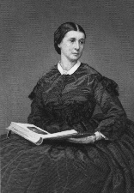
Clara Barton
First woman to work at the U.S. Patent Office
After 1st Bull Run she helped wounded soldiers and got medical supplies behind enemy lines
Established the American Red Cross (1881)
Rosie O’Neal Greenhow
A Confederate Spy who entertained Union leaders in Washington, D.C., picking up information about Union plans that she passed to the South. She was caught, convicted of treason, and exiled.
Other Important Civil War Women:
Belle Boyd – Confederate Spy informed on Union Army Movements
Loretta Janeta Valasquez – Disguised as a man fought for the South at 1st Bull Run & Shiloh. She became a Confederate Spy

Slide 13
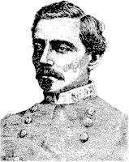
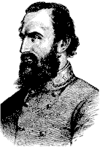
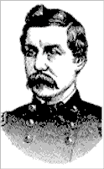
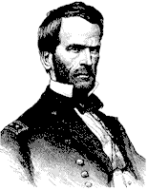
Thomas "Stonewall" Jackson Confederate General nicknamed "Stonewall" because he stood like a stone wall against the Union Army at the First Battle of Bull Run | Pierre Beauregard Confederate General ordered the attack on Fort Sumter
George MacClellan Union General known as "Little Mac" President Lincoln fired him as head of the Union Army | William Tecumseh Sherman Union General Led march from Atlanta to Savannah , Georgia destroying everything in his path

Slide 14

Excerpt from: The Civil War by Ken Burns

