Slide 1
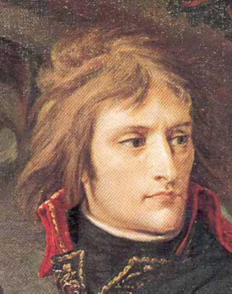
The Napoleonic Wars
(1792-1815)
&
Napoleon’s Empire (1804-1815)
AIM: How did Napoleon rise to power?
Do Now: Napoleon Worksheet
Napoleon, 1796

Slide 2

Please take notes on the graphic organizer provided or in your notebook.
You will need them for tomorrow.

Slide 3
Classwork Activity
Complete the worksheet – Napoleon’s Decisions
You may work in groups of 2 or 3

