Slide 1
European State Consolidation in the 17th & 18th Century
AP EURO - Chapter 16
The Dutch Republic

Slide 2
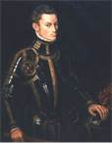
The Netherlands (The Dutch Republic)
The Dutch Republic emerged as an independent nation in the mid 1500’s

Slide 3
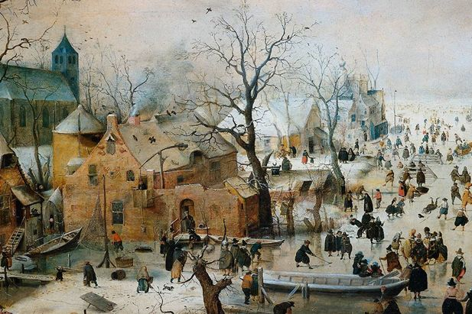
The Netherlands (The Dutch Republic 17th & 18th Centuries)
Political organization:
1. Not governed by absolute monarch
2. Political power in hands of wealthy merchants
3. 7 Independent provinces negotiated with Central government

Slide 4
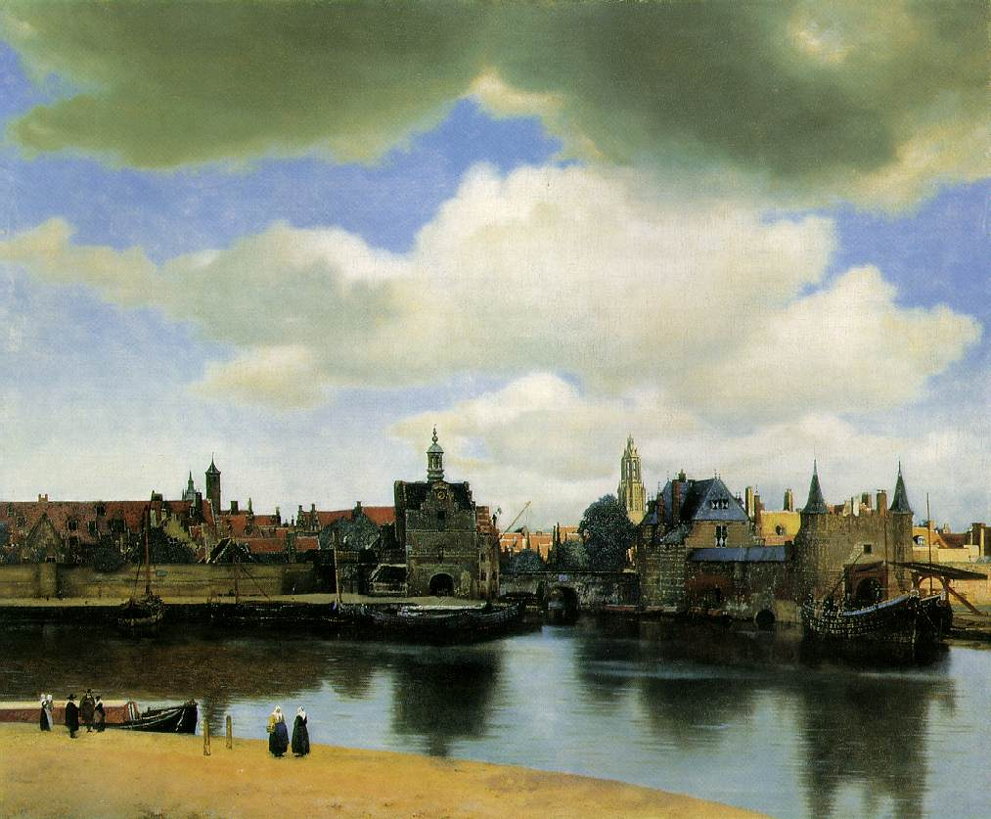
The Dutch Republic
Europe’s leading commercial power during the 17th century
1. Dutch fleet largest in the world
2. Overseas commercial empire
3. Large urban population

Slide 5
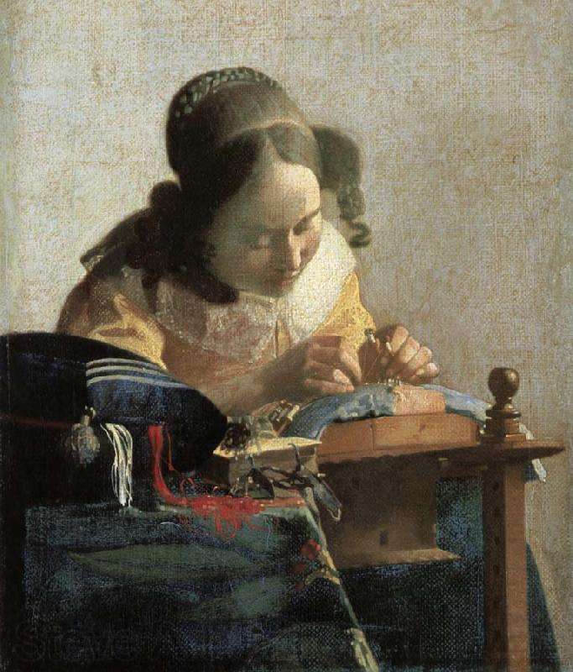
Dutch Republic – Commercial Exports
1. Farming (beef, fish, dairy, tulips)
2. Ship building
3. Textile production
Johannes Vermeer- “the Lacemaker”-1669

Slide 6
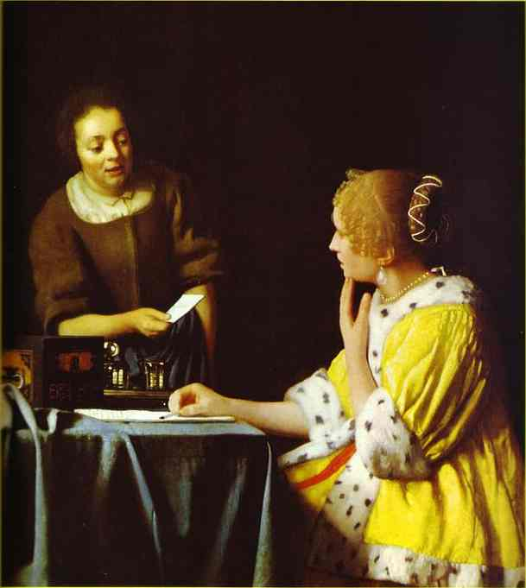
Economic Prosperity in the Netherlands (Dutch Republic)
Dutch replaced the Italians as the “bankers” of Europe
Amsterdam Exchange Bank established 1609
Johannes Vermeer- “Lady with her Maidservant” ->
Economic Decline- 18th century

Slide 7
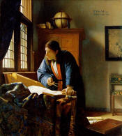
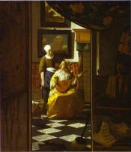
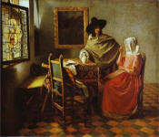
Art During the Dutch Golden Age – Johannes Vermeer

Slide 8
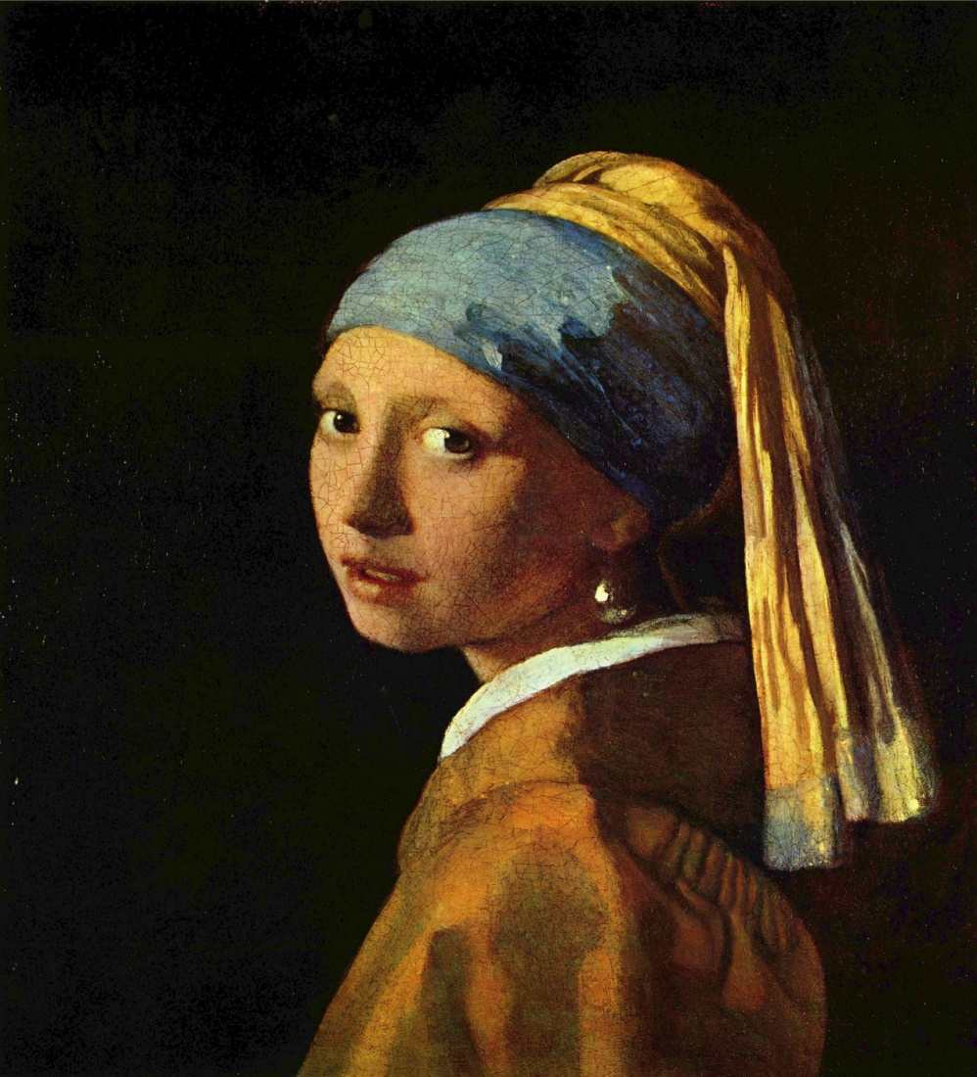
Art During the Dutch Golden Age
Johannes Vermeer “Girl with a Pearl Earring”- 1665-1666

