Slide 1

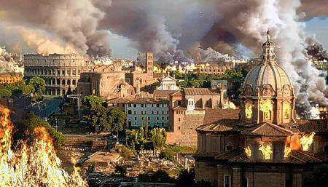
Fall of Roman Empire
AIM: What were the causes & results of the Fall of the Roman Empire?
476 AD
Do Now: What is a barbarian?
A barbarian is member of a people considered by those of another nation or group to have a primitive civilization.

Slide 2
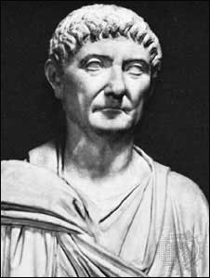
The Origins
292: Diocletian divides the Roman empire into two.
324: Constantine reunites the two parts
330: Constantine builds a new capital in the location of ancient Byzantium
337: The death of Constantine results in division between east and west.

Slide 3
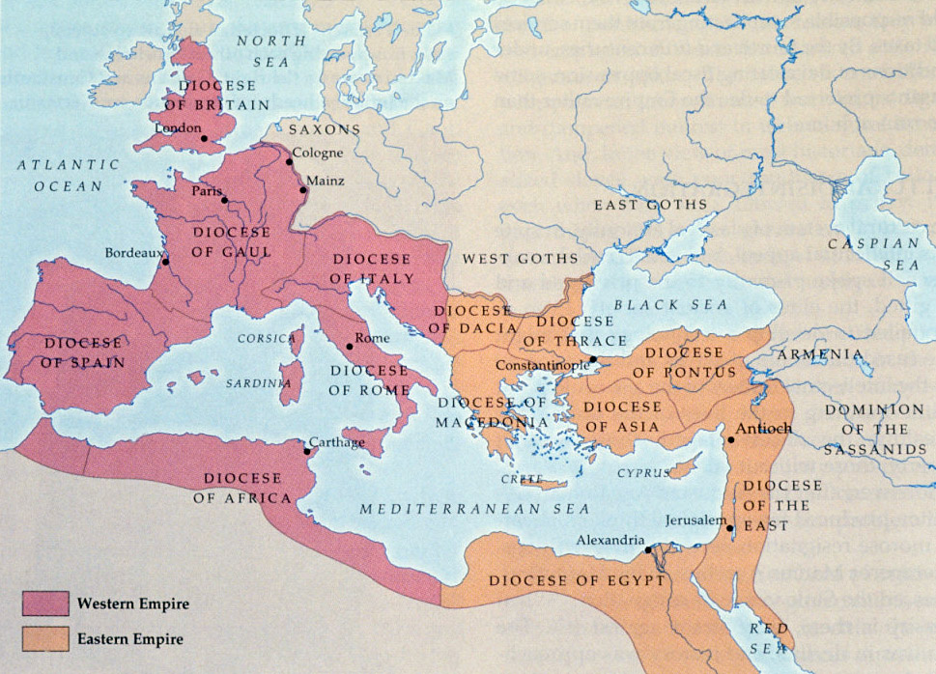
Roman Empire Divides into Eastern & Western Empire

Slide 4
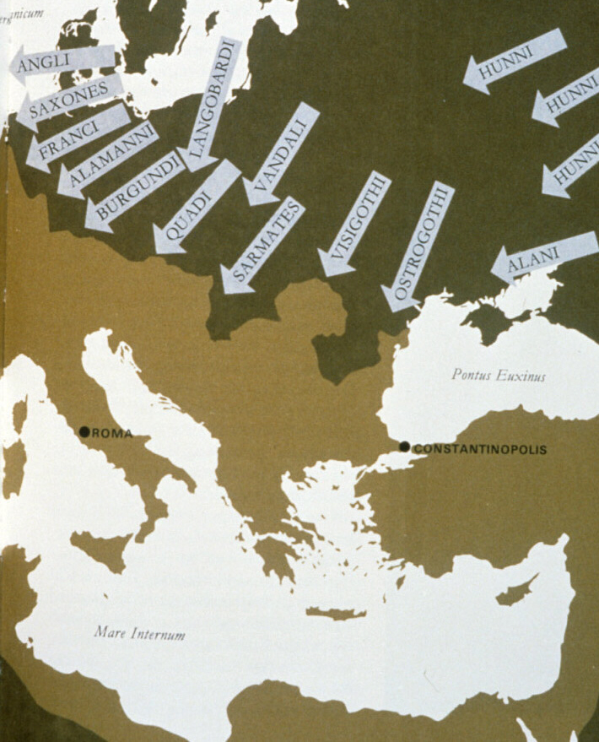
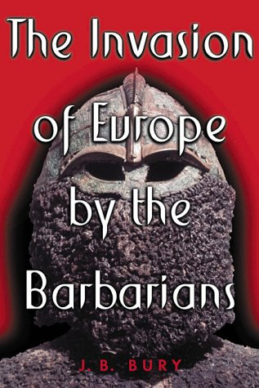
Fall of Rome (Western Empire)
Rome was besieged (invaded) by various tribes from modern day Germany and France.
Disease – Plague
No Strong Central Authority – Empire Split – East Strong – West Weak

Slide 5
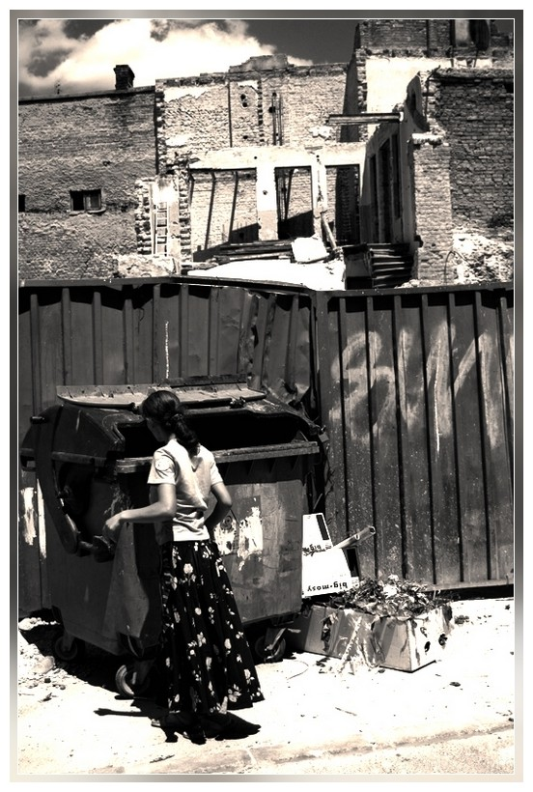
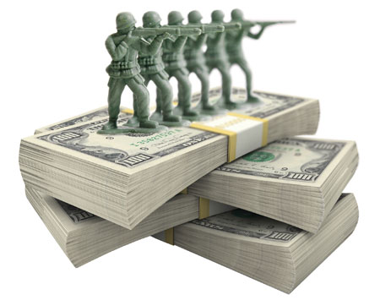
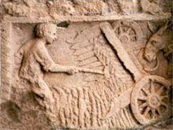

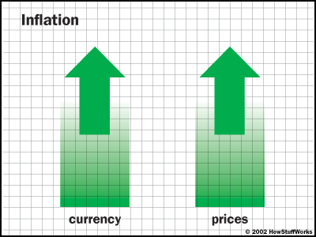

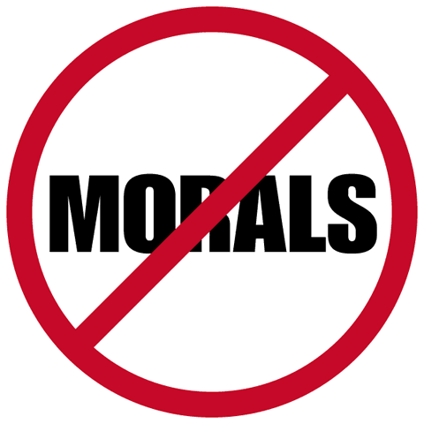
Fall of Rome (Western Empire)
Decline in Morals and Values
Political Corruption
Unemployment
Inflation – Rise of
Price of Goods &
Service with little rise
in income.
Urban decay
Inferior Technology
Military Spending

Slide 6
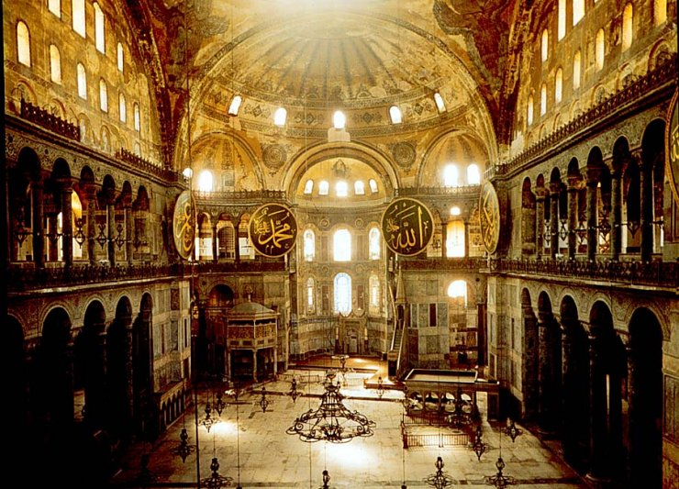
Byzantine Empire
(Eastern Empire)
476 – 1453 CE

Slide 7
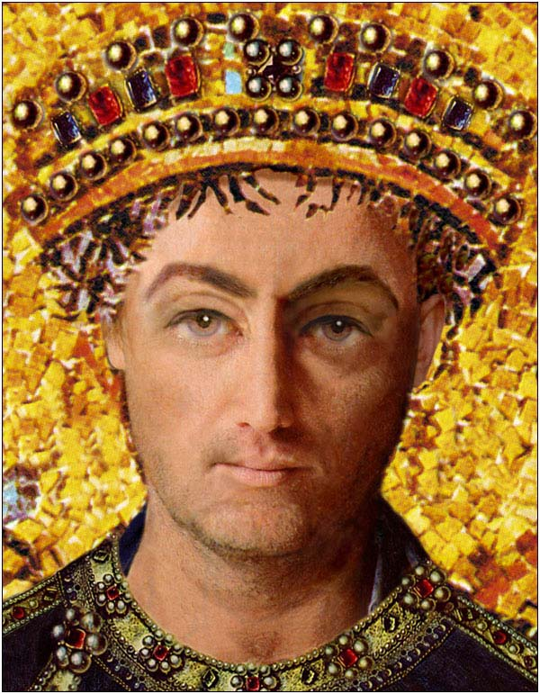
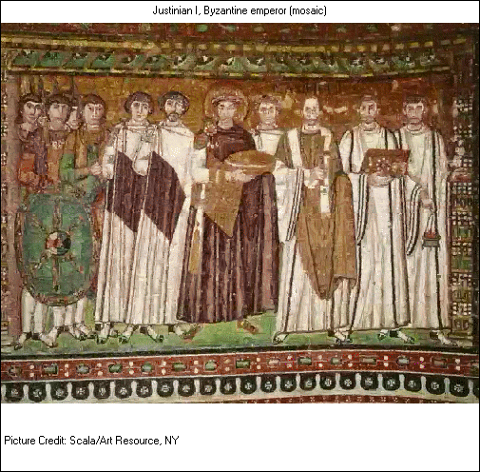
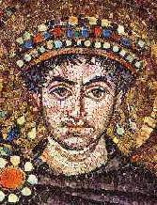
Emperor Justinian

Slide 8
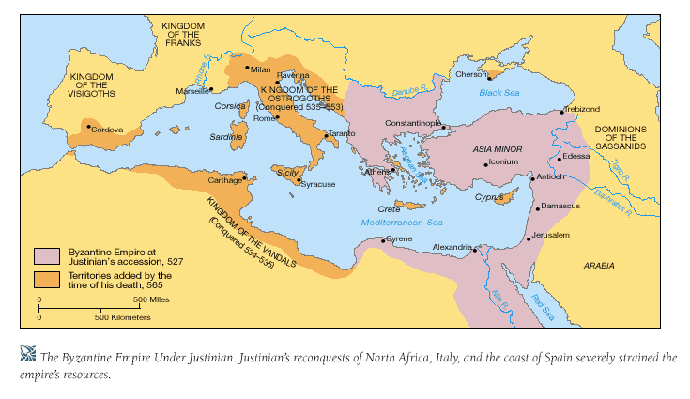

Slide 9
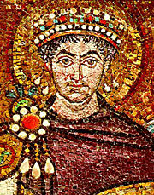
The Age of Justinian (527-575)
536: Re-conquest of Rome and much of Italy took many years.
North Africa and the Spanish coast were easily conquered.
Victories over Persia in the east consolidate the borders

Slide 10
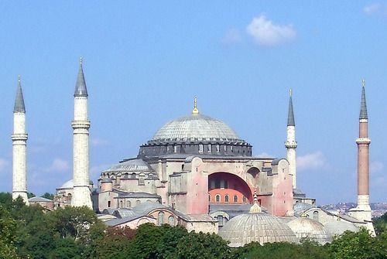
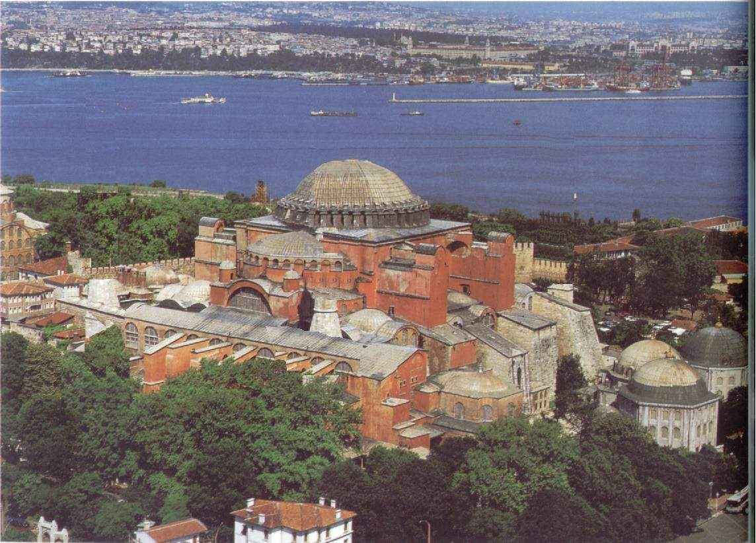
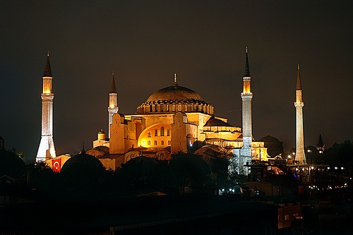
Hagia Sophia, Church of the Holy Wisdom, 6th c.

Slide 11
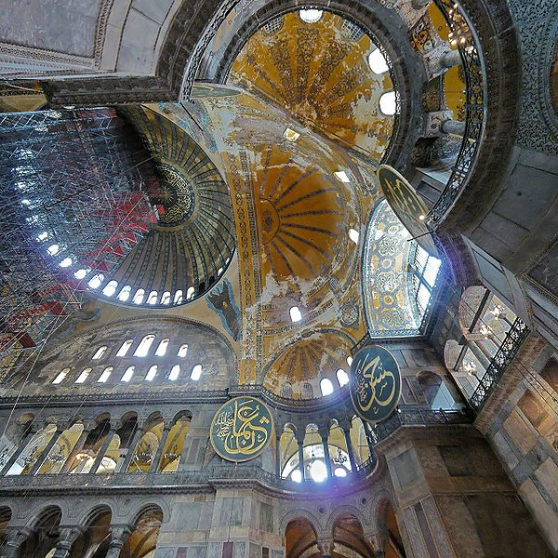

Slide 12
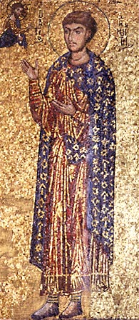
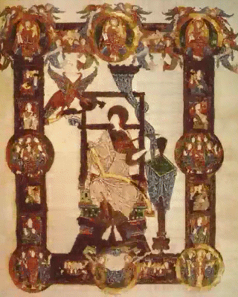
Byzantine Art: Mosaics
and Illuminated Manuscripts

Slide 13
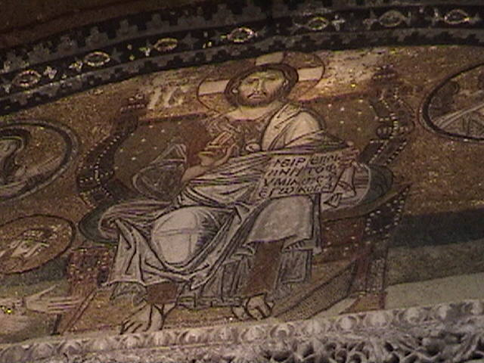

Slide 14
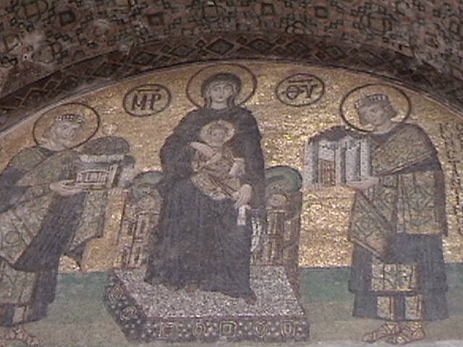

Slide 15
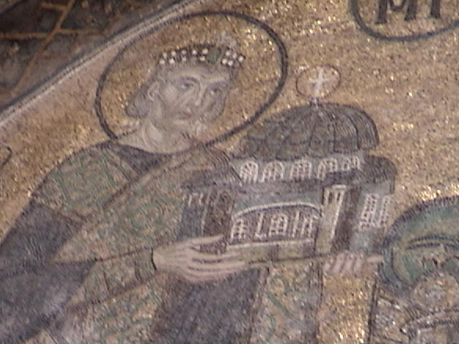

Slide 16
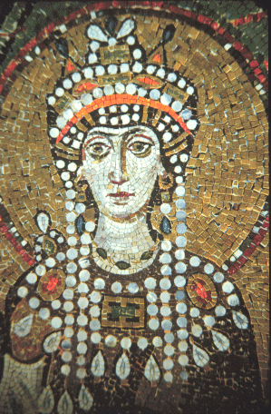
Justinian’s Legacy
Built Hagia Sophia Church which remained the seat of Eastern
Christianity until the Fall of Constantinople.
Rebuilt the Hippodrome
(chariot race track)
552: Byzantine monks sneak
silkworms and mulberry out of China.
Justinian orders the codification of Roman Christian law known
as the Justinian Code
Destroyed the last stronghold of paganism (non-believers in Christianity)
Ruled as an Autocrat with help from wife Theodora.
Empress Theodora
wife of Justinian I
a person (as a monarch) ruling with unlimited authority

Slide 17


Slide 18
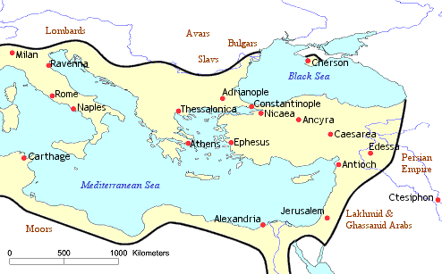
The Byzantine empire in 565, at its largest expansion ever.

Slide 19
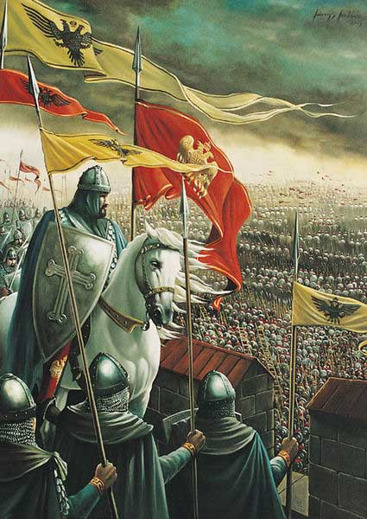
The End of the Byzantine Empire
The Byzantine empire drew to a close in 1453 when forces from the Muslim Ottoman Empire which surrounded and conquered Constantinople.
The ancient Christian city was renamed Istanbul and became the capital of the Ottoman Empire.

Slide 20
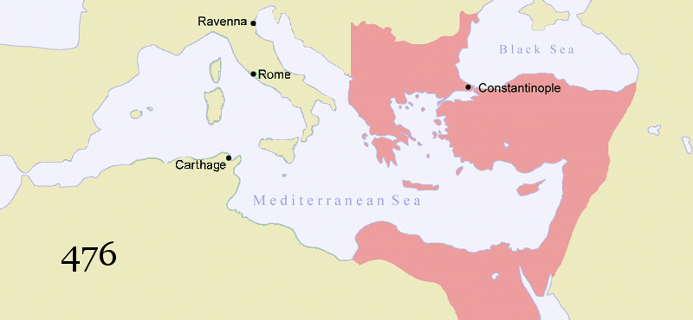
The Timeline of the
Byzantine Empire

Slide 21


Slide 22

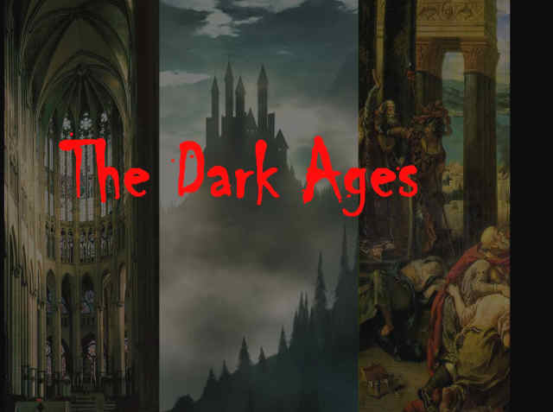

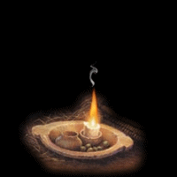
The Dark Ages/Middle Ages
476 – 1350 AD
What was the cause of the Dark Ages? Why do we call them dark?

Slide 23
No more large cities, trade, education
With all the disease, riots, outside attacks and starvation people fled the cities of the once strong Roman empire.
In Europe, people now lived on manors (self-sufficient communities) consisting of a castle, church, village and surrounding farmlands.

Slide 24
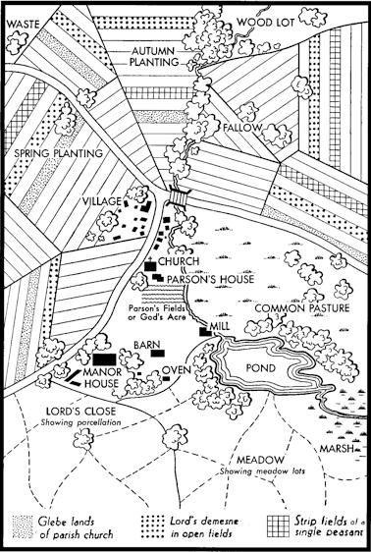
Manoralism
(Medieval Economic System)
Most people lived on a manor, which consisted of the castle, the church, the village, and the surrounding farm land.
For safety and for defense, people in the Middle Ages formed small communities around a central lord or master.
These manors were isolated,
with occasional visits from peddlers, pilgrims on their way to the Crusades, or soldiers
from other fiefdoms.

Slide 25


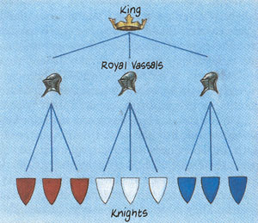
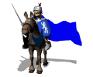
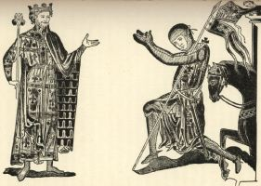
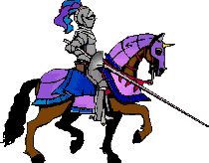
Feudalism: Land for
Military Service

Slide 26
Feudalism
(Medieval Political System)
The kings had lots of land; he gave land to lords in exchange for protection and money.
Lords gave their land to knights in exchange for protection & money.
Land given to knight for service was called a fief
  Anyone accepting fief was called a vassal
  Person from whom he accepted fief was his lord
Knights let serfs work the land and he would protect them.
Serfs got food and shelter.
Result: each person had rights and responsibilities
Historians call system of exchanging land for military service the feudal system, or feudalism

Slide 27
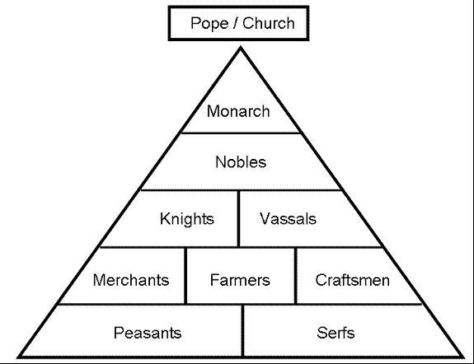
Feudalism
(Medieval Political System)

Slide 28
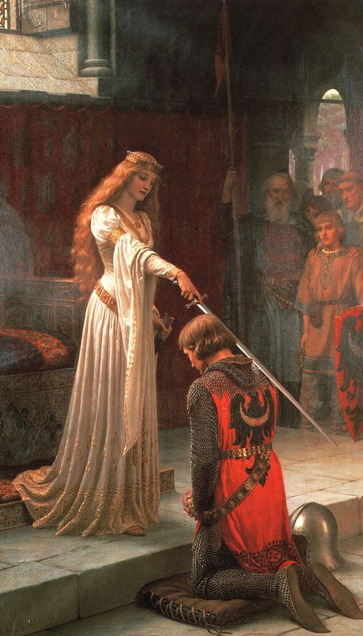
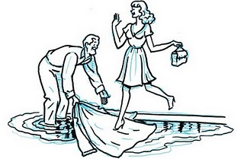
What is Chivalry?
A code of honor

