Slide 1
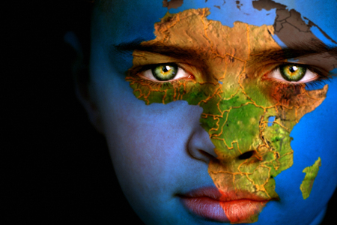
The Triangle Trade
AIM: What was the triangle trade?
Do Now: What was one cause of the triangle trade or slave trade?

Slide 2




Portugal
Countries Involved in the Slave Trade
Why?
To Support Their Colonies & Practice of Mercantilism
Colony:
a country ruled by another: a country or area that is ruled by a country
Mother
Country
Spain
England
While there are more countries that participated such as France and the Netherlands (Dutch) these were the three (3) main countries

Slide 3
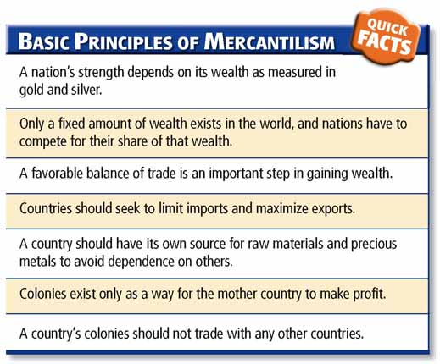

Slide 4
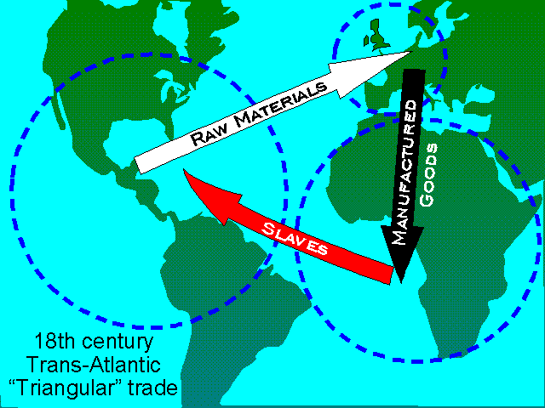

Slide 5
Stage One
Ships left Europe loaded with goods, such as guns, tools, textiles & rum.
Crews with guns went to West Africa and ashore to capture slaves.
Slaves were obtained by:
1. Kidnapping
2. Trading
3. People were given by chiefs as tributes (gifts)
4. Chiefs would send people who were in debt
5. Chiefs would send criminals through judicial
process
6. Prisoners of tribal wars were also sent.

Slide 6
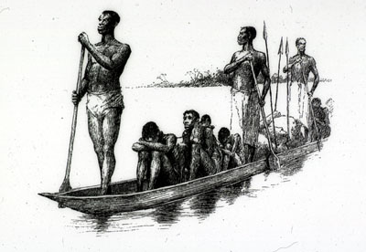
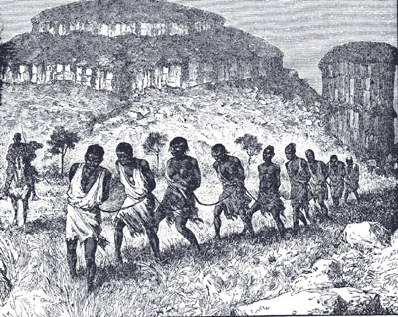
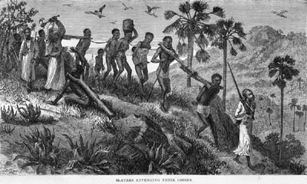

Slide 7
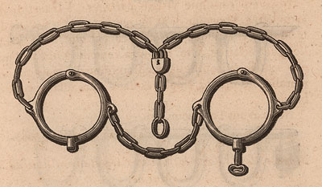
Forced Participation
African Chiefs did resist in the beginning; however, they needed weapons for defense.
The Europeans were too powerful; therefore, any effort to resistance was unsuccessful
If chiefs did supply slaves, they were threatened to be taken as slaves.

Slide 8
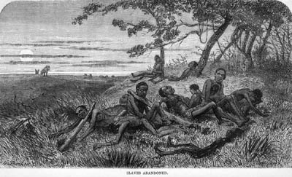
Slaves were held in prisons along the west coast of Africa.
They were waiting to put on slaves ships.
Those that journeyed from the interior and were not fit for the ship were left on the shores to die

Slide 9
Stage Two: The Middle Passage
Ships sailed across the Atlantic Ocean to the Americas
The journey took 8-10 weeks
Some Africans tried to jump ship, refused to eat and rebelled.
Loss of a slave’s life was a loss of $ for the sailors.

Slide 10
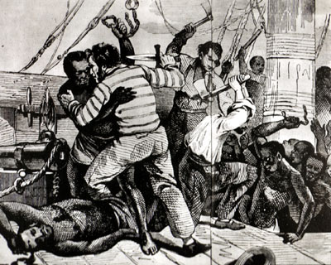
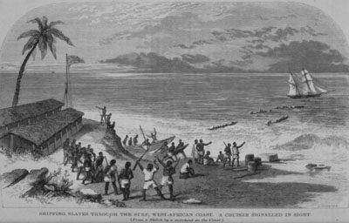
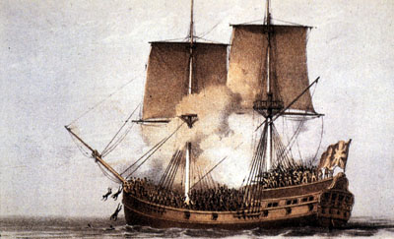

Slide 11
Stage Two
“Loose packing” meant that the captains would take on board fewer slaves in hope to reduce sickness and death.
“Tight packing” meant that the captains would carry as many slaves as their ship could hold, as they believed that many blacks would die on the voyage anyway

Slide 12
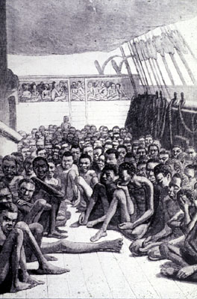
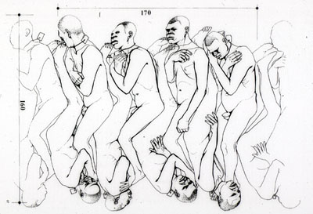
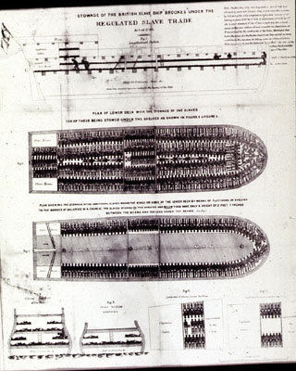
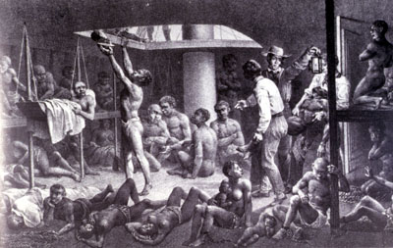

Slide 13
Stage Three
Africans would be sold at auctions in the Americas
The ships’ captains would use the $ from their sale to buy a 3rd cargo of raw materials: sugar, spices or tobacco.
They sold this for a further large profit in Europe.
In Europe, they would convert the raw materials into finished product.

Slide 14
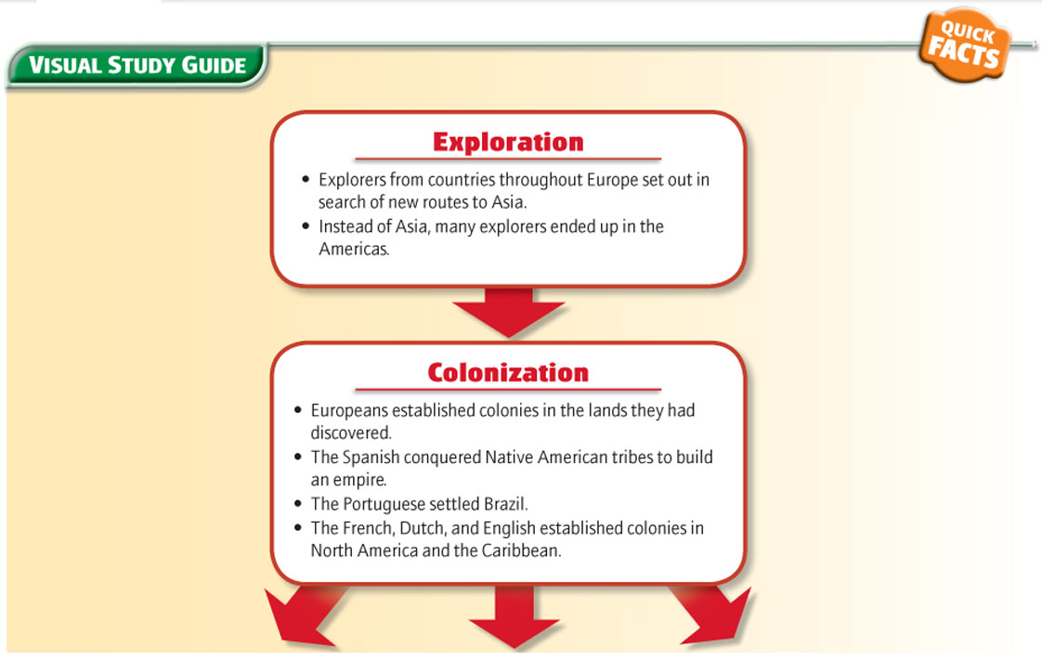
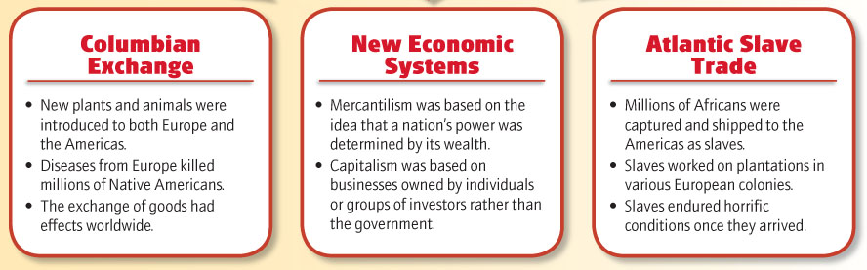

Slide 15
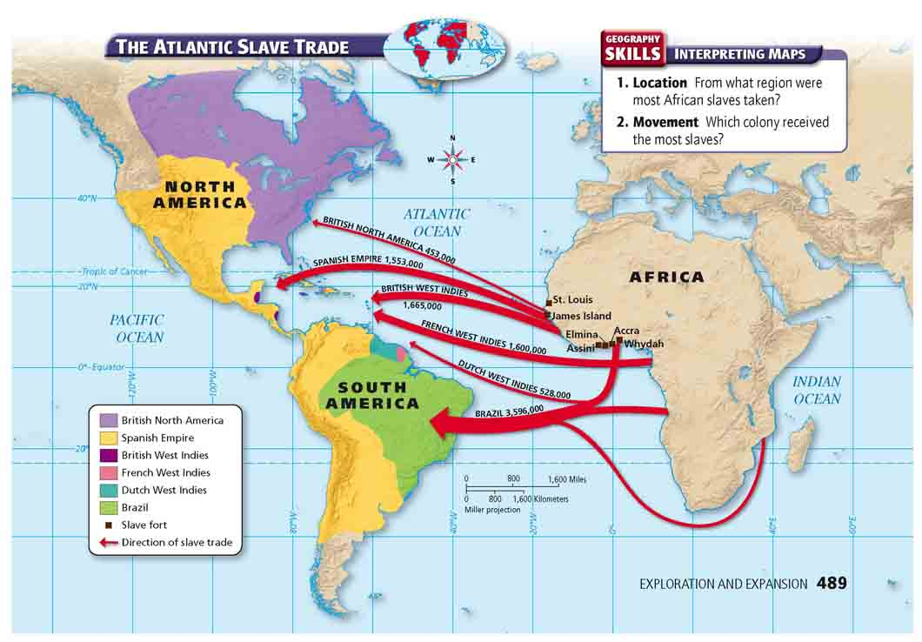
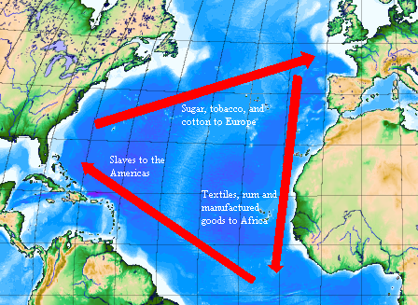
Triangular Trade
Trade routes between Africa, Europe and the Americas during the Atlantic Slave Trade.

