Slide 1
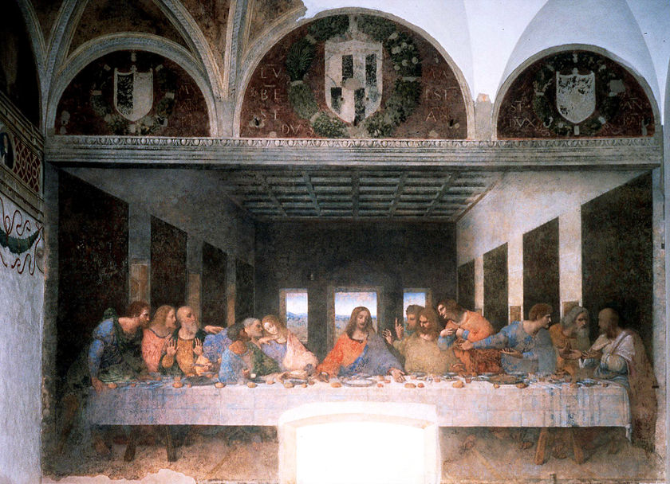
Aim: What was the Renaissance?
Do Now: What major time period (era) took place before the Renaissance?

Slide 2
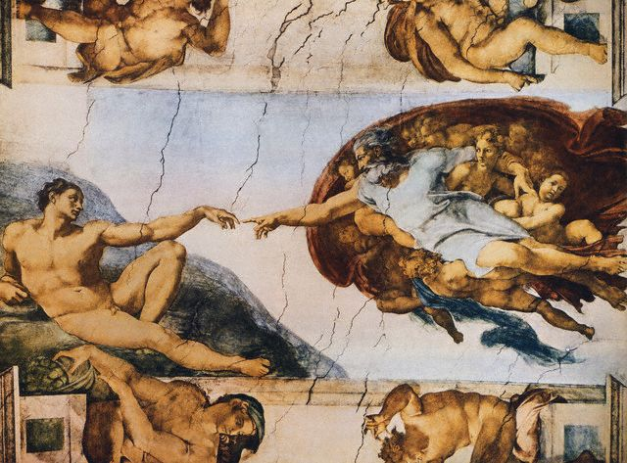
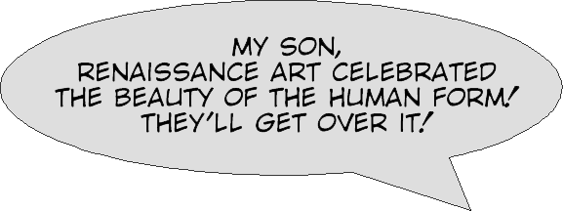
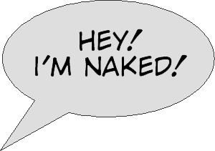


Slide 3


Slide 4
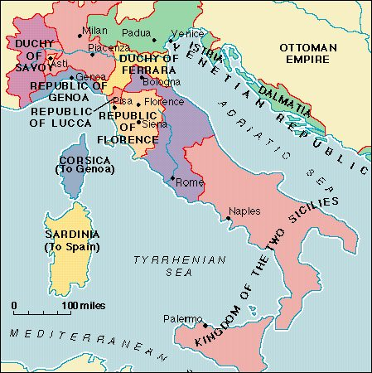
What was the Renaissance?
… and where did it begin?
Italy
Italian Cities
  Urban (Non-Rural) Societies
  Major Trading Centers
Secular (Non-Religious)
  Moved away from life in the church
  Focuses more on material objects and enjoying life

Slide 5
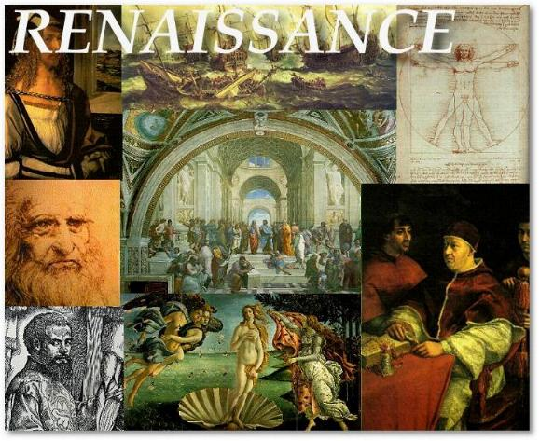
What does all this mean?
The Renaissance was
a time of renewal
Renaissance means rebirth or revival
and Europe was recovering from the Dark ages
and the plague
People had lost their
faith in the church and began to put more focus
on human beings.

Slide 6
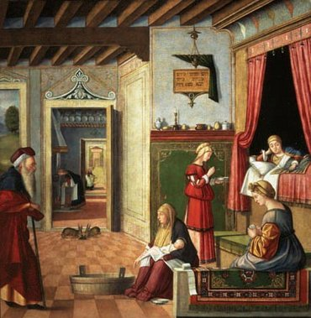
What caused this change in society?
Specialization (breaking tasks down to smaller tasks) in agriculture increased, resulting in more trade.
Urban areas became centers of commerce.
Merchants and artisans became important.
Some cities became displays of wealth.

Slide 7
How did the Crusades contribute to the Renaissance?
• Increased demand for Middle Eastern & Asian products
• Stimulated production of goods to trade in Middle Eastern & Asian markets
• Encouraged the use of credit and banking
• Church rule against usury (charging interest) and the banks’ practice of charging interest helped to secularize northern Italy.
• Letters of credit served to expand the supply
of money and expedite trade. (Commercial Revolution)
• New accounting and bookkeeping practices (use of Arabic numerals) were introduced.

Slide 8
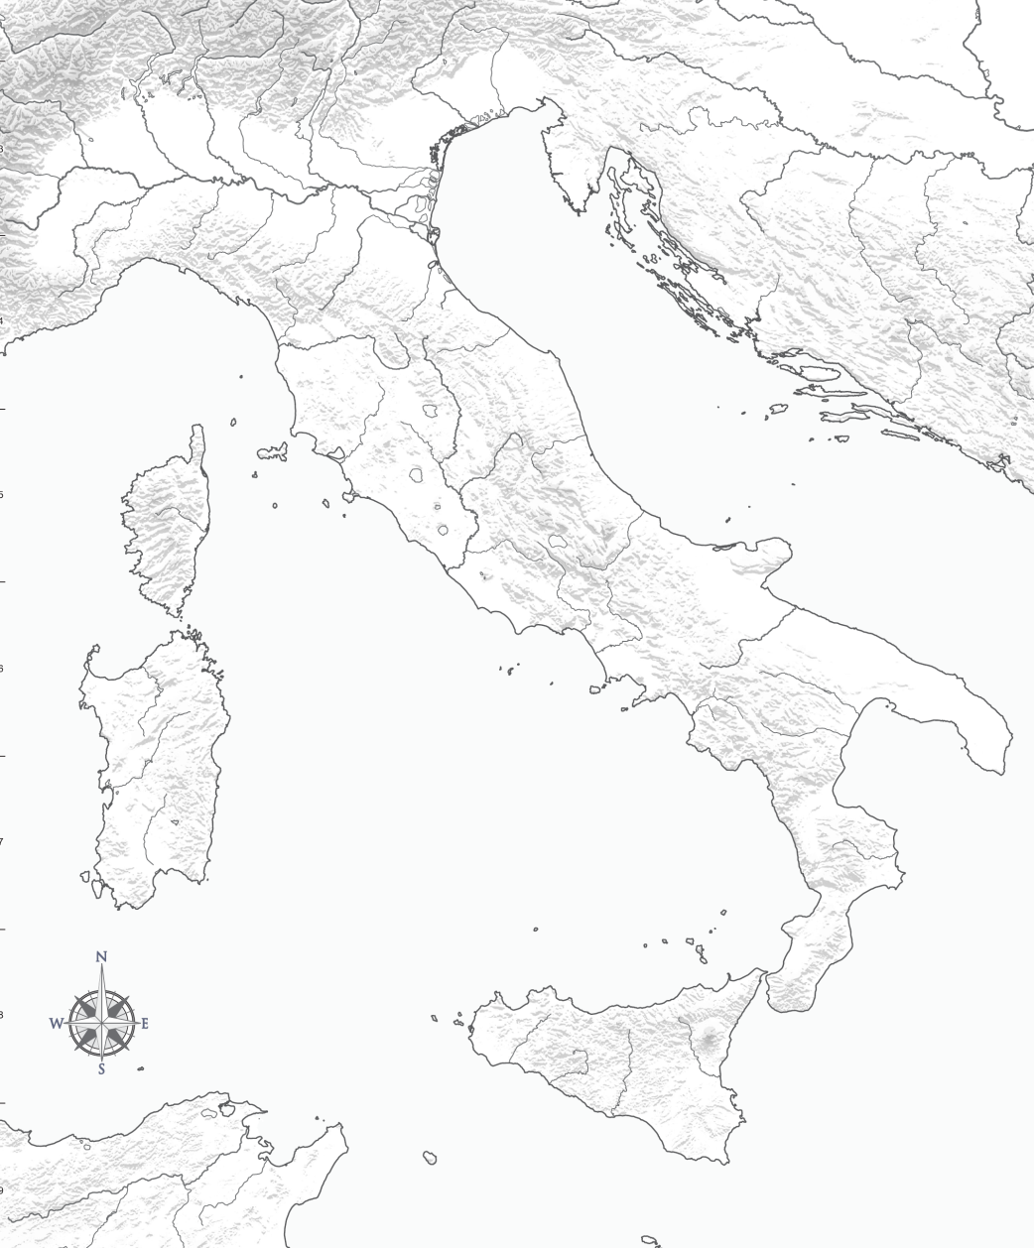
Major Italian Cities
Venice: Sitting on the Adriatic,
it attracts trade from
all over the world.
Milan: One of the richest cities, it controls trade
through the Alps
Milan
Venice
Italy failed to become united during the Ages.
Many independent
city-states emerged in northern and central
Italy that played an important role in Italian politics and art.
Genoa
Genoa: Had Access to Trade Routes
Florence
Adriatic Sea
Florence: Controlled by the De Medici Family, who became great patrons (financial supporter) of the arts.
All of these cities:
Had access to trade routes connecting Europe with Middle Eastern markets
• Served as trading centers for
the distribution of goods
to northern Europe
• Were initially independent
city-states governed as republics
Tyrrhenian Sea

Slide 9
The Crusades
Travel to Mideast
New/Old Ideas
Rise of Middle Class
Trade
Job Specialization
The Plague
Questione d Why?
Questioned Faith
Causes of the Renaissance

Slide 10
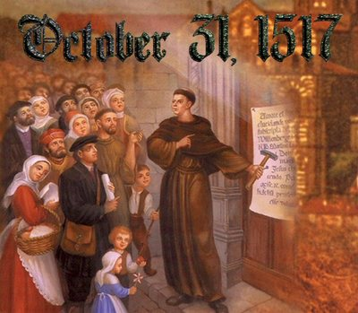
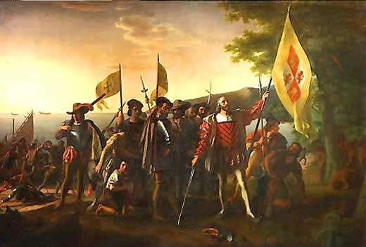
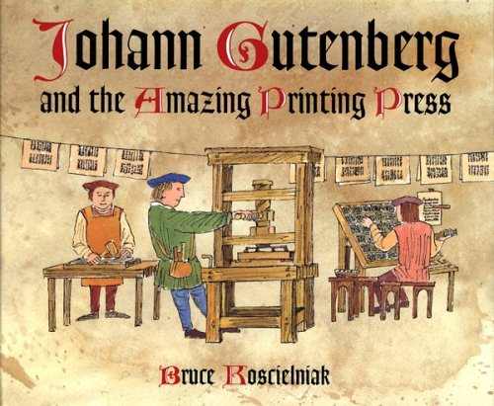
The Printing Press
Art, Architecture, Literature
Protestant Reformation
The Age of Exploration
Effects of the Renaissance

Slide 11
Classwork: Complete Renaissance Activity
Use the information in your reading to help you answer the following questions:
1. What does the word ‘renaissance’ mean?
2. During the Renaissance, which two classical civilizations did the Italians look to for their inspiration?
3. What development made it possible for the new culture to spread quickly throughout Europe?
4. Why was it possible for the Renaissance to take place in Italy at that time?
5. Why did Italian people admire ‘universal men’ such as Leonardo da Vinci?

