Slide 1
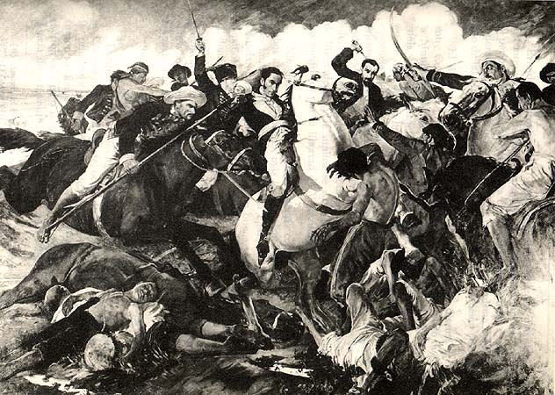
LATIN AMERICAN REVOLUTIONS

Slide 2
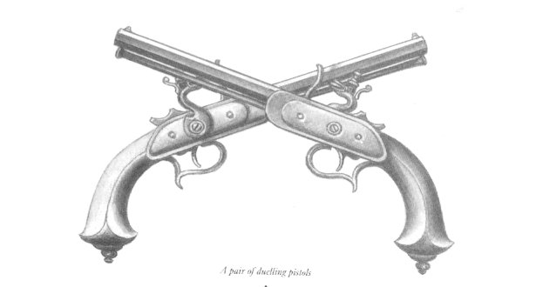
“It takes a revolution….
to make a solution….”
- Bob Marley
WHAT WERE THE PROBLEMS?

Slide 3
LATIN AMERICAN REVOLUTIONS: MENU
CAUSES
LEADERS
EFFECTS

Slide 4
CAUSES
PROBLEMS WITH
THE FRENCH AND
SPANISH EMPIRES
ENLIGHTENMENT
IDEALS
AMERICAN AND FRENCH
REVOLUTIONS
NATIONALISM
&
DESIRE FOR ECONOMIC
FREEDOM

Slide 5
DISCONTENT WITHIN THE
SPANISH EMPIRE
* Political Disempowerment:
Spanish colonies were run by the Council of the Indies, a group appointed by the King that met in Spain and sent its directives across the Atlantic. Viceroys, officials appointed by Spain, governed the colonies. Think about how American colonists felt when the British Parliament created policies to govern America without American representation.
* Economic Disempowerment:
Spain had the first right to colonial goods and resources. Excluding all competitors, economic policy was set for Spain’s maximum benefit (MERCANTILISM!)

Slide 6
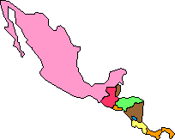

SOCIAL HIERARCHY
Creoles:
People of pure
European blood
But born in the
New World
Peninsulares:
Native Spaniards
P
Mulattos:
African +
European blood
C
Mestizos:
Indian +
European
blood
M & M
NA & A
Native Americans and Africans
CAUSES

Slide 7

THE ENLIGHTENMENT
BEFORE: Kings are placed on the throne by God. Only God can remove them. (Theory of Divine Right)
* Government is based on a contract between the ruler and the ruled (Locke).
* Government exists to protect the citizens’ natural rights of life, liberty, & property (Locke).
* If the government violates the natural rights of the people, the citizens have a right to revolt against that tyranny (Locke).
CAUSES

Slide 8
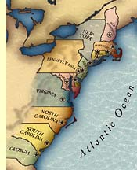

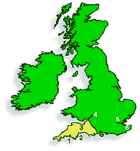
THE AMERICAN REVOLUTION
* The success of the American Revolution showed others that colonies could succeed in overthrowing their more powerful mother countries.
CAUSES

Slide 9
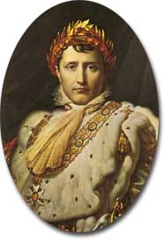
THE FRENCH REVOLUTION
* Napoleon crowns himself emperor of France in 1804.
* In an attempt to rule all of Europe, he puts family and friends in charge of the territories he has conquered.
* In 1810, Napoleon puts his brother Joseph on the throne of Spain. The Spanish royal family flees.

Slide 10
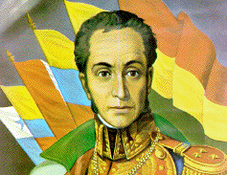
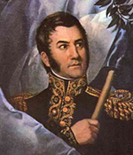
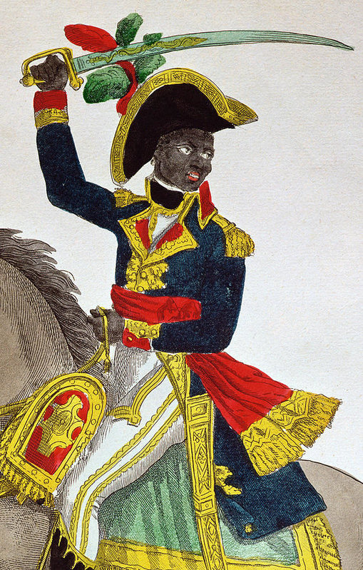
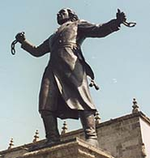
LEADERS
SANMARTIN
BOLIVAR
Tous sa i n
t
Louv e t u r
e
HIDALGO

Slide 11
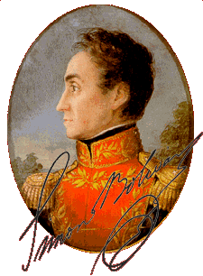
SIMON BOLIVAR
LEADERS
* Elite Creole planter
Military General
* Called the “George Washington of South America.”
* Liberated territories of modern day Venezuela, Colombia, Ecuador, Peru, & Bolivia
* Plan for a federated Latin America was crushed by political in-fighting.

Slide 12
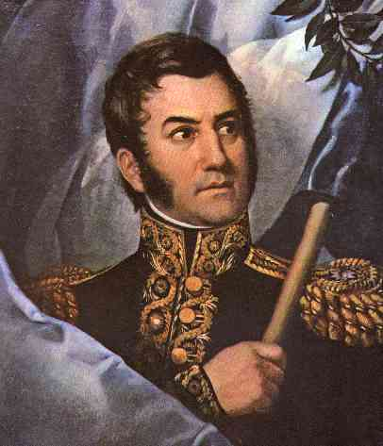
JOSE DE SAN MARTIN
LEADERS
* Creole officer who had trained in European armies.
* Liberated Argentina from Spanish control.
* Met with Bolivar in Guayaquil in 1822. While Bolivar favored democracy, San Martin felt only monarchy could work. Turned over command.
* Died in obscurity in Europe.

Slide 13
MIGUEL HIDALGO
LEADERS
* Highly educated Creole priest assigned to town of Dolores.
* September 16, 1810: El Grito de Dolores.
Hidalgo rang the church bell and called upon his mestizo and indigenous parishioners to take up arms against the Spanish.
* Led a rag-tag army toward Mexico City, unleashing mass slaughter of peninsulares in path.
* Never made it to the capital -- Captured and shot in 1811.

Slide 14
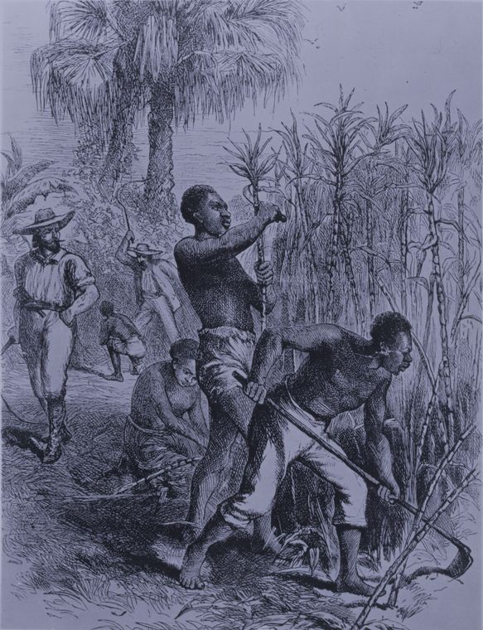
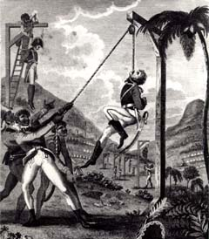

Haitian Revolution
1789-1804

Slide 15
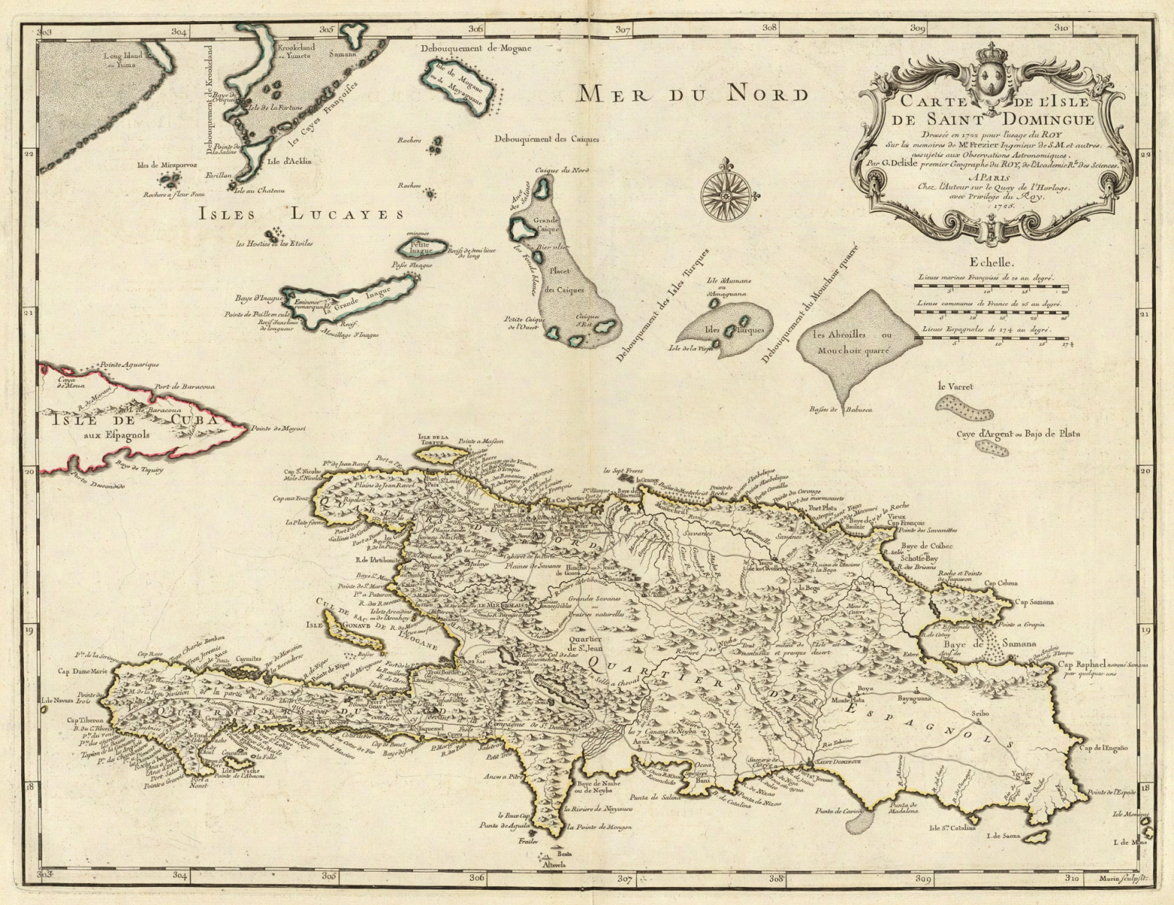
French
(Colony of St. Dominigue)
Spanish
France took western 1/3 of island from Spain

Slide 16
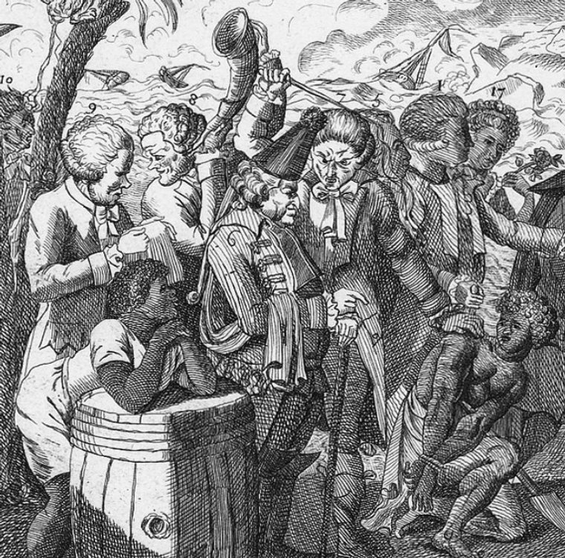
Social Structure in Haiti
Whites (20,000)
Gens de Couleur
(30,000)
Slaves
(500,000)

Slide 17
Pre-Revolution:
  French colonists brought African slaves to develop large sugar and coffee plantations
    40% of world’s sugar
    50% of world's coffee
  By 1788 - 500,000 slaves and 60,000 colonists (outnumbered 8 : 1)
Haiti the richest colony in the WORLD

Slide 18
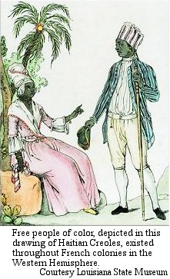
Early events (1789)
White planters (Grands Blancs) want “home rule” because of French Revolution
Small Farmers (Petit Blancs)
  want equal rights
Gens de couleur (free blacks)
  want equality (liberty, equality, fraternity) and citizenship
Slaves are not involved, yet…
WHY is France a catalyst for the Haitian Revolution?

Slide 19
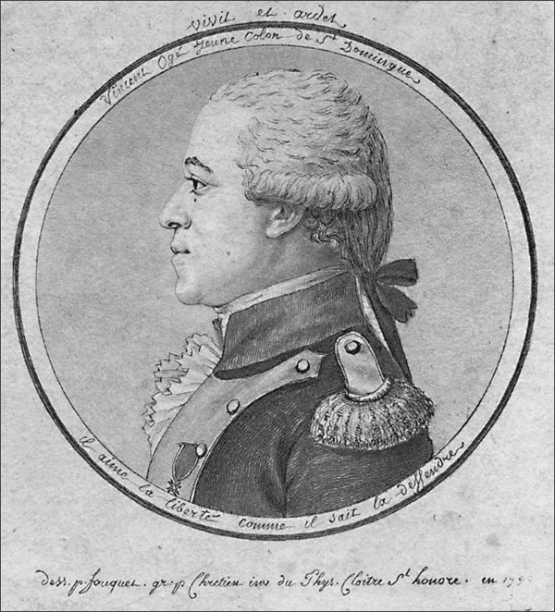
1790
Vincent Ogé (gens de couleur), goes to France, gets rights for free blacks
Ogé is killed by whites when he returns (chained to wagon wheel and repeatedly run over).
Whites allowed to rule the colony to keep it peaceful.

Slide 20
1791: Guerilla Attacks
Bands of runaway slaves, known as maroons (marrons), entrenched themselves in the colony's mountains and forests
From their they attacked white-owned plantations both to secure provisions and weaponry and to avenge themselves against the inhabitants.
As their numbers grew, these bands, sometimes consisting of thousands of people, began to carry out hit-and-run attacks throughout the colony.
However they lacked centralized organization and leadership.

Slide 21
1791: CRISIS
Slaves revolt
  Dutty Boukman (“Dirty Book Man” because he was accused of teaching slaves to read) leads thousands of Maroons (runaway slaves) to attack plantations across the colony killing 15,000. Boukman is killed and the revolt falters until Toussaint organizes them.
François-Dominique Toussaint L’ouverture becomes a military leader - insisted on discipline and restricted wholesale slaughter
Whites decide to fight for independence

Slide 22
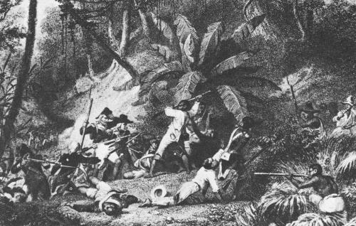
1791: Slave Revolt (Extreme)
The bands of slaves slaughtered every white person they encountered.
They torched property, fields, factories, and anything else that belonged to, or served, slaveholders.
The rebellion left an estimated 10,000 blacks and 2,000 whites dead and more than 1,000 plantations sacked and razed.

Slide 23
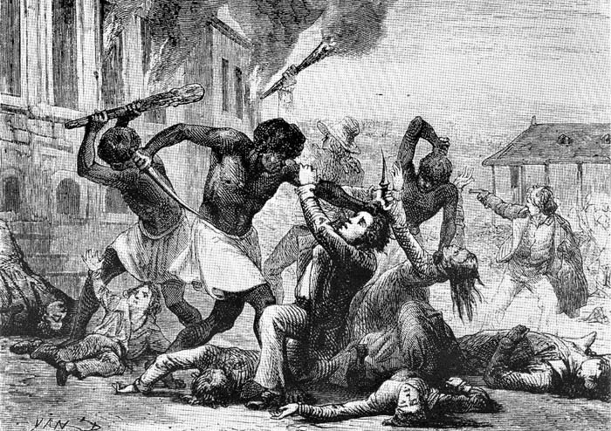
A contemporary cartoon of the Slave Revolt

Slide 24
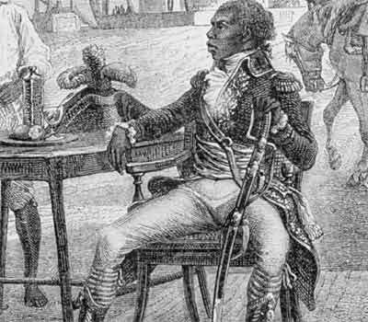
1793
Toussaint controls most of colony
Whites imprisoned, gens de couleur attempt to take power
French National Convention abolishes slavery in an attempt to pacify island.

Slide 25
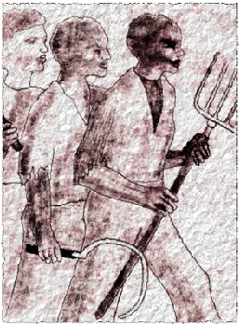
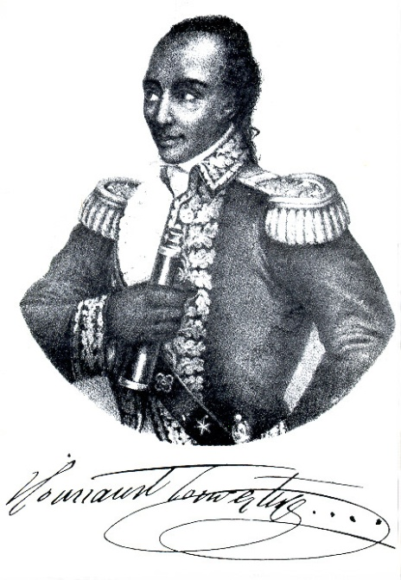
1799
War of the Castes
  Gens de couleur support France (want slaves back)
  Toussaint’s slave army turns on
  gens de couleur and kill them.
America helps Toussaint in order to get France out of the area.
Toussaint gets nickname “Louverture” (break through enemy lines) from the French

Slide 26
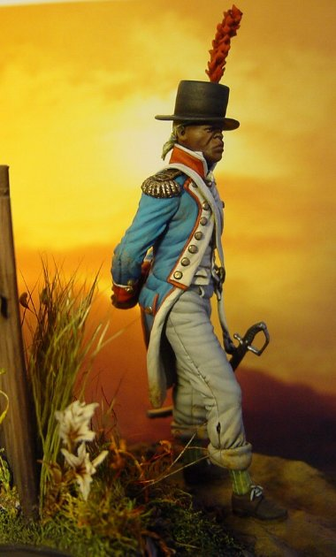
1800 - Extreme Action
Toussaint becomes dictator and needs money
  Re-imposes plantation system, sugar means money for Haiti.
  Uses freed slaves as forced labor (sounds like slavery to me)
  It doesn’t work

Slide 27
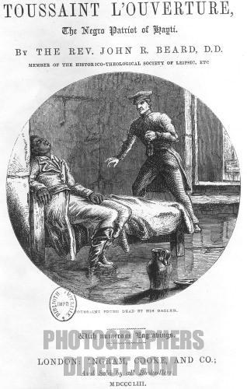
1802
Toussaint kidnapped and is taken to France - dies of neglect and starvation in jail

Slide 28
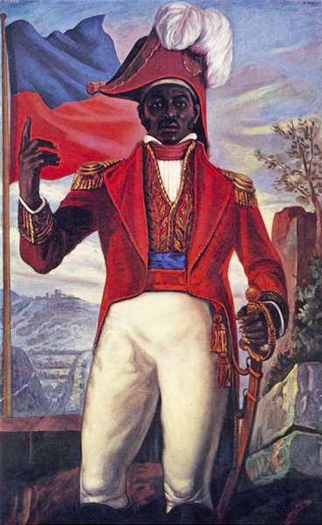
1802
Revolution is carried on by Jean-Jacques Dessalines
Both sides resort to atrocities
Haitians hang French prisoners
  U.S. and Britain fear slave revolt
  Newspapers cover the murder of the French but not the blacks
  British delay abolishing the slave trade
French flee and re-establish slavery on nearby island of Martinique

Slide 29
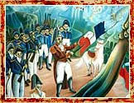
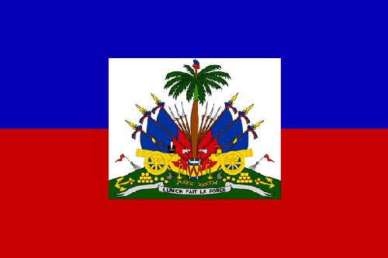
1804: Return to Normalcy
Dessalines officially declares independence, renaming "Haiti" after the indigenous Arawak name for mountain
Land redistribution ends the plantation system, subsistence farming begins.
Haiti, the richest colony in the world, becomes one of the poorest nations on earth.
Dessalines rips the white
from the flag.

Slide 30
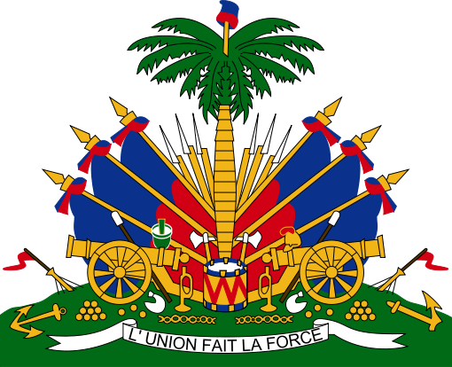

Slide 31
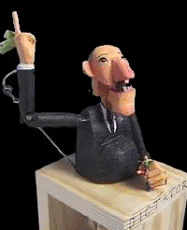
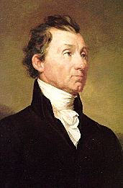
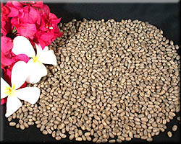
EFFECTS
POLITICAL
INTERNATIONAL
ECONOMIC

Slide 32
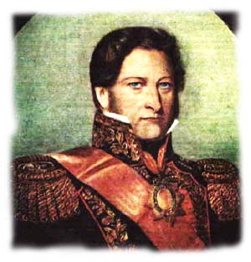
POLITICAL:
THE CAUDILLOS
* By 1830, nearly all Latin American countries were ruled by caudillos.
WHY?
* The upper classes supported dictatorship because it kept the lower classes out of power.
* The lower classes did not have experience with democracy. Dictatorship seemed normal.
EFFECTS

Slide 33
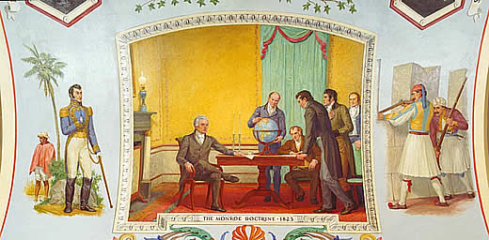
INTERNATIONAL:
THE MONROE DOCTRINE
“The American continents…are henceforth not to be considered as subjects for future colonization by any European powers.” - James Monroe, 1823

Slide 34
WHY?
* The War of 1812 with Britain had shown the U.S. that
some-times revolutionary victories could lead to sequels.
* The U.S. had political and economic interests in keeping Europe out of the Western hemisphere. From 1823 on, it would be the U.S.’ backyard.
* Though the U.S. did not have the muscle to back up its threats, Great Britain agreed to support the Monroe Doctrine due to its new favorable trading position in Latin America.
EFFECTS

Slide 35
ECONOMIC:
ONE-CROP ECONOMIES
* Now that trade was not restricted to the mother country, the U.S. and Great Britain became the new countries’ major trading partners.
* A colonial economy continued…Latin America mainly exported cash crops and raw materials while importing manufactured goods.

Slide 36
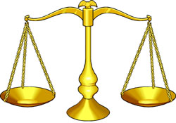
AN IMBALANCE OF TRADE
* As the imbalance of trade grew, Latin American countries took out large loans from the U.S., Britain, and Germany to build infrastructure.
* When the countries could not pay back their loans, foreign lenders gained control of major industries in Latin America.

Slide 37
THE QUESTION OF LAND
AT LEAST, DID THE SOCIAL PYRAMID CHANGE?
NO!
* Once the Spaniards were expelled, the new governments seized their lands and put them up for sale, BUT….only the creoles could afford to buy them.
* Thus, the creoles replaced the peninsulares at the top of the social pyramid, but other classes remained at the bottom of the ladder.
EFFECTS

Slide 38
Dictatorship of the Council of the Indies and the Viceroys
Dictatorship of the Caudillos
Unequal trade relationship with Spain benefiting
Unequal trade relationship with
Great Britain and the U.S. benefiting
Native Spaniards at the top of the social ladder, followed by creoles, and with the rest of the population at the bottom
Creoles at the top of the ladder with the rest of the population at the bottom.

Slide 39
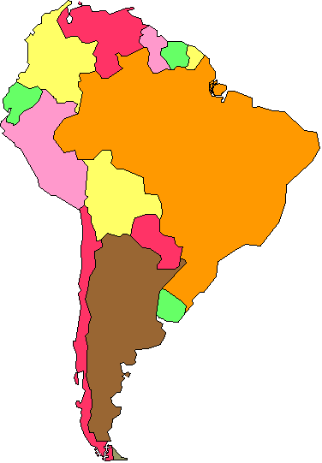
BOLIVAR’S LAST WORD
Simon Bolivar had taken up the cause of independence hoping to establish a new order where Latin American countries would be free, democratic, and federated (in agreement to work together.) Instead, upon his death, he saw a world in which dictators ruled and disunity reigned. Disgusted by what he saw, he gave this warning to future generations:
“America is ungovernable for us. He who serves a revolution plows the sea.”
MENU

Slide 40
Who led the independence movement in Haiti?
(A) San Martin
(B) L’Ouverture
(C) Bolivar
(D) Morelos

Slide 41
From whom did the Haitian’s seek to gain their independence?
Spain
Portugal
The Netherlands
France

Slide 42
What was the class of most of the revolutionaries in Haiti?
Peninsulares
Creoles
Mestizos
African and mulatto slaves

Slide 43
Which leader helped from Chile and Peru from Spanish domination?
Bolivar
San Martin
Iturbide
(D) Morelos

Slide 44
Which group had the most power in Latin American countries?
Which was the second-most powerful group?
Which two groups were the mixed-heritage groups? What is the different between them?
Which group ranked at the bottom of the pyramid?

Slide 45
Which two leaders were associated with the independence movement in Mexico?
L’Ouverture and Dessalines
San Martin and Bolivar
Hidalgo and Morelos
Don Jaio and Dom Pedro

Slide 46
Who is credited with leading the Latin American forces that freed Colombia and Venezuela?
Iturbide
Morales
Bolivar
Agustin I

Slide 47
Which group(s) was Father Hidalgo looking to help?
Peninsulares
Creoles
Mestizos
Native Americans

Slide 48
Why do you think the creoles were reluctant to support the efforts of Father Hidalgo and Morales?

Slide 49
Why did the people of Latin America want their independence?
Nationalism
Enlightenment ideals
American and French Revolutions
Tired of economic domination of mother countries and mercantilism

