Slide 1
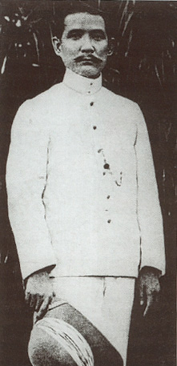
The rise and fall of the Kuomintang (The Nationalist Party)

Slide 2
The Chinese Revolution
Sun Yat-sen led the movement to replace the Qing Dynasty.
3 Goals:
End foreign domination
Form a representative government
Create economic security for the Chinese people
Sun Yat-sen’s attempt to unify China was unsuccessful
It resulted in political chaos after 1912.
Notes:
born into a farm-owning family
He attended an Anglican boys school in Honolulu, where he came under Western influence, particularly that of Christianity.
received a diploma from a Hong Kong medical school
Thereafter all his activities were devoted to overthrowing the Ch’ing dynasty and establishing a stable Chinese republic.
Revolution erupted in China, and Sun was elected provisional president
two months later he resigned in favor of another
Sun served as its director of guomindang

Slide 3
Kuomintang (The Nationalist Party)
Sun Yat-sen died in 1925.
Chiang Kai-Shek emerged as the leader of the Kuomintang. (The Nationalist Party)
At the same time, a split within the Kuomintang resulted in the formation of the Chinese Communist Party.

Slide 4
Civil War
By 1934, the Nationalists had the Communists surrounded.
The Long March
In October 1934, 100,000 communist fighters set out from Jianxi.
In the autumn of 1935, they reached the mountains in the north where they could regroup and launch new offensives.
Only a tenth of those who had set out were still alive.
Mao Ze Dong was elected Chairman of the party at the end of the march.

Slide 5
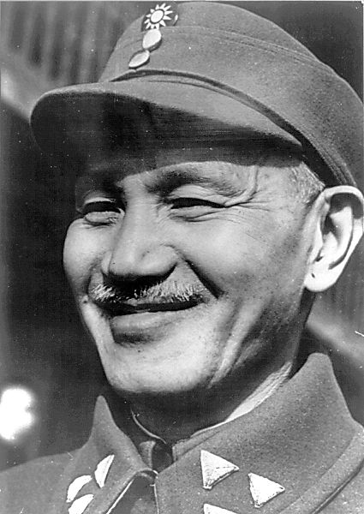
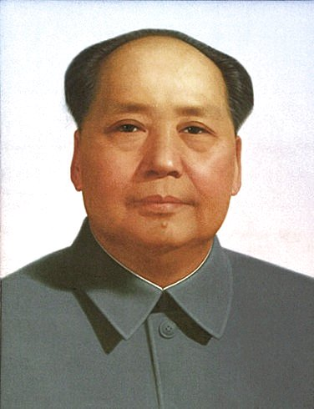
Chiang Kai-Shek v. Mao Zedong

Slide 6
Japanese Invasion
The Japanese invaded Manchuria in 1931 to obtain mineral resources.
In 1937, Japan used Manchuria as a base to invade eastern China.
Their invasion of Nanjing was so brutal that it became known as the “The Rape of Nanjing”
Notes:
Between December 1937 and March 1938 at least 369,366 Chinese civilians and prisoners of war were slaughtered by the invading troops. An estimated 80,000 women and girls were raped; many of them were then mutilated or murdered.

Slide 7
Communists and Nationalist join forces to fight against the Japanese
The Japanese were defeated in 1945.

Slide 8
Civil War
After the defeat of Japan, civil war broke out between the Communists and Nationalists it lasted until 1949.
The Nationalists were supported by the United States.
Communist supported by the Soviet Union

Slide 9
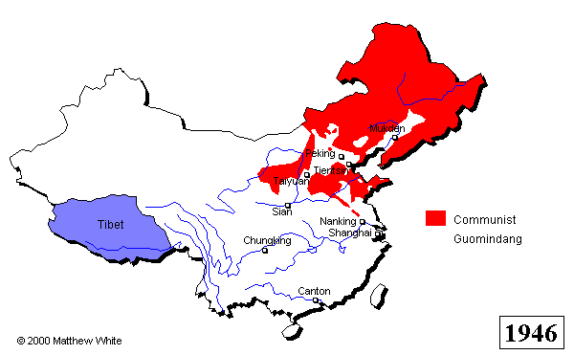
In 1949, the Communists led by Mao Zedong defeated the Nationalists led by Chiang Kai-Shek.

Slide 10
Why did the Communists win?
Mao won the support of the peasants by promising to give them land
Mao won the support of the women by rejecting the inequalities of traditional Confucian society
Many peasants opposed the Nationalist government-- they saw it as corrupt
Peasants felt Nationalists had allowed foreigners to dominate China

Slide 11
Nationalists escape to Taiwan
China considers Taiwan its 23rd province
Taiwan refers to itself as Republic of China
They considered themselves the government of China.
Today, they believe they are a sovereign state.
US government did not recognize People’s Republic of China as government of China they believed Republic of China was the head of the government.
Notes:
Also called chinese taipei after capital city
As a result of Cold War politics, the United States has provided military training and sold arms to the ROC armed forces.[11] However, the current status quo, as defined by the US, is supported on a quid pro quo basis between both Chinese states. The PRC is expected to "use no force or threat[en] to use force against Taiwan" and the ROC is to "exercise prudence in managing all aspects of cross-strait relations." Both are to refrain from performing actions or espousing statements "that would unilaterally alter Taiwan's status."[12]

