Slide 1
AIM: What is History?
DO NOW: Explore the quotes on the worksheet and determine whether they are a positive or negative view of history?

Slide 2


Slide 3
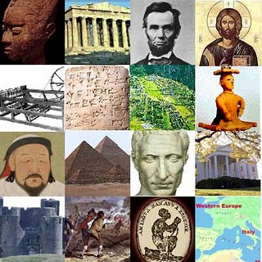
What is History?
History is the
study of the past
History is not just a simple list of facts from the past. It is the way people look at or interpret the meaning of those facts.
Different people will look at the facts in different ways.
Interpretation & Point of View (POV)

Slide 4
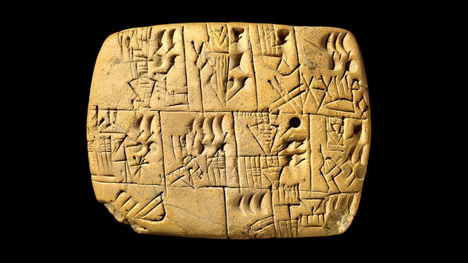
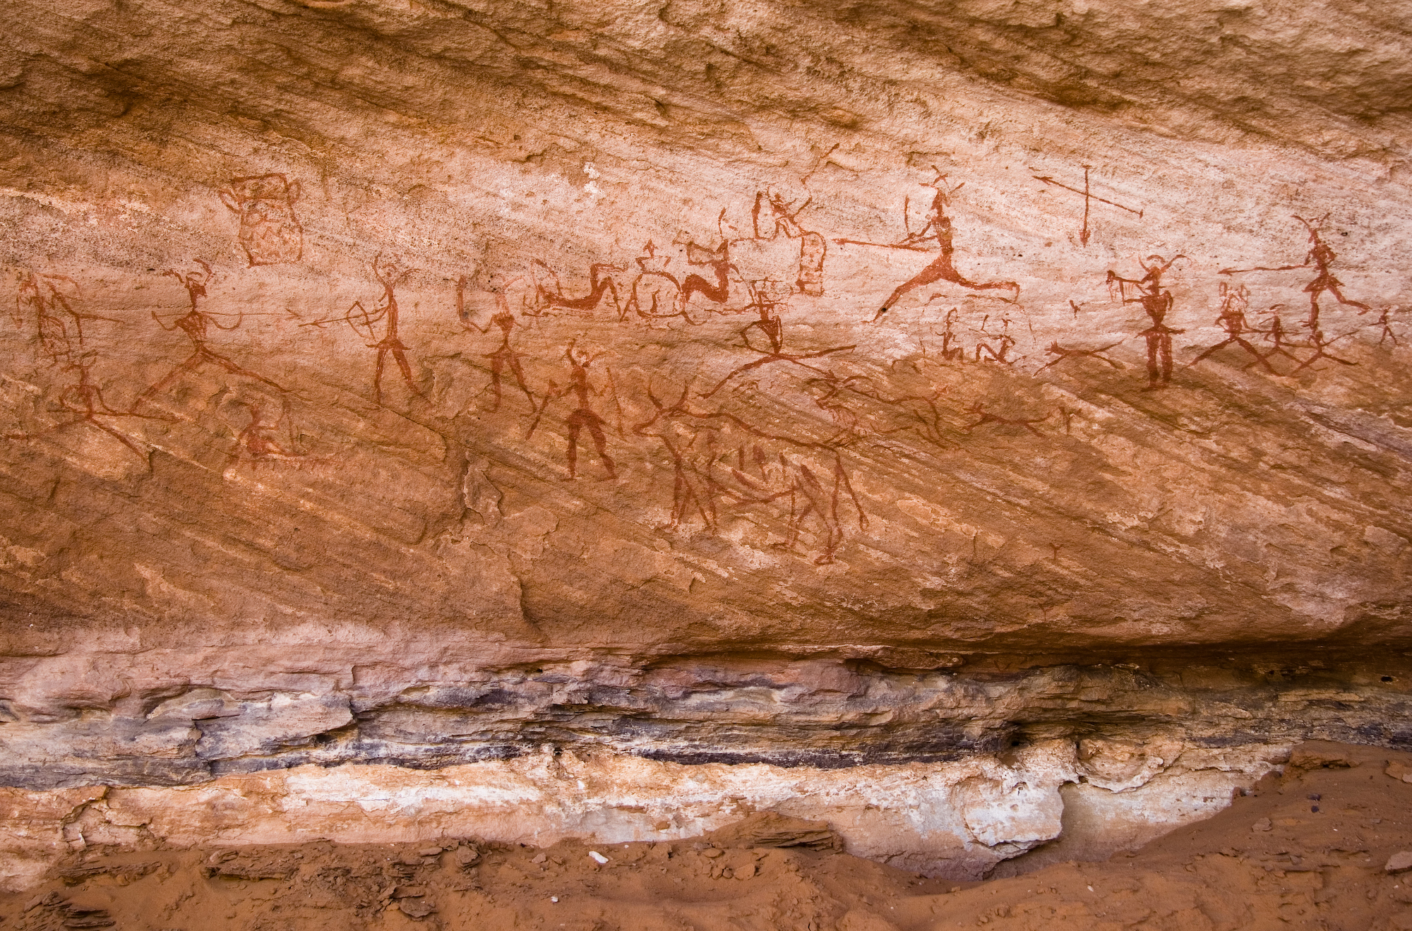
What’s Included?
Prehistory
History
Before Writing
Writing (800BC)
Notes:
C 5000 BC IRAQ – Make Beer

Slide 5
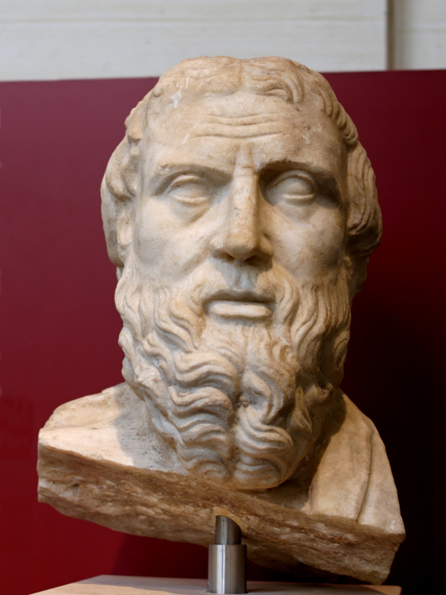
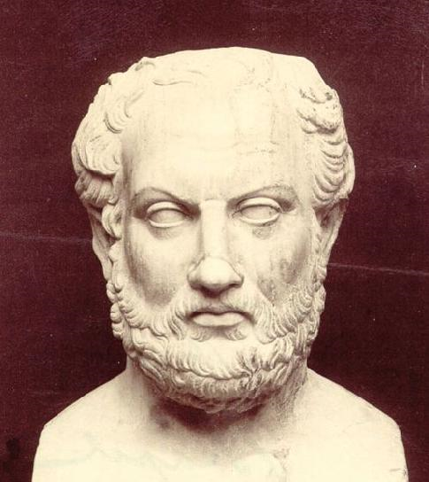
Different Methods ?
Used stories told to him from different cultures
to write his books
“The Histories”
Herodotus of Halicarnassus (c.484 BCE – c.425 BCE)
Used scientific approach attributing major events to human choice rather than divine intervention and relied of factual and observations.
Thucydides (c.460 BCE – c.400 BCE)

Slide 6
Timeline Basics
What is Circa?
Circa means: around or about
  Examples: c. 5000BC
  c. 20,000BCE
  c. 300AD
  c. 800CE

