Slide 1
European State Consolidation in the 17th & 18th Century
AP EURO - Chapter 16
Age of Absolutism & Constitutionalism in Western Europe

Slide 2
17th & 18th Century
England, France, Austria, Prussia, Russia Established/Maintained:
1. Strong Monarchies
2. Standing armies
3.Efficient tax structures
4. Large Bureaucracies (appointed govt. officials)
5. the Loyalty of their nobility

Slide 3
2 Models of Government Emerged:
1. Parliamentary Monarchy:
England
Parliament & Monarch work together
Parliament is summoned by King
2. Political Absolutism:
France
Monarch should have unlimited power

Slide 4
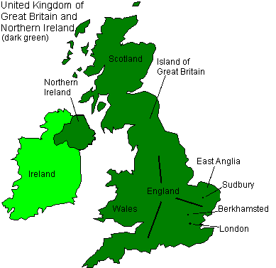
In England,
Political model: Parliamentary Monarchy
Parliament was dominated by landowners & nobles
17th & 18th century “Age of Aristocracy”

Slide 5
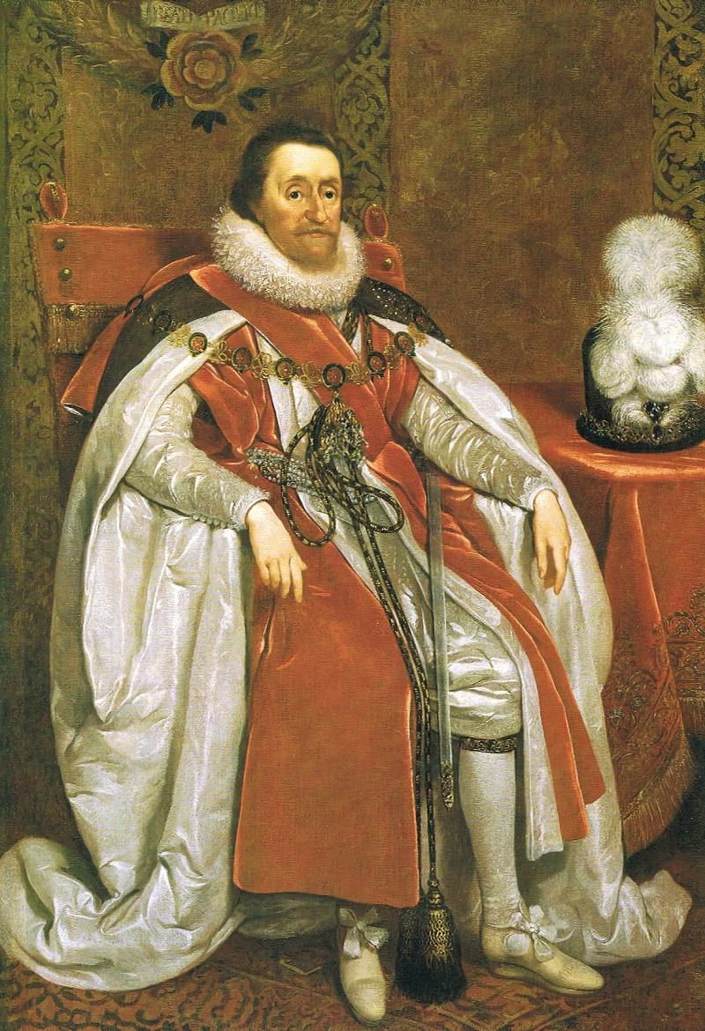
1. James I (ruled:1603-1625)
Believed in the “Divine Right of Kings”
And Rarely called on Parliament

Slide 6

King James I of England
“ Kings are not only God’s lieutenants upon earth, and sit on God’s throne, but even by God himself they are called gods.”
- King James I

Slide 7

The Duke Of Buckingham
James I’s Favorite noble
Sold noble titles to highest bidders
The Nobility was outraged!

Slide 8
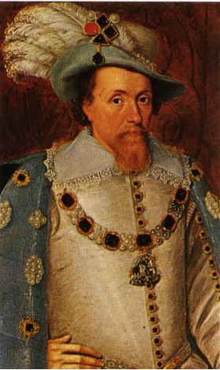
James I
Negotiated Peace with Spain in 1604
Parliament not happy
1624 England went to war with Spain (again)
Needed $ for war…

Slide 9
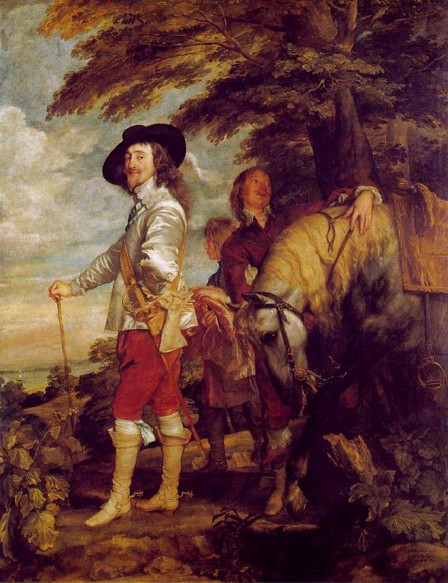
Charles I ( Ruled 1625-1649)
Son of James I - Became King 1625
Raised taxes without Parliament permission
“Forced Loan” tax imposed on English property owners
Imprisoned those who refused to pay

Slide 10
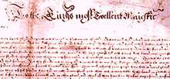
Parliament’s Response 1628:
Willing to approve $ for king ONLY if he agreed to the
Petition of Right:
1. No forced loans –”without consent by act of Parliament”
2. No imprisonment w/o due cause
3. No quartering of troops in private homes

Slide 11
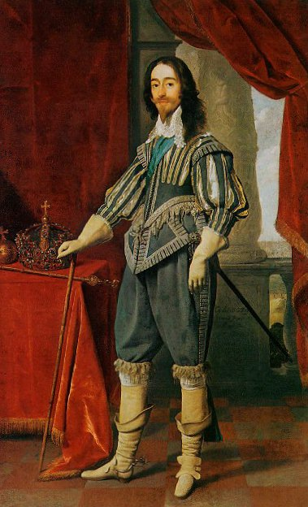
King Charles I
Agreed to petition…
But then dissolved the Parliament in 1629

Slide 12
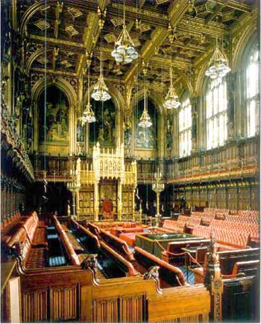
The Short Parliament
King Charles forced to call on Parliament in 1640 (April – May)
Because he Needed $ for war against Scotland

Slide 13
Parliament
Refused to give funds until King Charles I addressed a long list of grievances
As a result…
King Charles I dissolved Parliament again!

Slide 14
Long Parliament (1640-1660)
Scots defeated English (summer 1640)
King Charles I was forced to call on Parliament
How will members of Parliament react to the king?

Slide 15
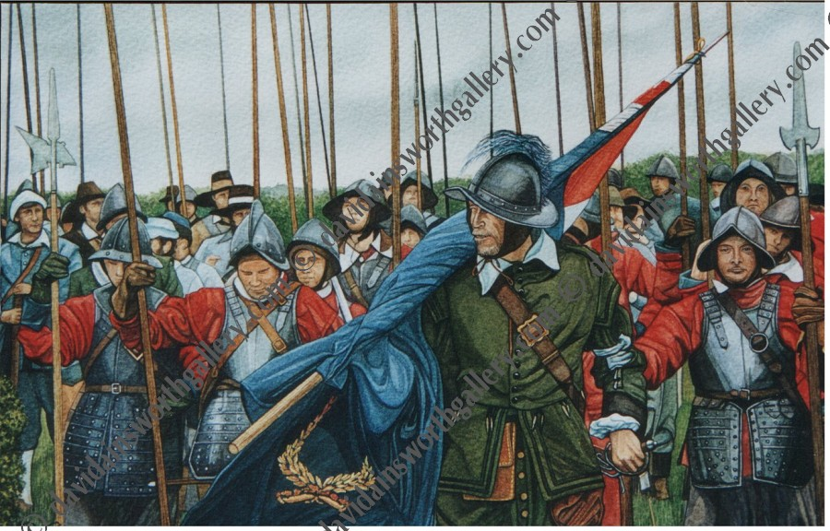
English Civil War Began When… (1642-1646)
Parliament overthrew King Charles I
King’s Supporters = Cavaliers
Parliamentary Opposition = roundheads

Slide 16
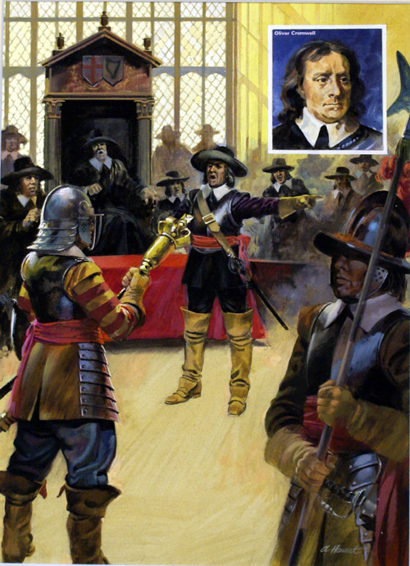
Parliament Victorious
1. Formed an Alliance w/ Scotland to overthrow King Charles I
2. Oliver Cromwell led Parliament army

Slide 17
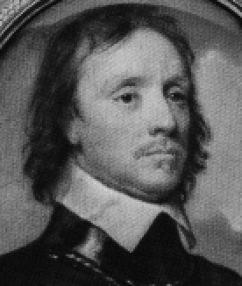
Charles I Was Defeated!
and Executed in 1649
1619-1660 England became :
A Puritan Republic
<- Oliver Cromwell emerged as political ruler / new military dictator

Slide 18
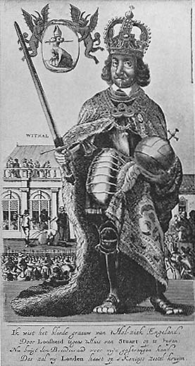
Oliver Cromwell
Conquered Scotland & Ireland
Disbanded Parliament
Proclaimed himself “Lord Protector”
Supported by army

Slide 19
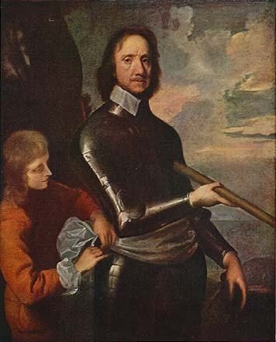
Oliver Cromwell’s Strict Puritanical Moral Code:
Prohibited:
Dancing, gambling, theatre going, alcohol, sports, freedom of the press
People disliked Cromwell’s strict, harsh, Puritanical rule ☹

Slide 20
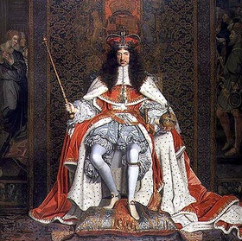
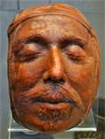
Oliver Cromwell died in 1658
English people restored the monarchy
Charles II became King 1660 _→
His Father was Charles I

Slide 21
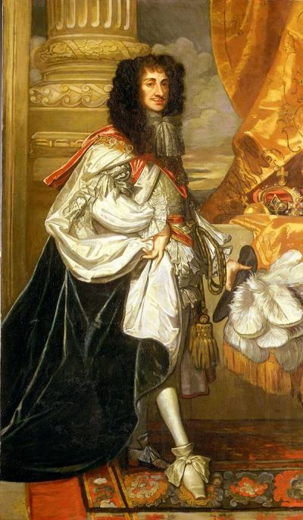
King Charles II (ruled: 1660-1685)
“Stuart Restoration”
Leaned lessons from past Kings- don’t mess with Parliament!
Tolerant of religious groups,but favored Catholicism

Slide 22
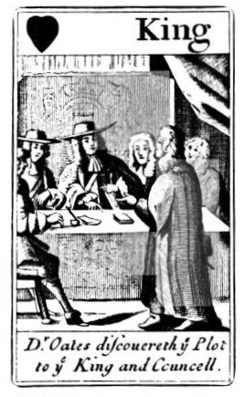
The Popish Plot, 1678
Titus Oates swore before a court…
That Jesuits were planning to kill King Charles II!!
And replace him with his Catholic Brother, James !

Slide 23
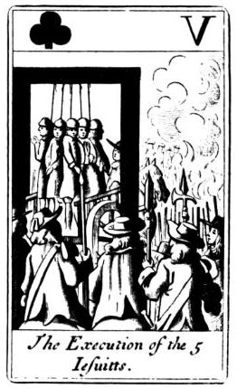
Accusation A Lie, However…
1. Stirred up anti-Catholic sentiments
2. Parliament believed Oates
3. Innocent people tried & executed for treason

Slide 24
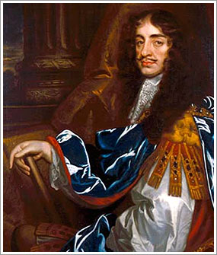
As A Result,
Catholics were banned from Parliament in1678
Ironically, Charles II converted to Catholicism on his deathbed (1685)

Slide 25
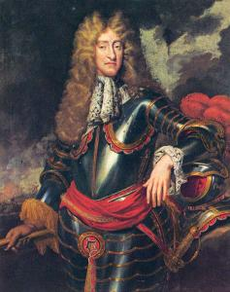
James II (R. 1685-1688)
Brother of Charles II
Unpopular monarch
1. Catholic = controversial
Why?
2. Absolute ruler

Slide 26
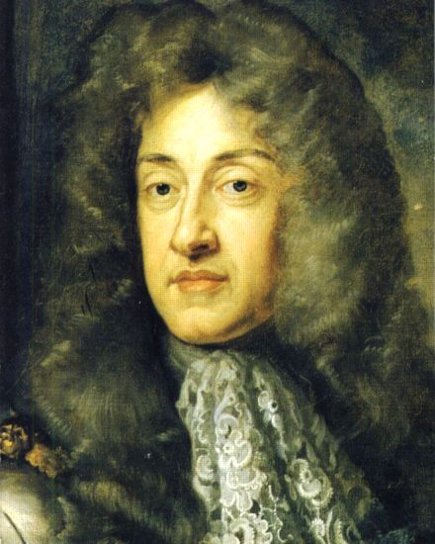
James II Repealed the
Test Act – required all civil & military officials of the crown to swear an oath against the doctrine of Transubstantiation

Slide 27
Monarch vs. Parliament (again)
Parliament was upset, so…
James II dissolved Parliament!!
Appointed Catholics to high positions in court, army.

Slide 28
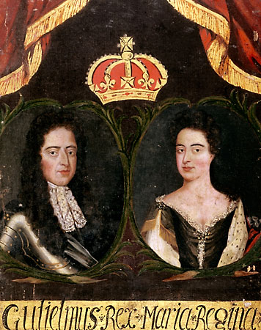
English People Fed Up With Political Instability
People wanted James II ‘s Protestant Daughter Mary to succeed him…
But then James II HAD A SON…

Slide 29
The End of James II’S Reign
An army was sent to depose him…
James II forced to flee -to France
1689 Parliament Proclaimed :
Mary II & William III King & Queen
“Glorious Revolution” – a bloodless event.

Slide 30
Parliamentary Monarchy- England
Power struggles between King & Parliament 17TH Century.
1. James I (1603), Charles I (1625)
2. Oliver Cromwell ‘s Puritan Republic (deviation from Monarchy (1619-1660)
3. Charles II (1660), James II (1685)
4. “Glorious Revolution” – William & Mary, 1689

Slide 31
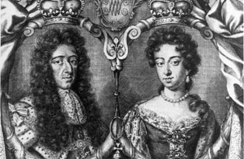
William & Mary Established
Bill of Rights
1. Limited powers of monarchy
2. Guaranteed civil liberties for privileged
3. Monarchs subject to law
4. Monarchs would rule by consent of parliament
5. Prohibited Catholics from occupying English Throne

Slide 32
Making Connections…
College of William & Mary
Founded 1693 in Williamsburg, Virginia (U.S.A.)
Second oldest University in U.S.A
Educated 3 Future Presidents :Thomas Jefferson, John Tyler & James Monroe

Slide 33
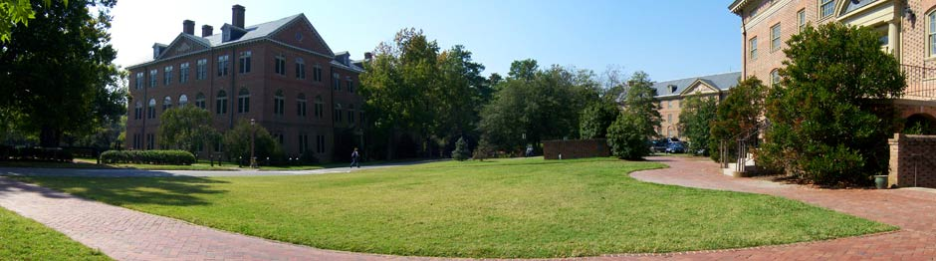



College of William & Mary

