Slide 1
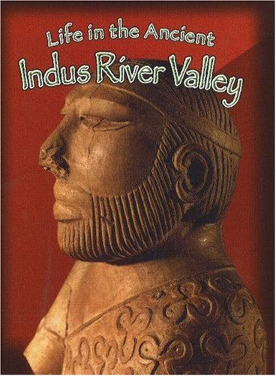

Indus
River Valley
Civilizations
AIM: What contributions did Ancient Indian Civilization have?
Do Now: Geography of Ancient India Worksheet

Slide 2
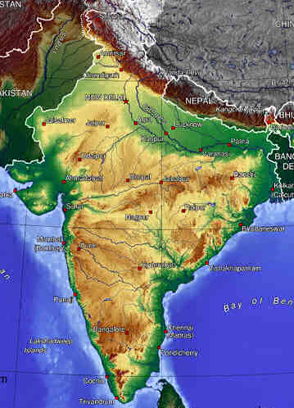
Subcontinent
A large land mass geographically separated from the rest of the continent.
India is a subcontinent, separated from Asia by Himalaya Mountains.

Slide 3
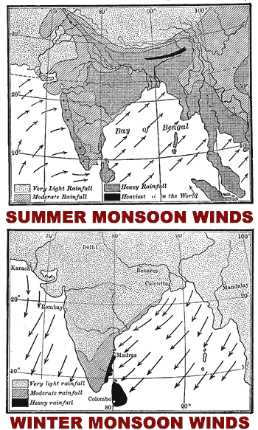
monsoon
Definition – seasonal winds that bring rain
Indus Valley farmers depended on the rains to irrigate their land

Slide 4
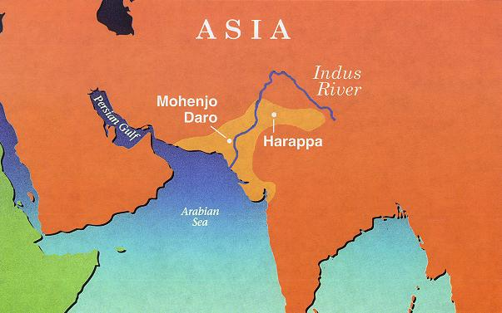
Civilization Develops
Sophisticated urban centers
Harappa and Mohenjo-Daro
Dynamic trade state - trade with Mesopotamia and China
Monsoons

Slide 5
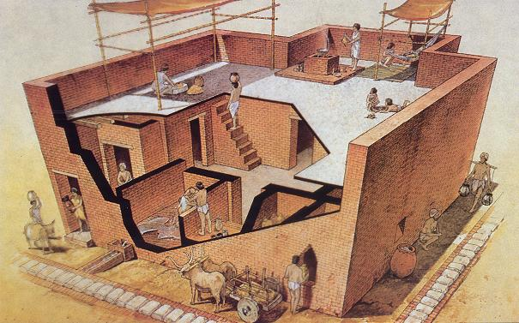
Cities very sophisticated with advanced sewage systems

Slide 6
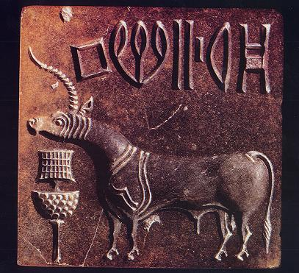
Harappan writing has not yet been deciphered

Slide 7
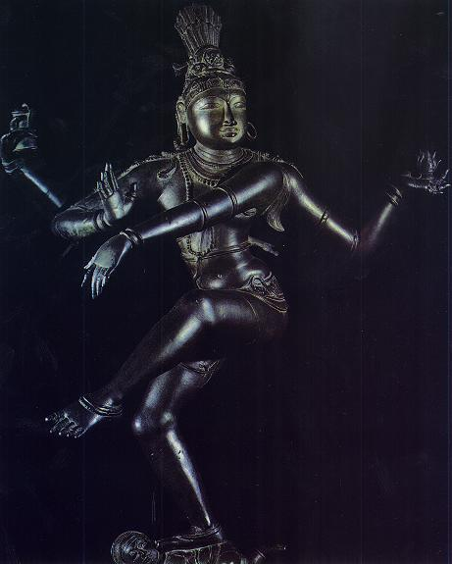
Harappans worshipped cattle and Shiva

Slide 8

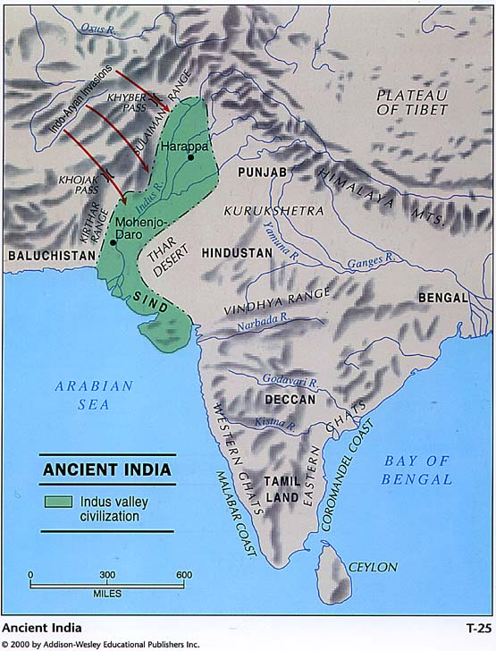
Aryans:
  “Noble People”
  Indo-European
Decline due to
  Degradation of the ecosystem
  Migration of nomadic Aryans
  Political collapse

Slide 9
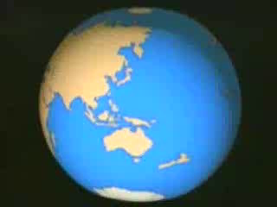
Ancient India

