Slide 1

Global History & Geography
Terrorism
AIM: What is Terrorism?
Do Now: Define Terrorism

Slide 2

Terrorism
What is it?
Where does it come from?
Why is it used?
How can we prevent it?
What do we fear about Terrorism?
Notes:
The objective of this lecture is to present some scientific facts about terrorism, so that teachers can educate the next generation, to understand terrorism and help to prevent terrorism. This is a template lecture for teachers. Please feel free to add or take out any slides. For example, you might want to include information about terrorism in your country, rather than the examples used in this lecture. The lecture is designed to be apolitical. The objectives are to 1) provide information to students about terrorism in general, 2) to show that terrorism has had a long history, 3) to demonstrate that terrorism has taken place in all areas of the world and 4 to demonstrate that terrorism although scaring many people is very rare. We must be concerned about terrorism, however, we cannot be paralyzed due to fear.

Slide 3
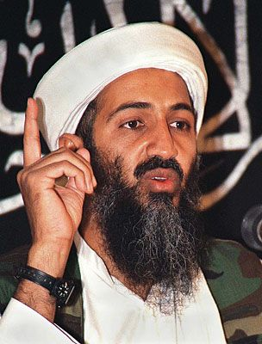
Terrorism
Is an unlawful act of violence
Intimidates governments or societies
Goal is to achieve political, economic, religious, social or ideological objectives
Notes:
Terrorism is a political act designed by groups to have their message heard.
Arthur H. Garrison, How the World Changed: a History of the Development of Terrorism, presented at Delaware criminal Justice Council Annual Retreat, Oct 28-29, 2001
http://www.state.de.us/cjc/history.ppt

Slide 4

Early History of Terrorism
Terror has been used to achieve political ends and has a long history
  As early as 66 – 72 A.D. Resistance to Roman occupation, terrorists killed Roman soldiers and destroyed Roman property.
Terror was used to resist occupation.
Notes:
Terror in many ways has been the weapon of groups who want their message heard, and want a political change, but do not feel that they have a way to be heard or have a voice. Terrorism is viewed as a means to be heard.
Arthur H. Garrison, How the World Changed: a History of the Development of Terrorism, presented at Delaware criminal Justice Council Annual Retreat, Oct 28-29, 2001
http://www.state.de.us/cjc/history.ppt

Slide 5
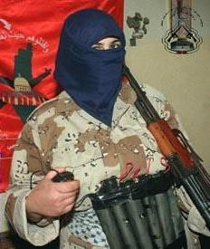
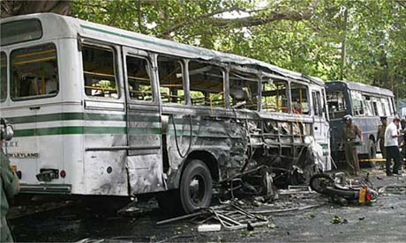
Early History of Terrorism
Suicidal martyrdom represented being killed by invaders which resulted in rewards in heaven. It dates back thousands of years in most societies and religions.
Terrorism against the enemy is often viewed as a religious act.
Notes:
Terrorism has been viewed as honorable by the side who practices it. It is viewed as a crime against humanity by the victims of the countries attacked.
Arthur H. Garrison, How the World Changed: a History of the Development of Terrorism, presented at Delaware criminal Justice Council Annual Retreat, Oct 28-29, 2001
http://www.state.de.us/cjc/history.ppt

Slide 6
Modern History of Terrorism
The term “terrorism” was coined in the French Revolution’s Reign of Terror (1793 – 1794). .
This was the birth of Government-Sponsored Terrorism
The line between terrorism and political violence is often blurred
Goal: of State terrorism was to eliminate opposition, consolidate power, e.g., the Vanished in Argentina
Notes:
.
Governments will sometimes try to suppress dissent. In the Military regime in Argentina in the 1960, young protestors sometimes even your age would sometimes “disappear” because of their views. The goal was to eliminate dissent, and maintain power.
Arthur H. Garrison, How the World Changed: a History of the Development of Terrorism, presented at Delaware criminal Justice Council Annual Retreat, Oct 28-29, 2001
http://www.state.de.us/cjc/history.ppt

Slide 7

Modern History of Terrorism:
Middle 20th century, terrorism became a tool used by both sides of colonial conflicts.
The last 20 years of the
20th century religious based terrorism became more and more frequent. Islamic Terrorism
Another format is economic terrorism, which destructs industry and agriculture system.
Notes:
Arthur H. Garrison, How the World Changed: a History of the Development of Terrorism, presented at Delaware criminal Justice Council Annual Retreat, Oct 28-29, 2001
http://www.state.de.us/cjc/history.ppt

Slide 8
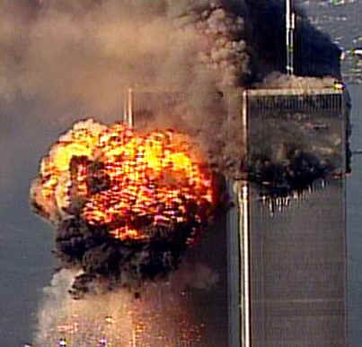

Terrorism conclusions
Terrorism is an ancient tactic.
Terrorism is a mode of communication.
Terrorism is a special type of violence.
Terrorism is used in times of peace, conflicts and war.
Terrorism is designed to make a point, through psychological means, fear.
Terrorism is a political act.
Notes:
We were surprised on Sept. 11. However, it is very important to recognize that terrorism is not new, and it’s primary goal is not to kill, but to communicate a message. Terrorism is a form of violence, and has been used throughout history. Terrorism most certainly has a psychological impact, and is a very powerful political act. It gets people heard.
Arthur H. Garrison, How the World Changed: a History of the Development of Terrorism, presented at Delaware criminal Justice Council Annual Retreat, Oct 28-29, 2001
http://www.state.de.us/cjc/history.ppt

Slide 9
Property of Terrorism
Terrorism is different from regular crime because of its strong political properties
The definition of terrorism can vary from people to people due to the differences in standpoint
One person’s terrorist can be another’s fighter

Slide 10

Prevention of Terrorism
Primary prevention:
  Education!!!
  Understand the differences in cultures, religions, beliefs and human behaviors
  Think of the peace, freedom and equality of all human beings, not just “my group of people”
  Eliminate the root of terrorism
Notes:
Just because of its uncertainty, it is hard to collect unbiased data on terrorism and it is hard to propose specific prevention measures. Here we present the general approaches of prevention from the epidemiological and public health point of view.

Slide 11

Prevention of Terrorism
Secondary prevention:
  Establish surveillance and monitoring system against terrorism attack
  Improve citizen awareness.
  Systems to protect citizens

Slide 12
Types of Terrorism
Domestic terrorism involves groups whose terrorist activities are directed at elements of our government without foreign involvement. Oklahoma City is a primary example.
International terrorism involves groups whose terrorist activities are foreign-based and/or directed by countries or groups outside the United States. Sept. 11 is an example of International Terrorism.
Notes:
Recent Trends in Domestic and International Terrorism, the Center for National Security Studies, http://nsi.org/Library/Terrorism/tertrend.html

Slide 13
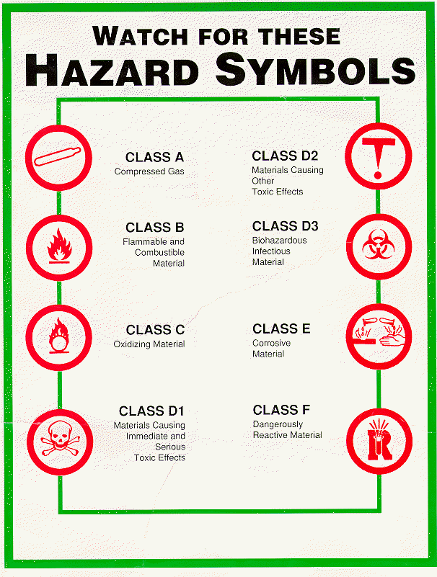
Methods of Terrorism
Firearms
Explosive and
Incendiary Devices
Chemical Agents
Biological Agents
Nuclear Weapon

Slide 14
Conclusion
Terrorism is unlawful act
Terrorism has a long history of being used to achieve political, religious and ideological objectives
Terrorism can be conducted through firearms, explosive devices and biological, chemical, nuclear materials
Even through the events of 2001,the risk of dying from terrorism has remained much lower than that from motor vehicles, smoking, and alcoholic beverage.
Notes:
Sources: Information on how to help children understand the terrorist attacks:
Suggestions for Adults: Talking and Thinking with Children About the Terrorist Attacks
http://www.ed.gov/inits/september11/adults.html
Suggestions for Educators: Meeting the Needs of Students
http://www.ed.gov/inits/september11/educators.html
A Letter to Elementary School Students from First Lady Laura Bush
http://www.whitehouse.gov/news/releases/2001/09/letter2.html
A Letter to Middle and High School Students from First Lady Laura Bush
http://www.whitehouse.gov/news/releases/2001/09/letter1.html
President Bush Participates in Launch of Friendship Through Education Consortium
http://www.friendshipthrougheducation.org/
School Officials Urged to Prevent Harassment of Muslim and Arab-American Students
http://www.ed.gov/PressReleases/09-2001/09192001c.html
Where you can find additional information and resources:
American Academy of Child and Adolescent Psychiatry
http://www.aacap.org/
American Counseling Association
http://www.counseling.org
American Psychological Association Online: Help with Trauma
http://www.apa.org/psychnet/coverage.html
Emergency Services and Disaster Relief Branch, Center for Mental Health
http://www.mentalhealth.org/cmhs/emergencyservices/
Helping Children and Adolescents Cope with Violence and Disasters
http://www.nimh.nih.gov/publicat/violence.cfm
Helping Children Cope with Disaster, National Parent Information Network
http://npin.org/library/2001/n00563/n00563.html
High Schools for Heroes
http://www.hs4heroes.org
National Association of School Psychologists
http://www.nasponline.org
National Center for Post-Traumatic Stress Disorder
http://www.ncptsd.org/what_is_new.html
Post-Traumatic Stress Disorder (PTSD), Trauma, Disasters, and Violence
http://www.nimh.nih.gov/anxiety/ptsdmenu.cfm
Talking with Children When Disaster Strikes
http://www.tpt.org/TPTspecial_edition/walsh.html
Ten Tips to Help Your Kids Deal with Violence, Parenting Press
http://www.parentingpress.com/resp_10_tips.html
Terrorism and Children, Purdue University Extension
http://www.ces.purdue.edu/terrorism/children/index.html
University of Oklahoma, Department of Pediatrics
http://peds.ouhsc.edu/
U.S. Government Information and Resources in Response to September 11th Events
http://www.firstgov.gov/featured/usgresponse.html

Slide 15
The only thing we have to fear is fear itself. FDR, 1933

