Slide 1
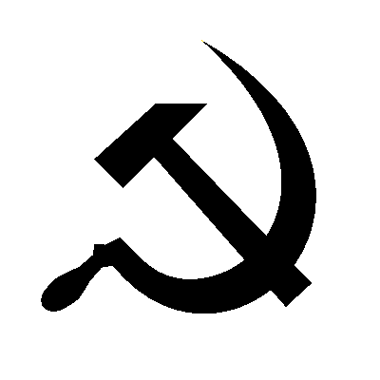
A Leader’s Statistics:
- millions imprisoned or exiled
- 6 to 7 million killed by a forced famine
-millions executed
-4 to 6 million dispatched to forced labor camps
Final Death Toll is unknown but estimated to be
between 20-60 Million

Slide 2
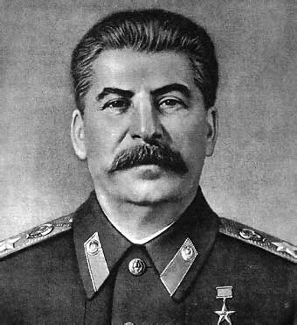
Stalin
Global 2
Patten/Kempton

Slide 3
The fundamental task of the five-year plan was to transfer our country, with its backward, and in part medieval, technology, on to the lines of new, modern technology.
The fundamental task of the five-year plan was to create in our country an industry that would be capable of re-equipping and reorganizing, not only industry as a whole, but also transport and agriculture—on the basis of socialism.
Joint Plenum of the C.C. and C.C.C., C.P.S.U.(B.) 1 January 7-12, 1933
The Results of the First Five-Year Plan
Report Delivered on January 7, 1933
https://www.marxists.org/reference/archive/stalin/works/1933/01/07.htm

Slide 4
Lenin died in 1924
Who would take power?
Trotsky or Stalin

Slide 5
Stalin Takes Power
The name Stalin means Man of Steel
Once in power, Stalin set out to make the Soviet Union a Modern Industrial Nation.
Stalin’s plan to industrialize the USSR was known as the Five Year Plan

Slide 6
Stalin’s Five-Year Plans
Aimed at building heavy industry,
transportation and increase farm output
Brought all economic activities under government control
Stalin set goals that must be met (quotas). Workers who succeeded received bonuses. Workers who did not were punished.

Slide 7
During the 1930s, oil, steel and coal production grew.
  New railroads were built across the Soviet Union.
Stalin set goals that must be met (quotas). Workers who succeeded received bonuses. Workers who did not were punished.
During the 1930s, oil, steel and coal production grew. New railroads were built across the Soviet Union.

Slide 8
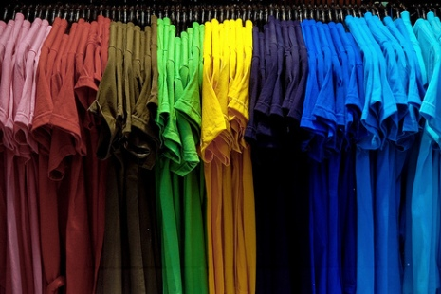
Mixed Results of the Five-Year Plan
The standard of living remained Poor
Didn’t focus on producing consumer goods

Slide 9
Revolution in Agriculture
Stalin also put agriculture under government control
Forced peasants to give up their land and live on state-owned farm called collectives which were large farms owned and operated by peasants as a group (Collectivization)

Slide 10
Peasants were allowed to keep their personal possessions but had to turn over all farm animals and farm tools to the government.
The government set prices and quotas
Peasants resisted collectivization by killing animals, destroying tools and equipment and burning crops.

Slide 11
Results of Collectivization
The government responded with brutal force
    Forced Famine 1932-1933 – 7,000,000 Deaths
Increased Stalin’s control, but did not improve farm output
    It was the official policy of the Soviet Union to deny the existence of a famine and thus to refuse any outside assistance. Anyone claiming that there was in fact a famine was accused of spreading anti-Soviet propaganda. Inside the Soviet Union, a person could be arrested for even using the word 'famine' or 'hunger' or 'starvation' in a sentence.

Slide 12
The Great Purge
To Purge means to Eliminate opposition
In the 1930’s, out of fear that other Communist party members were plotting against him, Stalin launched The Great Purge
During the Great Purge, Stalin accused thousands of people of crimes against the government (treason)

Slide 13
Stalin targeted writers, teachers, army heroes and Bolsheviks through a Reign of Terror
During the Great Purge, Stalin tried these people in public. These trials were called show trials.
Many of the accused were tortured, executed or sent to prison camps

