Slide 1

The Enlightenment
AIM: What was the Enlightenment?
Do Now: What era/revolution led to the Enlightenment?
Mr. Ott - Global History & Geography @ Park East

Slide 2

What do you think the word Enlightenment means?
The belief that humans could use logic and reason to solve the P.E.R.S.I.A. problems of the day.

Slide 3
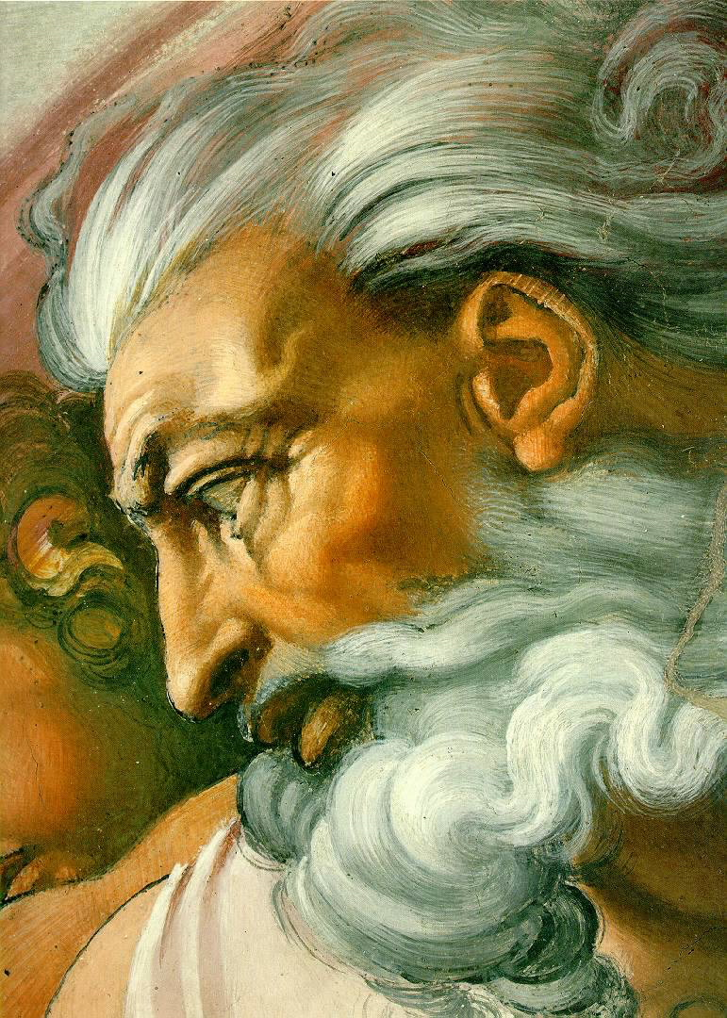
Before the Enlightenment…
Until then, most people believed that god controlled the universe.
What made people start to think differently?
Renaissance
Humanism
Scientific Revolution

Slide 4
Causes of The Age of Reason
Scientific Revolution convinced many European thinkers about power of reason
Scientific method and reason led to discoveries about physical world
Wondered if reason could be used to study human nature, society, politics, and economics
New generation of philosophers, 1600s
Viewed reason as best way to understand truth
Concluded reason could be used to solve all human problems
This time of optimism now called the Enlightenment

Slide 5
The Age of Reason
Ideas of Enlightenment
Peak of Enlightenment
Educated people throughout Europe, beyond, inspired
Held notion that world problems could be solved
New ideas debated in coffeehouses, public spaces
Writers published ideas in books, magazines, pamphlets
Reached peak in 1700s
Paris, center of intellectual activity
Parisian women hosted social gatherings, salons
Philosophers, artists, scientists, writers regularly discussed ideas

Slide 6
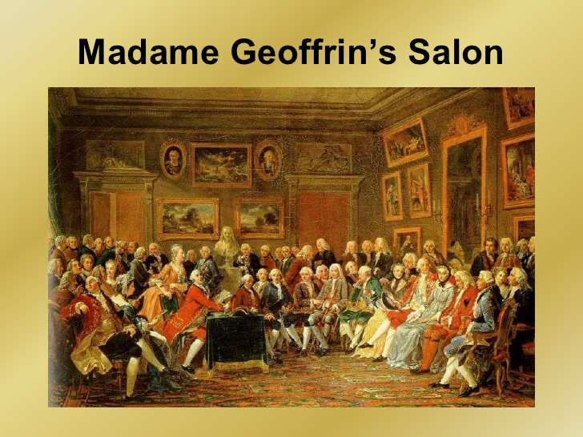

Slide 7
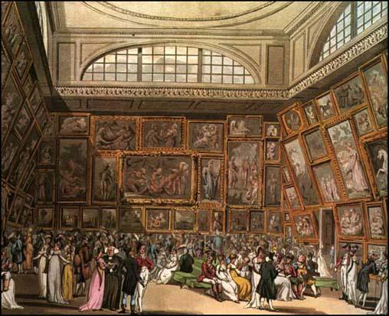
The Royal Academy

Slide 8

What drink helped spur/create new ideas and awoke the mind?
Answer(s): Coffee
WHY?
Many studies have demonstrated that caffeine leads to enhanced cognitive performance involving various tasks (Brunye et al., 2010). It is often cited for its positive effects on vigilance, mental alertness, feeling of well-being. Caffeine also has a positive effect on various domains of attention (Trayambak et al., 2009).

Slide 9
In some European nations, and particularly in Britain, coffee was challenged by tea imported from China. Its popularity in Europe helped to open lucrative trade routes with the East and underpinned imperialism and industrialization on an unprecedented scale, enabling Britain to become the first global superpower.
Tom Standage
History of the World in Six Glasses

Slide 10

Enlightenment Thinkers
Thomas Hobbes
John Locke
Baron de Montesquieu
Jean Jacque Rousseau
Mary Wollstonecraft
Denis Diderot

Slide 11
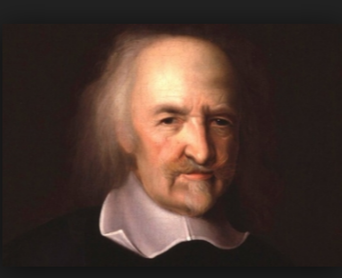
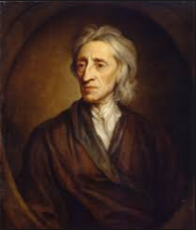
New Views on Government
As the Enlightenment began, European thinkers began looking for ways to apply reason in order to improve the human condition.
Thomas Hobbes
John Locke
English thinker, wrote views of government in Leviathan
Absolute monarchy best
Believed people needed government to impose order
People selfish, greedy
Should exchange some freedoms for peace, safety, order
Social contract
“ Life is Nasty, Brutish, and Short”
English philosopher, believed all people born equal
Government should protect people’s natural rights
Monarchs not chosen by God
Government by “consent of the governed”
Power limited by laws
Ideas foundation for modern democracy
“Life, Liberty, and Property”

Slide 12
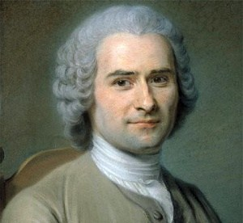
Jean-Jacques Rousseau
French philosopher, believed people basically good
Believed society corrupted people
Wrote The Social Contract, contract between all members of society
“Man is born free but everywhere is in chains.”
View of Government, Society
Believed government should work for common good, not wealthy few
Individuals should give up some freedoms for benefit of community
Despised inequality in society
Views inspired revolutionaries in years to come

Slide 13

Baron de Montesquieu
The Spirit of the Laws
Published 1748, showed admiration of Great Britain’s government
Powers divided into branches: legislative, executive, judicial
Parliament made laws, king carried out laws, courts interpreted laws
Separation of powers
Best form of government divided power among branches of government
Separation of powers kept individual or group from abusing power
Checks and balances
Misunderstood structure of British government, rational conclusion anyway
Separation of powers allowed each branch to check against power of others
Concept later important structure of democratic governments

Slide 14
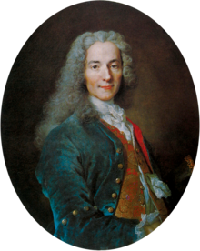
New Views on Society
Some Enlightenment philosophers focused on government, others on issues in society
Francois-Marie Arouet, wrote as Voltaire
Outspoken philosopher, wrote with biting wit
Attacked injustice among nobility, government, church
Created enemies, imprisoned twice
Exiled to England for two years
Defended principles, fought superstition, ignorance
Lifelong struggle for justice, toleration, liberty

Slide 15

New Views on Society
Denis Diderot
French philosopher
Determined in mid-1700s to try to compile great expansion of human knowledge into a single work
Encyclopedia
Diderot’s extensive 35-volume work, to promote knowledge
Explained new ideas about art, science, government, religion
Lifelong work
Worked on Encyclopedia 27 years, last volume published 1772
Spread Enlightenment ideas across Europe, North America
Attacks by French leaders
Criticisms of church, government, legal system
Tried to stop publication, 1759
Last volumes completed in secret, but immediate success

Slide 16
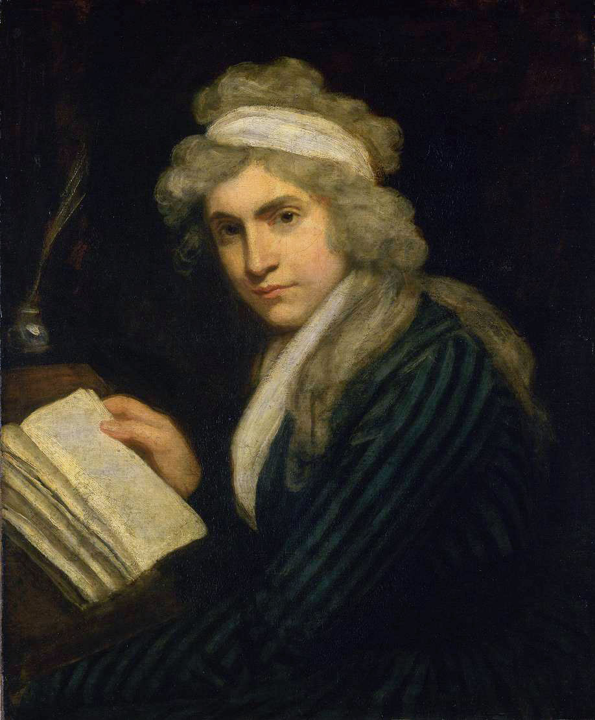
Mary Wollstonecraft
Enlightenment thinkers still held traditional views about women
Proper roles wives, mothers; should receive limited education
Wollstonecraft demanded equal rights for women
A Vindication of the Rights of Woman, equal education for women

Slide 17
Enlightenment Ideas Spread
The spirit of optimism quickly spread throughout Europe. A few monarchs became enlightened despots, changing their systems of government and ruling according to Enlightenment ideas.
Prussia
Reforms
Limitations
Frederick II, had duty to rule with absolute power
Also strongly influenced by ideas of Voltaire
Built powerful military, introduced reforms
Elementary education for all children
Abolished torture
Supported most forms of religious tolerance
Reduced censorship
No religious tolerance for Jews
Opposed serfdom, did not abolish
Did not make reforms to achieve justice but to make own rule more powerful

Slide 18
Enlightenment Ideas Spread
Russia
Catherine II became ruler, 1762
Dreamed of establishing order, justice, supporting education, culture
Read works of, corresponded with Voltaire, Diderot
Reforms
Drafted Russian constitution, code of laws
Considered too liberal, never put into practice
Limitations
Intended to free serfs, but would lose support of wealthy landowners
Catherine had no intention of giving up power
Became tyrant, imposed serfdom on more Russians than ever before

Slide 19
Enlightenment Ideas Spread
Most radical enlightened despot, Austria
Joseph II, became emperor 1780
Ambitious reform program
Eliminated torture, death penalty
Provided free food, medicine for poor
Granted religious tolerance to Protestants and Jews
Abolished serfdom, laborers to be paid
Changes resisted by nobility, church

Slide 20
Enlightenment Ideas Spread
Challenged Beliefs
Writers, philosophers questioned ideas long held as absolute truth
Challenged beliefs in absolute monarchies
Questioned relationship between church and sate
Debated rules and rights of people in society
Promoted ideas reformers and revolutionaries would later use to change society
Reforms
Revolutions
Belief in progress spurred many to enact reforms
Believed reason could solve any problem, debated ways to make society more just
Did not accept poverty, ignorance, inequality as facts of life
Ideas about power, authority inspired reforms and revolutions
American colonists inspired to break free from British monarchy
Colonists strongly influenced by political views of Locke, Rousseau

Slide 21


