Slide 1

Essay Writing
AIM: How do I maximize the most amount of points for my Introduction on a Thematic Essay?
Do Now: What does the word “paraphrase” mean?
The Introduction

Slide 2
Introduction Paragraph
DEFINE – “D”
Read Theme or Historical Context / Define Theme
Use Word Replacement Strategy
List – “L”
Add/List Topic(s) to Discuss
Re-Write – “R”
Theme Using WRS
Step #1
Step #2
Step #3
Step #4

Slide 3
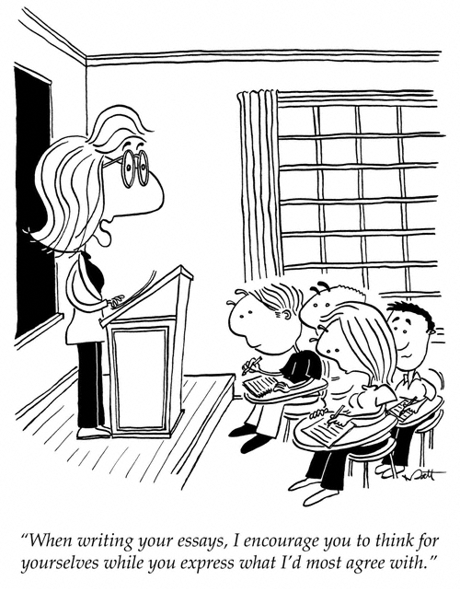
Word Replacement Strategy (WRS)
1. Read the theme or historical context
2. Circle the important words.
3. Think of replacements for the most of the important words and phrases. (Multiple replacements will be necessary)
4. Paraphrase (put into your own words) the theme or historical context using the replacement words.

Slide 4
Word Replacement Strategy (WRS)
Theme: Culture and Intellectual Life
Intellectuals, philosophers, and leaders have often recorded their ideas in written works. These ideas have been used throughout history to guide societies and influence the course of national and regional development.
Word | Replacement #1 | Replacement #2 | Replacement #3
Intellectuals | smart people | academics | thinkers
philosophers | thinkers | dreamers | truth-seeker
leaders | people in power | people in charge | rulers
written works | literature | texts / words | books
guide | steer | direct | move
society | people | culture | civilization
influence | persuade | affect | shape
national | nationwide | state | countrywide
regional | area | region | province
development | progress | advancement | evolution

Slide 5
Re-Write the Theme
All over the world, thinkers, dreamers, and the people in power use words such as books to move and shape their culture within their state in order to affect the advancement of their society.
You must re-write the theme in order to receive a score higher than a three (3)

Slide 6
Introduction Paragraph
Read Theme or Historical Context
Write a definition of the main theme
Use Word Replacement Strategy
Add Topic(s) to Discuss
Re-Write Theme Using WRS
Step #1
“D”
Step #2
Step #3
“R”
Step #4
“L”

