Slide 1
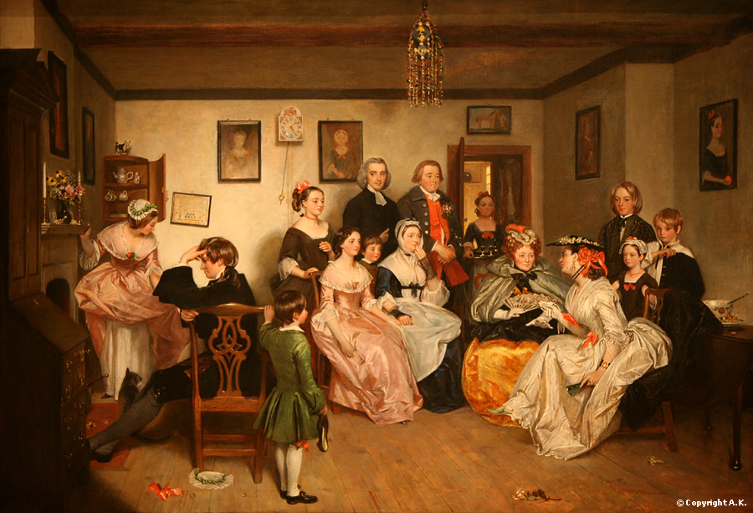
The Victorian Age
1830-1901
AIM: What effect did Britain have on the world during the Age of Victoria?

Slide 2
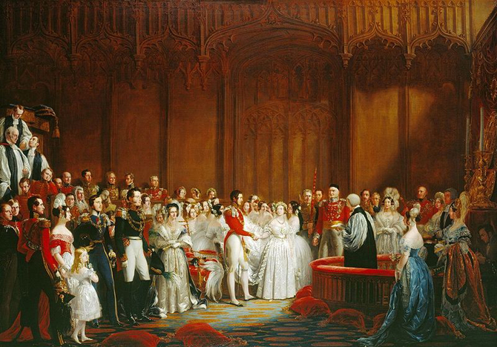
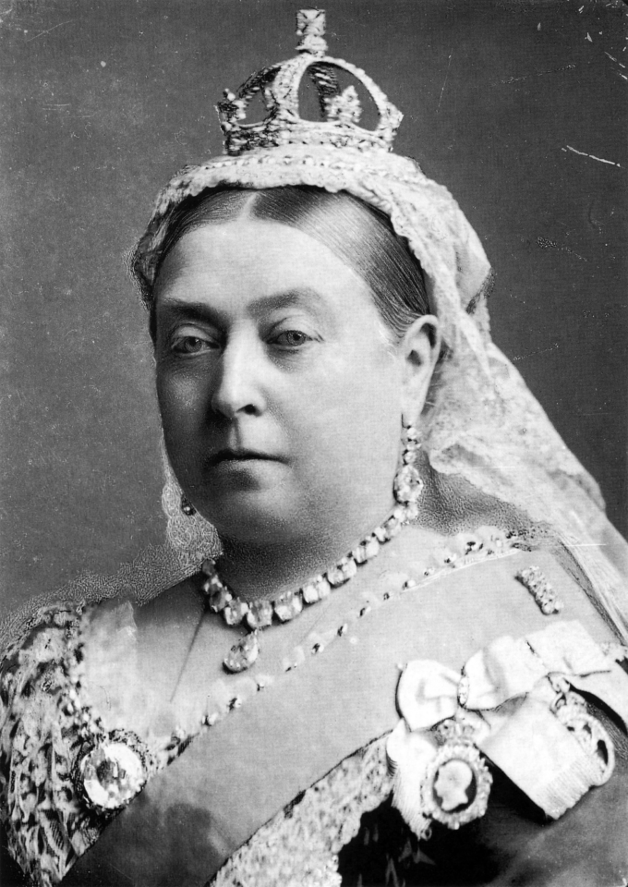
Queen Victoria (r. 1837-1901)
Her Majesty Victoria, by the Grace of God, of the United Kingdom of Great Britain and Ireland Queen, Defender of the Faith, Empress of India
Reigned for 63ys 7 mos
Empire was at the greatest extent
Industrial Revolution at height
Imperialism at height
Married Prince Albert has 9 children
Albert dies in 1861 (mourns for rest of her life)

Slide 3
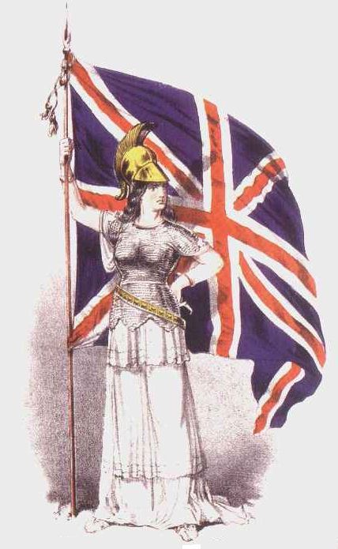
“The sun never sets on the British Empire.”
During Victoria’s reign, 25% of the world’s population, was part of the British Empire
England was a imperial nation gaining control of countries around the world.

Slide 4
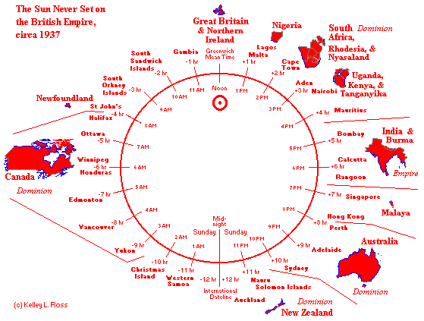

Slide 5
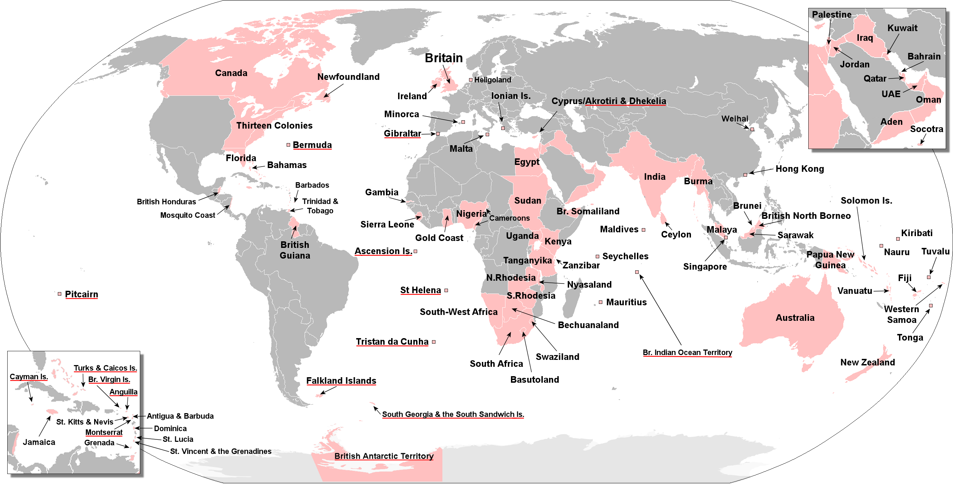

Slide 6
A Time of Change
London becomes most important city in Europe
Population of London expands from two million to six million
Shift from ownership of land to modern urban economy
Impact of industrialism
Increase in wealth
World’s foremost imperial power
Victorian people suffered from anxiety, a sense of being displaced persons in an age of technological advances.

Slide 7
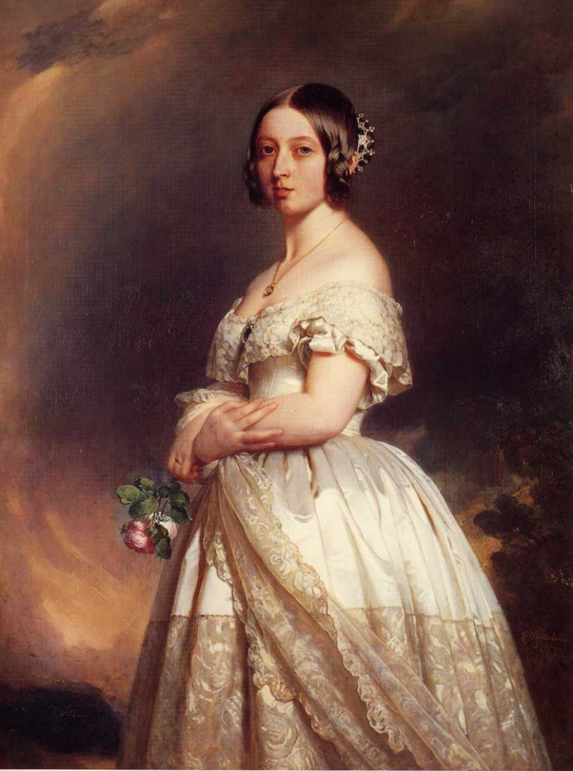
Queen Victoria and the Victorian Temper
Ruled England from 1837-1901
Exemplifies Victorian qualities: earnestness, moral responsibility, domestic respectability
The Victorian Period was an age of transition
An age characterized by energy and high moral purpose

Slide 8
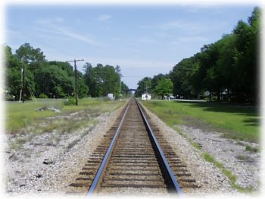
The Early Victorian Period 1830-1848
In 1830, the Liverpool and Manchester Railway opened, the first public railway line in the world.
By 1850, railway lines connected England’s major cities
By 1900 , England had 15,195 lines of railroad and an underground rail system beneath London.
The train transformed England’s landscape, supported the growth of commerce, and shrank the distance between cities.

Slide 9
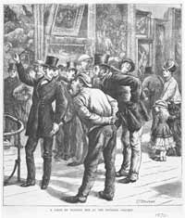
The Reform Bill of 1832
Transformed English class structure
Extended the right to vote to all males owning property
Second Reform Bill passed in 1867
Extended right to vote to working class

Slide 10
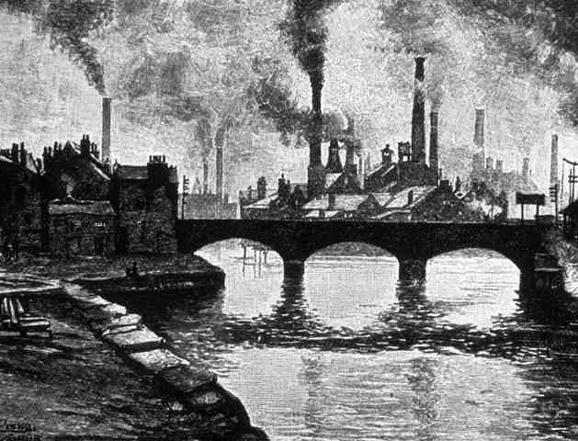
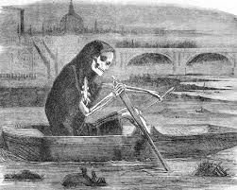
The Time of Troubles 1830’s and 1840’s
Unemployment
Poverty
Rioting
Slums in large cities
Working conditions for women and children were terrible

Slide 11
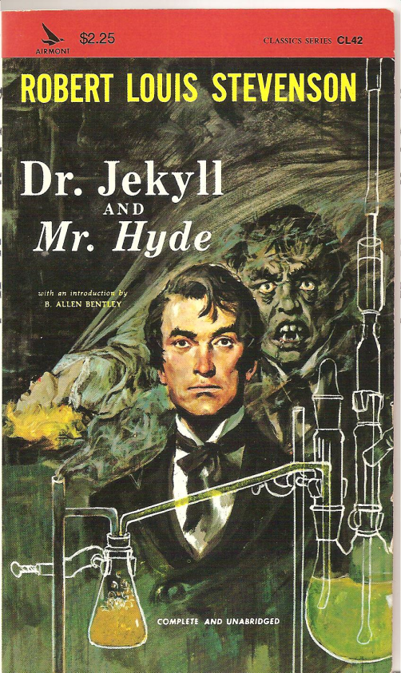
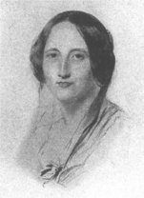
Impact on Victorian Literature
The philosophers and novelists of the 1840’s and the 1850’s responded to the industrial, economic, and political scene:
Charles Dickens: Oliver Twist, A Christmas Carol, A Tale of Two Cities
Elizabeth Gaskell: Mary Barton “A Watched Pot Never Boils”
Karl Marx/ Friedrich Engels: The Communist Manifesto

Slide 12
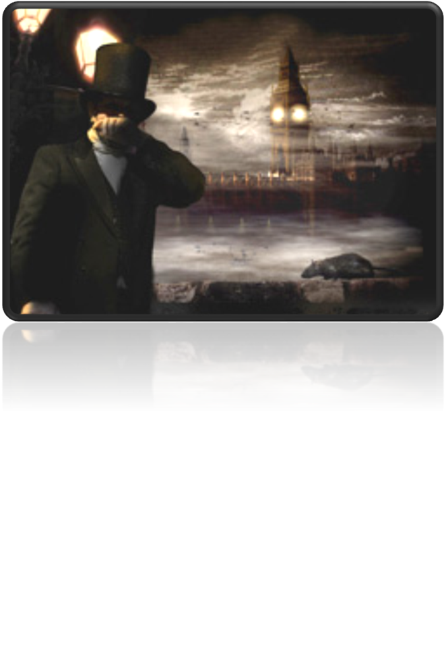
The Mid-Victorian Period 1848-1870
A time of prosperity
A time of improvement
A time of stability
A time of optimism
The Great Stink (1858)

Slide 13
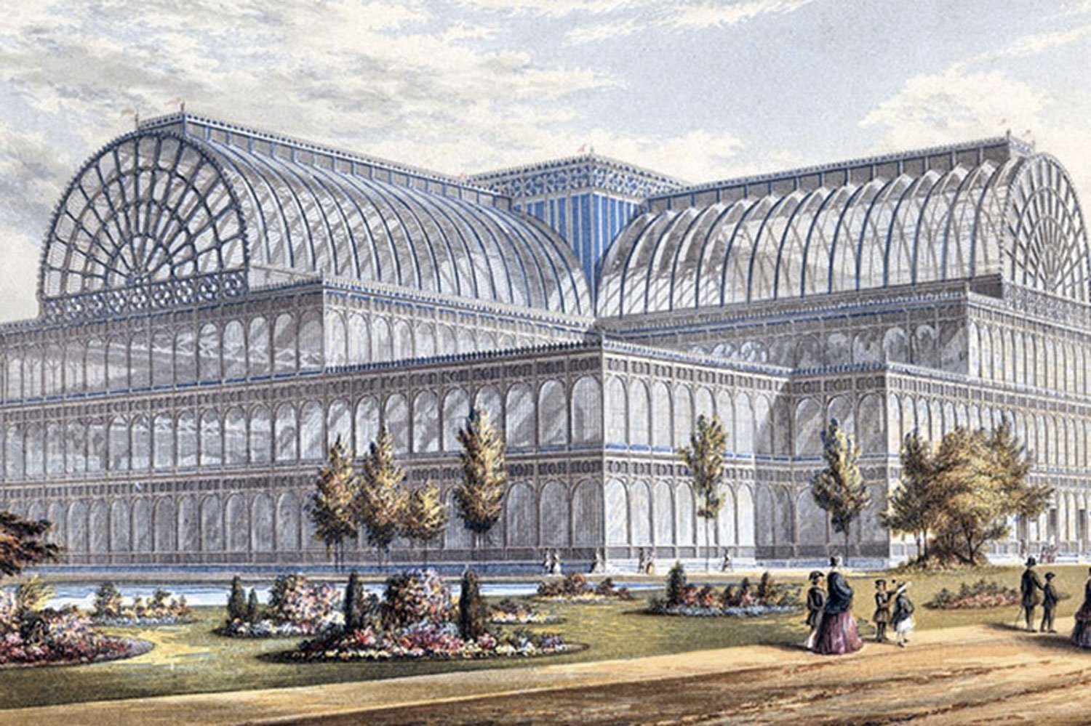
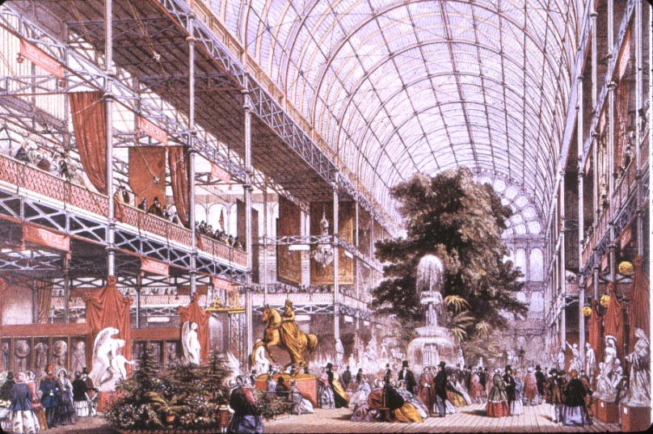
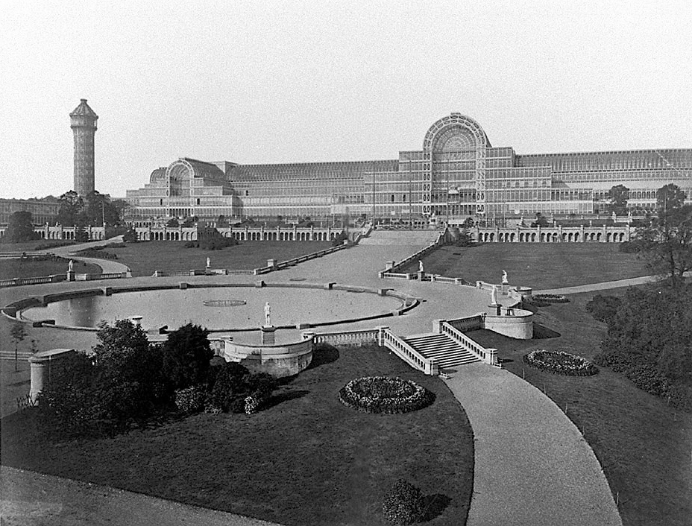
The Crystal Palace
Erected to display the exhibits of modern industry and science at the 1851 Great Exhibition
One of the first buildings constructed according to modern architectural principles
The building symbolized the triumphs of Victorian industry

Slide 14
Challenges to Religious Belief
Science
Darwin - Origin of Species and The Descent of Man
Higher Criticism
Examination of the Bible as a mere text of history
Source Studies
Geology
Astronomy

Slide 15
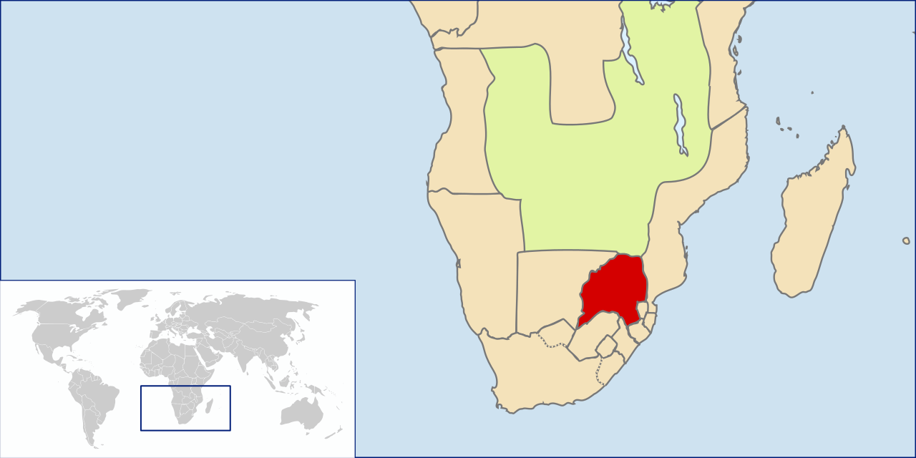
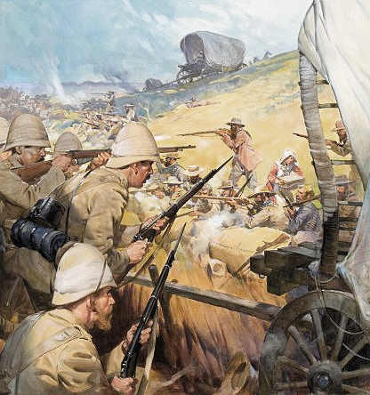
The Late Victorian Period 1870-1901
Decay of Victorian values
Increased British imperialism
Boer Wars (South Africa (Dutch) vs British Empire)
Irish question (Self-Rule?)
Bismarck's Germany became a imperial rival power (hegemony)
Economic depression led to mass immigration
Socialism

Slide 16
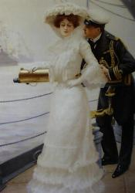
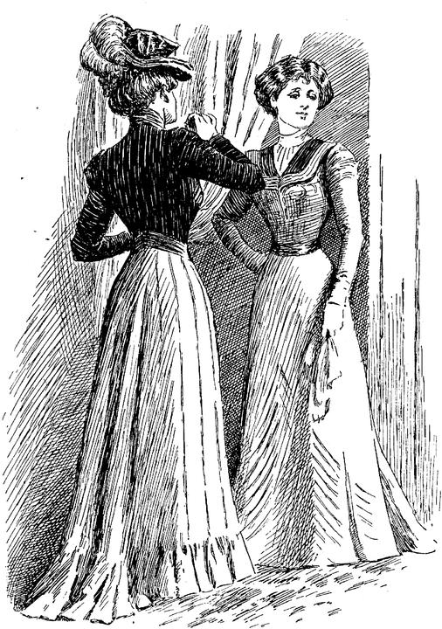
The Role of Women
The Woman Question
Changing conditions of women’s work created by the Industrial Revolution
The Factory Acts (1802-78) – regulations of the conditions of labor in mines and factories
The Custody Act (1839) – gave a mother the right to petition the court for access to her minor children and custody of children under seven and later sixteen.
The Divorce and Matrimonial Causes Act – established a civil divorce court
Married Women’s Property Acts

Slide 17
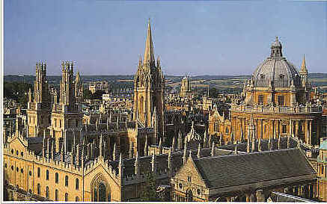
Educational Opportunities for Women
First women’s college established in 1848 in London.
By the end of Victoria’s reign, women could take degrees at twelve university colleges.

Slide 18
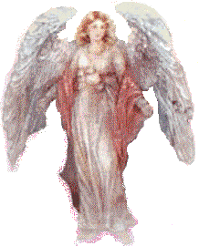
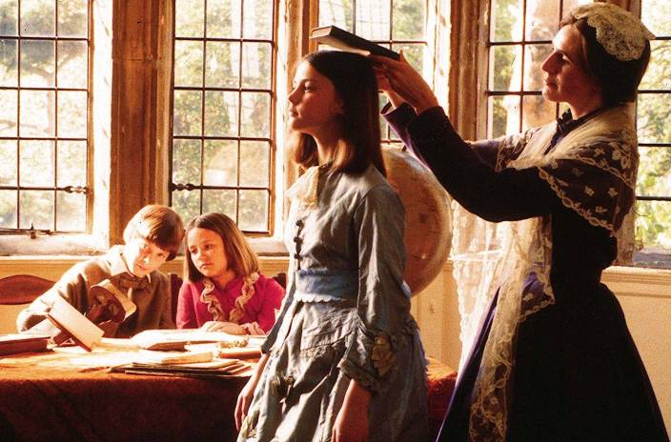
Working Conditions for Women
Bad working conditions and underemployment drove thousands of women into prostitution.
The only occupation at which an unmarried middle-class woman could earn a living and maintain some claim to gentility was that of a governess.

Slide 19
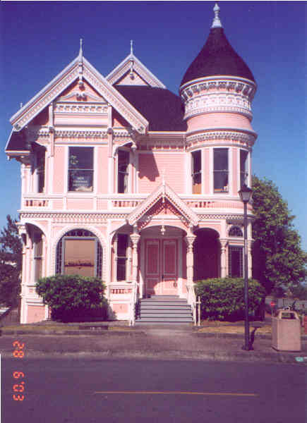
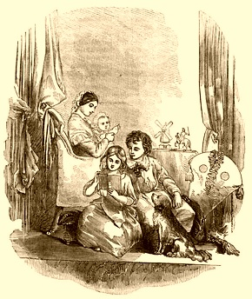
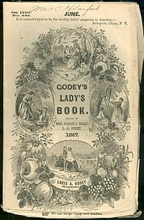
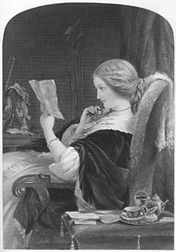
Victorian Women and the Home
Victorian society was preoccupied with the very nature of women.
Protected and enshrined within the home, her role was to create a place of peace where man could take refuge from the difficulties of modern life.
The Cult of Domesticity – A Women’s place was in the home, taking care of children, and providing a safe refuge for the man (husband).

Slide 20
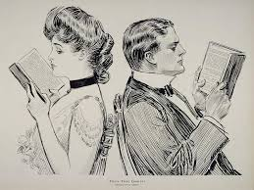
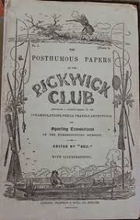
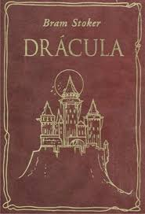
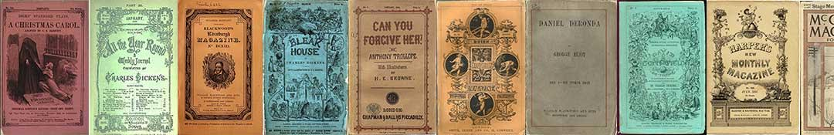

Literacy, Publication, and Reading
By the end of the 19th century, literacy was almost universal.
Compulsory national education required to the age of ten.
Due to technological advances, an explosion of things to read, including newspapers, periodicals, and books.
Growth of the periodical
Novels and short fiction were published in serial form.
The reading public expected literature to illuminate social problems.

Slide 21
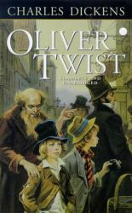
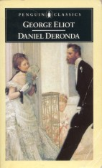
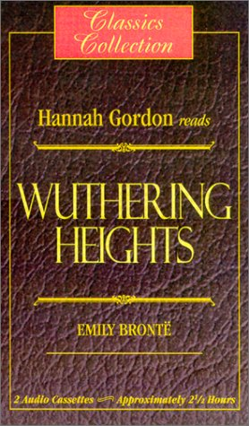

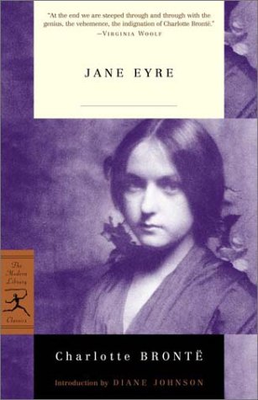
The Victorian Novel
The novel was the dominant form in Victorian literature.
Victorian novels seek to represent a large and comprehensive social world, with a variety of classes.
Victorian novels are realistic.
Major theme is the place of the individual in society, the aspiration of the hero or heroine for love or social position.
The protagonist’s search for fulfillment is emblematic of the human condition.
For the first time, women were major writers: the Brontes. Elizabeth Gaskell, George Eliot.
The Victorian novel was a principal (main) form of entertainment.

Slide 22
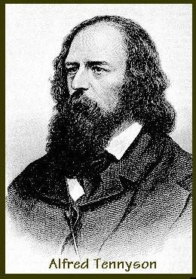
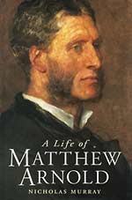
Victorian Poetry
Victorian poetry developed in the context of the novel. Poets sought new ways of telling stories in verse
All of the Victorian poets show the strong influence of the Romantics, but they cannot sustain the confidence the Romantics felt in the power of the imagination.
Victorian poets often rewrite Romantic poems with a sense of belatedness.
Dramatic monologue – the idea of creating a lyric poem in the voice of a speaker ironically distinct from the poet is the great achievement of Victorian poetry.
Victorian poetry is pictorial; poets use detail to construct visual images that represent the emotion or situation the poem concerns.
Conflict t between private poetic self and public social role.

Slide 23
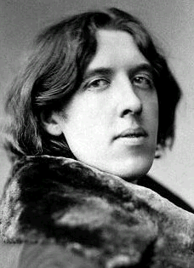
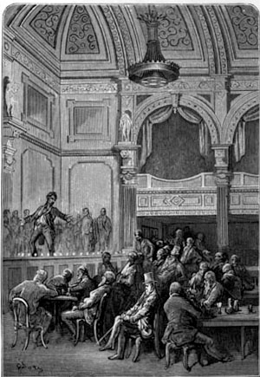
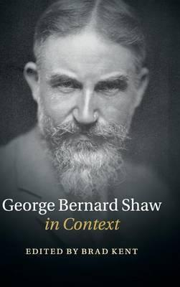
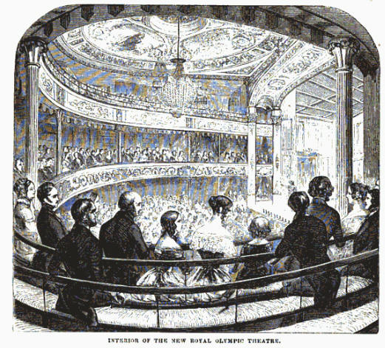
Victorian Drama
The theater was a flourishing and popular institution during the Victorian period.
The popularity of theater influenced other genres.
Bernard Shaw and Oscar Wilde transformed British theater with their comic masterpieces.

Slide 24
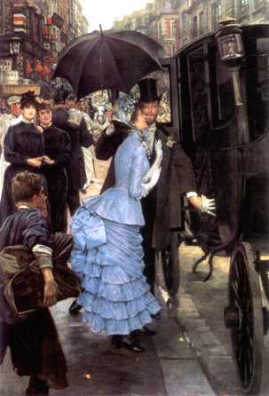
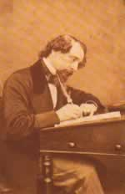
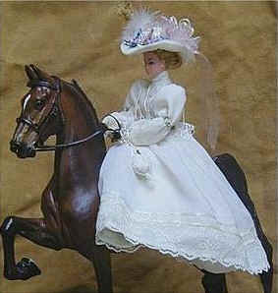
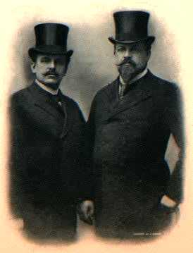
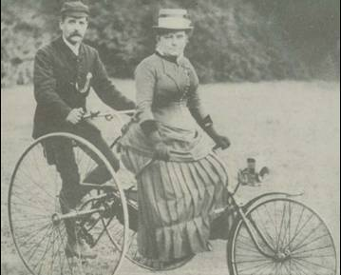
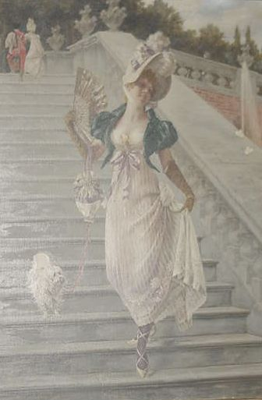
Images of the Victorian Period

