Slide 1
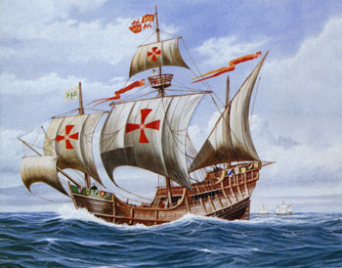

European Exploration
The Explorers
AIM: What did the Age of Exploration directly lead to?
Do Now: Exploration Worksheet
BETA: Mr. Ott
Global History & Geography

Slide 2
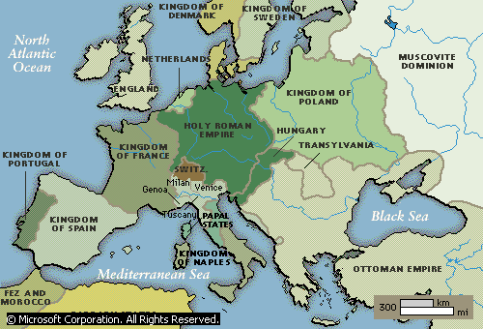
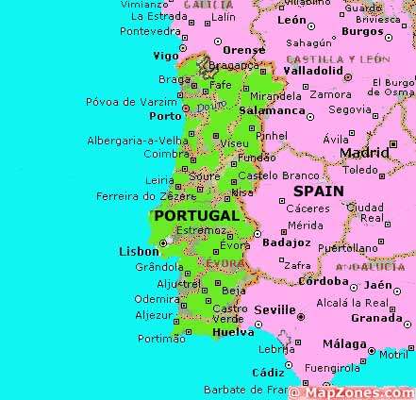
Portugal Leads The Way
Located right by the Atlantic Ocean
Whole country is
within 100 miles of the ocean
Leader in exploration under Prince Henry
the Navigator
First country to have trading posts down
west coast of Africa
Henry wants to get to
Asia and spread Christianity
Atlantic

Slide 3
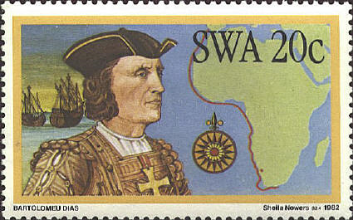
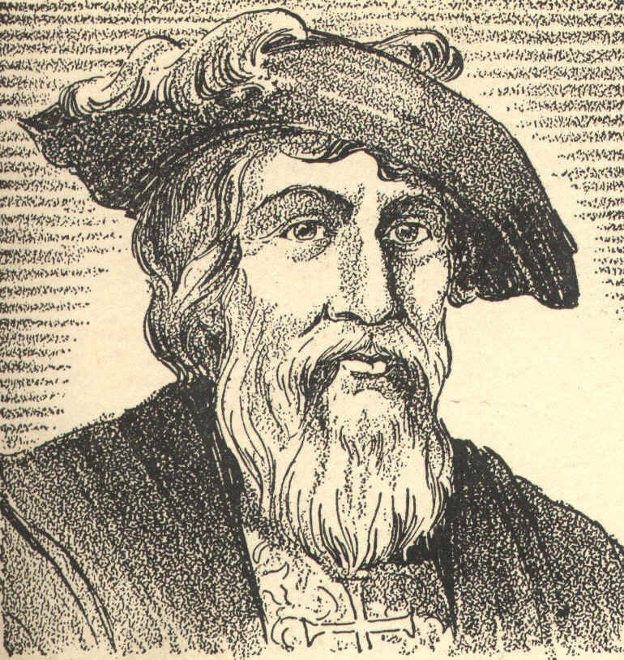
Portugal Leads the Way
Portuguese also trade slaves for guns and rum with Africans
1487- Bartolomeau Dias reaches the Southern tip of Africa
1489- Vasco Da Gama rounded African & reached India

Slide 4
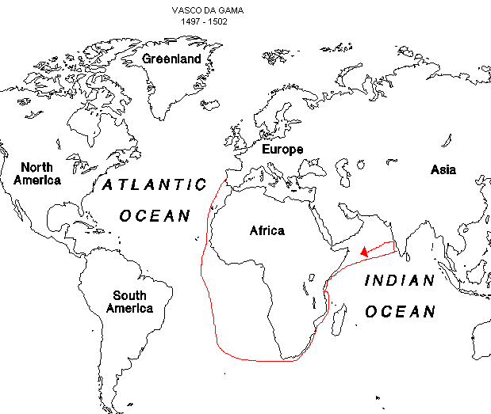

Slide 5
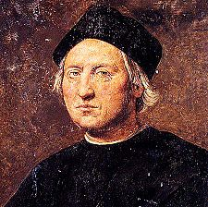
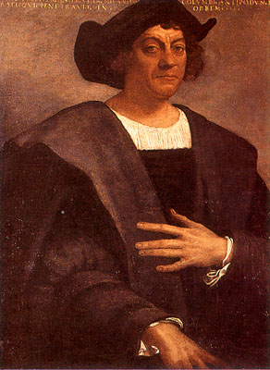
Christopher Columbus
(c. 1451 – 20 May 1506)
Explorer, Navigator, Colonizer
Voyages across Atlantic led to general European awareness of the American continents (Did not discover America – Vikings here 1st)
Voyages funded by Isabella I Castile (Spain)
Initiated Spanish Colonization of the
“New World” which would lead to European Colonization of the Americas (Was not aware of problem of European diseases such as Small Pox, which the Native population did not have an immunity)

Slide 6
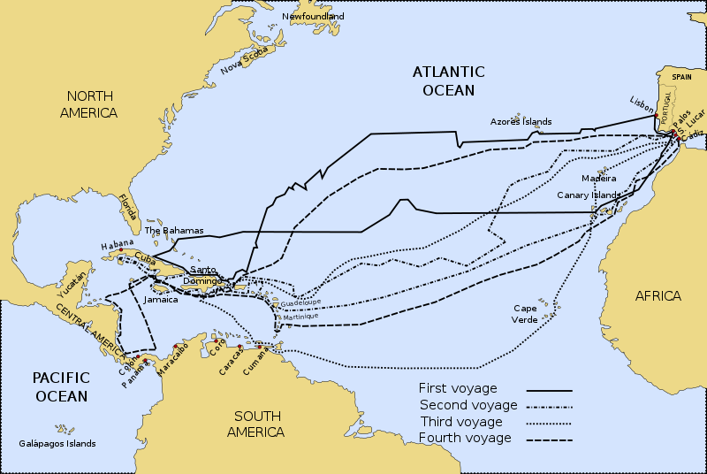
In 1492, Columbus sailed the ocean blue.
The Nina, the Pinta, and the Santa Maria

Slide 7
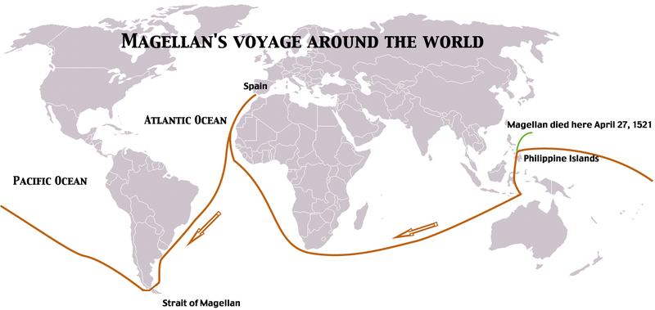
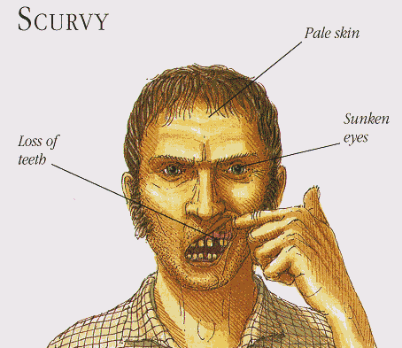
Ferdinand Magellan
1519- Ferdinand Magellan tries to sail around the world.
He dies in the Philippines, but his crew makes it back in 1522.
Problem with long travels was a lack of vitamin “C”
Sailors developed Scurvy from which they could die on the voyage

Slide 8
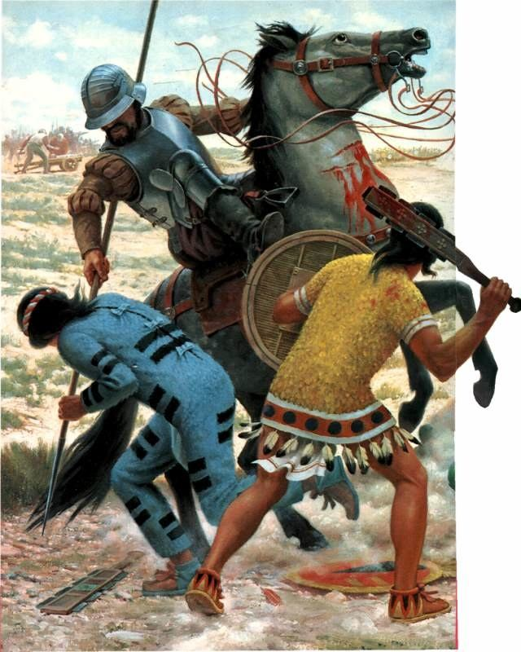
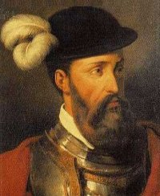
The Conquistadors
Spanish explorers following Columbus became known as conquistadors, or conquerors
The 2 most famous were
Hernando Cortez and
Francisco Pizarro.
Cortez conquered the Aztecs and Pizarro conquered the Incas.
Pizarro

Slide 9
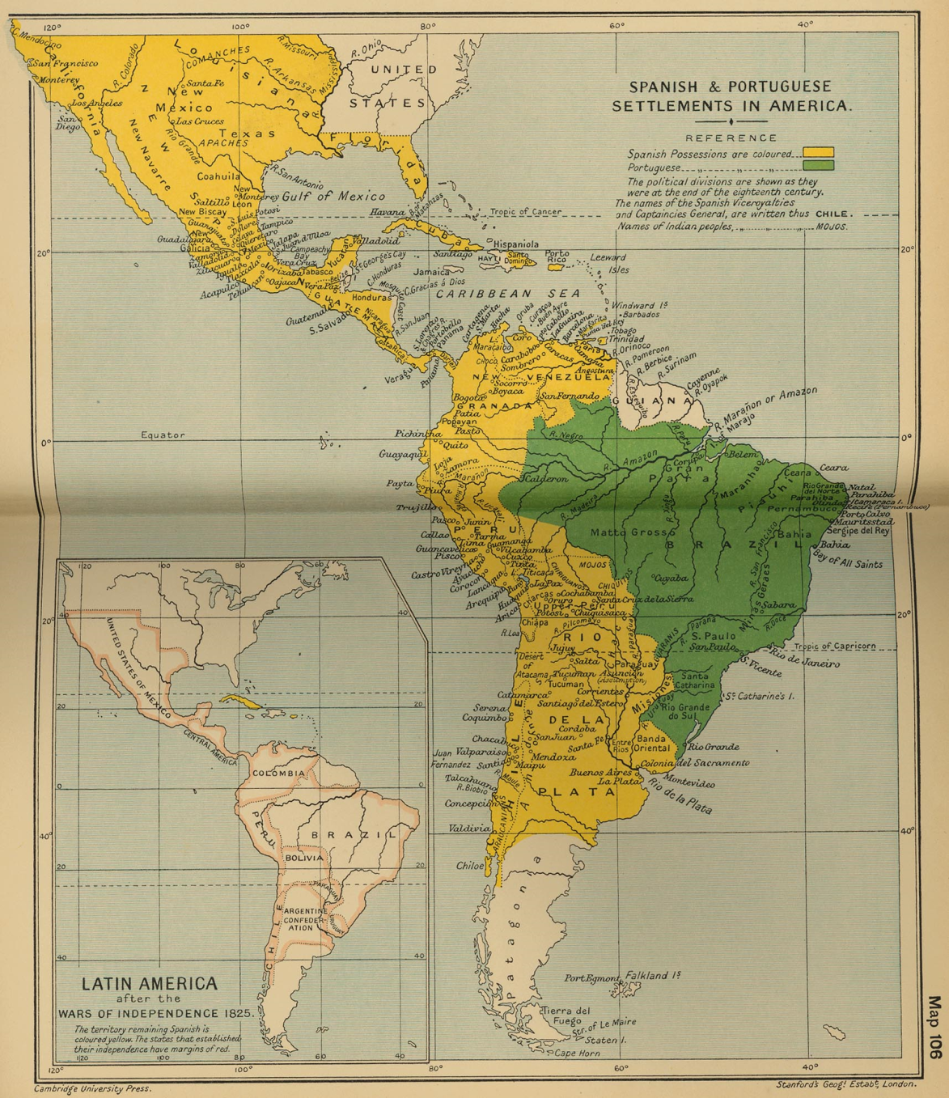
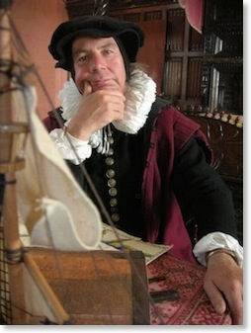
The Spanish Possessions
These and others helped Spain claim most of Mexico, the Western U.S.
and most of South America
What is a Cartographer?
A Mapmaker

Slide 10

The Spanish Conquest

Slide 11
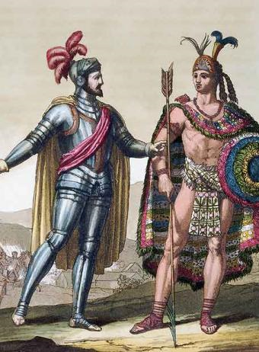
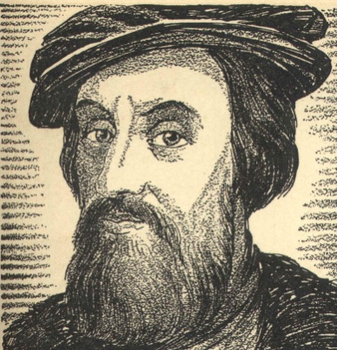
Hernando Cortez
Cortez lands in Mexico in 1519
Soon hears about the Aztecs
The Aztec leader Montezuma II believes that the Spanish are Gods
Cortez takes the Aztec’s gold and makes them mine more.
Aztec’s rebel, but Cortez eventually conquers them. He uses other natives to fight for him and with him.
He eventually kills Montezuma II

Slide 12
Cortez the Conqueror
Cortez was able to conquer the Aztecs for several reasons:
SUPERIOR
WEAPONS
OTHER
NATIVES
DISEASES: MEASLES, MUMPS, TYPHUS, AND SMALLPOX
This was to become a theme for future conquests

Slide 13
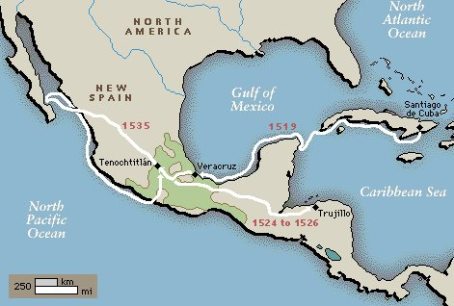
Conquest of Cortez

