Slide 1
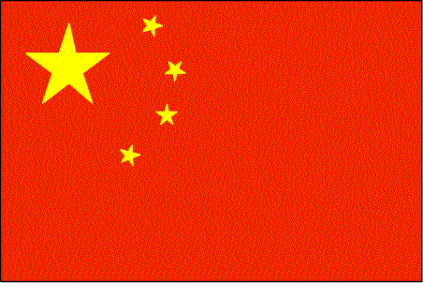
Communism in China

Slide 2
1953: Five Year Plan
Give land back to the peasants
Organized the peasants to attack landlords and seize their property
Millions of people were killed.
Millions of acres of land were seized and redistributed to peasants.
They also invested heavily in industry such as coal and steel.
Notes:
Mao goes to local areas and treats peasants with respect, no rank, no uniform, peasants begin to beat their landlords to death, this is seen as justice for all of the injustice of the landlords over the years.
PRC constitution: men=women, Mao will rule in name of people until they can take over, forms a one party dictatorship that denied people basic rights and freedoms. At first they don’t care because they love Mao.

Slide 3
1958: Great Leap Forward
Design to modernize China overnight
1st major aspect:
Created large collective farms called communes
Apply principles of mass production and efficiency to agriculture
2nd major aspect:
Industrial experts were sent into the countryside to teach peasants to build small blast furnaces to produce steel
Outcome:
Within 4 months 1 million backyards had furnaces
Notes:
Farmland reorganized into about 26,000 communes
Each farm had about 25,000 people
Strengthen China and establish China’s leadership position among Asian countries

Slide 4
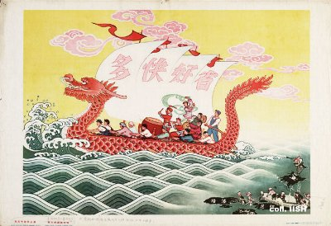
Propaganda: used to keep Chinese people excited about the plan
Notes:
The poster also tries to impress on the population how all this will improve their welfare, as opposed to that of the Taiwanese, who are shown in the right-hand corner as suffering under the GMD-regime and the presence of Americans. The poster also tries to impress on the population how all this will improve their welfare, as opposed to that of the Taiwanese, who are shown in the right-hand corner as suffering under the GMD-regime and the presence of Americans.

Slide 5
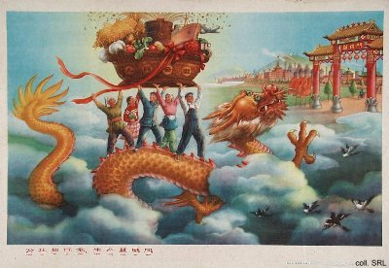
More Propaganda
Notes:
It was also intended to show the Soviet Union that the Chinese approach to economic development was more vibrant, and ultimately would be more successful, than the Soviet model

Slide 6
Outcome
People give false reports on agriculture to Mao
Mao begins to tax the people
20 million people die of hunger between 1958-1960
Mao resigned as head of the government
Notes:
People love Mao do not want to disappoint him.
Advisors tell mao people are dying, Mao eventually sees.

Slide 7

Soviet Union and China Split
After Stalin’s death, Khrushchev took over as leader of the Soviet Union.
The Soviet Union began pursuing more open relations with the West.
1960: The Soviets withdrew all of their technicians that had been helping with Chinese industrialization.
Mao began to see the Soviet Union as China’s greatest enemy.
During the 1960’s and 1970’s the two countries fought each other in multiple border skirmishes.
Notes:
Tried to ally themselves with the Soviet Union but Russians do not see China as true Communism because the peasants revolted instead of the working class.

Slide 8
The Return of Mao
1964: Mao’s Little Red Book is published
Book of his speeches and his communist philosophy.
Used by the People’s Liberation Army for inspiration.
The army encouraged the people to study the book and follow Mao’s teachings.
Notes:
Used as a brainwashing tool

Slide 9
Cultural Revolution
Students formed groups of fighters called the Red Guards
Taught to criticize their parents and teachers
They attacked professors, government officials, and factory managers, many were executed or exiled to the countryside
This lasted until 1968, when Mao gained full control over China again
Notes:
Middle school kids
Tell them to critizes their parents and teachers, Most of them had been taken off to dormitories during the great leap forward. Had been taught to revere Mao. Then gives guns and tells them to kill teachers.,
Parents won’t critizes mao either

Slide 10
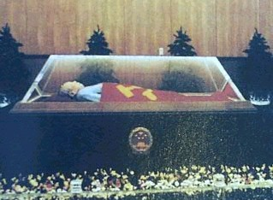
Mao Dies in 1976
Mao’s Mausoleum
Notes:
In the crypt one can find Mao's body lying on a bed covered in a crystalline sarcophagus and surrounded by flowers.
By day, Chairman Mao goes by elevator to be on display for tourist and faithful alike.
At night his body retires to an earthquake-proof chamber deep in the bowels of Tiananmen Square.

