Slide 1
Thematic Essay
Practice for Success

Slide 2
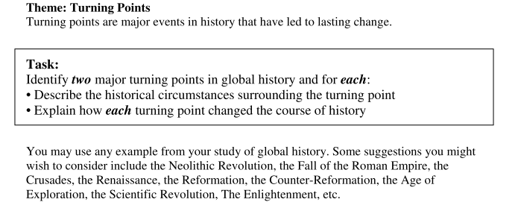
Complete Track “A” or “B” or “C” or ALL as instructed.
Track A: Write a list of possible topics for the essay below.
Track B: Write an Introduction to the essay theme below.
Track C: Write an Outline for the essay theme below.
Turning Points

Slide 3
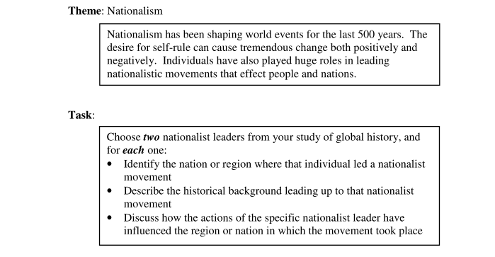
Complete Track “A” or “B” or “C” or ALL as instructed.
Track A: Write a list of possible topics for the essay below.
Track B: Write an Introduction to the essay theme below.
Track C: Write an Outline for the essay theme below.
Nationalism

Slide 4
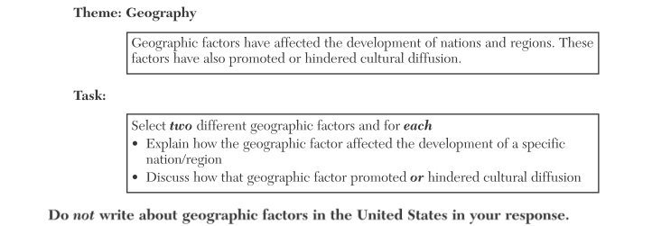
Complete Track “A” or “B” or “C” or ALL as instructed.
Track A: Write a list of possible topics for the essay below.
Track B: Write an Introduction to the essay theme below.
Track C: Write an Outline for the essay theme below.
Geography

Slide 5
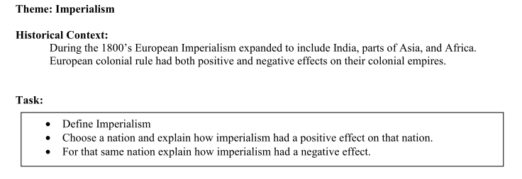
Complete Track “A” or “B” or “C” or ALL as instructed.
Track A: Write a list of possible topics for the essay below.
Track B: Write an Introduction to the essay theme below.
Track C: Write an Outline for the essay theme below.
Imperialism

Slide 6
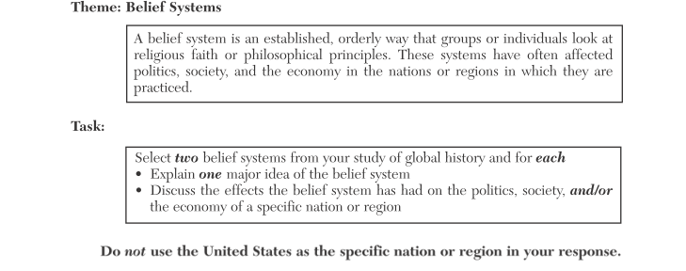
Complete Track “A” or “B” or “C” or ALL as instructed.
Track A: Write a list of possible topics for the essay below.
Track B: Write an Introduction to the essay theme below.
Track C: Write an Outline for the essay theme below.
Belief Systems

Slide 7
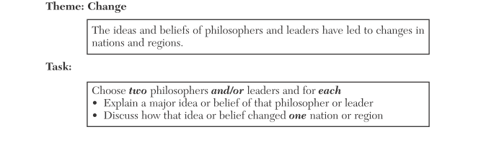
Complete Track “A” or “B” or “C” or ALL as instructed.
Track A: Write a list of possible topics for the essay below.
Track B: Write an Introduction to the essay theme below.
Track C: Write an Outline for the essay theme below.
Change – Philosopher and
Leaders

Slide 8
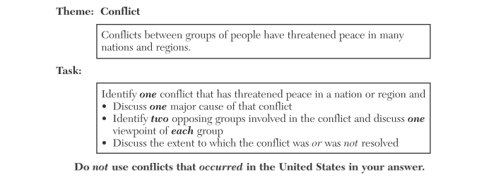
Complete Track “A” or “B” or “C” or ALL as instructed.
Track A: Write a list of possible topics for the essay below.
Track B: Write an Introduction to the essay theme below.
Track C: Write an Outline for the essay theme below.
Conflict

Slide 9
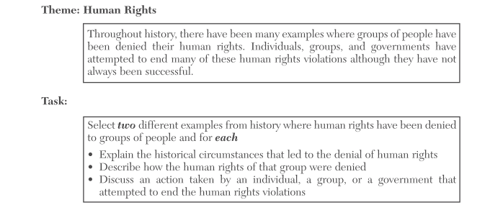
Complete Track “A” or “B” or “C” or ALL as instructed.
Track A: Write a list of possible topics for the essay below.
Track B: Write an Introduction to the essay theme below.
Track C: Write an Outline for the essay theme below.
Human Rights

Slide 10
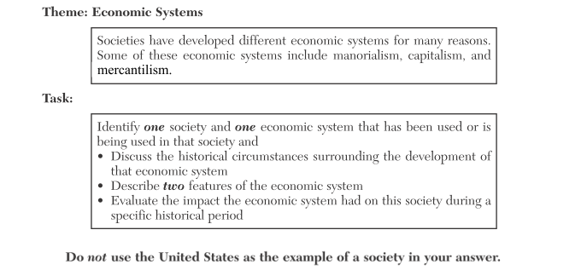
Complete Track “A” or “B” or “C” or ALL as instructed.
Track A: Write a list of possible topics for the essay below.
Track B: Write an Introduction to the essay theme below.
Track C: Write an Outline for the essay theme below.
Economic Systems

Slide 11
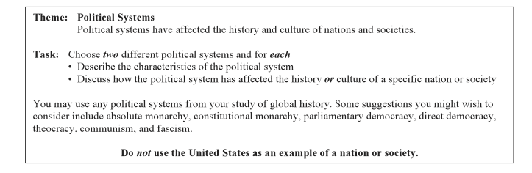
Complete Track “A” or “B” or “C” or ALL as instructed.
Track A: Write a list of possible topics for the essay below.
Track B: Write an Introduction to the essay theme below.
Track C: Write an Outline for the essay theme below.
Political Systems

Slide 12
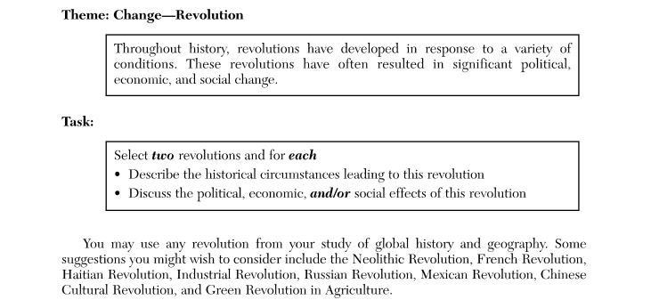
Complete Track “A” or “B” or “C” or ALL as instructed.
Track A: Write a list of possible topics for the essay below.
Track B: Write an Introduction to the essay theme below.
Track C: Write an Outline for the essay theme below.
Revolutions

Slide 13
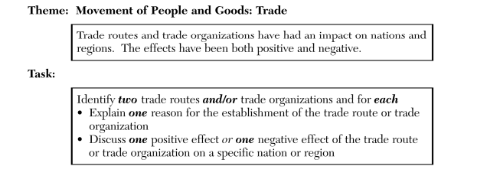
Complete Track “A” or “B” or “C” or ALL as instructed.
Track A: Write a list of possible topics for the essay below.
Track B: Write an Introduction to the essay theme below.
Track C: Write an Outline for the essay theme below.
Movement of People and Goods: Trade

Slide 14
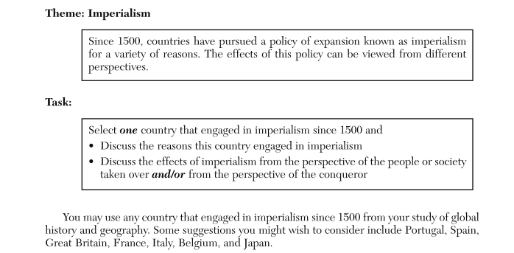
Complete Track “A” or “B” or “C” or ALL as instructed.
Track A: Write a list of possible topics for the essay below.
Track B: Write an Introduction to the essay theme below.
Track C: Write an Outline for the essay theme below.
Imperialism

Slide 15
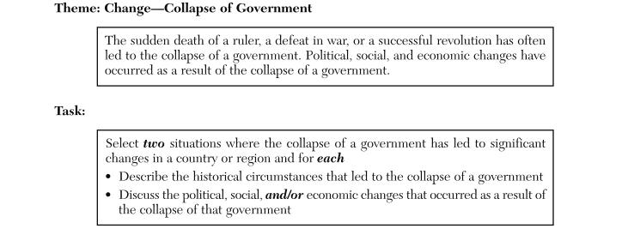
Complete Track “A” or “B” or “C” or ALL as instructed.
Track A: Write a list of possible topics for the essay below.
Track B: Write an Introduction to the essay theme below.
Track C: Write an Outline for the essay theme below.
Change – Collapse of Government

Slide 16
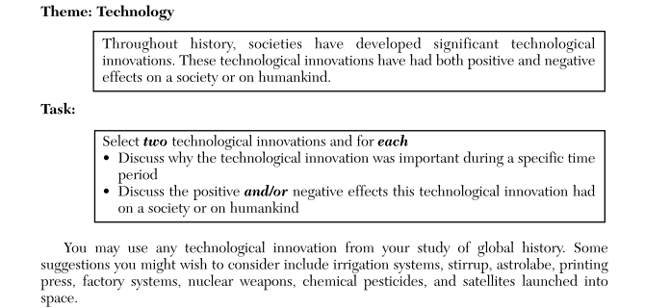
Complete Track “A” or “B” or “C” or ALL as instructed.
Track A: Write a list of possible topics for the essay below.
Track B: Write an Introduction to the essay theme below.
Track C: Write an Outline for the essay theme below.
Technology

Slide 17
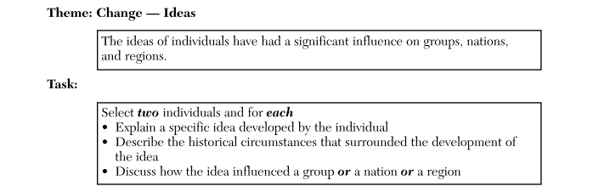
Complete Track “A” or “B” or “C” or ALL as instructed.
Track A: Write a list of possible topics for the essay below.
Track B: Write an Introduction to the essay theme below.
Track C: Write an Outline for the essay theme below.
Change - Ideas

Slide 18
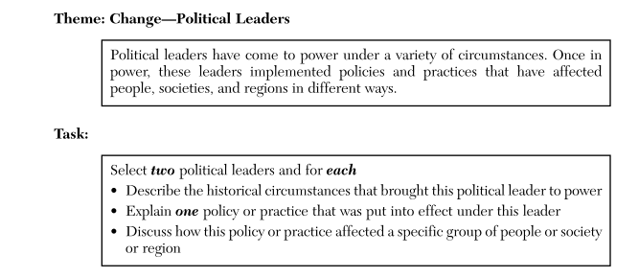
Complete Track “A” or “B” or “C” or ALL as instructed.
Track A: Write a list of possible topics for the essay below.
Track B: Write an Introduction to the essay theme below.
Track C: Write an Outline for the essay theme below.
Change – Political Leaders

Slide 19
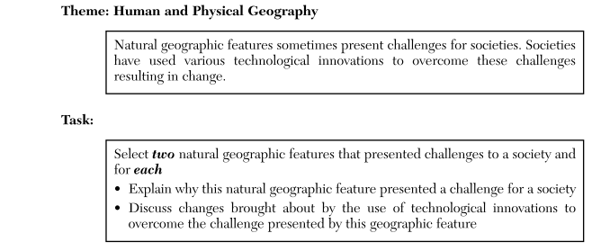
Complete Track “A” or “B” or “C” or ALL as instructed.
Track A: Write a list of possible topics for the essay below.
Track B: Write an Introduction to the essay theme below.
Track C: Write an Outline for the essay theme below.
Human and Physical Geography

Slide 20
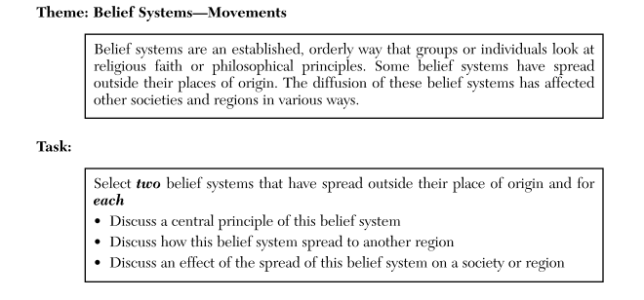
Complete Track “A” or “B” or “C” or ALL as instructed.
Track A: Write a list of possible topics for the essay below.
Track B: Write an Introduction to the essay theme below.
Track C: Write an Outline for the essay theme below.
Belief Systems - Movements

