Slide 1
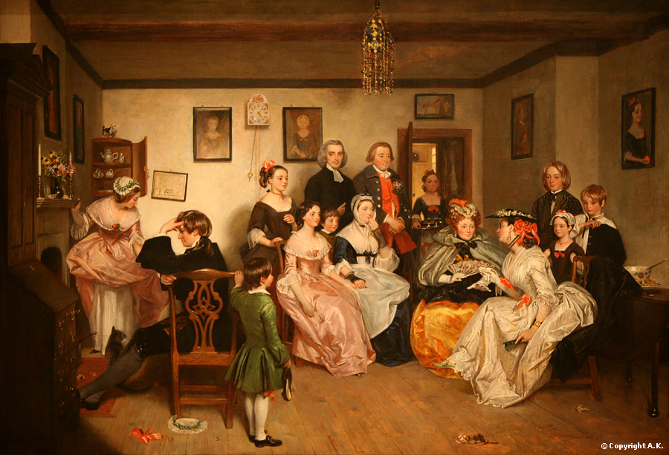
The Victorian Age
1830-1901
AIM: What effect did Britain have on the world during the Age of Victoria?
Do Now:
Put them in order:
Age of Exploration
Industrial Revolution
Neolithic Revolution
Age of Enlightenment
Roman Empire
Middle Ages
French Revolution

Slide 2
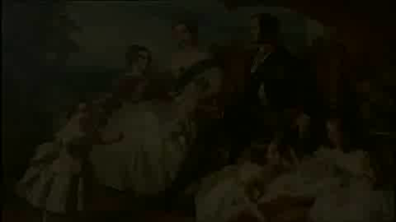

Slide 3
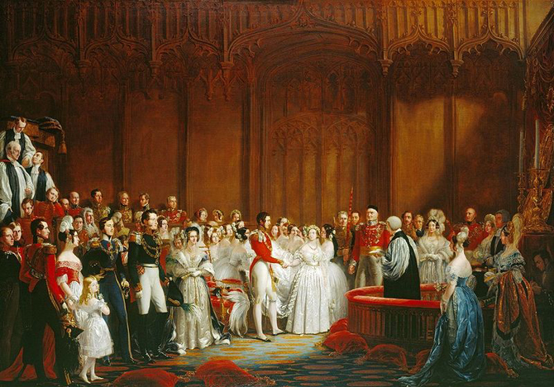
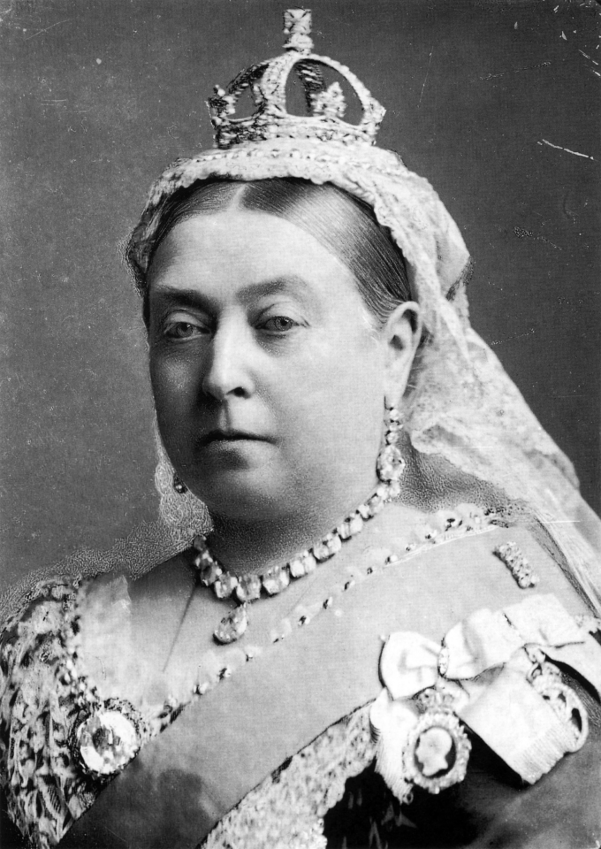
Queen Victoria (r. 1837-1901)
Her Majesty Victoria, by the Grace of God, of the United Kingdom of Great Britain and Ireland Queen, Defender of the Faith, Empress of India
Reigned for 63ys 7 mos
Empire was at the greatest extent
Industrial Revolution at height
Imperialism at height
Married Prince Albert has 9 children
Albert dies in 1861 (mourns for rest of her life)

Slide 4
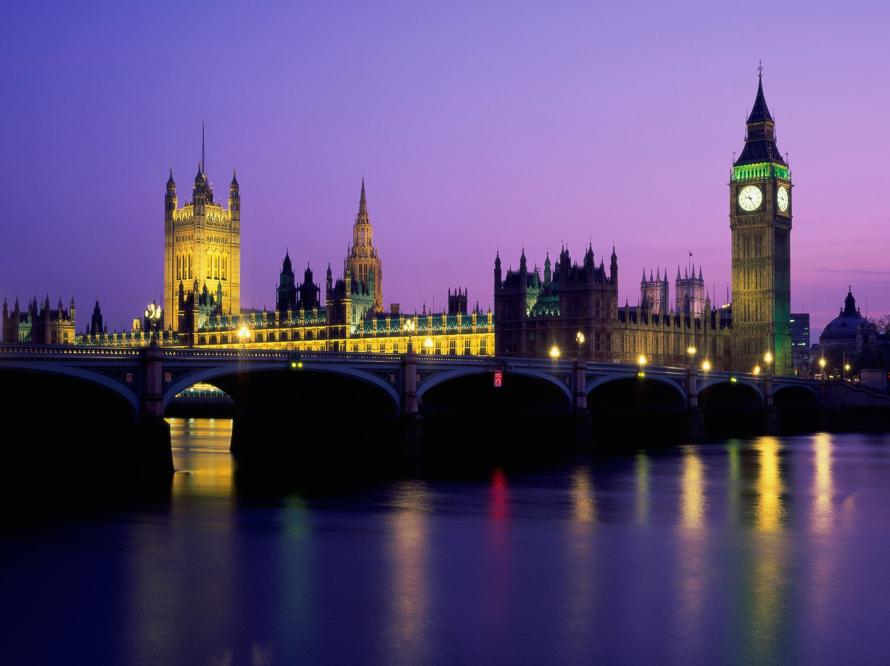
A Time of Change
London becomes most important city in Europe
From a city of 2 million to 6 million people
Shift from ownership of land to modern urban economy
Impact of industrialism & an increase in wealth
World’s foremost imperial power

Slide 5
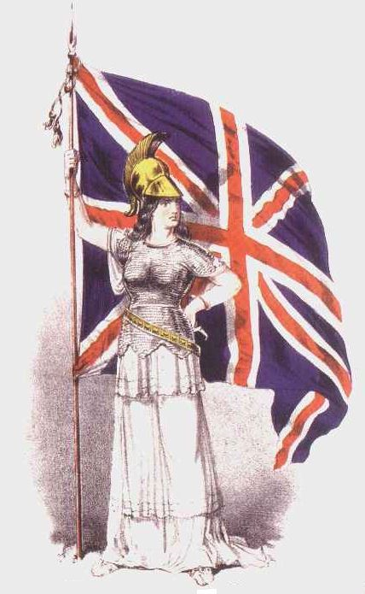
“The sun never sets on the British Empire.”
During Victoria’s reign, 25% of the world’s population, was part of the British Empire
England was a imperial nation gaining control of countries around the world.

Slide 6
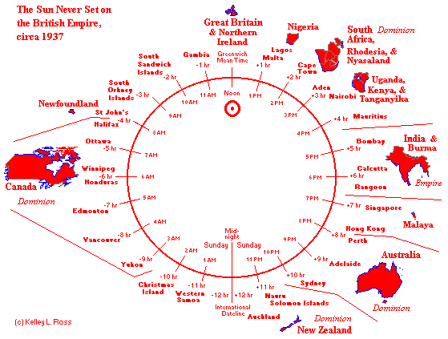

Slide 7
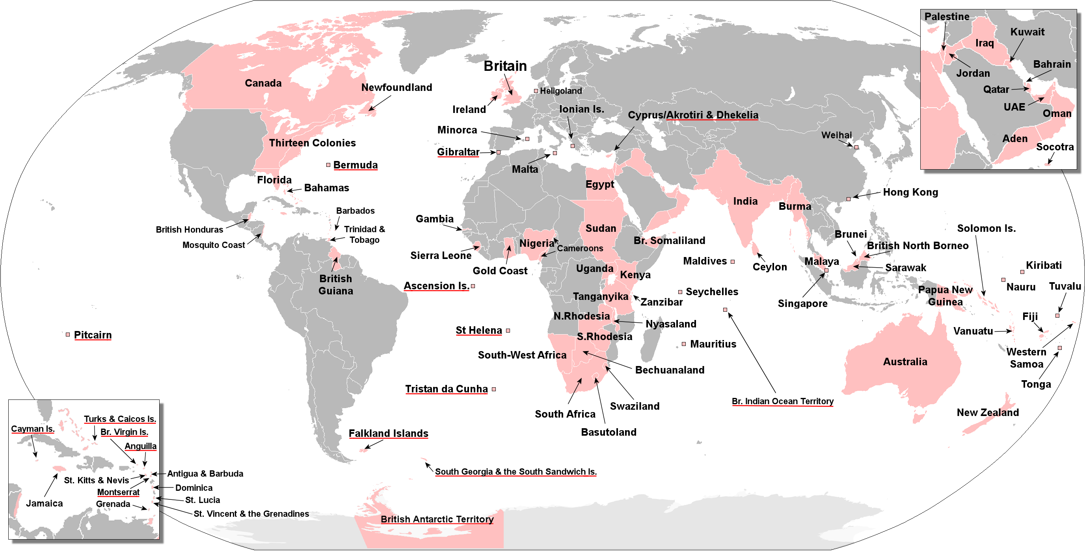

Slide 8
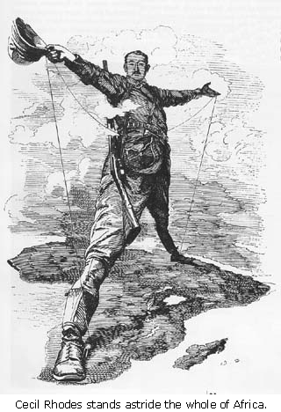
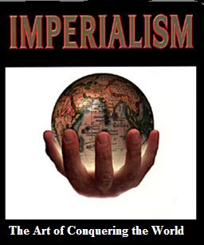
Imperialism: policy of extending a nation’s authority be acquiring territory or by dominating their politics and economy.

Slide 9
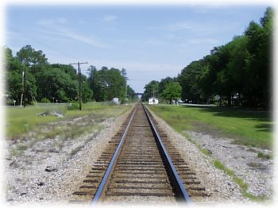
The Early Victorian Period (1830-1848)
In 1830, the Liverpool and Manchester Railway opened, the first public railway line in the world.
By 1850, railway lines connected England’s major cities.
By 1900 , England had 15,195 lines of railroad and an underground rail system beneath London.
The train transformed England’s landscape, supported the growth of commerce, and shrank the distance between cities.

Slide 10

The Time of Troubles (1830’s and 1840’s)
Unemployment
Poverty
Rioting
Slums in large cities
Working conditions for women and children were terrible
The “Great Stink” London (1858)

Slide 11
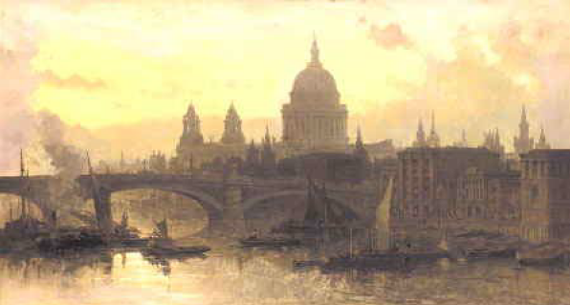
The Mid-Victorian Period (1848-1870)
A time of prosperity
A time of improvement
A time of stability
A time of optimism

Slide 12
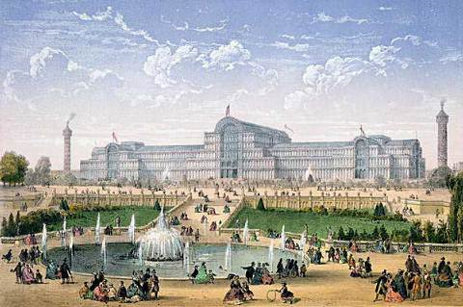
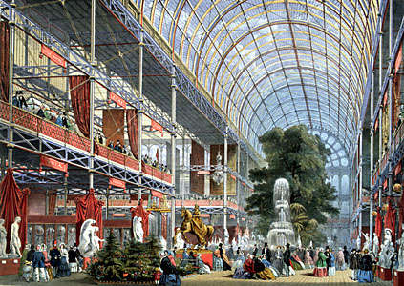
The Crystal Palace
Erected to display the exhibits of modern industry and science at the 1851 Great Exhibition
The building symbolized the triumphs of Victorian industry

Slide 13
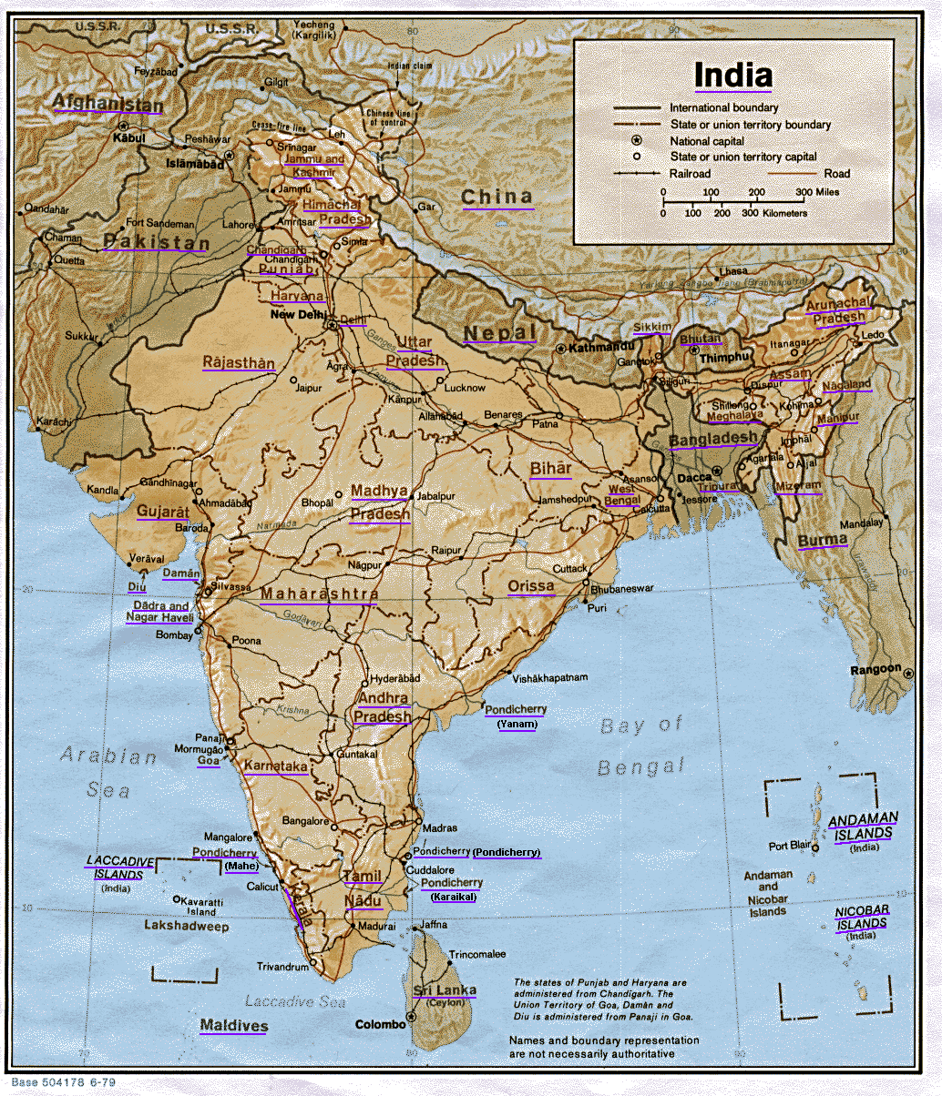
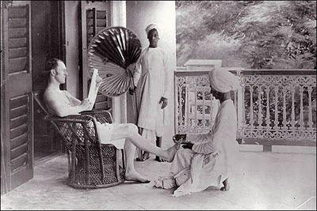
The British Empire
Many British people saw the expansion of empire as a moral responsibility to civilize the world.
Missionaries spread Christianity in India, Asia, and Africa.
“White Man’s Burden”

Slide 14
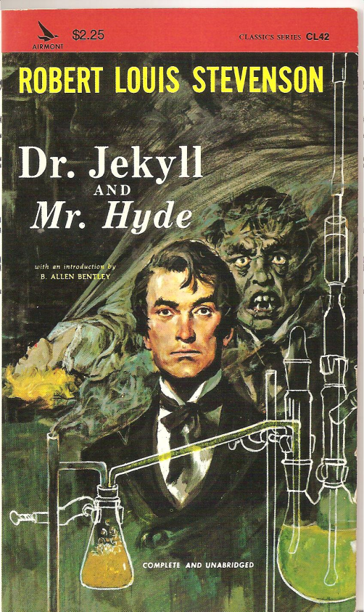
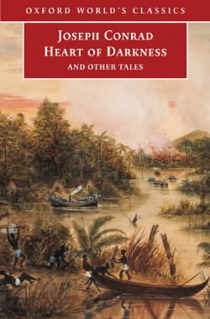


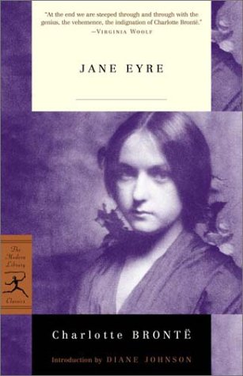
The Victorian Novel
1899
1886
The novel was the dominant form in Victorian literature
Some dealt with the social anxieties of the day. (technology, work, social class, welfare)
1848
1838

Slide 15

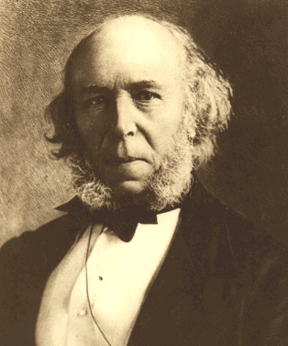
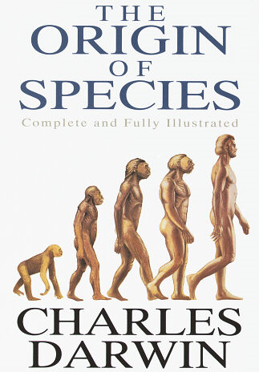
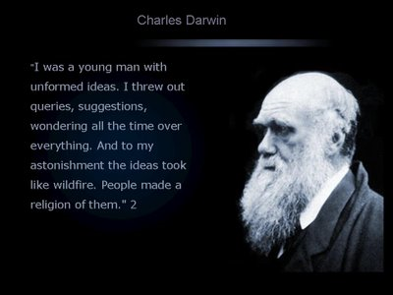
Social Changes
Herbert Spencer

Slide 16
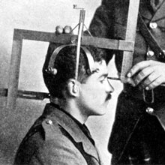
Using Darwinism to fix Social Problems?
Herbert Spencer Applied Darwinism to human society
As in nature, survival properly belongs to the fittest, those most able to survive.
Social Darwinism was used by many Victorians to justify social inequalities based on race, social or economic class, or gender
“survival of the fittest”

Slide 17
