Slide 1
Account Activation
& Set Up
Global History II
(1750 to Present)
Fall Semester

Slide 2

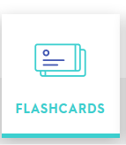
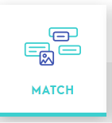
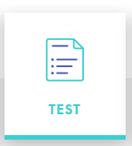

Set Up Accounts Instructions
CourseWorksPlus Account
This account and website is for accessing your homework assignments. These assignments account for 25% of your grade.
Open your browser and go to www.gmail.com
(don’t close tab)
Enter your Park East HS email address and password to login to gmail.
Open a new tab, go to www.courseworksplus.com
Select
On the left hand Navigation menu, select: Courses
Select in the middle section:
Park East High School
Select: Global History II (1750 to Present)
Below Course Description, Enter Enrollment Key: PEHS-Pride
Select:
Quizlet Account
Your Quizlet account will give you access to the vocabulary for this course as well as practice for in-class vocabulary quizzes.
Open a browser tab and go to: www.quizlet.com
If you have a Quizlet account, select: Login
If you do not have a Quizlet account, select: Setup
After Setup or Login, Open a browser tab, select:
https://quizlet.com/join/dGvBz28gQ
You should now have access to our class vocabulary.
The first set of words you should start to study is:
Unit #0 Skill-Based Terms
To study a set choose:
Note: for Test, Select Options and uncheck, written and true/false

Slide 3
Start you first Homework Assignment:
Complete - Global Student Survey - Due 9/12

