Slide 1
The Results/Outcomes of War War II
AIM: What were the long lasting results of WWII?
Do Now: Answer the following questions in your notebook.
1. Who were the Allied Powers?
2. Who were the Axis Powers?
3. Name two (2) causes of World War II?
4. Name two opposing leaders of World War II?

Slide 2
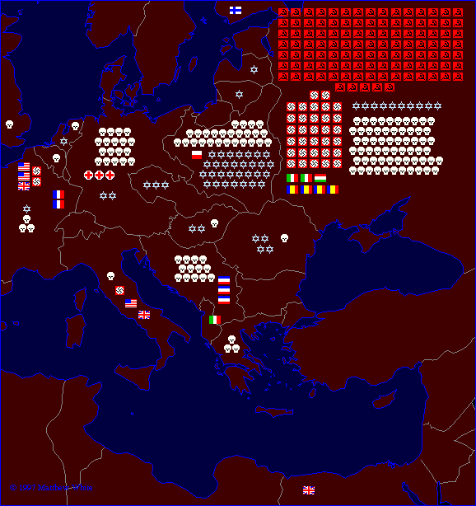

WW II Casualties: Europe
Each symbol indicates 100,000 dead in the appropriate theater of operations

Slide 3
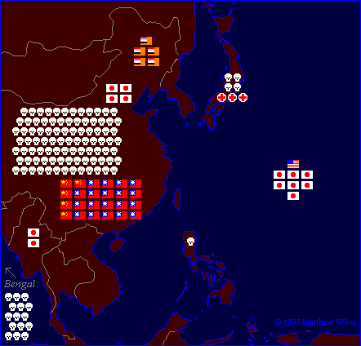
WW II Casualties: Asia
Each symbol indicates 100,000 dead in the appropriate theater of operations

Slide 4
Country | Men in war | Battle deaths | Wounded
Australia | 1,000,000 | 26,976 | 180,864
Austria | 800,000 | 280,000 | 350,117
Belgium | 625,000 | 8,460 | 55,513¹
Brazil² | 40,334 | 943 | 4,222
Bulgaria | 339,760 | 6,671 | 21,878
Canada | 1,086,343⁷ | 42,042⁷ | 53,145
China³ | 17,250,521 | 1,324,516 | 1,762,006
Czechoslovakia | — | 6,683⁴ | 8,017
Denmark | — | 4,339 | —
Finland | 500,000 | 79,047 | 50,000
France | — | 201,568 | 400,000
Germany | 20,000,000 | 3,250,000⁴ | 7,250,000
Greece | — | 17,024 | 47,290
Hungary | — | 147,435 | 89,313
India | 2,393,891 | 32,121 | 64,354
Italy | 3,100,000 | 149,496⁴ | 66,716
Japan | 9,700,000 | 1,270,000 | 140,000
Netherlands | 280,000 | 6,500 | 2,860
New Zealand | 194,000 | 11,625⁴ | 17,000
Norway | 75,000 | 2,000 | —
Poland | — | 664,000 | 530,000
Romania | 650,000⁵ | 350,000⁶ | —
South Africa | 410,056 | 2,473 | —
U.S.S.R. | — | 6,115,000⁴ | 14,012,000
United Kingdom | 5,896,000 | 357,116⁴ | 369,267
United States | 16,112,566 | 291,557 | 670,846
Yugoslavia | 3,741,000 | 305,000 | 425,000
WW II Casualties
Civilians only.
Army and navy figures.
Figures cover period July 7, 1937 to Sept. 2, 1945, and concern only Chinese regular troops. They do not include casualties suffered by guerrillas and local military corps.
Deaths from all causes.
Against Soviet Russia; 385,847 against Nazi Germany.
Against Soviet Russia; 169,822 against Nazi Germany.
National Defense Ctr., Canadian Forces Hq., Director of History.

Slide 5
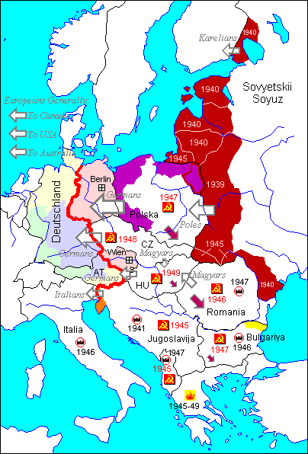
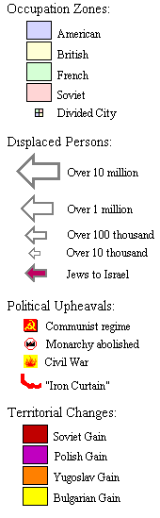
Massive Human Dislocations

Slide 6
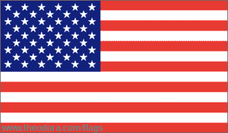
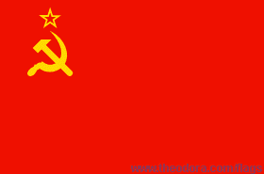
The U. S. & the U. S. S. R. Emerged as the Two Superpowers of the later half of the 20th century
U.S.S.R. = Union of the Soviet Socialist Republics
U.S. = United States

Slide 7
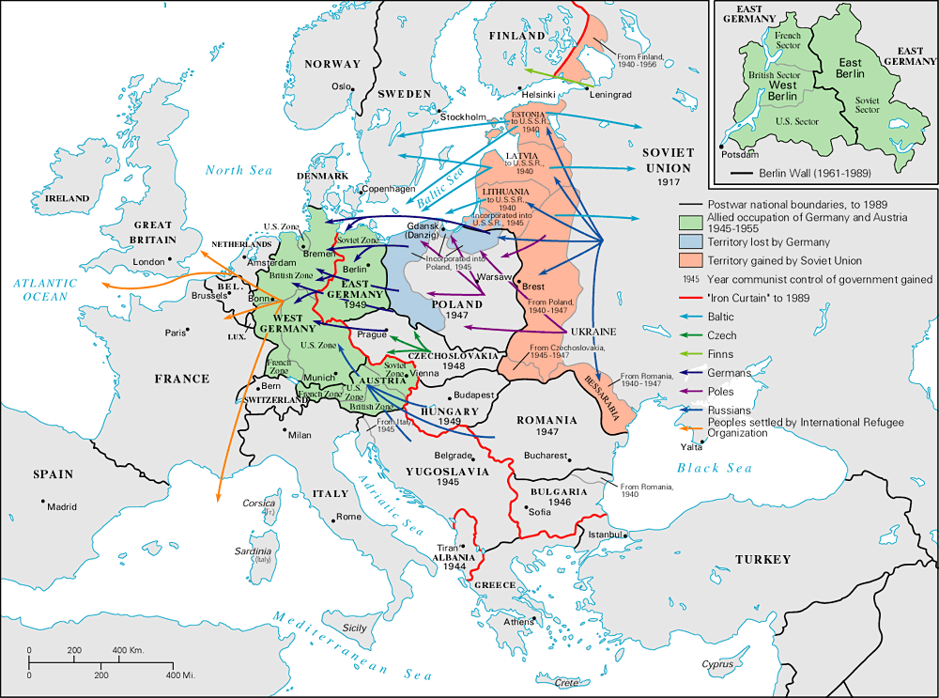
The Bi-Polarization of Europe: The Beginning of the Cold War

Slide 8
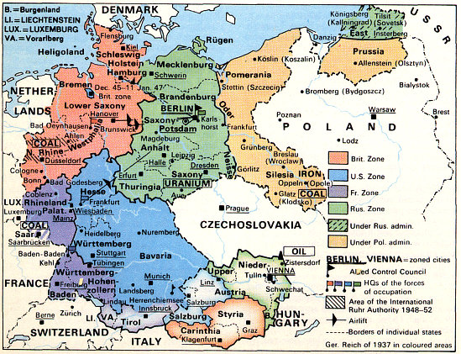
The Division of Germany: 1945 - 1990

Slide 9
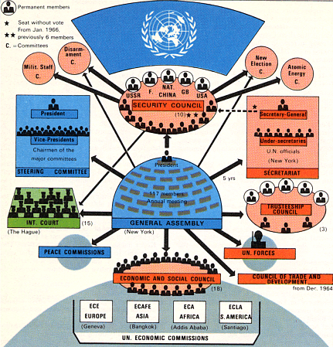
The Creation of the U. N.

Slide 10
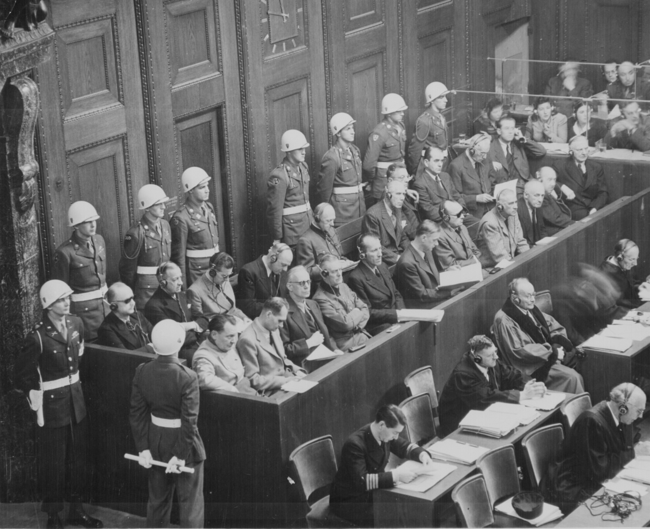
The Nuremberg War Trials: Crimes Against Humanity

Slide 11
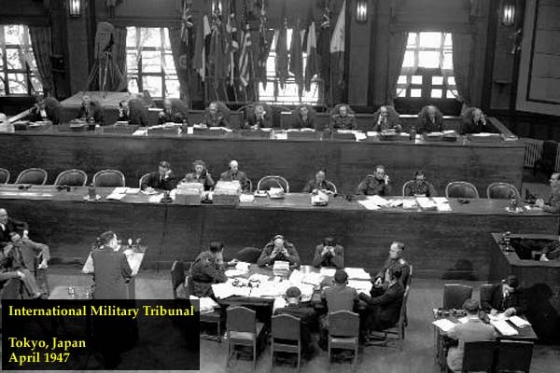
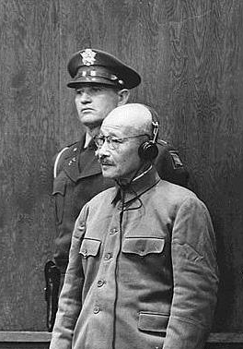
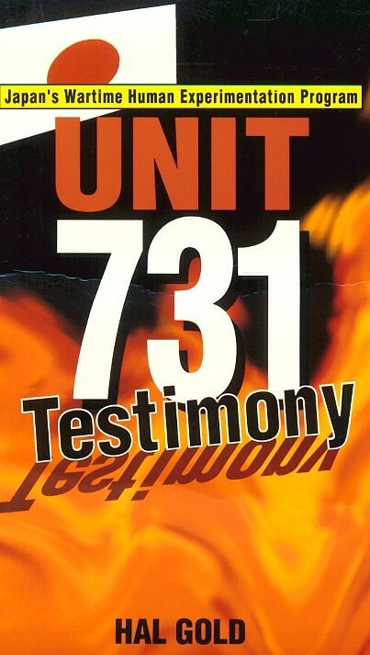
Japanese War Crimes Trials
General Hideki Tojo
Bio-Chemical Experiments

Slide 12
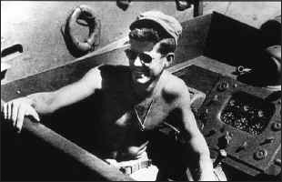
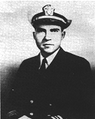
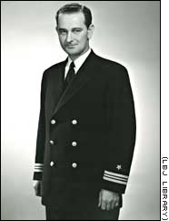
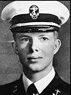
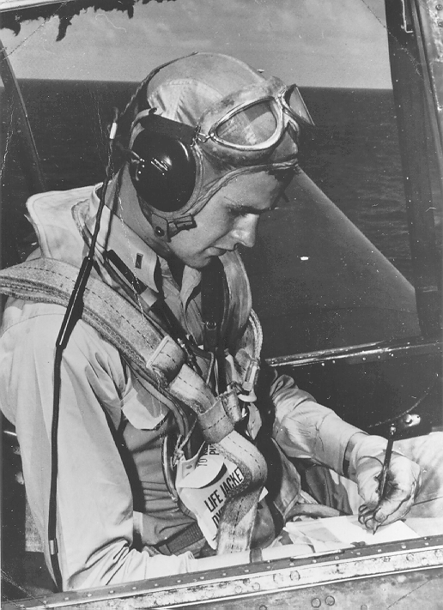
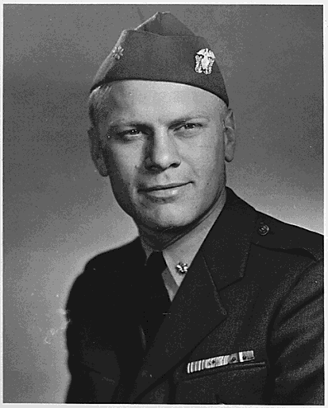
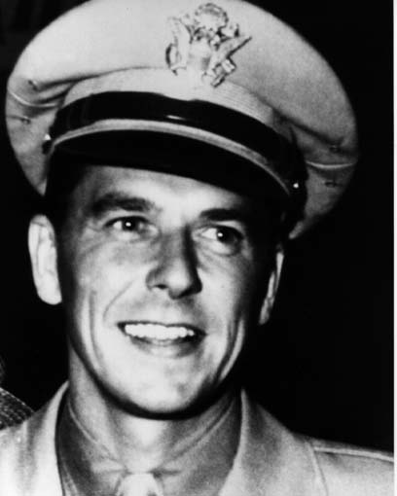
7 Future American Presidents’ Lives Were Impacted by World War II

Slide 13
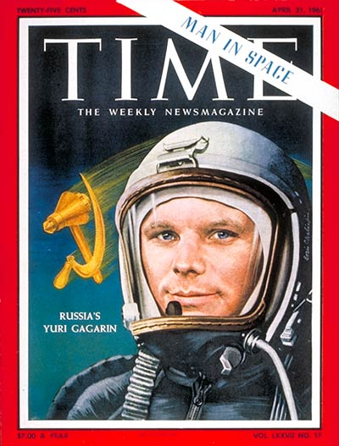
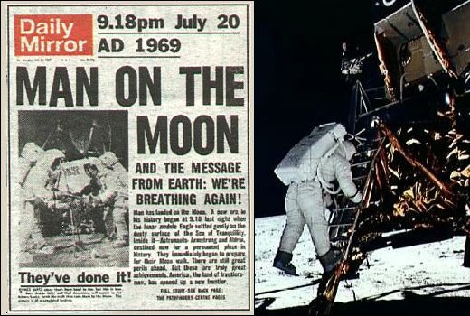
The Race for Space

Slide 14
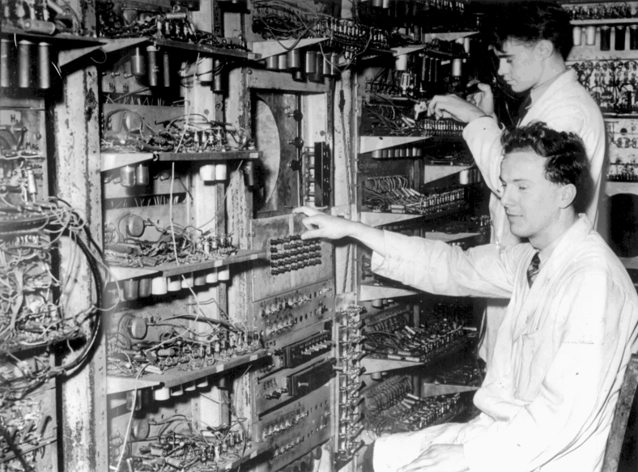
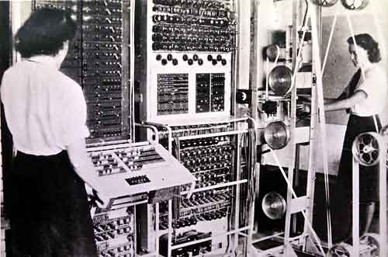

Early Computer Technology Came Out of WW II
Colossus, 1941
Mark I, 1944
Admiral Grace Hooper, 1944-1992 COBOL language

Slide 15
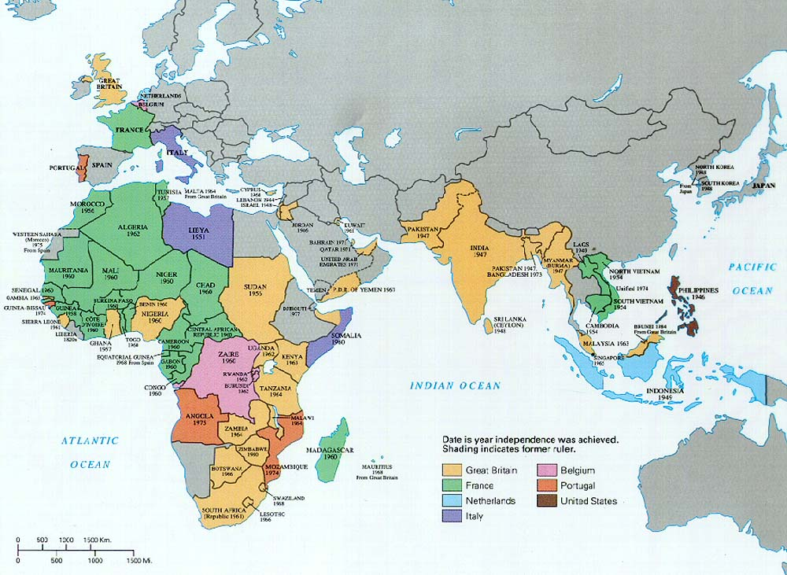
The De-Colonization of European Empires

Slide 16
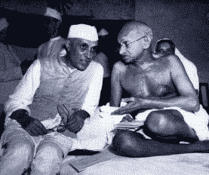
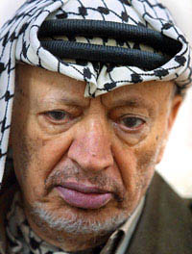
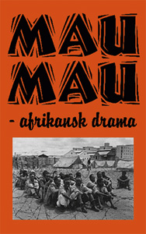
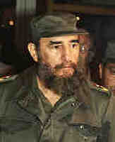
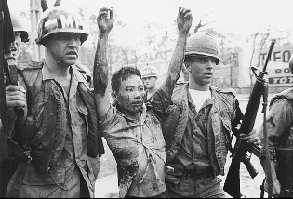
The Emergence of Third World Nationalist Movements

Slide 17
The World
We Live in Today
Was Formed
by the Events
of World War II

