Slide 1
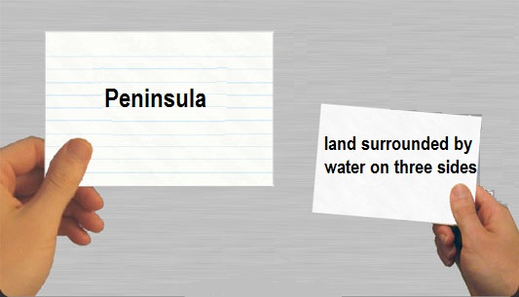
Terms/Concepts Review
Global History & Geography

Slide 2
______
Advanced Technologies
Complex
Government & Laws
Writing
Advanced
Cities
Job Specialization
Surplus
Characteristics or Traits Of Civilization

Slide 3
Mesopotamia
I. _______________________________
A. Sumerian
B. Babylonian
D. Hittites
C. Phoenician

Slide 4
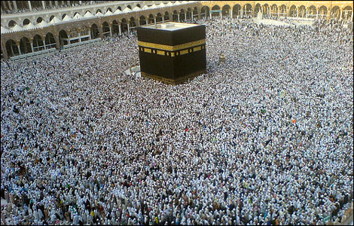
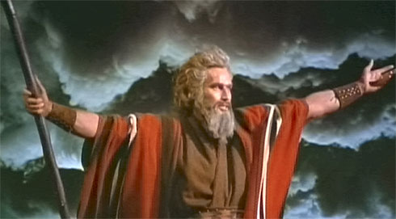

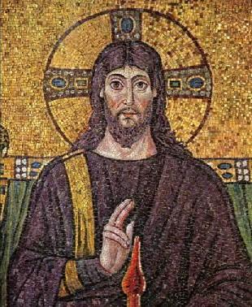
___________
Islam
Judaism
Christianity
Monotheism

Slide 5
Dark & Middle Ages
Feudalism
(Political System)
Manorialism
(Economic System)
Knights
Code of Chivalry
No Central Government
Crusades
Plague

Slide 6
World War I
Trench Warfare
First use of tanks &
mustard gas
Treaty of Versailles ends war

Slide 7
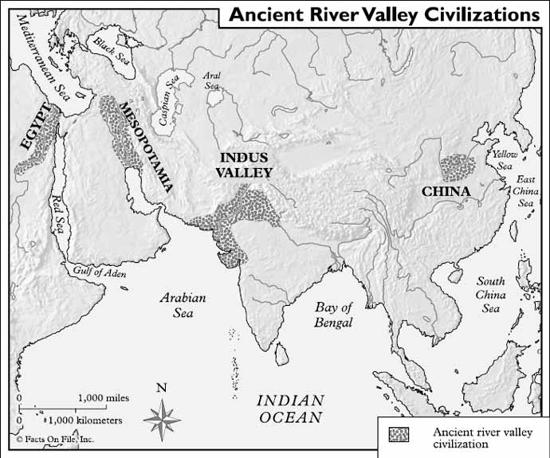
River Valley Civilizations
Indus River
Mesopotamia
Huang He River
Nile River

Slide 8
JAPAN
Tokugawa Shogunate
Meiji Restoration
_______________________- VS - __________________________
* Isolation from other nations
* Tried to
Improve Japan
* Open trade with other nations
* Influenced by Commodore
Matthew Perry

Slide 9
Pray 5x’s a Day
Give to Charity
Allah is the only God
Fast During Ramadan
Pilgrimage to Mecca
ISLAM
5 Pillars of Faith

Slide 10
________
_________
Nature Worship
2 Belief Systems
Taoism/Daoism
Shinto/Shintoism

Slide 11
Empires
Mongols
Gupta
Inca
Byzantine

Slide 12
Green Revolution
Fertilizers
Pesticides
Agricultural Machines
More Surplus

Slide 13
Poor Working Conditions
Workers’
unions
Karl Marx
Vs.
Adam Smith
Urbanization
Child Labor
Unsanitary Living Conditions
Spread of Diseases
THE INDUSTRIAL REVOLUTION

Slide 14
Buddhism
Four Noble Truths
Eightfold Path
Reach Nirvana in one lifetime instead of reincarnation
Sidhartha Guatama

Slide 15
Writing Systems
Sumerian
Cuneiform
Egyptian
Hieroglyphics
Indus Valley
Pictographs
Inca Quipus

Slide 16
The Cold War
?
Communism vs. Capitalism
USA vs. USSR
VIETNAM & KOREAN WAR
IRON CURTAIN
SPACE RACE
BERLIN WALL
NATO (North Atlantic Treaty Organization) vs. Warsaw Pact

Slide 17
_________
Twelve Tables
Code of Hammurabi
Napoleonic Code
Justinian Code
Law Codes

Slide 18
Scientific Revolution
Galileo = Proved Heliocentric Universe, Invented Telescope
Francis Bacon = Scientific Method
Copernicus = Universe is Heliocentric
Newton = Gravity

Slide 19
______
Gandhi led
Independence
Movement
Civil Disobedience
Hindus &
Muslims
Ganges
River
South
Asia
Salt
March
Imperialized by Great Britain
Sepoy Rebllion
India

Slide 20
World War II
Atomic Bomb dropped on
Hiroshima & Nagasaki Japan
D-Day (Allied Invasion of Europe) Normandy, France
Allies vs Axis Powers
German Blitzkreig
(Lightening War)

Slide 21
Confucianism
The Five (5) Basic Relationships
Filial Piety
Brought Order & Ended Chaos in China
Confucius’ Analects

Slide 22
_________
Vladmir Lenin
Led by Bolsheviks
“Peace, Land & Bread”
The March Revolution (1917)
Russian Revolution

Slide 23
______
Occurred During Renaissance
Triangular Trade
Encomienda
System
Mother Country
Natural Resources
New Markets
Middle Passage
Mercantilism
Age of
Imperialism

Slide 24
Locke
Hobbes
Rousseau
Voltaire
Montesquieu
The Enlightenment
Philosophers

Slide 25
The Renaissance
Church Power Declines
Scientific Revolution
Rebirth Roman & Greek Culture
Humanism
Da Vinci
Protestant Reformation
Age of Exploration

Slide 26
_________
Christian Armenians in Ottoman Empire
Rwandan Tutsis by Rwandan Hutus
Dafur
Famine
Apartheid in South Africa
Jews in Nazi Germany
(Holocaust)
Non-Cambodians by Pol Pot/Khmer Rouge
Human Rights
Violations
Genocide

Slide 27
______
Louis XIV
(Absolute Monarch Executed)
Robespierre
(Reign of Terror)
1789
National Assembly
Storming of the
Bastille
3rd Estate
(over taxed, no power in gov’t)
Napoleon
(Nationalism, Expansion, Battle of Waterloo)
France
The French Revolution

Slide 28
Totalitarian Leaders
Adolf Hitler in Germany (Fascist)
Fidel Castro in Cuba (Communist)
Ma0 Zedong in China (Communist)
Joseph Stalin in Soviet Union (Communist)

