Slide 1
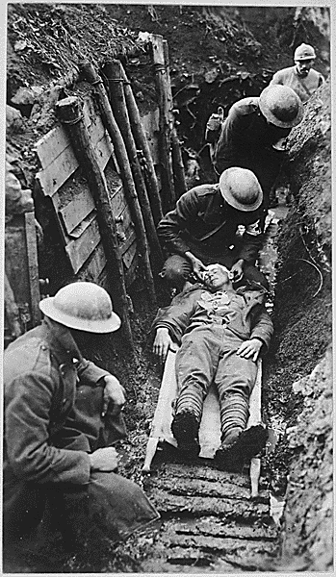
The Causes of World War One (WWI)
Aim: How connected were the world powers before WWI?
Do Now: What is an acronym?
What are these?
FBI
CIA
DHS
NATO
WHO
BETA
NESW
Militarism
Alliances
Imperialism
Nationalism
Significant individuals

Slide 2
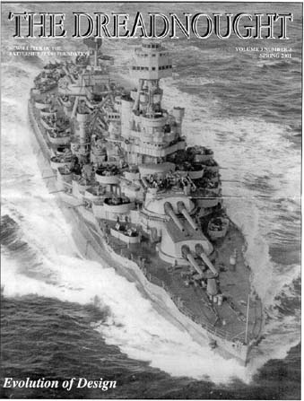
Militarism
Germany was competing with the UK to build battleships.
The British feared an attack on their Empire

Slide 3
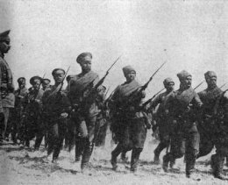
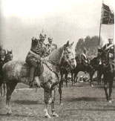
Militarism
Germany was competing with Russia and France to expand their armies
        1880 1914
Germany 1.3m 5.0m
France 0.73m 4.0m
Russia 0.40m 1.2m

Slide 4
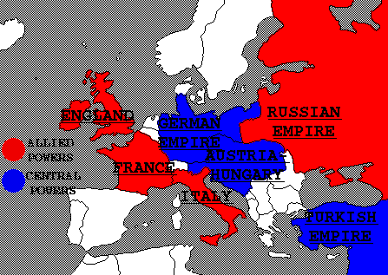
System of Alliances
By 1914 all the major powers were linked by a system of alliances.
The alliances made it more likely that a war would start.
Once started, the alliances made it more likely to spread.

Slide 5
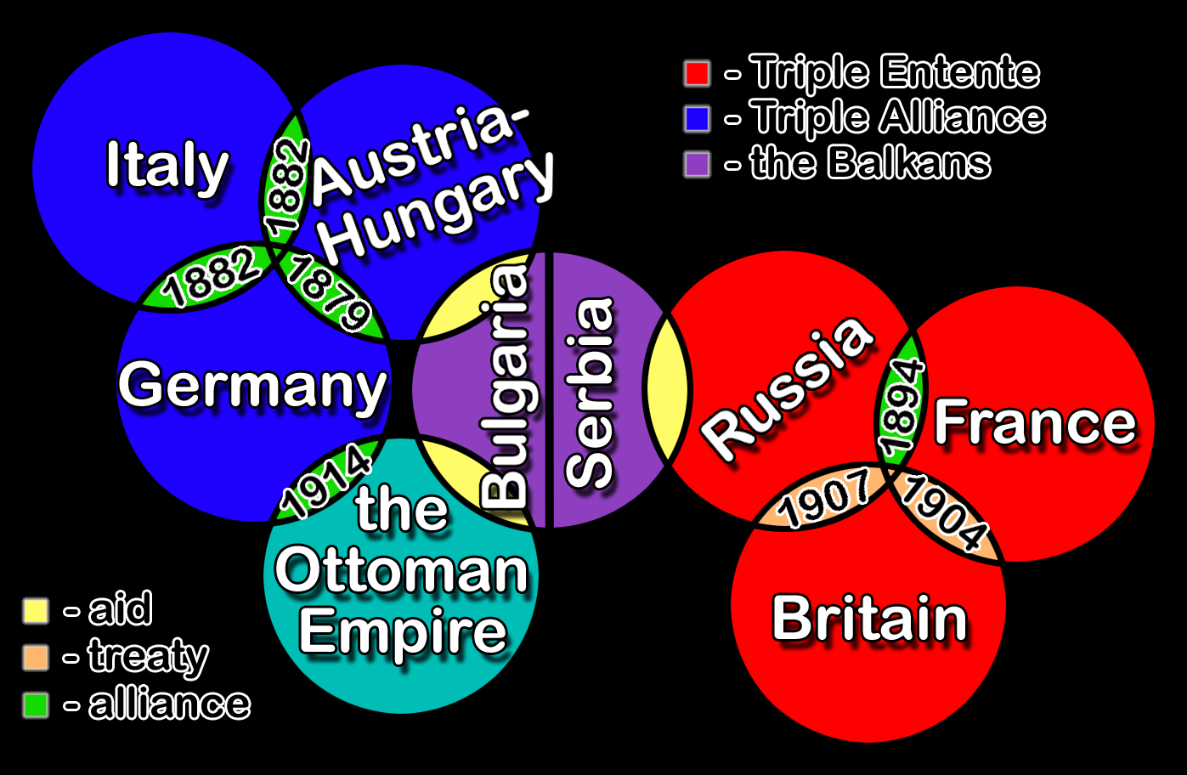

Slide 6
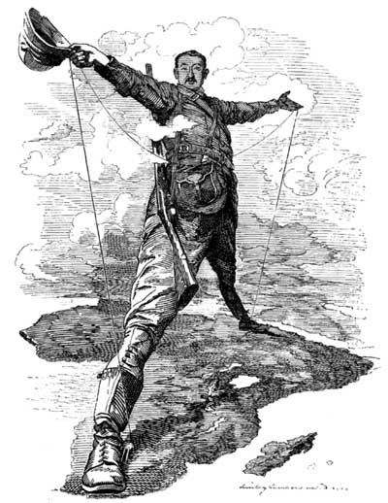
Imperialism
All the great powers were competing for colonies / territory.
The British feared Germany in Africa.
The Austrians feared Serbia / Russia in the Balkans

Slide 7

Nationalism
This was an age when all nations wanted to assert their power and independence.
In Europe Slavs, aided by Serbia and Russia, wanted to be free of Austrian rule.
Serbia’s national flag

Slide 8
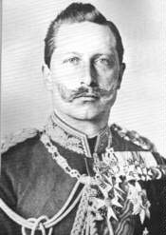
Significant Individuals
Kaiser Wilhelm II
Built up German army and navy
Aggressive foreign policy
Determined to make Germany a top nation.
Distrusted by other powers
“Germany must have its place in the sun”
“The world belongs to the strong.”

Slide 9
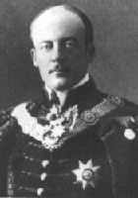
Significant Individuals
Count Berchtold
Austrian Prime Minister.
During the July Crisis, decided on a very tough ultimatum for Serbia
“Were the Serbs to agree to all the demands, this would not be to my liking”

Slide 10
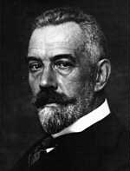
Significant Individuals
Bethmann Hollweg
German Prime Minister
Gave very strong support to Austria during the July crisis while Kaiser was cruising on his yacht
“The Austrian demands are moderate. Any interference by Britain, France and Russia would be followed by incalculable consequences”

Slide 11
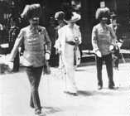

The Crisis
28 June 1914
Heir to Austrian throne Franz Ferdinand visits Sarajevo.
Capital of Bosnia, recently grabbed by Austria.
Balkins a hotbed of Slav nationalism
Seal of the Black Hand group

Slide 12
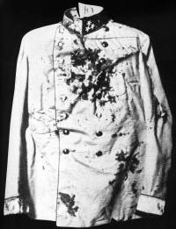
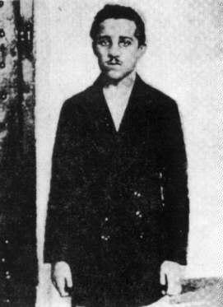
The Crisis
“Black Hand” terrorists attack the Arch Duke
Bomb attempt fails in morning
Gavrilo Princip shoots & kills Archduke and wife in the afternoon.
Austrians blame Serbia for supporting terrorists.

Slide 13
The Crisis
Austrians, supported by Germany, send Serbia a tough ultimatum.
Serbia agrees to all but two terms of the ultimatum.
Russia mobilizes her troops to support Serbia
Germany demands that Russia stands her armies down.
Germany declares war on Russia
“Demands must be put to Serbia that would be wholly impossible for them to accept …”

Slide 14
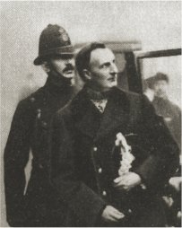
Why did Britain get involved?
Britain had Ententes (Alliances) with France and Russia.
Only “friendly agreements” but French and Russians given impression Britain would fight.
The Schlieffen Plan
Sir Edward Grey
British Foreign Secretary … “There’s some devilry going on in Berlin”

Slide 15
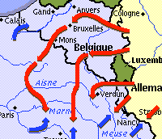
The Schlieffen Plan
Germany’s military plan to defeat France and Russia.
“Knock out blow” aimed at France first.
Avoid French defences by invasion of Belgium.
Germans thought Britain would not intervene.

Slide 16
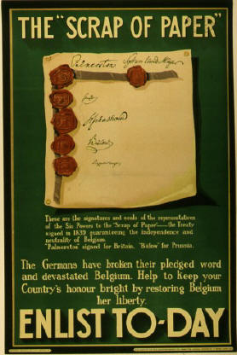
Britain’s Reaction
1838- UK had signed a Treaty to protect Belgium.
Britain also scared of Germany controlling Channel ports.
Did not want Germany to defeat France and dominate Europe. Britain next?
UK issued ultimatum to Germany to withdraw troops from Belgium.
War declared August 4 1914

Slide 17


