Slide 1

Regents Basics
AIM: What are the basic skills needed for passing the NYS Regents exam in Global History & Geography?

Slide 2
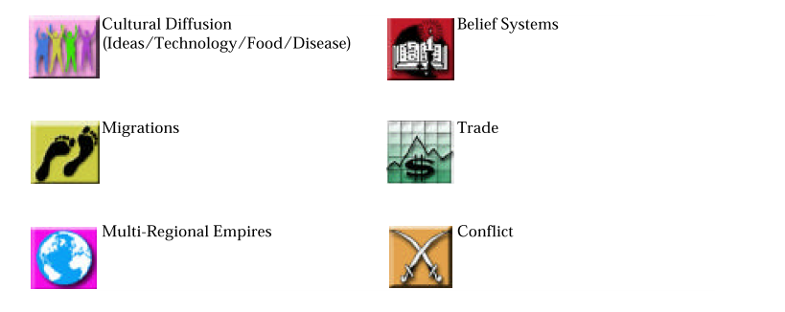
Connections
The Global History & Geography exam explores connections with
The following categories:

Slide 3
Content/Subject Areas
The Global History & Geography exam explores content/subjects in
the following areas:
Belief Systems
Change
Citizenship
Conflict
Culture and Intellectual Life
Decision Making
Diversity
Economic Systems
Environment and Society
Factors of Production
Human and Physical
Geography
Human Rights
Imperialism
Interdependence
Justice
Movement of People and Goods
Nationalism
Nation State
Needs and Wants
Political Systems
Power
Scarcity
Science and Technology
Urbanization

Slide 4
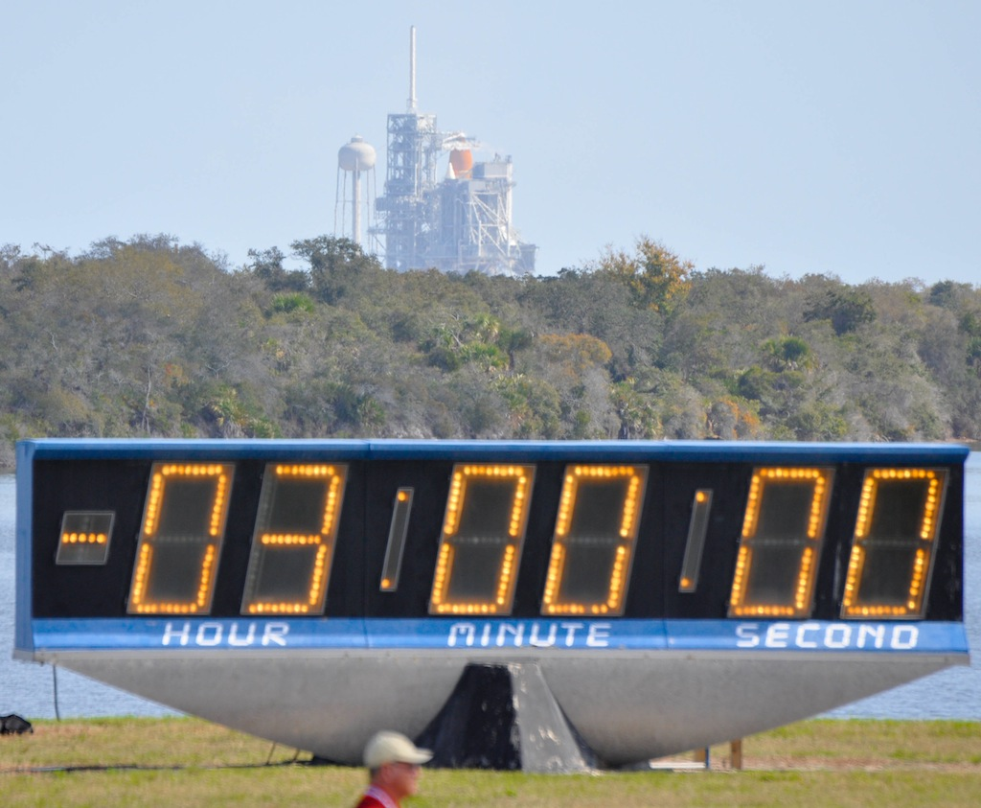
Time Management
The Global History & Geography exam tests your ability to complete
Specific tasks in a timely manner such as:
Task | Time Limit | Order to Complete
Multiple Choice 50 Questions | 50 Minutes | 1st
Thematic Essay | 50 Minutes | 2nd
DBQ’s 13 Questions | 30 Minutes | 3rd
DBQ Essay | 50 Minutes | 4th

Slide 5
Geography
The Global History & Geography exam explores geography –
Which is the connection between people and the physical earth.
Great Britain
Island nation: Isolated, good ports, good for trading and strong navy.
China
Isolated by deserts, Himalayan mountains, ocean.
Africa
Northern & Central/Southern African isolated by Sahara desert and Congo rain forest.
Geographic determinism is the theory that the human habits and characteristics of a particular culture are shaped by geographic conditions.
Jared Diamond – “Guns, Germs, and Steel” (1997)

Slide 6
Outline
The Global History & Geography exam explores outlines in bulleted
List forms such as:
Which heading best completes the partial outline below?
I. ___________________________
Centralized governments
Organized religions
Social Classes
Specialization of labor
Which heading best completes the partial outline below?
1. Economic Development in Ancient Egypt
2. Cultural Diffusion in Mohenjo-Daro
3. Features of the Old Stone Age
4. Characteristics of Civilizations
They are looking for a
Topic or header for the list below.
The list of linked items for the topic above
Question can appear at top or before answers

Slide 7
Fact vs. Opinion
The Global History & Geography exam explores Fact vs. Opinion questions such as:
Which statement about Greek civilization is an opinion rather than a fact?
1. Boys in Sparta were trained to be soldiers.
2. Athens had a better culture than that of Sparta.
3. Socrates, Plato, and Aristotle were Greek philosophers.
4. Many adults in Athens did not have the right to vote.
To see if something is a FACT, ask yourself, “Can this statement be proved?
and
Look for OPINION clue words such as feel, believe, always, never, least, best, and worst.

Slide 8
Vocabulary
The Global History & Geography exam explores basic history
Vocabulary such as:
One country taking over another country politically, economically, and/or socially
imperialism
hierarchy
totalitarianism
is an arrangement of items in which the items are represented as being "above“ or "below a certain level
is when a leader of a country has total control over the society (politically, socially, economically)
Knowing the basic 100 vocabulary words will assist you in answering many multiple choice questions and help with essays.

Slide 9
Primary vs. Secondary
The Global History & Geography exam explores Primary vs. Secondary documents such as:
Primary
Autobiography
Secondary
Biography
Journal / Diary
Newspaper Account
Video of Event
Photos
Portraits/Paintings
Novel/Textbook
Texts – Laws, Letters, Poems
Article in a periodical
Historic Journal
Movies (non-documentary)
Record of the Event
During time period of event
Long after time period of event

Slide 10
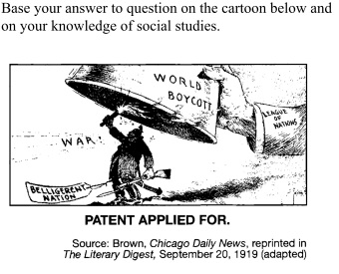
Cartoon Analysis
The Global History & Geography exam explores Cartoons in which
Meaning needs to be ascertained (found) such as:
Which statement best reflects the main idea of this cartoon?
1. The League of Nations is stopping world boycotts.
2. The League of Nations hopes to use boycotts to end war.
3. Belligerent nations wish to be included in the League of Nations.
4. War is likely if the League of Nations acts.

Slide 11
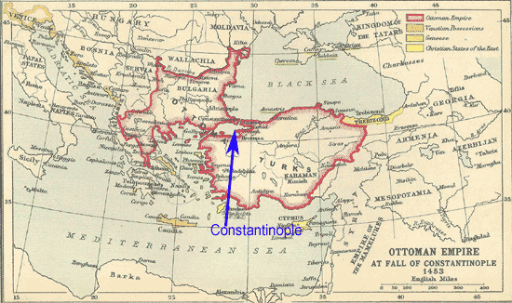
Map Skills
Europe
Asia
Constantinople became the center of the Byzantine Empire because
the pope had made it the capital of the Christian world
it was a religious center for Muslims
its location made it the crossroads of Europe and Asia
it was geographically isolated from surrounding empires

Slide 12
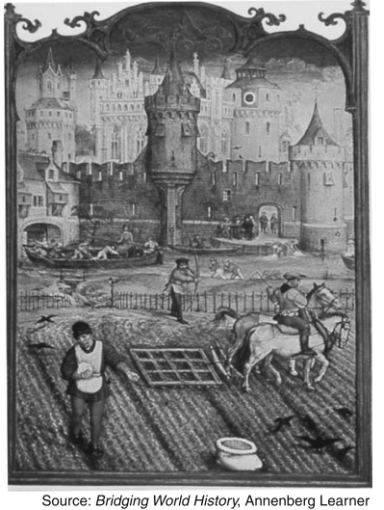
Photo/Painting Analysis
Which economic system is most closely associated with the activities shown in this art work?
1) manorialism 2) communism
3) capitalism 4) socialism
Tips:
Ask yourself, what to you see?
What time period is this?
What is the activity, if any?
castle
Moat (water around the castle)
Farmer planting seeds

Slide 13
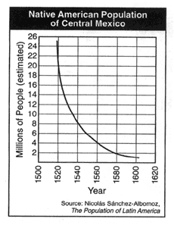
Charts & Graphs
Between 1540 and 1580, what happened to the native population of Central Mexico?
1. It decreased by approximately 6 million people.
2. It increased to a high of 26 million people.
3. It increased by approximately 2 million people per year.
4. It decreased to 8 million people.
Tip:
Watch for words such as;
Increase, decrease, more, less, positive, negative, etc.

Slide 14
P.E.G.S. Strategy
Using the P.E.G.S. Strategy to eliminate choices t hat will not be the answer.
Political
Anything to do with Government (law, system, military)
Geography
Interaction between people and the physical earth.
Economic
Anything to do with Trading (type of system) – Not Money!
Social
Anything to do with People (culture, tradition, religion, social class, etc)

