Slide 1
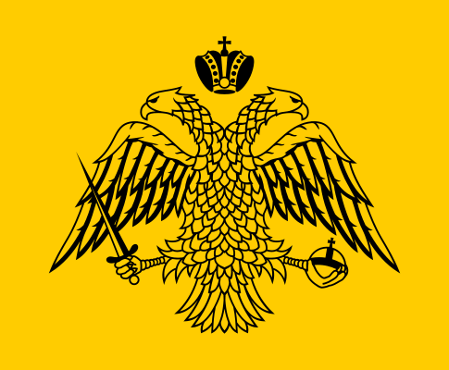
Byzantine Empire (330-1453)
AIM: Did the Roman Empire really end or was it reborn?
Do Now: Constantinople & Geography Worksheet

Slide 2
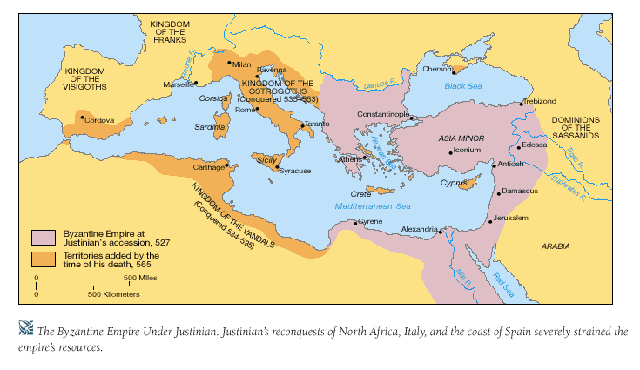

Slide 3
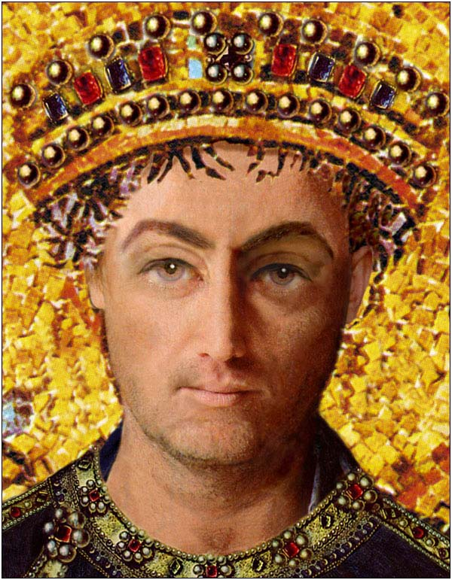
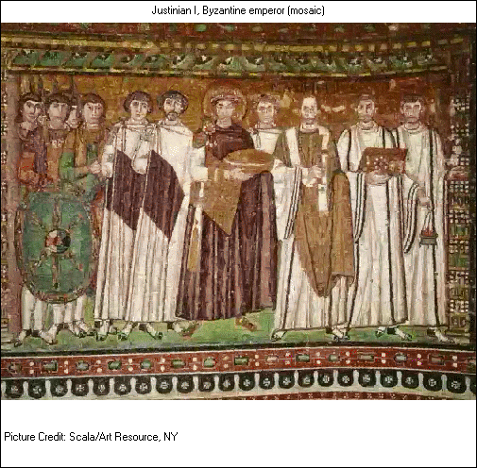
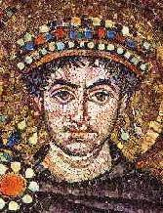
Emperor Justinian

Slide 4
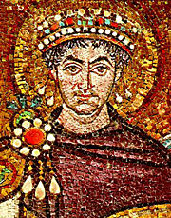
The Age of Justinian (527-575)
536: Re-conquest of Rome and much of Italy took many years.
North Africa and the Spanish coast were easily conquered.
Victories over Persia in the east consolidate the borders

Slide 5
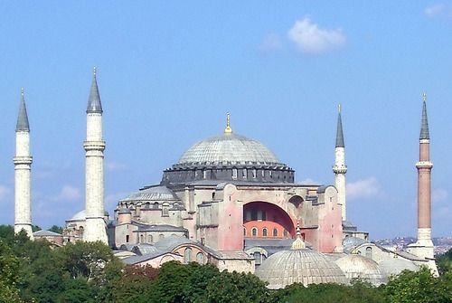
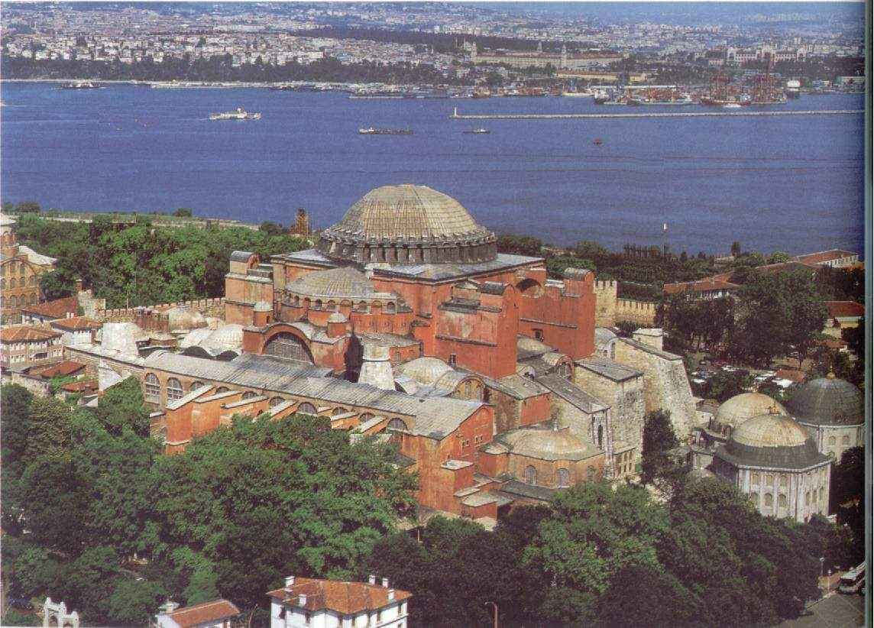
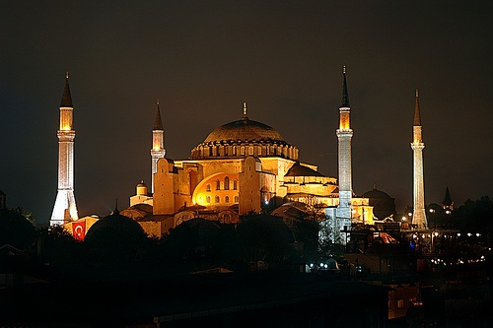
Hagia Sophia, Church of the Holy Wisdom, 6th c.

Slide 6
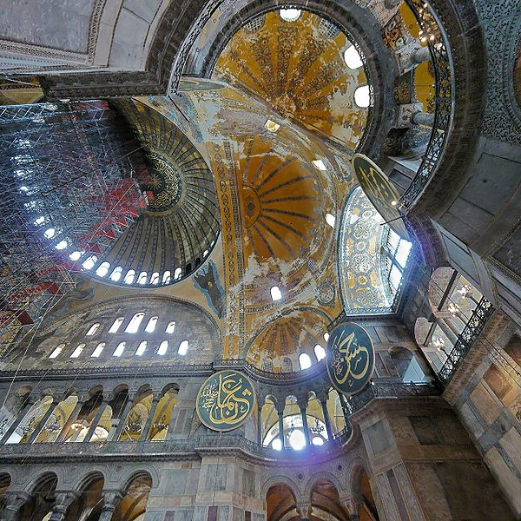

Slide 7
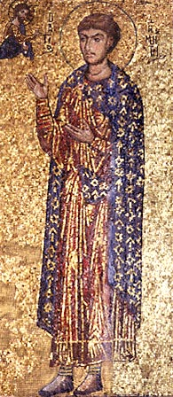
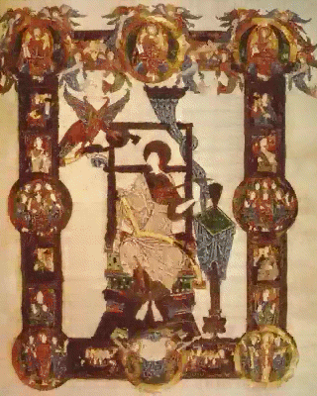
Byzantine Art: Mosaics
and Illuminated Manuscripts

Slide 8
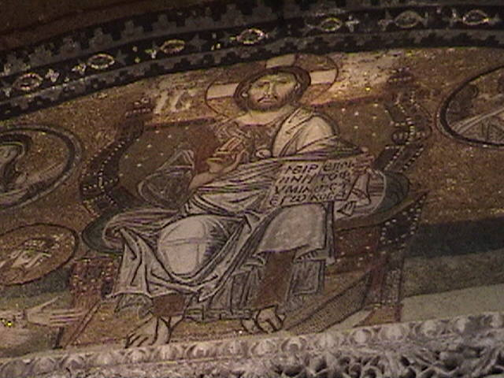

Slide 9
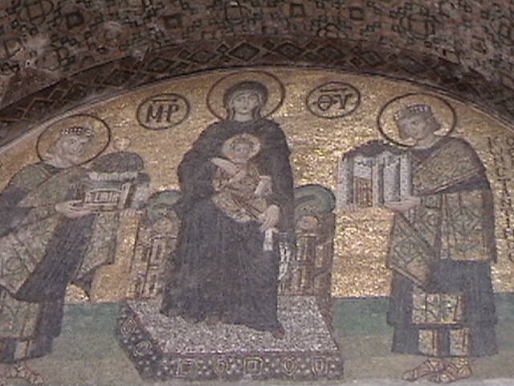

Slide 10
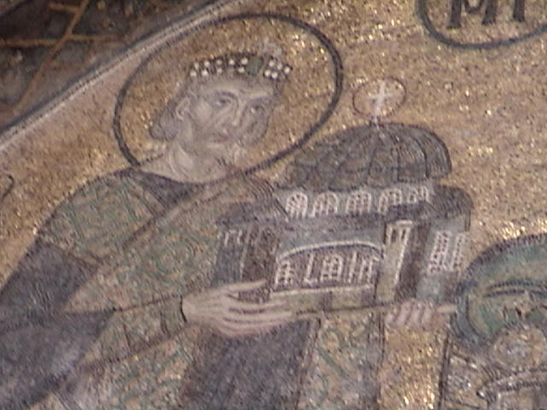

Slide 11
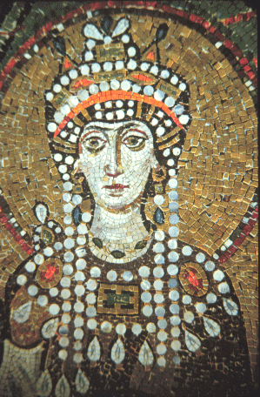
Justinian’s Legacy
Built Hagia Sophia Church which remained the seat of Eastern
Christianity until the Fall of Constantinople.
Rebuilt the Hippodrome
(chariot race track)
552: Byzantine monks sneak
silkworms and mulberry out of China.
Justinian orders the codification of Roman Christian law know known
as the Justinian Code
Destroyed the last stronghold of paganism (non-believers in Christianity)
Ruled as an Autocrat with help from wife Theodora.

Slide 12
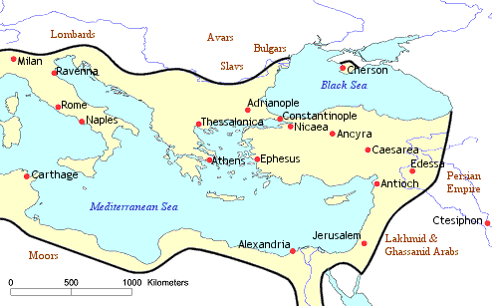
The Byzantine empire in 565, at its largest expansion ever.

Slide 13
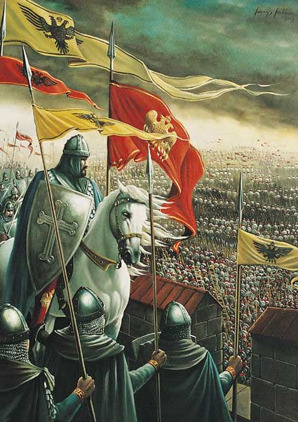
The End of the Byzantine Empire
The Byzantine empire drew to a close in 1453 when forces from the Muslim Ottoman Empire which surrounded and conquered Constantinople.
The ancient Christian city was renamed Istanbul and became the capital of the Ottoman Empire.

Slide 14
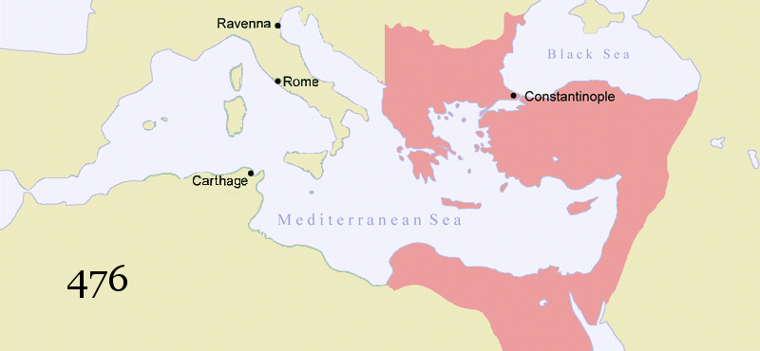
The Timeline of the
Byzantine Empire

Slide 15
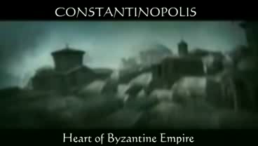

Slide 16
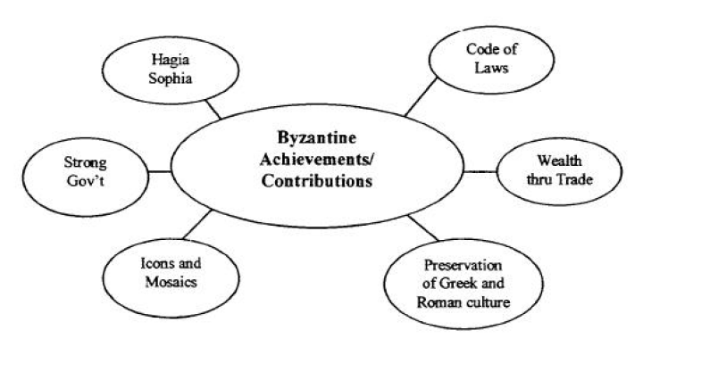
The Contributions/Achievements of the Byzantine Empire

