Slide 1
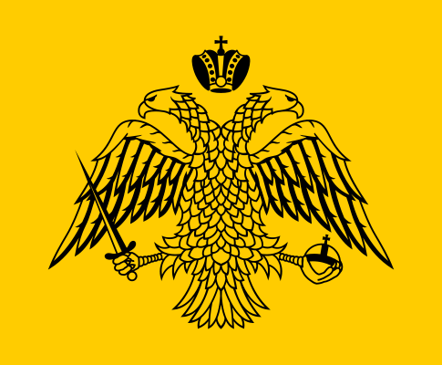
Byzantine Empire (330-1453)
AIM: Why was the Eastern Roman Empire (Byzantine Empire) successful while the Western Roman Empire,
was not?
Do Now: List at least three (3) causes of the fall of the Roman Empire?
AD or BC?

Slide 2
What were three (3) Causes of the fall of the Roman Empire?

Slide 3
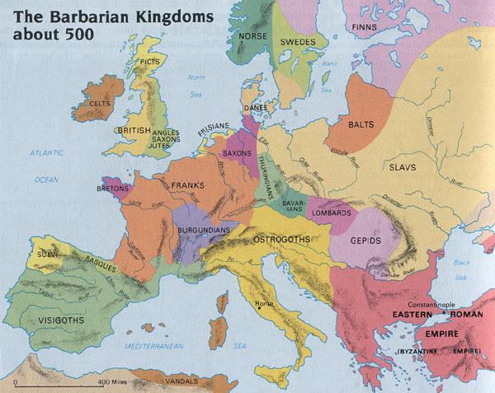

Slide 4
The Byzantine Empire with territory in the Balkans, the Middle East, and the eastern Mediterranean, maintained very high levels of political, economic, and cultural life between 500 and 1450 C.E.
The Byzantine Empire, once part of the grater Roman Empire continued flourishing from an eastern Mediterranean base after Roman decline
The empire continued many Roman patterns and spread its Orthodox Christian civilization through most off eastern Europe.
Split of Roman Empire

Slide 5
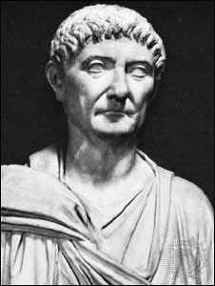
The Origins
292: Diocletian divides the Roman empire into two.
324: Constantine reunites the two parts
330: Constantine builds a new capital in the location of ancient Byzantium
337: The death of Constantine results in division between east and west.

Slide 6
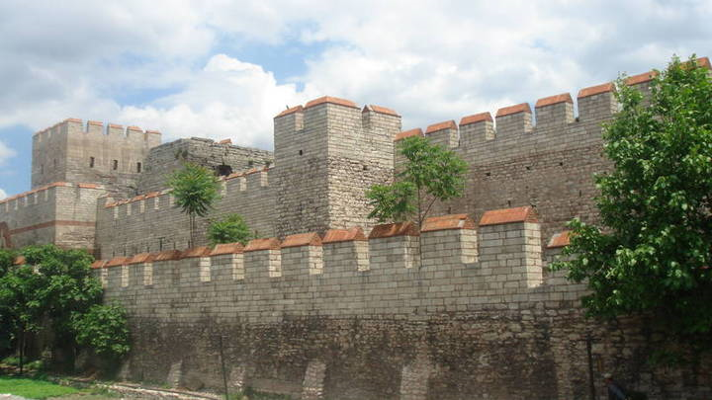
Constantinople
Successive emperors build strong walls, palaces, churches, gardens, aquaducts and made the city the biggest, strongest and most enlightened city of medieval Christendom
The Walls of Theodosius

Slide 7
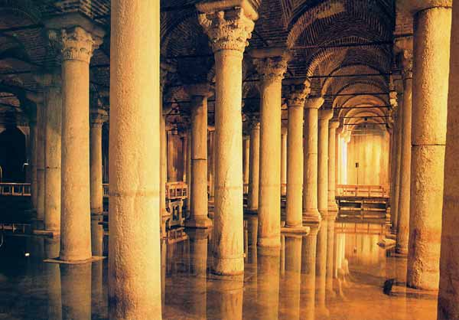
Cistern Basilica

Slide 8
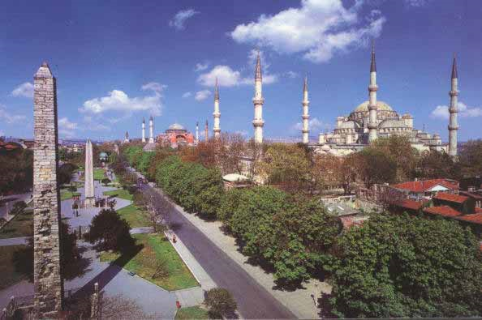
Hippodrome (Circus Maximus)

Slide 9
Complete Activity Worksheet
Make sure your name is on it.
It will be collected at the end of the period.

