Slide 1

The Causes of The French Revolution
Essential Question: What were the social, political,
and economic causes of the French Revolution
Through Primary & Secondary Sources

Slide 2
Word Bank
Do Now: Each Group will define one (1) word in the word bank below. (you have 3 minutes) – If stuck, you may have to visit
another group to assist.
Group | Word | Definition
Whole Class | Revolution | A major change
#1 | Levied
#2 | Censorship
#3 | Warrant
#4 | Clergy
#5 | Discontent
#6 | Arbitrarily
#7 | Attribute
Class | Symmetry

Slide 3
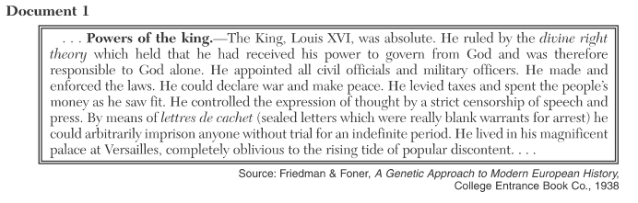

Group #1: According to this document by Friedman and Foner, What was one cause of the French Revolution?
Group #2: What parts of P.E.R.S.I.A, is the document related to /and/ how?

Slide 4
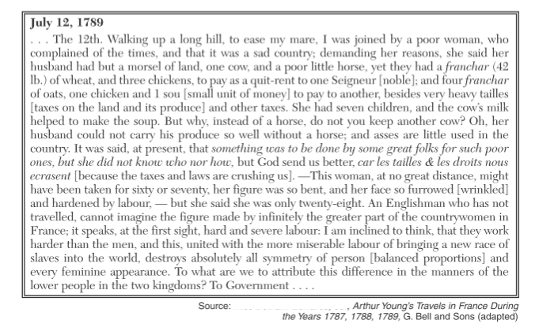
female horse
Rent paid to landlords
Group #5: Based upon this document of Arthur Young’s travels, state one reason the French Peasants were dissatisfied with life during this period of French history?

Slide 5
SOAPSTone
Group #6:
Speaker:
Occasion
Audience:
Group #7:
Purpose:
Subject:
Tone:

Slide 6
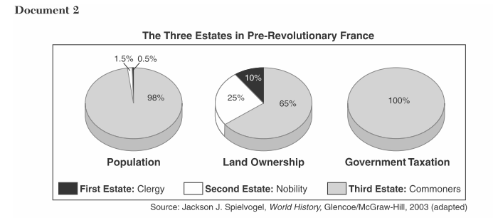
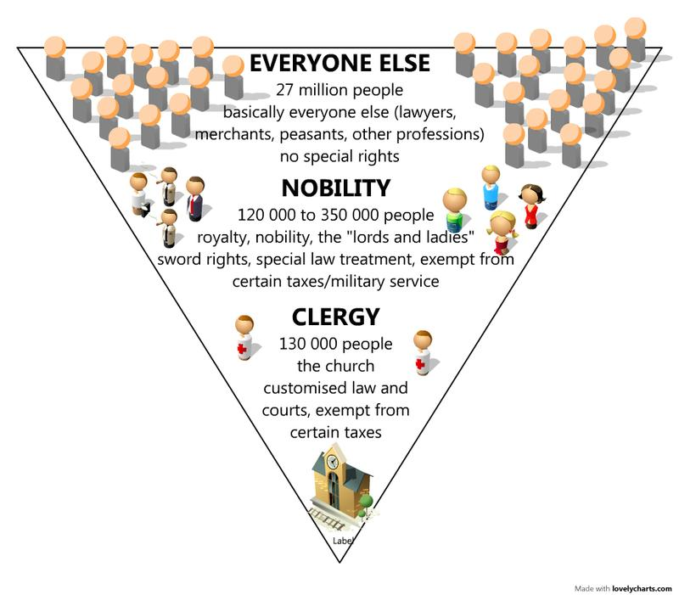
Group #4: Based upon the information in these graphs, what was one cause of the French Revolution?
Group #5: What parts of P.E.R.S.I.A, is the document related to /and/ how?

Slide 7

Pre-Revolutionary France

Slide 8
Culminating Activity: (Due tomorrow)
Write a well-developed paragraph(s) on the Causes of the French Revolution by incorporation your prior knowledge of
The Enlightenment and the documents from today’s lesson.

