Slide 1
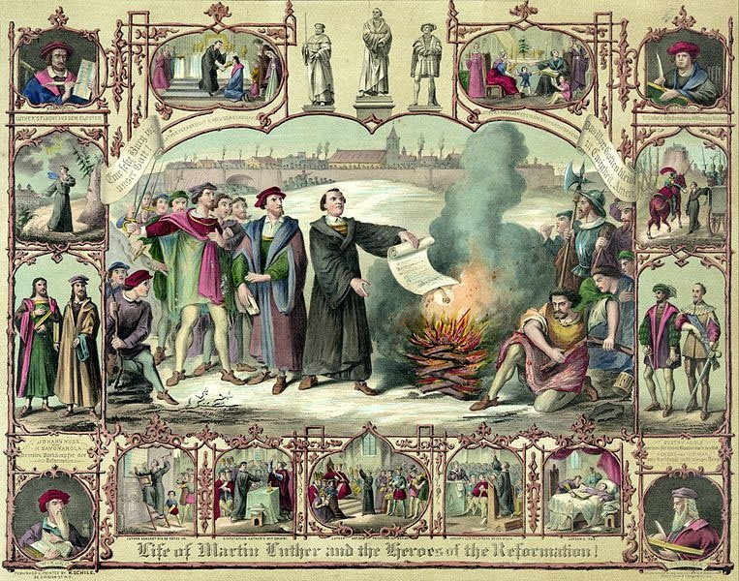
Protestant Reformation Results
AIM: What
were the Results of the Protestant Reformation?
Do Now: In your notebook define the term – Protestant Reformation

Slide 2
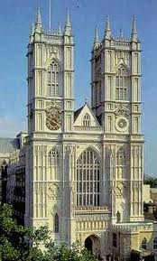
What is the results of Luther’s actions?
Opened people’s eyes to
corruption of the church
Soon others began to create
new churches away from the
Roman Catholic Church based
on own beliefs– John Calvin– Calvinism
New Christian Denominations (religions) emerged: Protestant, Lutheran, Baptists, Puritans, Methodists, Calvinists, etc.
Royal power grew as Church’s power lessoned

Slide 3
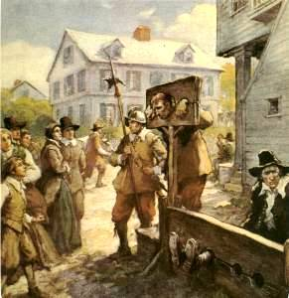
John Calvin - Calvinism
French lawyer - moved to religious community in Geneva, Switzerland
“Faith Alone” saves you
The Bible holds the truth
Religious Education
PREDESTINATION - God has already decided who is saved/condemned.

Slide 4
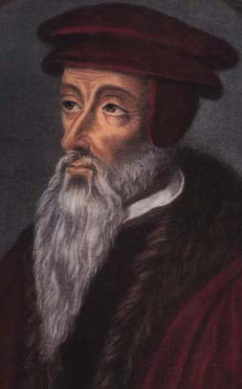
Calvinism
Spreads to France, Germany, Netherlands, Scandinavia, Scotland
Dutch Reformed,
Scottish Presbyterians, American Baptists, Puritans, from this branch

Slide 5
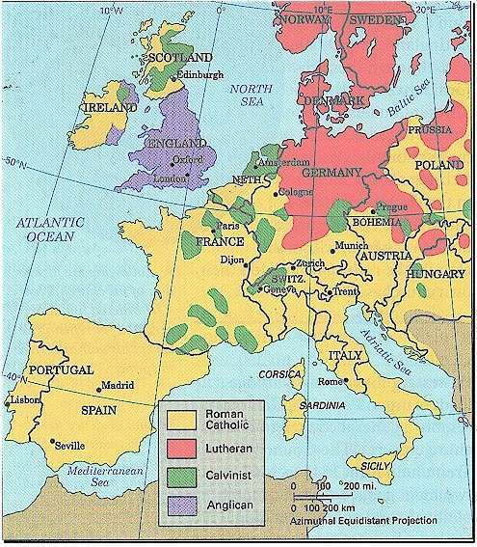

Slide 6
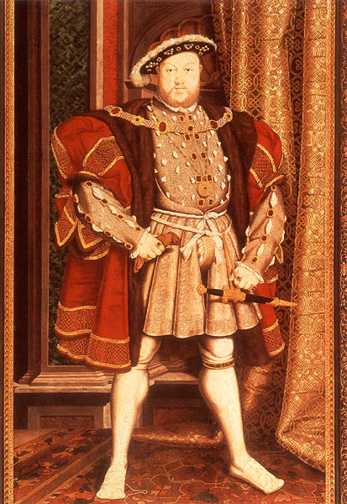
Henry VIII of England
Wished to divorce Catherine of Aragon and marry Anne Boleyn
Pope refused to grant it
Henry declares himself head of the Church of England in the “Act of Supremacy” 1534
In America we call this the Anglican Church

Slide 7


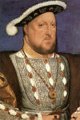
Act of Supremacy- 1534
The King is head of the church in England, not the Pope!!

Slide 8
Activity: Protestant Reformation Worksheet
Complete worksheet with a partner.
Submit at end of class, if not completed, it’s homework

