Slide 1
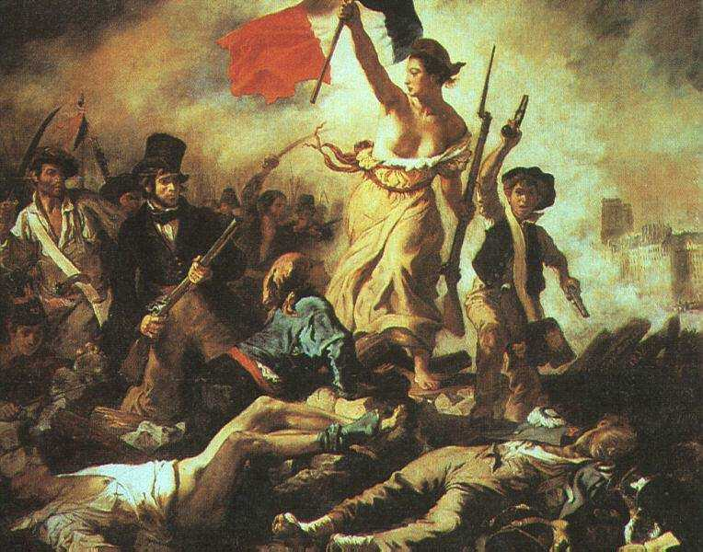
French Revolution
AIM: What were the causes of the French Revolution?
Do Now:
Describe the conditions in France that led to the French Revolution
"Liberty Leading the People“
(Eugene Delacroix, 1830).

Slide 2
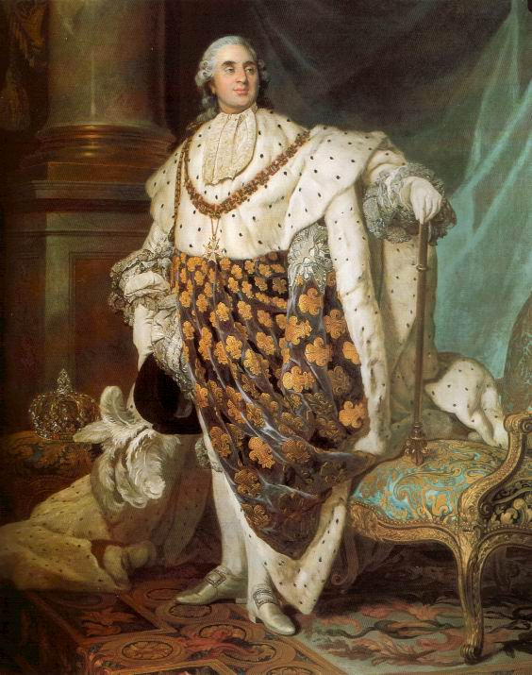
Causes and Attitudes
The Enlightenment
The American Revolution
French system’s lack of change
Louis XVI clung to Absolutism
King’s response to the poor
Class resentment
Economic problems

Slide 3
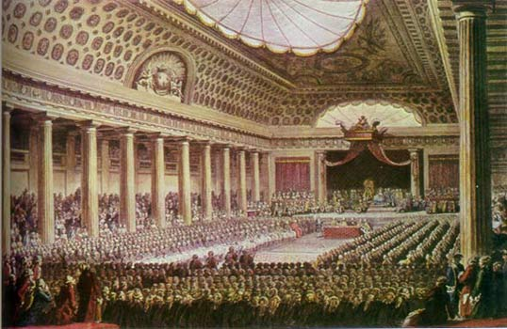
First Stage (1789-1793)
King desired new tax to stabilize economy
King called the Estates General (3 estates – 3 Classes)
Not met for 175 years
Election for representative to meeting in early 1789
Finally met in Spring 1789
3rd Estate walked out

Slide 4
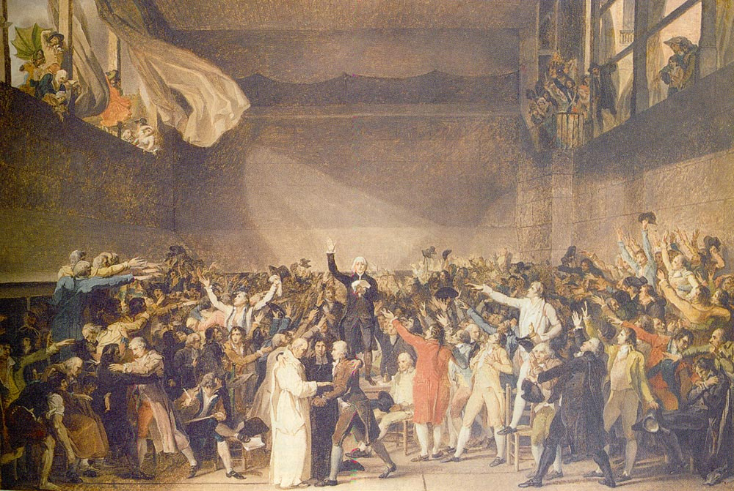
First Stage
National Assembly (1789-1793)
3rd estate met in indoor tennis court
Resolved to stay in session until constitution could be written
Formed municipal (city) government

Slide 5
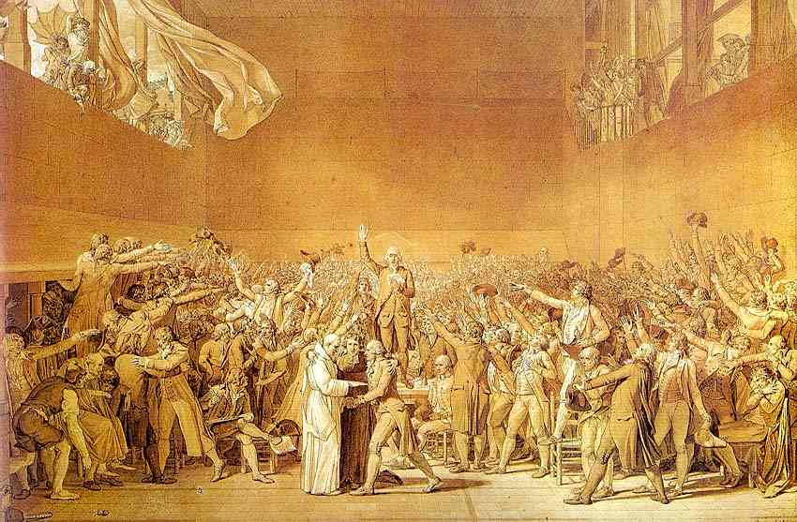

Slide 6
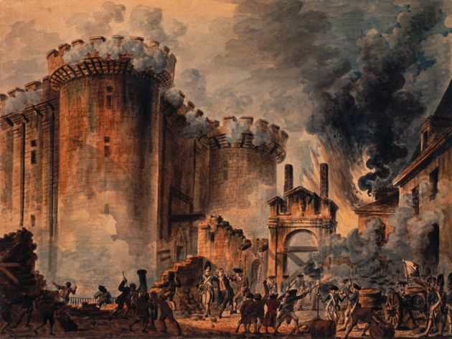
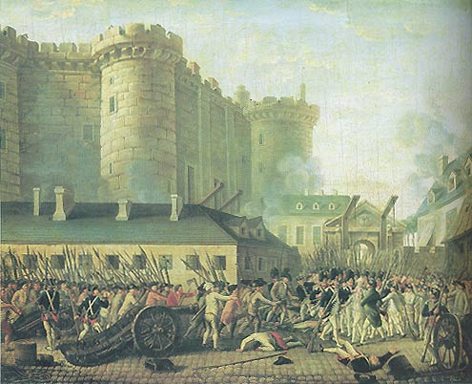
First Stage
Events at Bastille Prison
July 14, 1789
Municipal government trying to get arms
Only 7 prisoners inside!
Revolts in the countryside

Slide 7
Actions of the National Assembly
End to the “Ancien’ Regime” Old Feudal System (3 Estates)
Declaration of the Rights of Man and of Citizen (1789)
Secularization of the church – Worship “Reason, Wisdom, & Logic”
New Constitution – Limited Monarchy

Slide 8
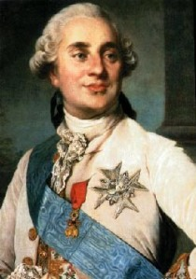
Class Debate
Write a paragraph of the Historical Context on the causes of the French Revolution and how King Louis XVI could have responded to avoid the Revolution.

