Slide 1
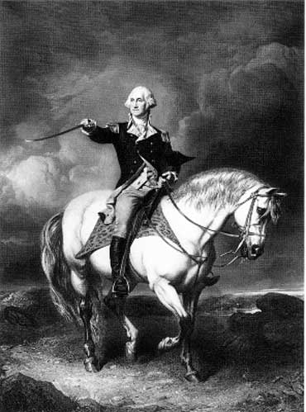
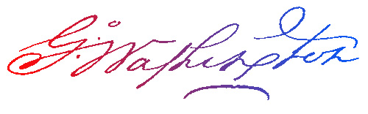
George Washington
The Model Citizen
Part 1
Aim: Why was George Washington’s presidency important to the country today?
Do Now: Why would government officials take an oath?

Slide 2
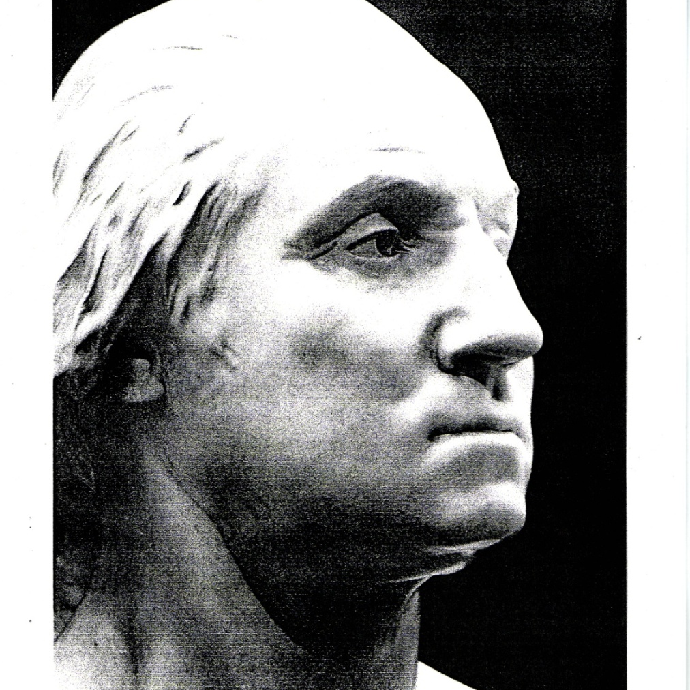
Born: February 22, 1732 in Westmoreland County, Virginia
Died: December 14, 1799 in Mount Vernon, Virginia
Married to: Martha Dandridge Washington

Slide 3
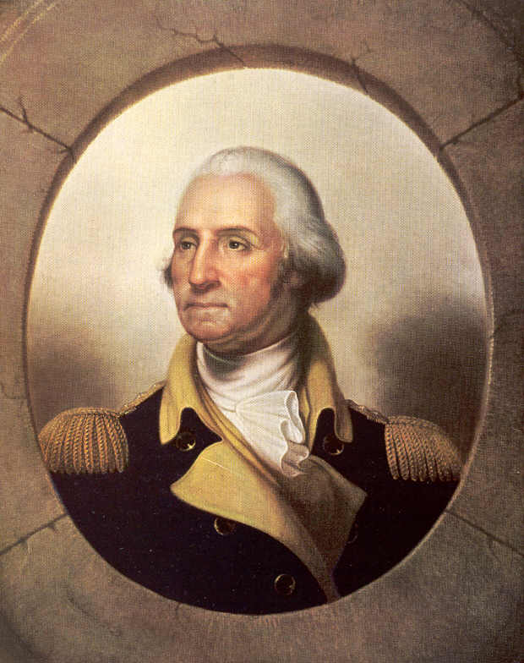
ACCOMPLISHMENTS
Surveyor
Farmer/Planter
  Tobacco, Fruit, Grains, Vegetables
Colonel in French & Indian War
Commander in Chief – Continental Army
Winter at Valley Forge, PA
Completes British Defeat at Yorktown
President of the Constitutional Convention
Promotes the new Constitution
Becomes 1st President Unanimously

Slide 4
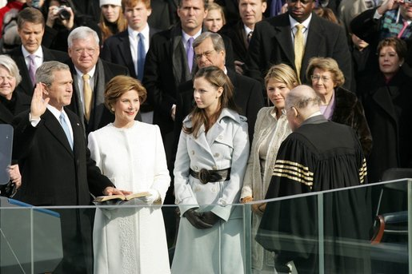
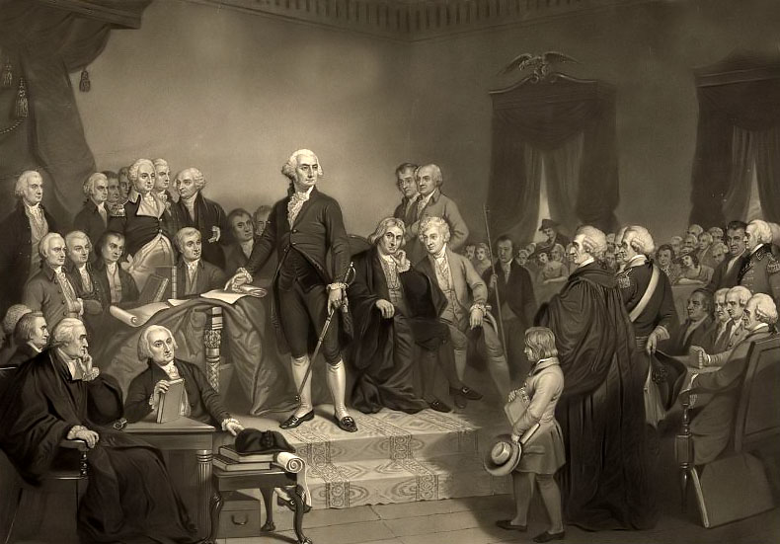
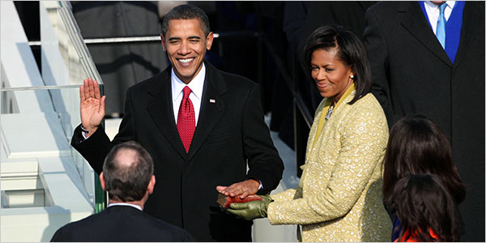
Inauguration
It all begins with this oath
Presidential Oath of Office
"I, ___________do solemnly swear
that I will faithfully execute the office of President of the United States,
and I will to the best of my ability, preserve, protect, and defend the Constitution of the United States."
So Help Me God.

Slide 5
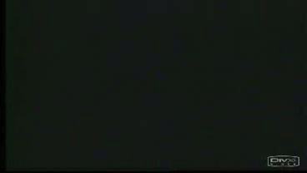
Inauguration of John F. Kennedy (1961)

Slide 6

Inauguration of Ronald Reagan (1981)

Slide 7

Inauguration of George W. Bush (2001)

Slide 8
Inauguration of John F. Kennedy (2008)

Slide 9
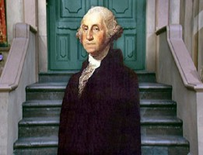
Activity:
Read the inauguration of George Washington
Similarities and Differences of the Presidential Inaugurations of Washington, JFK, Ronald Reagan, George W. Bush,
and Barak Obama
Use the Worksheet provided.

