Slide 1
Sources
What is a “Source” ?
In Social Studies
A Source is a place from which information is taken.

Slide 2

Primary or 1st Source
Secondary or 2nd Source
Two (2) Types of Sources
1st
2nd

Slide 3
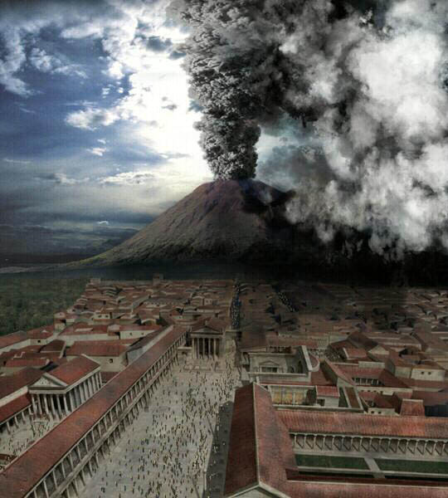
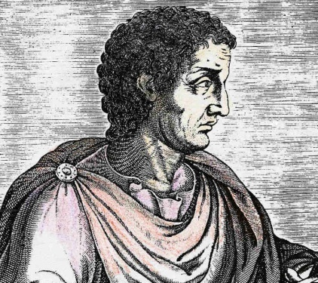
What is a Primary Source ?
A primary source is something written, spoken, heard, or seen by a witness to an event.
Vesuvius – 79AD / CE
Notes:
Plinny the Younger

Slide 4

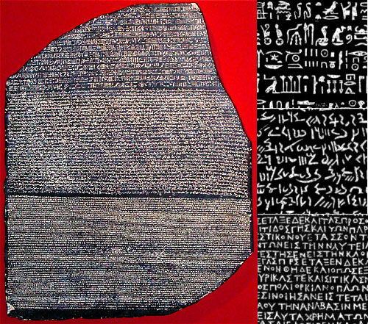
Primary Sources are actual records of events that have survived from the past.
Rosetta Stone
Hieroglyphic – Picture Writing
Letters
Photographs (Gabby’s Photo’s)
Diaries
Poems
Newspaper Accounts
Interviews
Class Notes & Meeting Notes
Autobiography
Recordings / Video
Portraits/Statues/Monuments (at or near the time)
Demotic – Egyptian Script
Greek (Ancient)

Slide 5
How to Know If Something is a Primary Source?
Primary Source
Person witnessed the event (First Hand Account or First Person)
Time of Event Recorded
It was written, heard, spoken, or recorded at the time of the event
Person was alive when the event happened

Slide 6
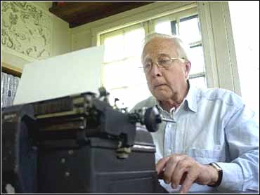
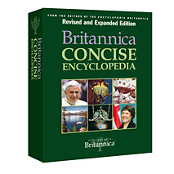
What is a Secondary Source?
A Secondary source is something completed after.
Secondary sources offer a retelling of primary sources.
Dictionaries (all)
Encyclopedias (all)
Text Books (all)
Term Papers
Essays
Biographies (all)
Start Activity

Slide 7
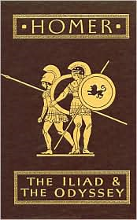
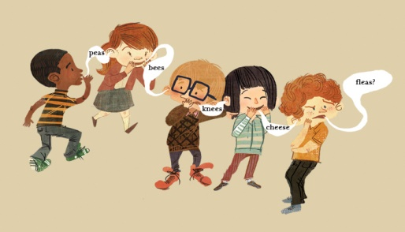
Oral History/Tradition
Oral History can be a primary or secondary source.
Why?
Because if the person witnessed the event
It’s primary. If it was written down after the event, and not witnessed, it’s secondary.
Let’s play telephone!

Slide 8
Primary Source/Document ?
Rosetta Stone
Found in Alexandria Egypt
3 Languages
Classic Greek
Demotic (Egyptian Script)
Hieroglyphic (Egyptian Pictures)
Translated by Champollion which unlocked Hieroglyphic writing
The inscription is about how temple priests would honor the pharaoh (king).
Primary Source

Slide 9
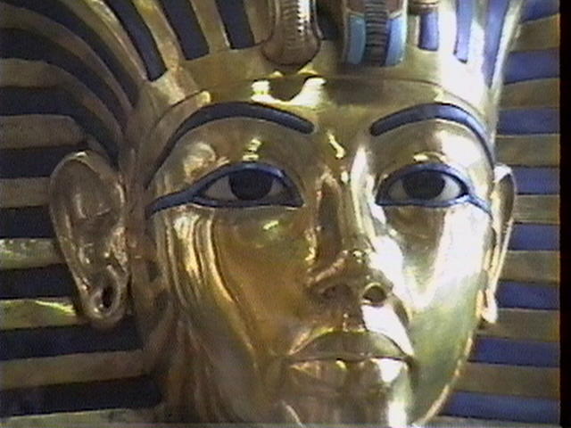
In 1996, Mr. Ott travelled to Egypt. After seeing “wondrous things” In 2007, he wrote a term paper on King Tutankhamun long after the events had happened.
In order to complete his paper he had to look up information in an encyclopedia and talked to an Egyptologist.
Is this a primary source?
Not a Primary Source
Secondary Source
“I see wondrous things.” - Howard Carter, Nov 5, 1922 after opening King Tut’s Tomb

Slide 10
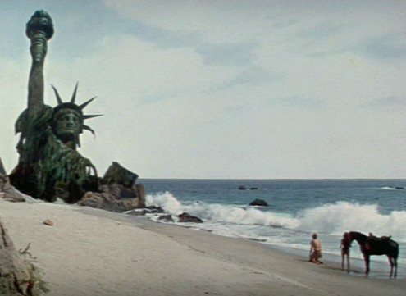
Primary Source?
Secondary Source ?
Neither Fake/Made Up

Slide 11
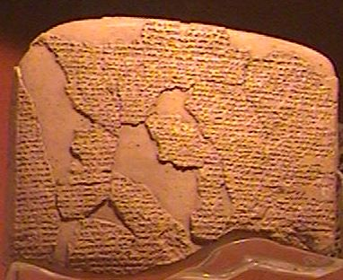
Treaty of Kadesh
Earliest Peace Treaty
Written around 1274BC/BCE
Egyptians vs. Hittites
Ramesses II (Pharaoh)
Primary Source
The peace treaty was recorded (written) in two versions, one in Egyptian hieroglyphs, the other in Akkadian, using cuneiform script; fortunately, both versions survive.

Slide 12
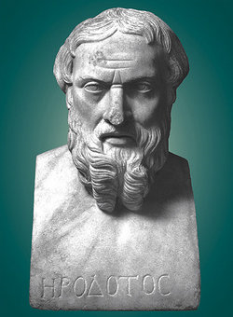
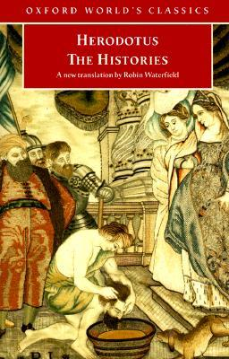
Not a Primary Source
Secondary Source
But Very Very Close!
Historian Herodotus who lived in the 5th Century BC/BCE writes a book called “The Histories” and writes about Ramesses II and the Hittites and the Treaty of Kadesh. He was told this story from an Egyptian on his travels in Egypt. The event (treaty) was not written during his lifetime but over 1000 years earlier.
Is this a primary source?

Slide 13
Primary Sources Secondary Sources Oral Tradition/History
What We Learned
Start Sourcing Activity

