Slide 1
Thematic Essay
U.S. History & Government
Practice for Success

Slide 2
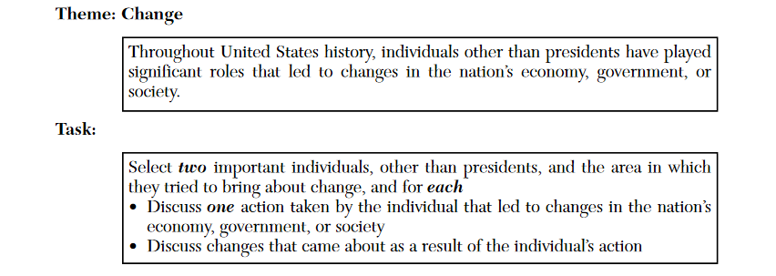
Complete Track “A” or “B” or “C” or ALL as instructed.
Track A: Write a list of possible topics for the essay below.
Track B: Write an Introduction to the essay theme below.
Track C: Write an Outline for the essay theme below.

Slide 3
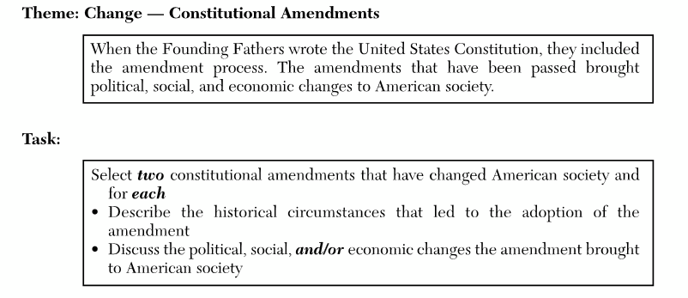
Complete Track “A” or “B” or “C” or ALL as instructed.
Track A: Write a list of possible topics for the essay below.
Track B: Write an Introduction to the essay theme below.
Track C: Write an Outline for the essay theme below.

Slide 4
Complete Track “A” or “B” or “C” or ALL as instructed.
Track A: Write a list of possible topics for the essay below.
Track B: Write an Introduction to the essay theme below.
Track C: Write an Outline for the essay theme below.

Slide 5
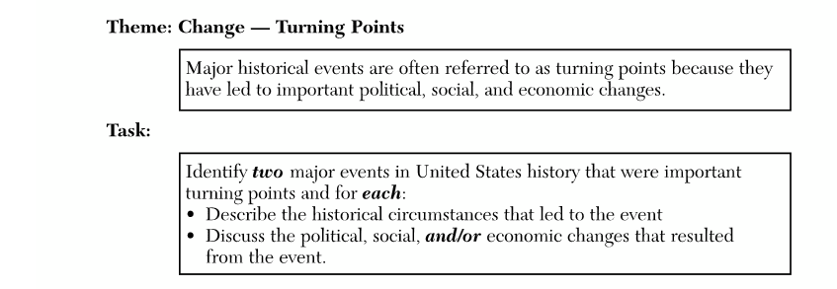
Complete Track “A” or “B” or “C” or ALL as instructed.
Track A: Write a list of possible topics for the essay below.
Track B: Write an Introduction to the essay theme below.
Track C: Write an Outline for the essay theme below.

Slide 6
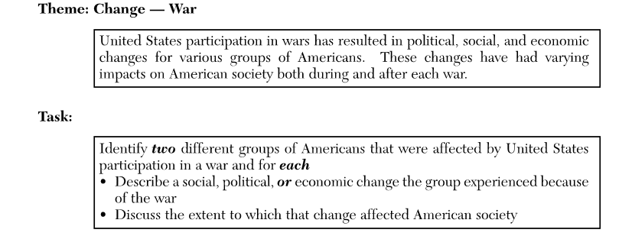
Complete Track “A” or “B” or “C” or ALL as instructed.
Track A: Write a list of possible topics for the essay below.
Track B: Write an Introduction to the essay theme below.
Track C: Write an Outline for the essay theme below.

Slide 7
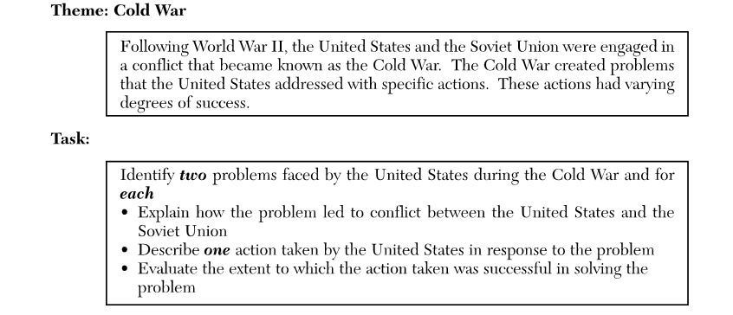
Complete Track “A” or “B” or “C” or ALL as instructed.
Track A: Write a list of possible topics for the essay below.
Track B: Write an Introduction to the essay theme below.
Track C: Write an Outline for the essay theme below.

Slide 8
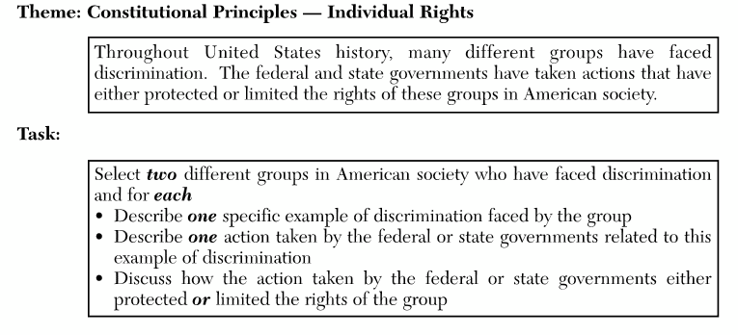
Complete Track “A” or “B” or “C” or ALL as instructed.
Track A: Write a list of possible topics for the essay below.
Track B: Write an Introduction to the essay theme below.
Track C: Write an Outline for the essay theme below.

Slide 9
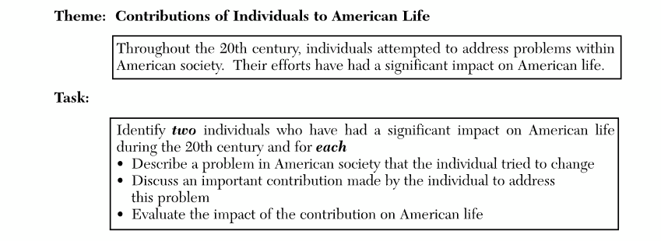
Complete Track “A” or “B” or “C” or ALL as instructed.
Track A: Write a list of possible topics for the essay below.
Track B: Write an Introduction to the essay theme below.
Track C: Write an Outline for the essay theme below.

Slide 10
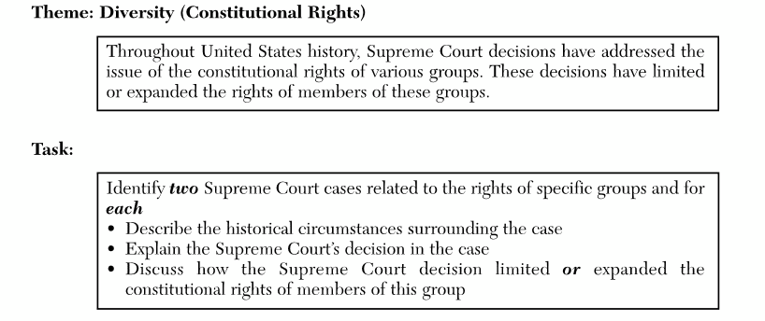
Complete Track “A” or “B” or “C” or ALL as instructed.
Track A: Write a list of possible topics for the essay below.
Track B: Write an Introduction to the essay theme below.
Track C: Write an Outline for the essay theme below.

Slide 11
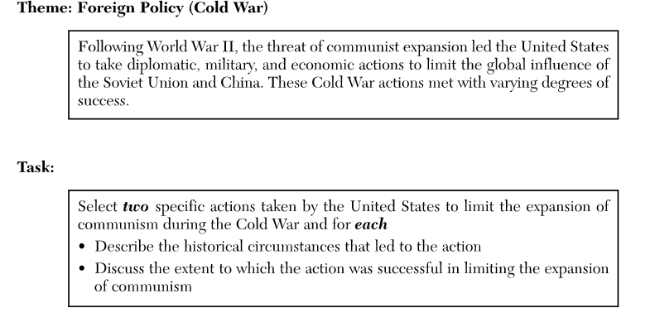
Complete Track “A” or “B” or “C” or ALL as instructed.
Track A: Write a list of possible topics for the essay below.
Track B: Write an Introduction to the essay theme below.
Track C: Write an Outline for the essay theme below.

Slide 12
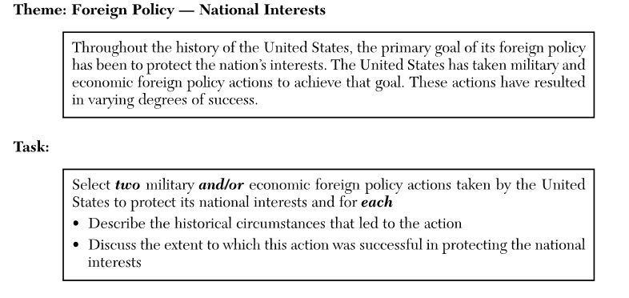
Complete Track “A” or “B” or “C” or ALL as instructed.
Track A: Write a list of possible topics for the essay below.
Track B: Write an Introduction to the essay theme below.
Track C: Write an Outline for the essay theme below.

Slide 13
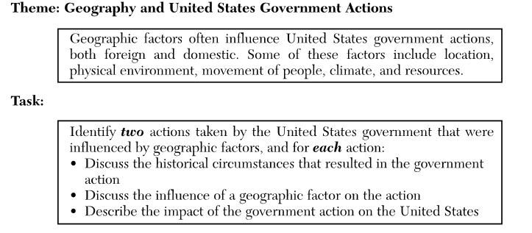
Complete Track “A” or “B” or “C” or ALL as instructed.
Track A: Write a list of possible topics for the essay below.
Track B: Write an Introduction to the essay theme below.
Track C: Write an Outline for the essay theme below.

Slide 14
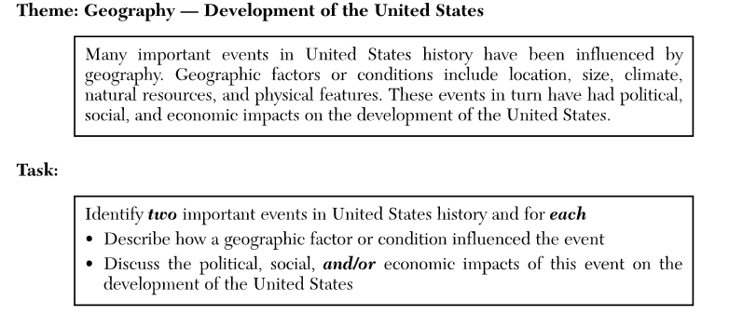
Complete Track “A” or “B” or “C” or ALL as instructed.
Track A: Write a list of possible topics for the essay below.
Track B: Write an Introduction to the essay theme below.
Track C: Write an Outline for the essay theme below.

Slide 15
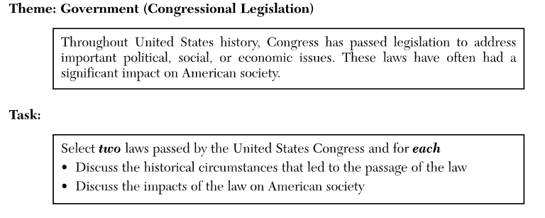
Complete Track “A” or “B” or “C” or ALL as instructed.
Track A: Write a list of possible topics for the essay below.
Track B: Write an Introduction to the essay theme below.
Track C: Write an Outline for the essay theme below.

Slide 16
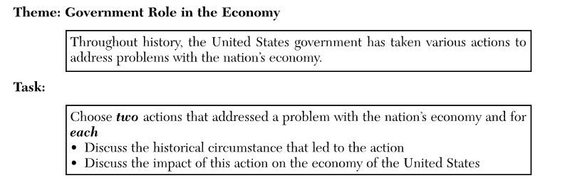
Complete Track “A” or “B” or “C” or ALL as instructed.
Track A: Write a list of possible topics for the essay below.
Track B: Write an Introduction to the essay theme below.
Track C: Write an Outline for the essay theme below.

Slide 17
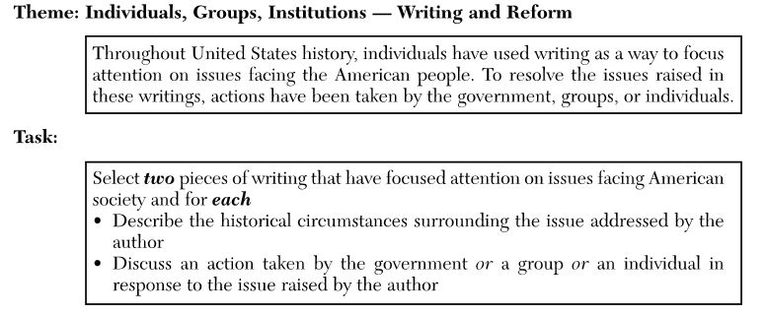
Complete Track “A” or “B” or “C” or ALL as instructed.
Track A: Write a list of possible topics for the essay below.
Track B: Write an Introduction to the essay theme below.
Track C: Write an Outline for the essay theme below.

Slide 18
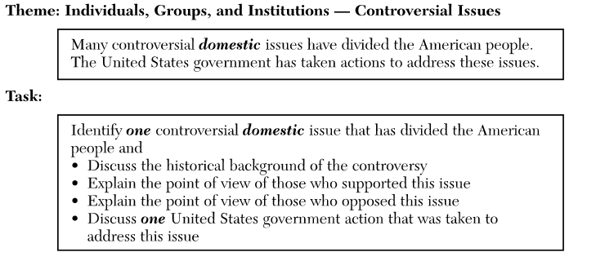
Complete Track “A” or “B” or “C” or ALL as instructed.
Track A: Write a list of possible topics for the essay below.
Track B: Write an Introduction to the essay theme below.
Track C: Write an Outline for the essay theme below.

Slide 19
Complete Track “A” or “B” or “C” or ALL as instructed.
Track A: Write a list of possible topics for the essay below.
Track B: Write an Introduction to the essay theme below.
Track C: Write an Outline for the essay theme below.

Slide 20
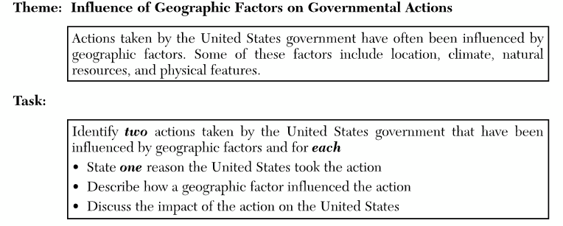
Complete Track “A” or “B” or “C” or ALL as instructed.
Track A: Write a list of possible topics for the essay below.
Track B: Write an Introduction to the essay theme below.
Track C: Write an Outline for the essay theme below.

Slide 21
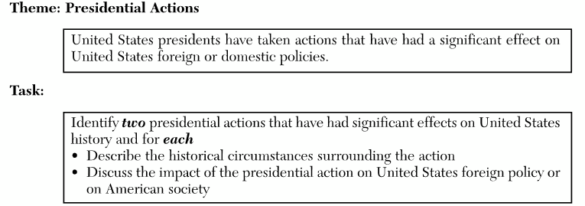
Complete Track “A” or “B” or “C” or ALL as instructed.
Track A: Write a list of possible topics for the essay below.
Track B: Write an Introduction to the essay theme below.
Track C: Write an Outline for the essay theme below.

Slide 22
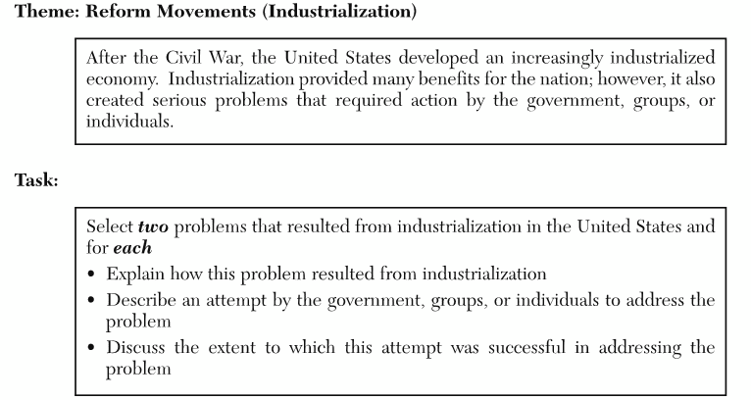
Complete Track “A” or “B” or “C” or ALL as instructed.
Track A: Write a list of possible topics for the essay below.
Track B: Write an Introduction to the essay theme below.
Track C: Write an Outline for the essay theme below.

Slide 23
Complete Track “A” or “B” or “C” or ALL as instructed.
Track A: Write a list of possible topics for the essay below.
Track B: Write an Introduction to the essay theme below.
Track C: Write an Outline for the essay theme below.

Slide 24
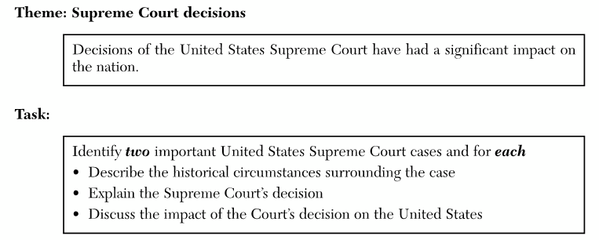
Complete Track “A” or “B” or “C” or ALL as instructed.
Track A: Write a list of possible topics for the essay below.
Track B: Write an Introduction to the essay theme below.
Track C: Write an Outline for the essay theme below.

Slide 25
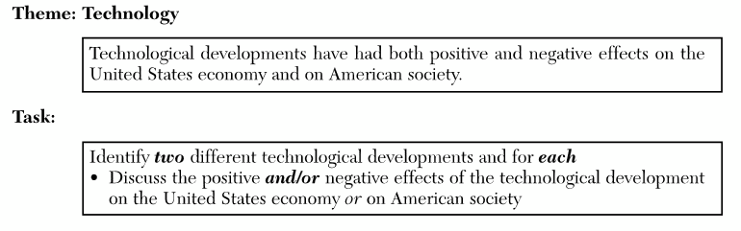
Complete Track “A” or “B” or “C” or ALL as instructed.
Track A: Write a list of possible topics for the essay below.
Track B: Write an Introduction to the essay theme below.
Track C: Write an Outline for the essay theme below.

Slide 26
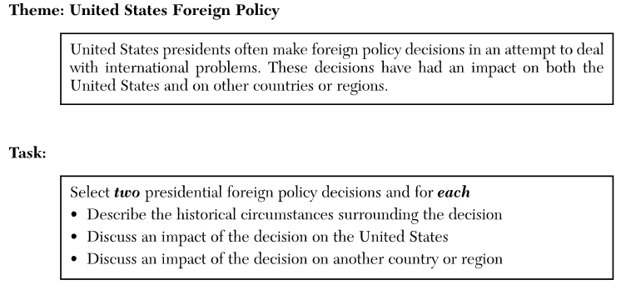
Complete Track “A” or “B” or “C” or ALL as instructed.
Track A: Write a list of possible topics for the essay below.
Track B: Write an Introduction to the essay theme below.
Track C: Write an Outline for the essay theme below.

Slide 27
Complete Track “A” or “B” or “C” or ALL as instructed.
Track A: Write a list of possible topics for the essay below.
Track B: Write an Introduction to the essay theme below.
Track C: Write an Outline for the essay theme below.

Slide 28
Complete Track “A” or “B” or “C” or ALL as instructed.
Track A: Write a list of possible topics for the essay below.
Track B: Write an Introduction to the essay theme below.
Track C: Write an Outline for the essay theme below.

Slide 29
Complete Track “A” or “B” or “C” or ALL as instructed.
Track A: Write a list of possible topics for the essay below.
Track B: Write an Introduction to the essay theme below.
Track C: Write an Outline for the essay theme below.

