Slide 1
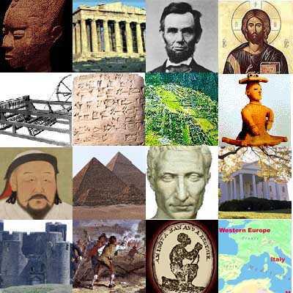
Time Periods & Civilizations
A Journey Through Time

Slide 2
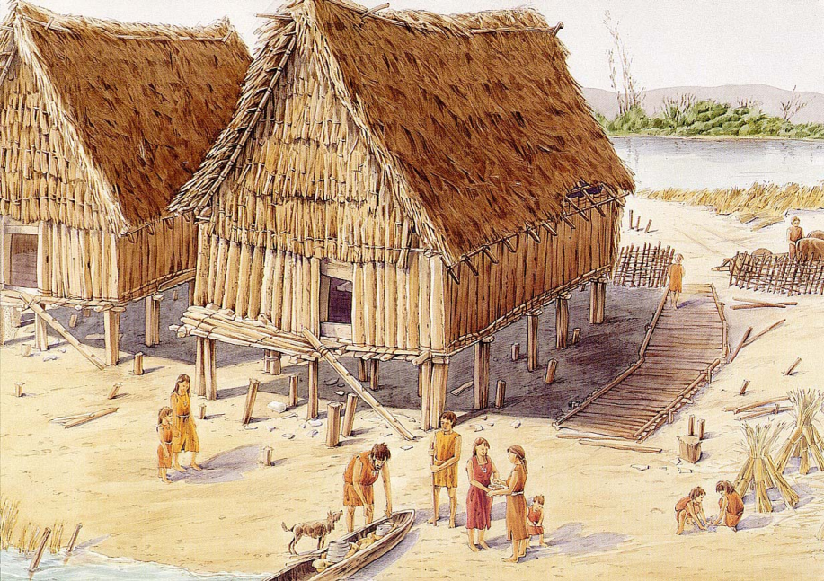
Permanent Settlements
Herding Animals
Surplus for Trade
Farming
Domestication of Plants & Animals
Writing
Job Specialization
Religion
Laws
Organized Government
Record your answer
Neolithic
“New Stone Age”

Slide 3
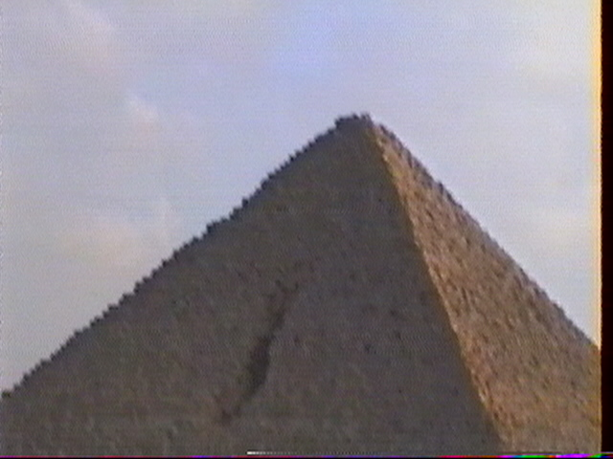
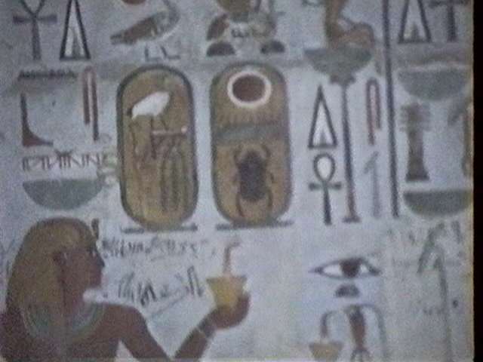
Nile River
Pyramids
Hieroglyphics
Tutankhamun
Pharaohs
Polytheism
Monumental Building
Record your answer
Ancient Egypt

Slide 4
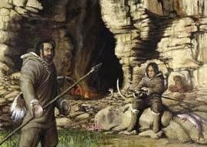
Hunted Animals
Nomadic
Gathered Food
Lived in Caves
Stone Tools
No Writing
No Organized Government
Record your answer
Paleolithic
“Old Stone Age”

Slide 5
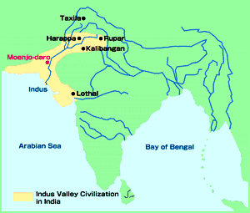
Harappa
Concept of Zero
Moenjo-Dara
Sewer System
City Planning – Grid System
Record your answer
Ancient India
Indus
River Valley Civilization

Slide 6
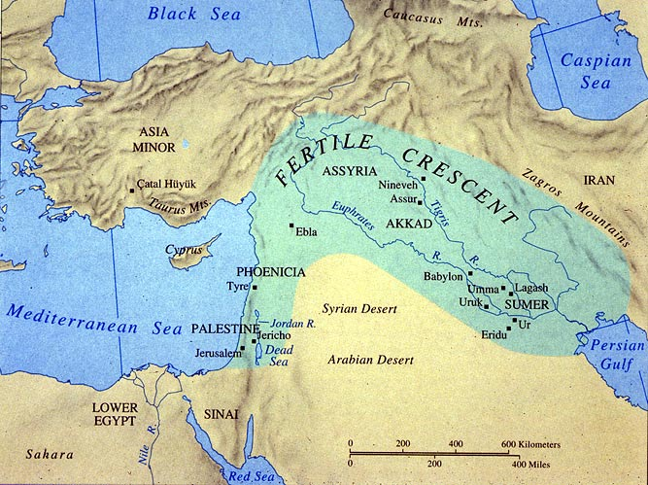
Sumerian Civilization
Babylonians
Euphrates River
Tigris River
Polytheism
Hammurabi Code of Laws
Cuneiform Writing
Ziggurat
Record your answer
Mesopotamia
“The Fertile Crescent”

Slide 7
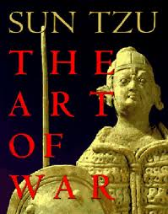
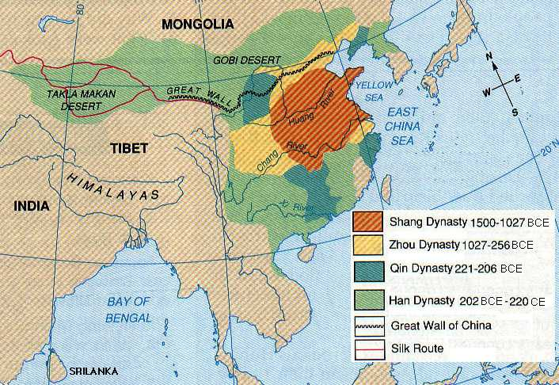
Yellow River
Shi Huangdi
Gunpowder
Compass
Chin Dynasty
Sun Tzu – “The Art of War”
Zhou Dynasty
Han Dynasty
Record your answer
Ancient China

