Slide 1
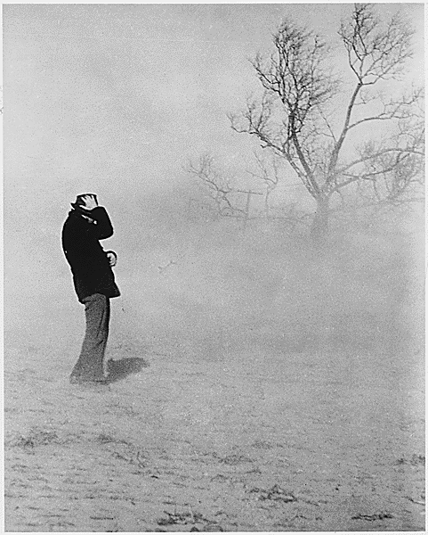
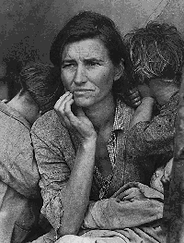
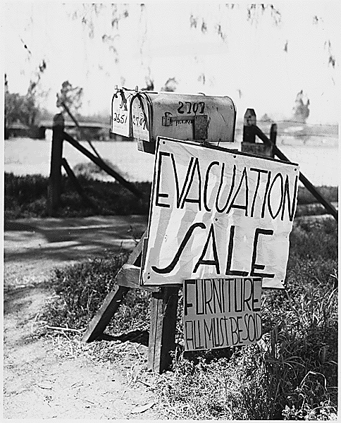
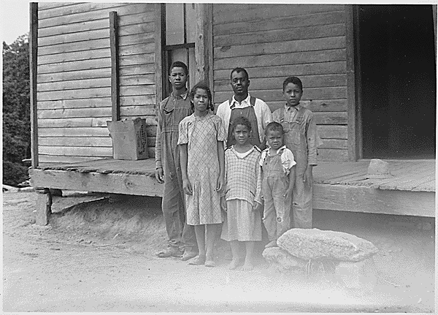
The Great Depression
Aim: What were the social affects of the Great Depression.
Do Now: Quiz – You have 5-7 Minutes.

Slide 2
What about the people?
Farmers were already feeling the effects
  Prices of crops went down
  Many farms foreclosed
People could not afford luxuries
  Factories shut down
  Businesses went out
Banks could not pay out money
People could not pay their taxes
  Schools shut down due to lack of funds
Many families became homeless and had to live in shanties

Slide 3
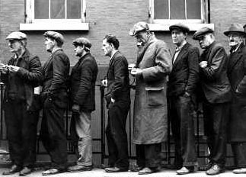
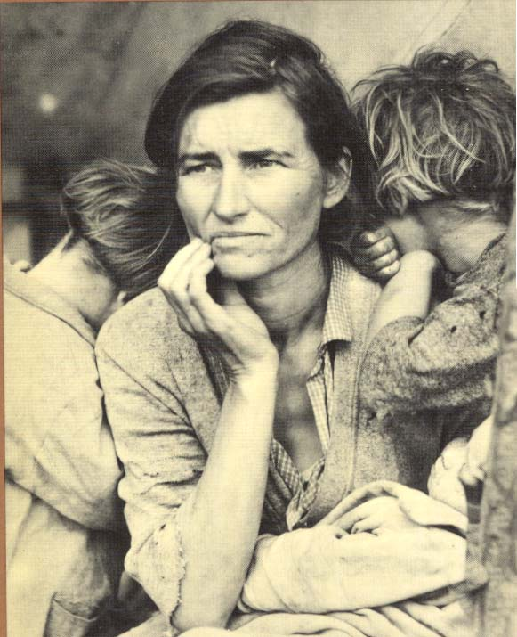
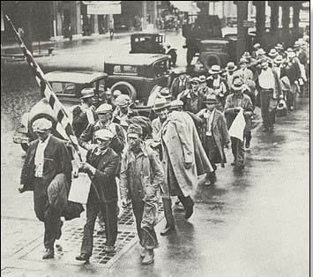


Slide 4
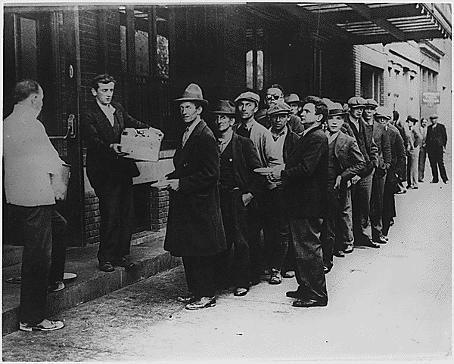
People in cities would wait in line for bread to bring to their family.

Slide 5
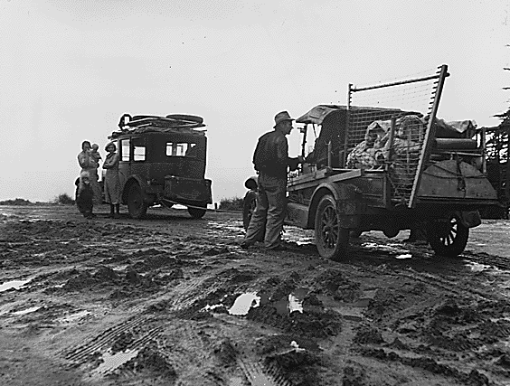
Some families were forced to relocate because they had no money.

Slide 6
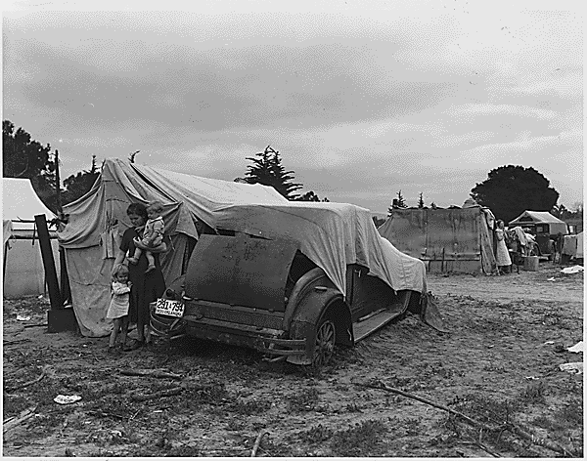
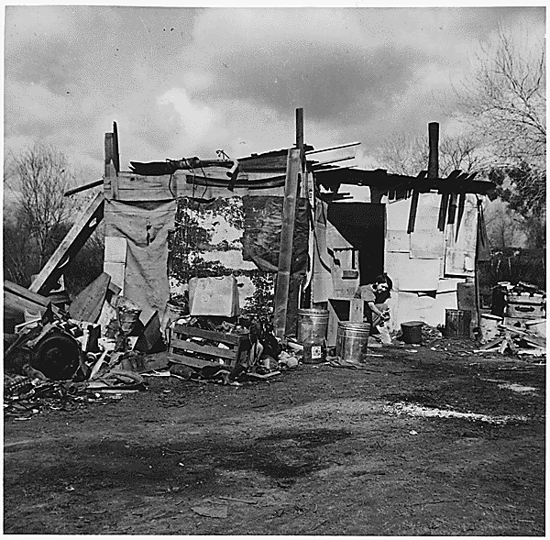
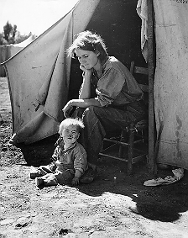
“Hooverville”
Some families were forced to live in shanty towns
  A grouping of shacks and tents in vacant lots
They were referred to as “Hooverville” because of President Hoover’s lack of help during the depression.

Slide 7
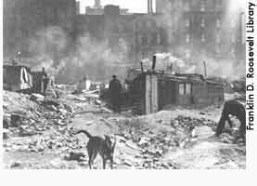
Hooverville

Slide 8
A drought in the South lead to dust storms that destroyed crops.
“The Dust Bowl”

Slide 9
The South Was Buried
Crops turned to dust=No food to be sent out
Homes buried
Fields blown away
South in state of emergency
Dust Bowl the #1 weather crisis of the 20th century

Slide 10

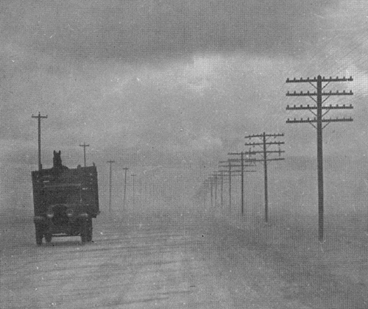
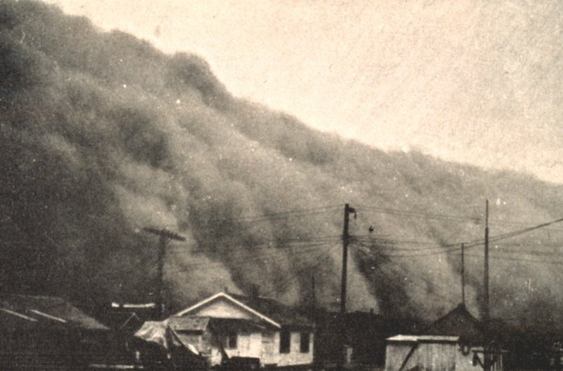
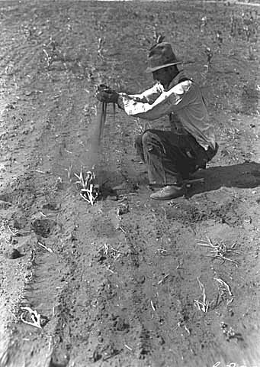
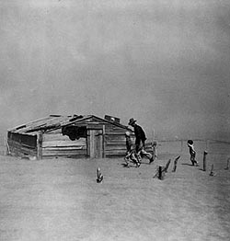
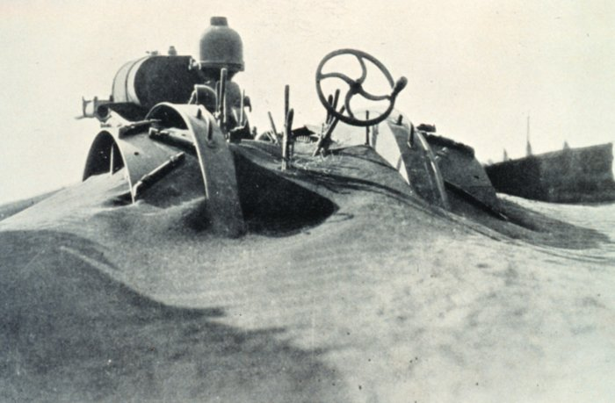

Slide 11


Slide 12
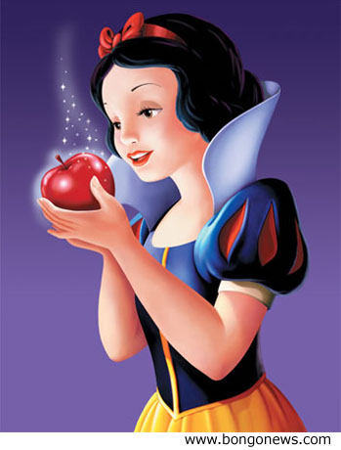
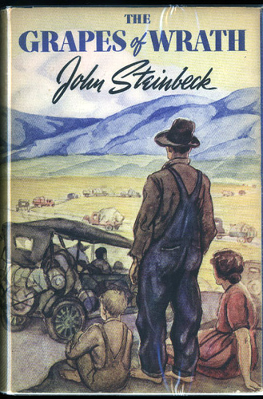
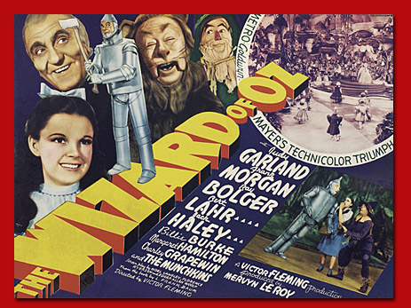
Social affects of the Great Depression
Escaping the Depression
Radio- Comedies, Soap Operas
Movies- Shirley Temple, Child Actors
  Snow White (first full-length animation)
  Wizard of OZ - Small girl escaping the Dust Bowl
Optimistic Voices: "You're out of the woods, You're out of the dark, You're out of the night, Step into the sun, Step into the light.“
Literature
Steinbeck, Grapes of Wrath -About a
family of ‘Okies’ escaping the Dust Bowl
and how horribly they were treated

Slide 13


