Slide 1
Constitutional Government in
England /Great Britain
AIM: How does constitutional government develop in England/Great Britain?
Do Now: What prevents the police from coming into your apartment/house in the middle of the night, pulling you out of your bed and executing you in the street? Explain in detail in your notebooks.

Slide 2
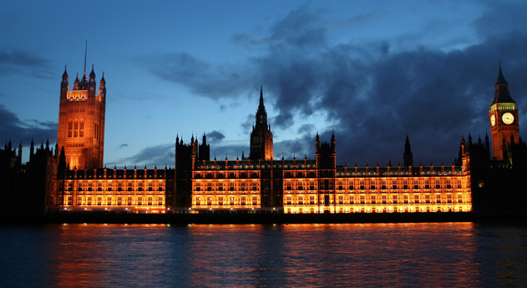
Background:
The government of Great Britain has developed gradually, so that tradition is a primary source of stability. Think Feudal system.
Great Britain’s constitution is unwritten having evolved from different documents, common law, legal codes, and customs often referred to collectively as the “Constitution of the Crown” (Constitutional Monarchy)
Magna Carta and the English Bill of Rights are central documents in the formation of the British “constitution”

Slide 3
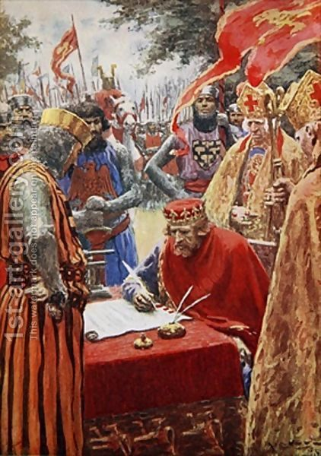
Magna Carta:
Magna Carta (1215) – King John agreed to consult the nobles before he made important decisions, in particular regarding taxes
Limited government – restrictions on the monarch began with the Magna Carta

Slide 4
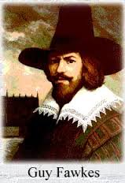
Gunpowder Plot:
Gunpowder Plot (1605) – a conspiracy to blow up James I & members of parliament by planting explosives under the Houses of Lords. Nov 5th
Guy Fawkes is arrested, convicted, and executed by James I.
Known and celebrated in the UK as “Guy Fawkes Day” to celebrate the discovery of the plot and James I who lived.

Slide 5

6m

Slide 6
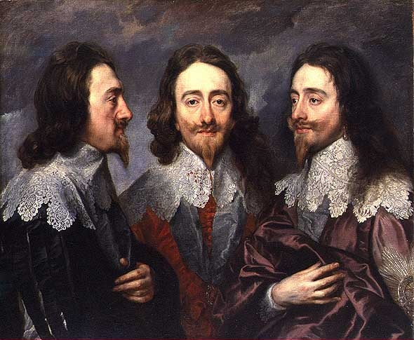
Petition of Rights:
The Petition of Rights, 1628
In return for money to fund his wars, against France & Spain, King Charles I agreed:
  No imprisonment without due cause.
  No taxation without Parliament’s consent.
  No putting soldiers in private homes.
  No martial law during peacetime.
Charles signed it, and then ignored it, dissolving Parliament!

Slide 7
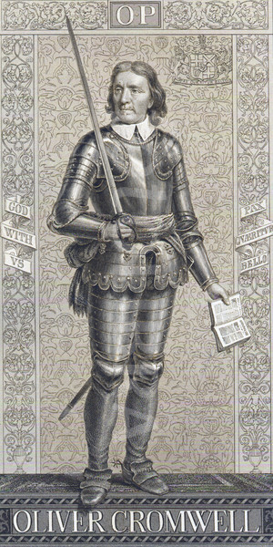
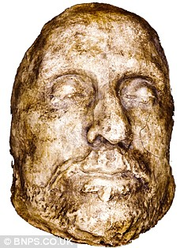
English Civil War:
English Civil War (1640s) – civil war between the supporters of King Charles I and Parliament (Roundheads).
Roundheads won, Charles I is executed
Oliver Cromwell becomes Lord Protector as a dictator until his death.

Slide 8
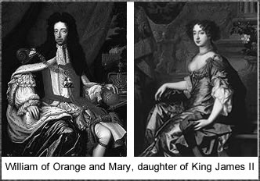
Glorious Revolution:
The Glorious Revolution (1688) – officially established Parliament as the ruling body of Great Britain.
The agreement signed between William & Mary and Parliament was known as the English Bill of Rights
Monarchy is restored, but with limited power by parliament.

Slide 9
English Bill of Rights:
The 1689 English Bill of Rights had a massive influence on the colonies in North America and the Constitution of the United States. The most important Articles of the 1689 English Bill of Rights are as follows:
A frequently summoned Parliament and free elections
Members should have freedom of speech in Parliament
No armies should be raised in peacetime
No taxes could be levied, without the authority of parliament
Laws should not be dispensed with, or suspended, without the consent of parliament
No excessive fines should imposed, nor cruel and unusual punishments inflicted

