Slide 1
An Age
of Nationalism
(1850-1871)

Slide 2
Napoleon III
&
the 2nd French Empire

Slide 3
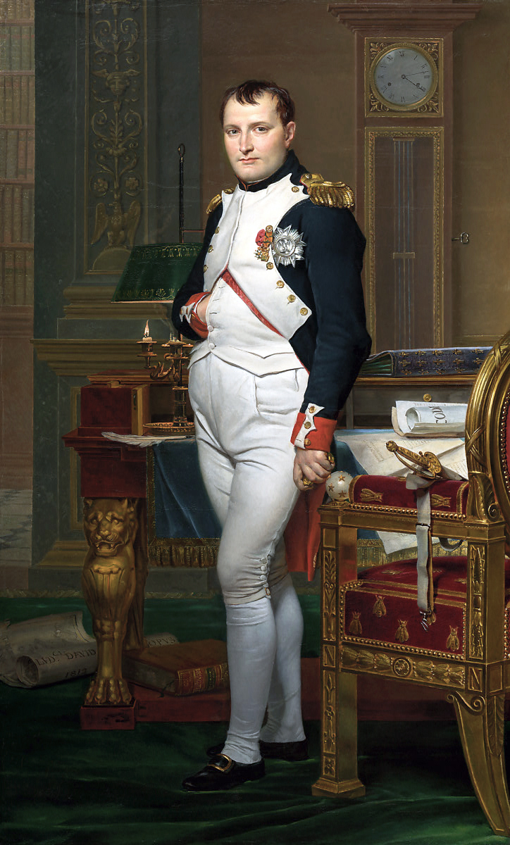
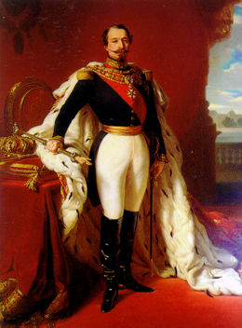
A Tale of Two Napoleons
Napoleon I (r.1804-1815)
Napoleon III (r.1852-1870)

Slide 4
A TALE OF TWO NAPOLEONS | NAPOLEON I | NAPOLEON III
RISE TO POWER
DOMESTIC POLICY
FOREIGN POLICY
DOWNFALL

Slide 5
A TALE OF TWO NAPOLEONS | NAPOLEON I | NAPOLEON III
RISE TO POWER | Coup d’état overthrew Directory (1799); est. himself as emperor after series of plebiscites
DOMESTIC POLICY
FOREIGN POLICY
DOWNFALL

Slide 6
A TALE OF TWO NAPOLEONS | NAPOLEON I | NAPOLEON III
RISE TO POWER | Coup d’état overthrew Directory (1799); est. himself as emperor after series of plebiscites | Coup d’état overthrew 2nd Republic (1851); est. himself as emperor after series of plebiscites w/ universal male suffrage
DOMESTIC POLICY
FOREIGN POLICY
DOWNFALL

Slide 7
A TALE OF TWO NAPOLEONS | NAPOLEON I | NAPOLEON III
RISE TO POWER | Coup d’état overthrew Directory (1799); est. himself as emperor after series of plebiscites | Coup d’état overthrew 2nd Republic (1851); est. himself as emperor after series of plebiscites w/ universal male suffrage
DOMESTIC POLICY | Authoritarian rule preserved legal equality of the French Rev., stabilized the French economy, & improved education; severely limited civil liberties
FOREIGN POLICY
DOWNFALL

Slide 8
A TALE OF TWO NAPOLEONS | NAPOLEON I | NAPOLEON III
RISE TO POWER | Coup d’état overthrew Directory (1799); est. himself as emperor after series of plebiscites | Coup d’état overthrew 2nd Republic (1851); est. himself as emperor after series of plebiscites w/ universal male suffrage
DOMESTIC POLICY | Authoritarian rule preserved legal equality of the French Rev., stabilized the French economy, & improved education; severely limited civil liberties | Used mix of authoritarianism, liberalism, & nationalism to industrialize economy, rebuild Paris, & serve interests of most people
FOREIGN POLICY
DOWNFALL

Slide 9
A TALE OF TWO NAPOLEONS | NAPOLEON I | NAPOLEON III
RISE TO POWER | Coup d’état overthrew Directory (1799); est. himself as emperor after series of plebiscites | Coup d’état overthrew 2nd Republic (1851); est. himself as emperor after series of plebiscites w/ universal male suffrage
DOMESTIC POLICY | Authoritarian rule preserved legal equality of the French Rev., stabilized the French economy, & improved education; severely limited civil liberties | Used mix of authoritarianism, liberalism, & nationalism to industrialize economy, rebuild Paris, & serve interests of most people
FOREIGN POLICY | Military conquests built the Grand Empire and spread the ideals of the French Rev. across the continent
DOWNFALL

Slide 10
A TALE OF TWO NAPOLEONS | NAPOLEON I | NAPOLEON III
RISE TO POWER | Coup d’état overthrew Directory (1799); est. himself as emperor after series of plebiscites | Coup d’état overthrew 2nd Republic (1851); est. himself as emperor after series of plebiscites w/ universal male suffrage
DOMESTIC POLICY | Authoritarian rule preserved legal equality of the French Rev., stabilized the French economy, & improved education; severely limited civil liberties | Used mix of authoritarianism, liberalism, & nationalism to industrialize economy, rebuild Paris, & serve interests of most people
FOREIGN POLICY | Military conquests built the Grand Empire and spread the ideals of the French Rev. across the continent | Imperial endeavors against Austria, in the Crimean War, & in Mexico hurt his prestige at home
DOWNFALL

Slide 11
A TALE OF TWO NAPOLEONS | NAPOLEON I | NAPOLEON III
RISE TO POWER | Coup d’état overthrew Directory (1799); est. himself as emperor after series of plebiscites | Coup d’état overthrew 2nd Republic (1851); est. himself as emperor after series of plebiscites w/ universal male suffrage
DOMESTIC POLICY | Civil Code preserved legal equality of the French Rev. but severely limited civil liberties | Used mix of authoritarianism, liberalism, & nationalism to industrialize economy, rebuild Paris, & serve interests of most people
FOREIGN POLICY | Military conquests built the Grand Empire and spread the ideals of the French Rev. across the continent | Attempted imperial endeavors in Mexico & the Crimean War hurt his prestige at home
DOWNFALL | Nationalistic resistance & survival of Great Britain led to poor foreign policy decisions.

Slide 12
A TALE OF TWO NAPOLEONS | NAPOLEON I | NAPOLEON III
RISE TO POWER | Coup d’état overthrew Directory (1799); est. himself as emperor after series of plebiscites | Coup d’état overthrew 2nd Republic (1851); est. himself as emperor after series of plebiscites w/ universal male suffrage
DOMESTIC POLICY | Civil Code preserved legal equality of the French Rev. but severely limited civil liberties | Used mix of authoritarianism, liberalism, & nationalism to industrialize economy, rebuild Paris, & serve interests of most people
FOREIGN POLICY | Military conquests built the Grand Empire and spread the ideals of the French Rev. across the continent | Imperial endeavors against Austria, in the Crimean War, & in Mexico hurt his prestige at home
DOWNFALL | Nationalistic resistance & survival of Great Britain led to poor foreign policy decisions. | Foreign policy failures culminated in defeat in Franco-Prussian War (1870)

Slide 13
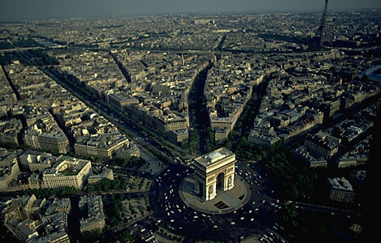
The Reconstruction of Paris
Architect → Baron Georges Haussman

Slide 14
The Crimean War
(1853-1856)

Slide 15
The Crimean War [1853-1856]
Ottoman Empire
Great Britain
France
Piedmont-Sardinia
Russia
Eastern Question: Who would be the chief beneficiaries of the disintegration of the Ottoman Empire?
    Russia → est. protectorate of the Orthodox Christians in the Ottoman Empire
    Austria → craved more land in the Balkans
    France & Britain → commercial opportunities & naval bases in the eastern Mediterranean

Slide 16
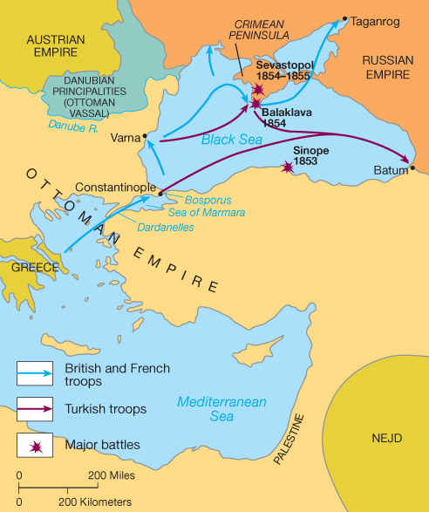
The Crimean War [1853-1856]

Slide 17
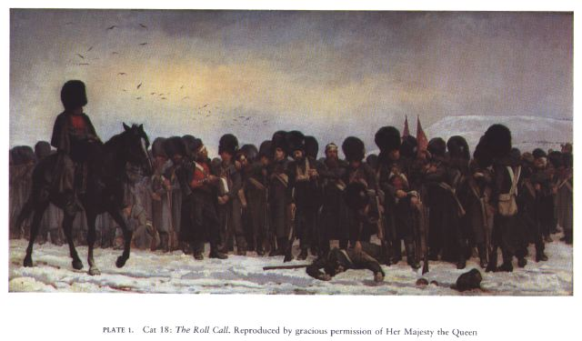

Slide 18
The Crimean War : Results & Legacy
War ended by Treaty of Paris (March 1856)
    No Russian or Ottoman naval forces on the Black Sea
    All major European powers had to respect political integrity of the Ottoman Empire
Legacy
    Destroyed the Concert of Europe & long-standing balance of power
    Russia humiliated & weakened (withdrew from European affairs for next 2 decades)
    Britain pulled back from Continental affairs
    Austria without friends among the great powers
    Work done by British nurse Florence Nightingale saved many lives & helped make nursing a profession of trained, middle-class women

Slide 19
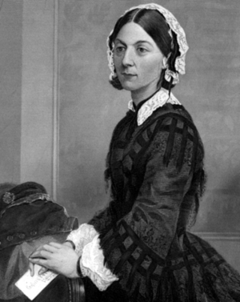
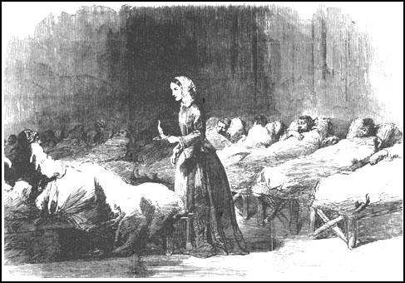
Florence Nightingale [1820-1910]
“The Lady with the Lamp”

Slide 20
Italian
Unification
vs.
German
Unification

Slide 21
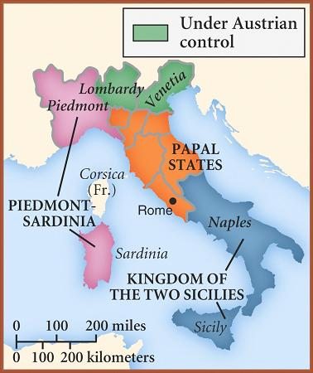
Key Question: How to Unify Italy?
Giusseppe Mazzini → democratic republic
Vincenzo Gioberti → loose federation headed by the pope
Others wanted a strong state to lead unification

Slide 22
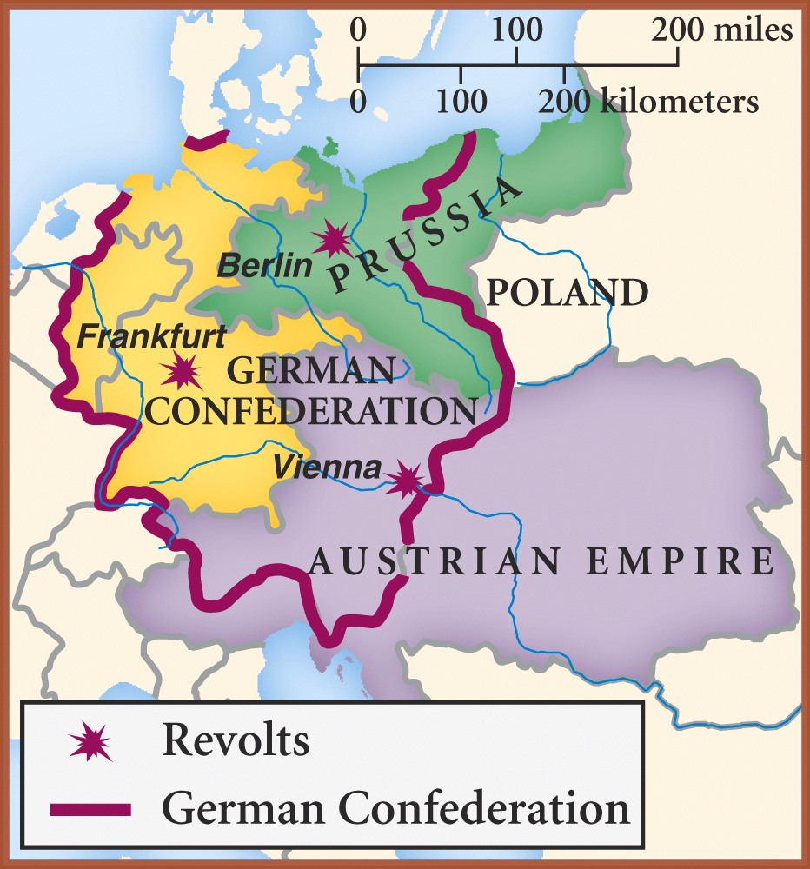
Germany before Unification: An Overview
Zollverein (1834) → German states in economic cooperation; Austria excluded
Prussian leadership won support of business & commercial interests
Prussian King Wilhelm I wanted to strengthen his army
Problem → Parliament rejects military budget (1862)

Slide 23
COMPARING LATE 19th CENTURY UNIFICATION MOVEMENTS | ITALY | GERMANY
KEY PLAYER & STATE
GOAL/PHILOSOPHY
STRATEGY
OUTCOME

Slide 24
COMPARING LATE 19th CENTURY UNIFICATION MOVEMENTS | ITALY | GERMANY
KEY PLAYER & STATE | Camillo di Cavour (Prime Minister, Piedmont-Sardinia)
GOAL/PHILOSOPHY
STRATEGY
OUTCOME

Slide 25
COMPARING LATE 19th CENTURY UNIFICATION MOVEMENTS | ITALY | GERMANY
KEY PLAYER & STATE | Camillo di Cavour (Prime Minister, Piedmont-Sardinia) | Otto Von Bismarck (Prime Minister, Prussia)
GOAL/PHILOSOPHY
STRATEGY
OUTCOME

Slide 26
COMPARING LATE 19th CENTURY UNIFICATION MOVEMENTS | ITALY | GERMANY
KEY PLAYER & STATE | Camillo di Cavour (Prime Minister, Piedmont-Sardinia) | Otto Von Bismarck (Prime Minister, Prussia)
GOAL/PHILOSOPHY | Risorgimento
STRATEGY
OUTCOME

Slide 27
COMPARING LATE 19th CENTURY UNIFICATION MOVEMENTS | ITALY | GERMANY
KEY PLAYER & STATE | Camillo di Cavour (Prime Minister, Piedmont-Sardinia) | Otto Von Bismarck (Prime Minister, Prussia)
GOAL/PHILOSOPHY | Risorgimento | Realpolitik
STRATEGY
OUTCOME

Slide 28
COMPARING LATE 19th CENTURY UNIFICATION MOVEMENTS | ITALY | GERMANY
KEY PLAYER & STATE | Camillo di Cavour (Prime Minister, Piedmont-Sardinia) | Otto Von Bismarck (Prime Minister, Prussia)
GOAL/PHILOSOPHY | Risorgimento | Realpolitik
STRATEGY | Secret diplomacy & well-chosen alliances
OUTCOME

Slide 29
COMPARING LATE 19th CENTURY UNIFICATION MOVEMENTS | ITALY | GERMANY
KEY PLAYER & STATE | Camillo di Cavour (Prime Minister, Piedmont-Sardinia) | Otto Von Bismarck (Prime Minister, Prussia)
GOAL/PHILOSOPHY | Risorgimento | Realpolitik
STRATEGY | Secret diplomacy & well-chosen alliances | “Manufacturing” War (“Blood and Iron”)
OUTCOME

Slide 30
COMPARING LATE 19th CENTURY UNIFICATION MOVEMENTS | ITALY | GERMANY
KEY PLAYER & STATE | Camillo di Cavour (Prime Minister, Piedmont-Sardinia) | Otto Von Bismarck (Prime Minister, Prussia)
GOAL/PHILOSOPHY | Risorgimento | Realpolitik
STRATEGY | Secret diplomacy & well-chosen alliances | “Manufacturing” War (“Blood & Iron”)
OUTCOME | Kingdom of Italy proclaimed (1870); major dissentions & regional differences threaten new nation

Slide 31
COMPARING LATE 19th CENTURY UNIFICATION MOVEMENTS | ITALY | GERMANY
KEY PLAYER & STATE | Camillo di Cavour (Prime Minister, Piedmont-Sardinia) | Otto Von Bismarck (Prime Minister, Prussia)
GOAL/PHILOSOPHY | Risorgimento | Realpolitik
STRATEGY | Secret diplomacy & well-chosen alliances | “Manufacturing” War (“Blood & Iron”)
OUTCOME | Kingdom of Italy proclaimed (1870); major dissentions & regional differences threaten new nation | Second Reich proclaimed (1871); regional differences pose problems for new nation.

Slide 32
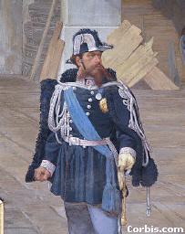
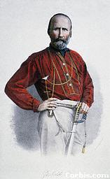
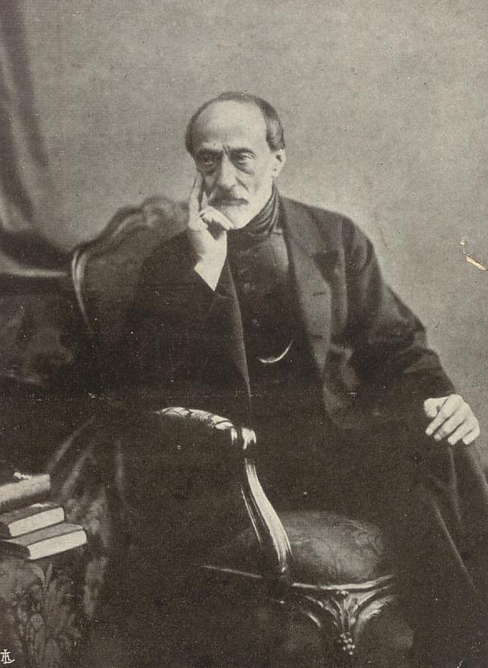
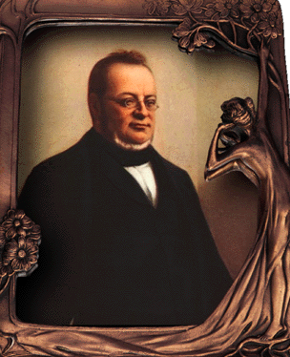
Leaders of the Risorgimento…
King Victor
Emmanuel II
Giuseppi Garibaldi
[The “Sword”]
Count Cavour
[The “Head”]
Giuseppi Mazzini
[The “Heart”]

Slide 33
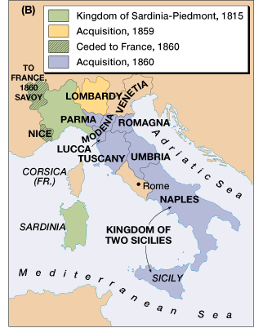
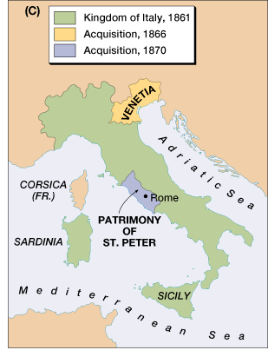
Cavour’s Well-Chosen Alliances
Austro-Sardinian War (1859)→ Napoleon III (France)
Austro-Prussian War (1866) → Otto Von Bismarck (Prussia)
United w/ Garibaldi

Slide 34
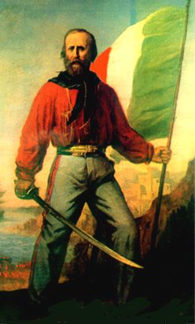
Garibaldi & His “Red Shirts” Unite with Cavour
“I offer neither pay, nor quarters, nor food; I offer only hunger, thirst, forced marches, battles and death. Let him who loves his country with his heart, and not merely with his lips, follow me.”

Slide 35
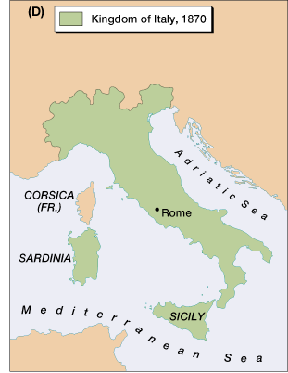
French Troops Leave Rome, 1870
Italy is united!

Slide 36
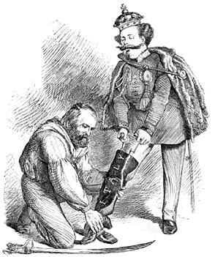
“Right Leg in the Boot at Last”

Slide 37
The Kingdom of Italy: 1871
What problems still remain for Italy?

Slide 38
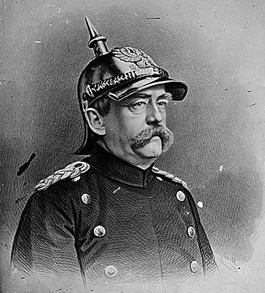
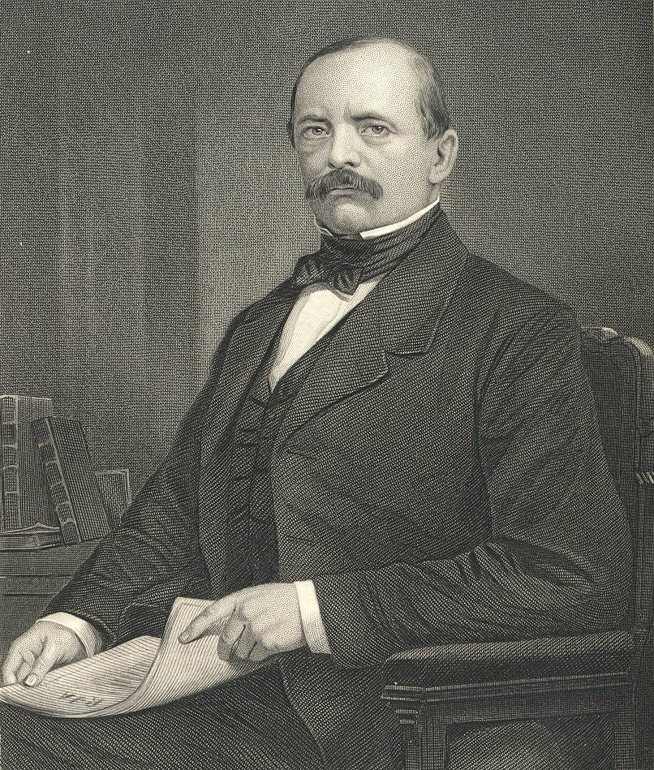
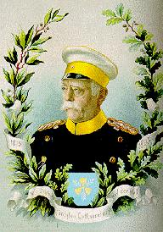
Chancellor Otto von Bismarck
The “Iron
Chancellor”
Realpolitik
“Blood
&
Iron”

Slide 39
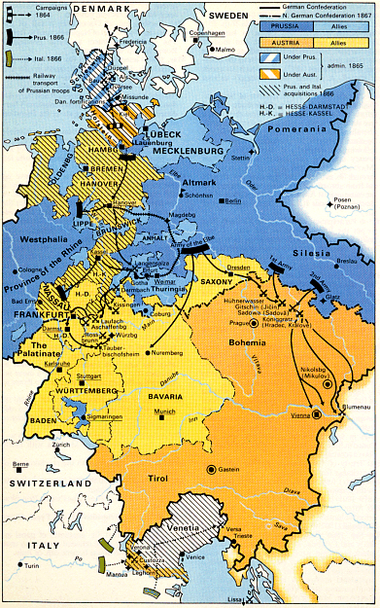
Bismarck’s “Manufactured” Wars
Danish War (1864)→ Prussia gains Schleswig; Austria gets Holstein
Austro-Prussian (Seven Weeks’ War, 1866) → created No. German Confederation
Franco-Prussian War (1870-71) → Rallies So. Germany behind the cause; gains Alsace-Lorraine

Slide 40
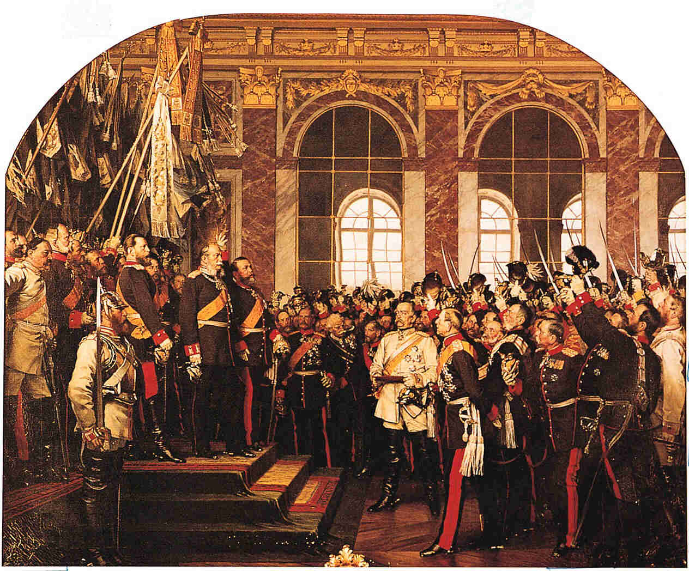
Coronation of Kaiser Wilhelm I
[r. 1871–1888]

Slide 41
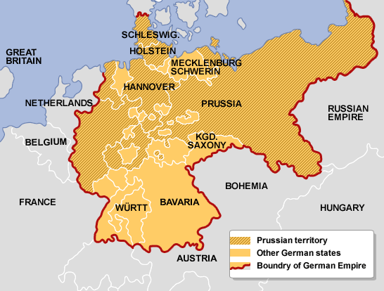
January 18, 1871 → The Second Reich is proclaimed

Slide 42
The wisdom of OVB. . . .
The less people know about how sausages and laws are made, the better they’ll sleep at night.
Never believe in anything until it has been officially denied.
The great questions of the day will not be settled by speeches and majority decisions—that was the mistake of 1848-1849—but by blood and iron.

Slide 43
The Wisdom of OVB (cont.). . . .
I am bored. The great things are done. The German Reich is made.
A generation that has taken a beating is always followed by a generation that deals one.
Some damned foolish thing in the Balkans will provoke the next war.

Slide 44
The Responsive
Nation-States
(1871-1914)

Slide 45
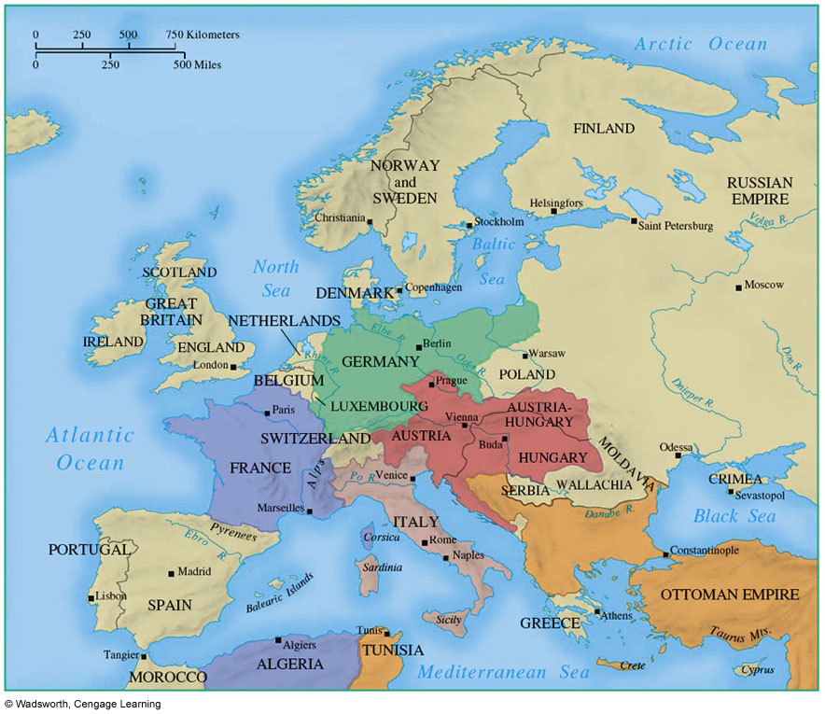

Slide 46

Great Britain

Slide 47

Great Britain (1871-1914)
TYPE OF GOV’T
    Two-party Parliamentary System
HEAD(S) OF STATE
    William Gladstone (Liberal)
    Benjamin Disraeli (Conservative)
    David Lloyd George (Liberal)
KEY REFORM(S)
    2nd Reform Bill (1867)→ extends suffrage to all middle class males & best paid workers
    3rd Reform Bill (1884) → gave vote to almost every adult male
    Extensive social legislation → national health insurance, unemployment benefits, & old-age pensions (1906-1914)
DEFINING ISSUE(S)/PROBLEM(S)
    Home rule for Ireland?
    Women’s suffrage?

Slide 48
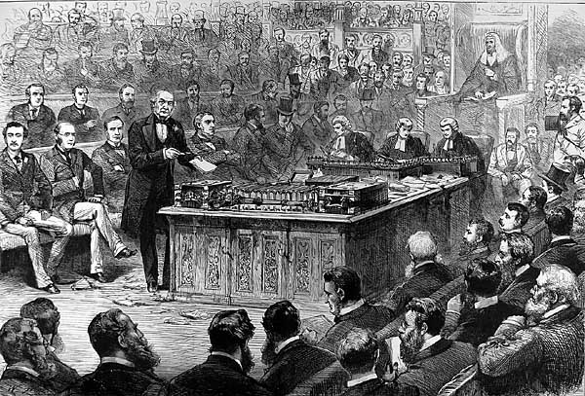
Home Rule for Ireland?
Gladstone debates Home Rule in Commons.

Slide 49
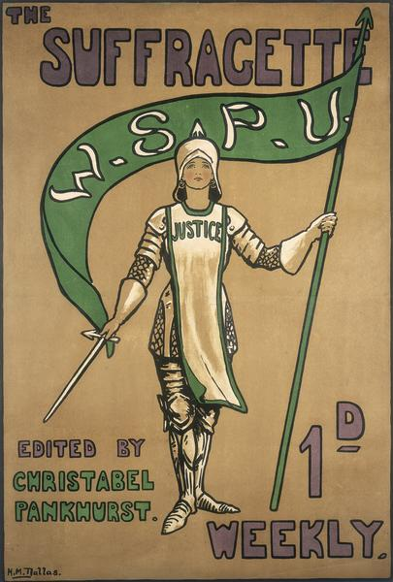
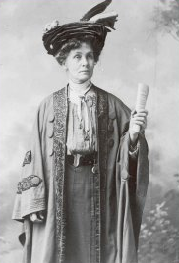
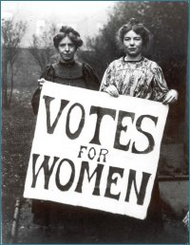
The “Suffragettes”
Emmeline Pankhurst
Women’s Social & Political Union

Slide 50

France

Slide 51

France (1871-1914)
TYPE OF GOV’T
    Republic w/ bicameral legislature (Third Republic)
HEAD(S) OF STATE
    President as chief executive → little political power
    Senate → conservative; blocked progressive legislation
    Prime minister responsible to Chamber of Deputies → elected by universal male suffrage
KEY REFORM(S)
    Legalized trade unions
    Free compulsory elementary education for boys & girls
    Expanded secondary school education
    Gov’t broke off all relations w/ Catholic Church
    Expanded French Empire
DEFINING ISSUE(S)/PROBLEM(S)
    Boulanger Crisis (1887)
    Panama Canal Scandal
    Dreyfus Affair (1895-1906)
    Growing socialist movement

Slide 52
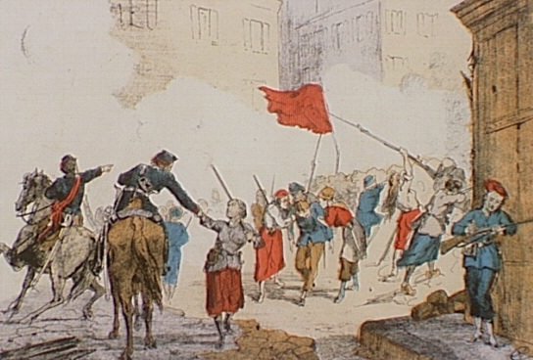
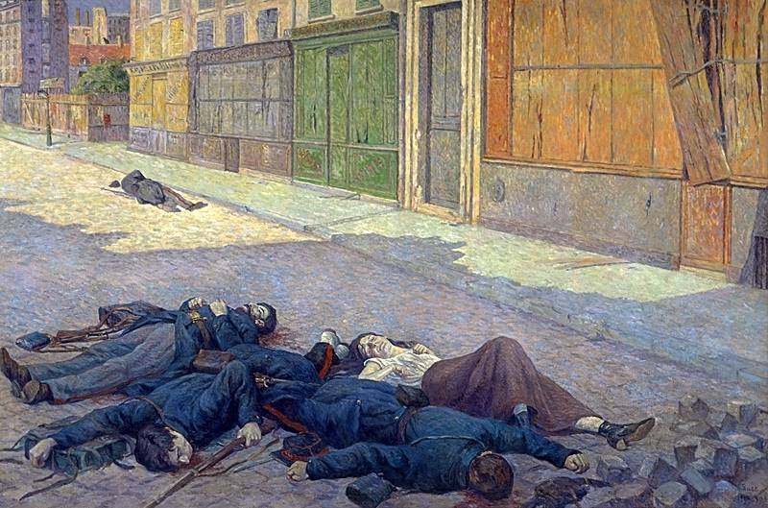
Paris Commune Revolt (1871):
It served as an inspiration
to later revolutionaries like Vladimir Lenin.
25,000 Communards killed.
35,000 were arrested.

Slide 53
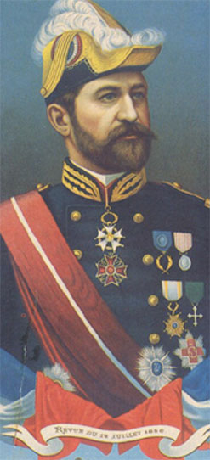
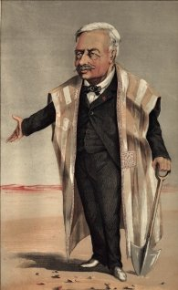
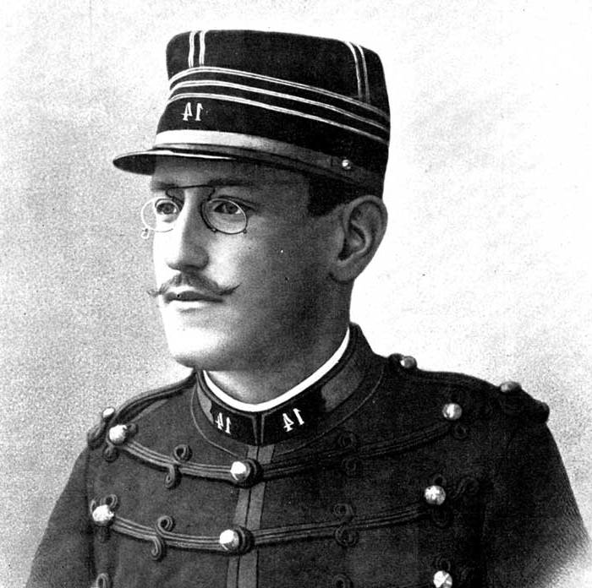
Third Republic Scandals:
Captain Alfred Dreyfus
Ferdinand de Lesseps: Panama Canal Scandal
General Georges Boulanger

Slide 54

Spain

Slide 55

Spain (1871-1914)
TYPE OF GOV’T
    Parliamentary Monarchy
HEAD(S) OF STATE
    King Alfonso XIII
KEY REFORM(S)
    Const. of 1875 → limited suffrage (propertied classes)
    2 Political Parties (Conservatives & Liberals )
DEFINING ISSUE(S)/PROBLEM(S)
    Loss of Cuba & Philippines to U.S.A.
    Social & political unrest → growing socialist & anarchist movements

Slide 56
The Kingdom of Italy

Slide 57
The Kingdom of Italy (1871-1914)
TYPE OF GOV’T
  Constitutional Monarchy
HEAD(S) OF STATE
  King Victor Emmanuel II
  Giovanni Giolitti ( Liberal P.M., 1903-1914)
KEY REFORM(S)
  Trasformismo → use of political/economic bribery to build party coalition
  Social welfare legislation & universal male suffrage (1912)
  Conquered Libya
DEFINING ISSUE(S)/PROBLEM(S)
  Divided loyalties amongst Italians
  Sectional differences → North vs. South
  Catholic Church refused to accept new state
  Corrupt & unmanageable politics

Slide 58
German Empire

Slide 59
German Empire (1871-1914)
TYPE OF GOV’T
  Federal Empire
HEAD(S) OF STATE
  Kaiser → emperor (Wilhelm I & Wilhelm II)
  Chancellor → Prime minister (Bismarck until 1890)
  Parliament → Reichstag (universal male suffrage)
KEY REFORM(S)
  Bismarck centralizes empire
  Most far-ranging social welfare measures → Social Security, National sickness & accident insurance
  Jews gain legal equality → restrictions on gov’t employment
DEFINING ISSUE(S)/PROBLEM(S)
  Kulturkampf → Bismarck’s attack on the Catholic Church
  Anti-socialist laws (1878)→ outlawed Social Democratic Party
  Rapid industrialization & Wilhelm II’s über-militarism
  Growth of the socialist parties

Slide 60
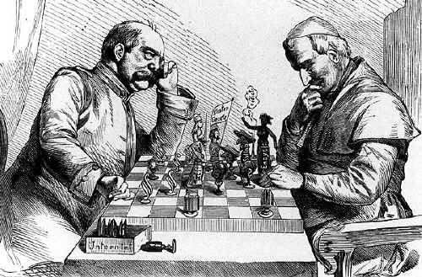
Bismarck’s Kulturkampf:
Bismarck & Pope Leo XIII

Slide 61

The Compromise of 1867:
The Dual Monarchy → Austria-Hungary

Slide 62

Austro-Hungarian Empire (1871-1914)
TYPE OF GOV’T
  Dual-Monarchy (one king wore both crowns)
HEAD(S) OF STATE
  Emperor Francis Joseph I
  Prime ministers that ruled by decree
KEY REFORM(S)
  Hungarians had virtual independence
  Magyarization policies put in place in Hungary
DEFINING ISSUE(S)/PROBLEM(S)
  Nationalities Problem → Ethnic Germans threatened by Slavs → Hungarians faced resentment from minorities

Slide 63
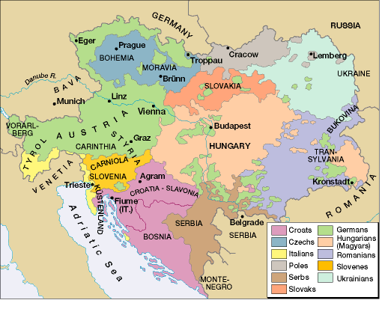
Differing Nationalities in the
Austrian Empire

Slide 64
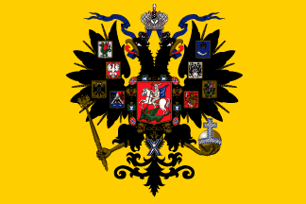
Russian Empire

Slide 65
Russian Empire (1871-1914)
TYPE OF GOV’T
  Autocratic (absolute) Monarchy
HEAD(S) OF STATE
  Alexander II (1855-1881)
  Alexander III (1881-1894)
  Nicholas II (1894-1917
KEY REFORM(S)
  Abolition of serfdom (1861) → land given to village communities
  New local assemblies (zemstovs) elected by towns, peasant villages & nobles
  Encouraged industrialization → finance minister Sergei Witte
DEFINING ISSUE(S)/PROBLEM(S)
  Alexander III’s “exceptional measures” → eliminated mass politics
  Breeding ground for radicalism (esp. anarchists)
  Militarily & industrially backward → defeated in Russo-Japanese War (1904-05)
  Heterogeneous empire → political unrest led to Revolution of 1905

Slide 66
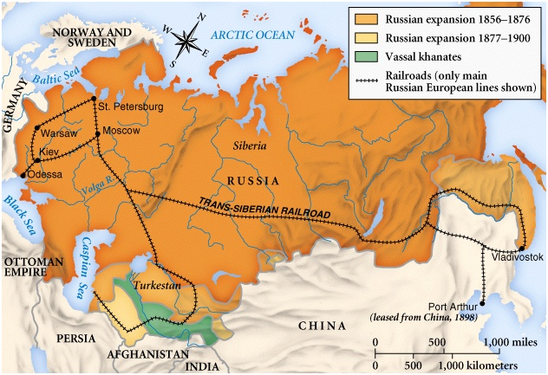
Russian Expansion
A heterogeneous empire

Slide 67
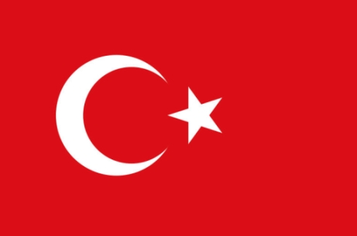
Ottoman Empire

Slide 68
Ottoman Empire (1871-1914)
TYPE OF GOV’T
    Absolute monarchy
HEAD(S) OF STATE
    Sultan Mahmud III
    Sultan Abdulhamid II
KEY REFORM(S)
    Destroyed Janissary Corps
    Tanzimat (1839) → equality before the law for Muslims, Christians & Jews; western education; liberalization of commercial laws
DEFINING ISSUE(S)/PROBLEM(S)
    Religious conflict
    Relied on Great Powers to keep empire together
    Abdulhamid II’s repressive regime breeds unrest

Slide 69
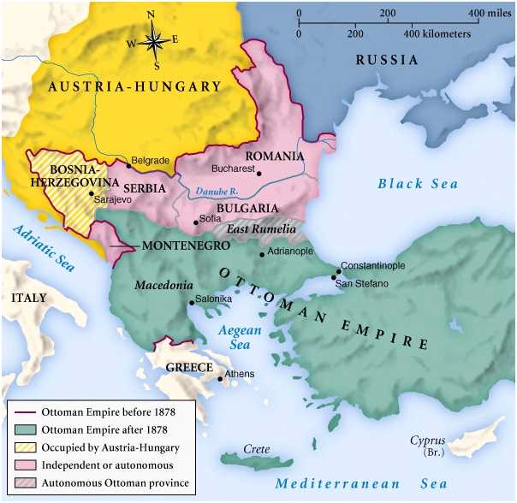
The Ottoman Empire -- Late 19^{c}
“The Sicker Man of Europe”

