Slide 1
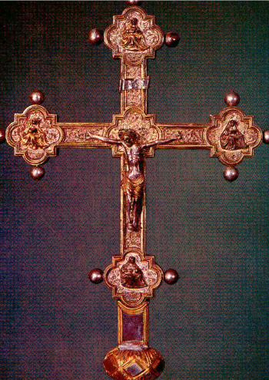
The Counter-Reformation
AIM: What was the reaction to the Protestant Reformation by the Roman Catholic church?
Or
The Roman Catholic Church
Strikes Back!!
Do Now:

Slide 2
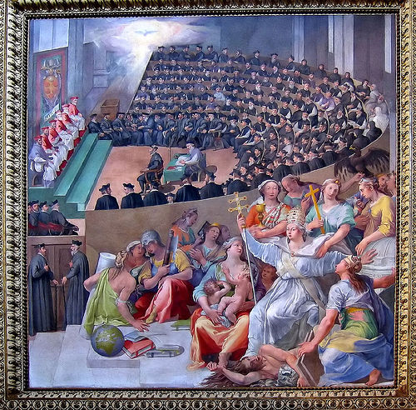
1545 - Council of Trent
Met over 17 years
Determined what was heresy (against church teachings)
Reaffirmed what was Church teachings
Launched the Inquisition, and the Jesuits

Slide 3
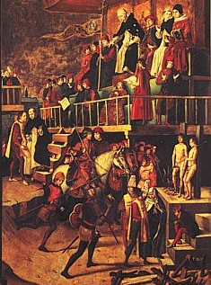
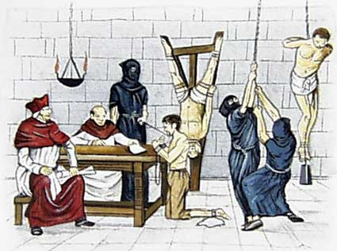
The Spanish Inquisition
Pope Sixtus IV signs the Papal Bull in 1478, which gives Spain the right to start the Inquisition.

Slide 4
The Inquisition
Roman Inquisition
1542, to counter Reformation, church established church court
Roman Inquisition tried people accused of being Protestants, of practicing witchcraft, of breaking church law
Spanish Inquisition
Spanish monarchs set up, controlled much harsher Spanish Inquisition, 1478
Used Inquisition to impose religious uniformity, especially on converted Jews, Muslims, later on Protestants
Abuse of Church’s Power
Church tried to stamp out rebellion through Index of Forbidden Books
Church warned reading these books would cause people to lose souls
Accounts of torture, executions by courts damaged church’s image

Slide 5

The Spanish Inquisition
King Ferdinand & Queen Isabella sent Columbus on his trip.
Estimated that between 3000-5000 people were killed by the state.
They were tortured & killed after a trial and convicted of heresy.

Slide 6
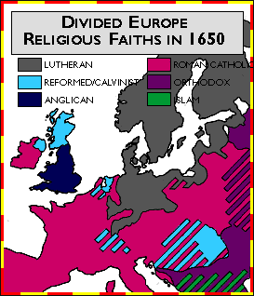
THE PROTESTANT REFORMATION
& COUNTER-REFORMATION
ENDED CHURCH UNITY IN WESTERN EUROPE
Lasting Result

Slide 7
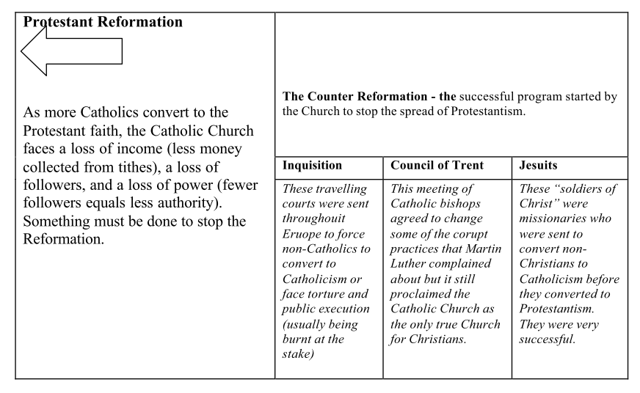
Successful

