Slide 1

Nazi Racism
The Foundations of
The belief that the Aryan race is superior to other sub-races.

Slide 2
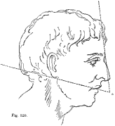
Scientific Racism Before 1933 & Nazification (Bn)
Linnaeus – 4 Groups Based on Skin Color (1758)
Blumenbach – 5 Groups Based on Biological Traits (1781)
Camper – Used Facial Angles to Determine (1722-1789)
de Gobineau – Superiority of Aryans (1853)
Darwin – Origin of Species (1859)
Nott – Types of Mankind (1850-60’s)
Lemark – Theorized Acquired Traits / Passed On Through Offspring (1809)
Lombrosso – Criminal Man Atlas (1876)
Galton - Conclusion: Genius & Talent Were Hereditary (1822-1911)
All Are Factors & Precursors for Nazi Racism

Slide 3
The Racial Players
Hans K.F. Gunter Short Ethnology of the German People (1929) | Ludwig Ferdinand Clauss The Nordic Soul (1932)
Alfred Rosenberg (Dietrich Eckart) The Earth-Centered Jew Lacks a Soul (1928) | Jakob Graf Heredity & Racial Biology for Students (1935)
Paul Brohmer The New Biology: Training in Racial Citizenship (1933) | Erich Ristow To Preserve the Strength of Race: Compulsory Sterilization (1935)

Slide 4
Jakob Graf Heredity & Racial Biology for Students (1935)
Nazi Student Assignments: (Mosse: pg 80) – 14 Points
Summarize the spiritual characteristics of the individual races.
What are the expressions, gestures, and movements which allow us to make conclusions as to the attitude of the racial soul.
Determine the physical features which go hand in hand with the specific racial soul characteristics of the individual figures.
When viewing monuments, busts, etc., be sure to pay attention to the race of the person portrayed with respect to the figure, bearing and physical characteristics.
Observe the Jew: his way of walking, his bearing, gestures, and movements when talking.

Slide 5
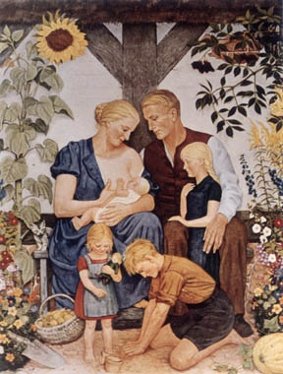
The Nazi racial stereotypical Aryan family reinforced in art. From a painting by Wolf Willrich.

Slide 6
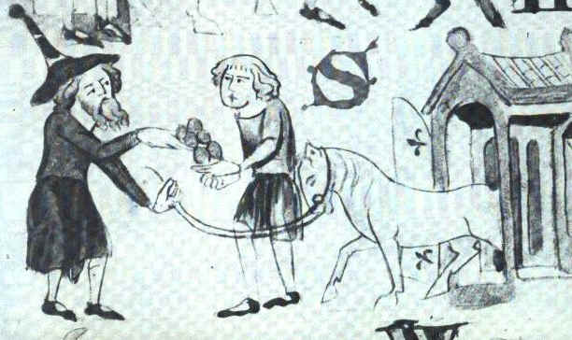
A Jew trading with a Christian, from the Dresden Sachsenspiegel, 1220

Slide 7
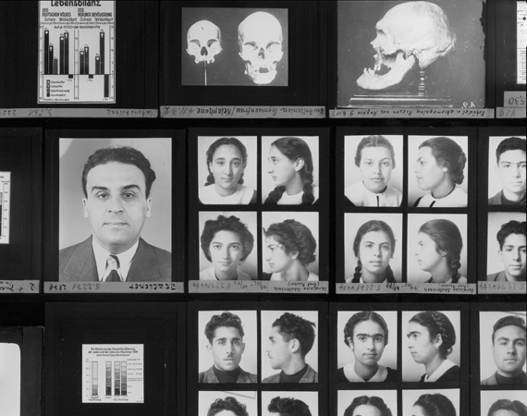

Slide 8
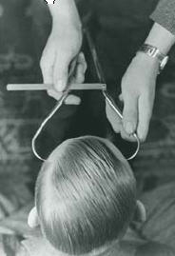
A Nazi racial hygienist measures the forehead of a young man to determine his "race", 1937
Courtesy of USHMM Photo Archives Washington, D.C.

Slide 9

“The Eternal Jew" is the most famous Jewish Nazi propaganda film. It depicts the Jews of Poland as corrupt, filthy, lazy, ugly, and perverse. They are an alien people which have taken over the world through their control of banking and commerce, yet which still live like animals.
http://www.holocaust-history.org/der-ewige-jude/

Slide 10

This quotation from Hitler's 30 January 1939 speech promises the destruction of the Jews. It appeared in September 1941, after the invasion of the Soviet Union, and during the opening stages of the Holocaust. The translation: "If International Finance Jewry should succeed once more in plunging the peoples into a world war, the result will not be the victory of Jewry, but rather the destruction of the Jewish race in Europe."
http://www.calvin.edu/academic/cas/gpa/ws.htm

Slide 11
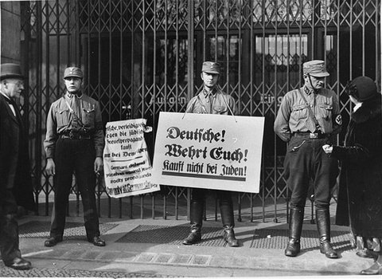
Nazi storm troopers block the entrance to a Jewish-owned store in Berlin. Their signs read: "Germans, defend yourselves against the Jewish atrocity propaganda, buy only at German shops!" and "Germans, defend yourselves, buy only at German shops!"
http://www.historyplace.com/worldwar2/holocaust/h-boycott.htm

Slide 12
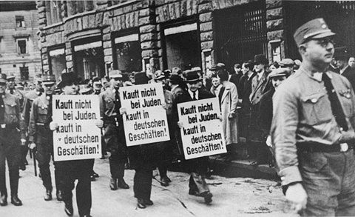
Nazis force three Jewish businessmen to march down Bruehl Strasse, one of the main commercial streets in central Leipzig, carrying signs that read: "Don't buy from Jews; Shop in German businesses!"
http://www.historyplace.com/worldwar2/holocaust/h-boycott.htm

Slide 13
Activity
Write Some Characteristics of the Following Groups
Jews
Homosexuals
Handicapped
Gypsies
Aryans (Germans)

Slide 14
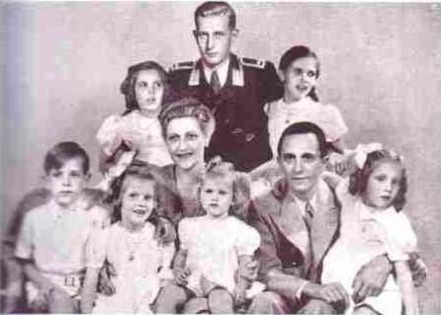
NAZI or Victim ?
Paul Joseph Goebbels (Propoganda Minister), Magda (wife) & Their Children with Magda’s Son From a Previous Marriage
NAZI

Slide 15
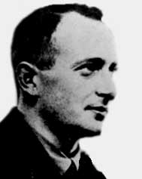
NAZI or Victim ?
Otto Adolf Eichman
NAZI

Slide 16
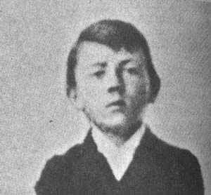
NAZI or Victim ?
Adolf Hitler
#1 NAZI

Slide 17
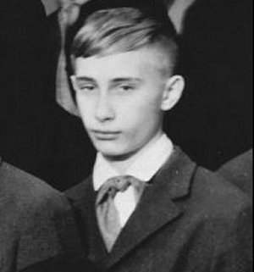
NAZI or Victim ?
Vladmir Putin
Current President of Russia
RUSSIAN

