Slide 1

English Constitutional Monarchy
Aim: How did Limited Monarchy develop in England?
Do Now: What prevents the police from coming into your apartment/house in the middle of the night, pulling you out of your bed and executing you in the street?

Slide 2
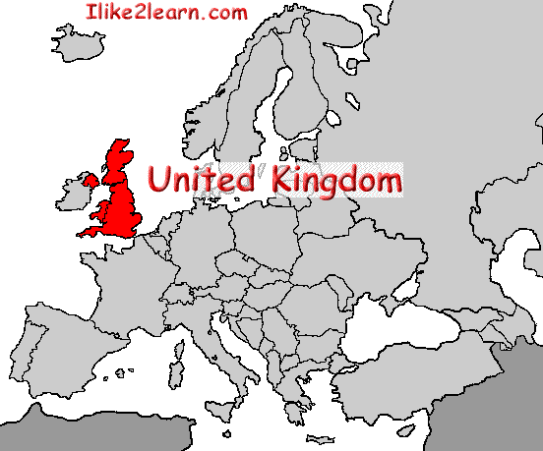
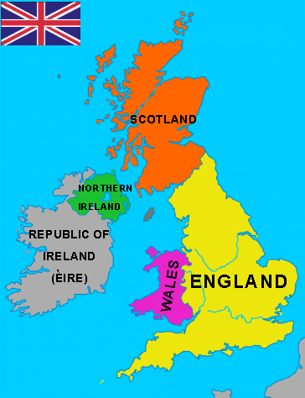
Geography
England, Scotland, Wales, Northern Ireland = United Kingdom (1803)
Island Nation – Protected by Rough Seas and English Channel from European Continent

Slide 3
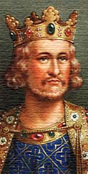
Could the rich control the king?
Around the picture below, you can read some of the qualities which medieval people expected their king to have!
Which three are the most important for a medieval king?
A good judge of character
Rich – but not greedy!
Fit and strong
A good soldier
God fearing
Inspiring!
Brave
Hardworking
Wise
Firm – but fair!

Slide 4
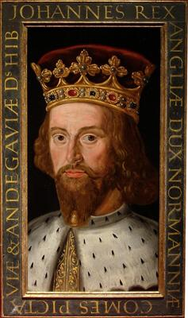
King John
He is famous as Prince John in make believe stories of Robin Hood.
In the stories he is a wicked and foolish prince who taxes the people of England unfairly.

Slide 5
King John ruled England from 1199 to 1216. He faced the following problems:
CHURCH
John disagreed with the Pope about how to run the Church. From 1208 until 1213, the Pope banned all church services in England and English people feared that they would all go to HELL! Some Church leaders blamed John for the trouble
LOST WARS
John went to war twice against the French king. His army was badly beaten both times. He lost almost all the land that his father had gained in France!
RAISED TAXES
John raised taxes in England to pay for the wars. This upset his BARONS! He ordered them to pay far more tax than earlier kings had done!

Slide 6
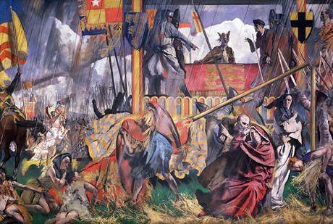
In 1214 many barons rebelled against John. They believed that he could not rule the country properly and was treating them unfairly.
In 1215, they surrounded the King’s Army on a field at Runnymede & forced him to sign the Magna Carta.

Slide 7
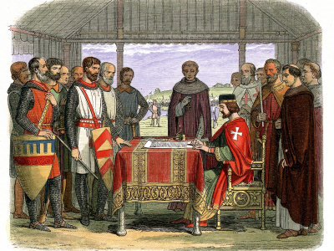
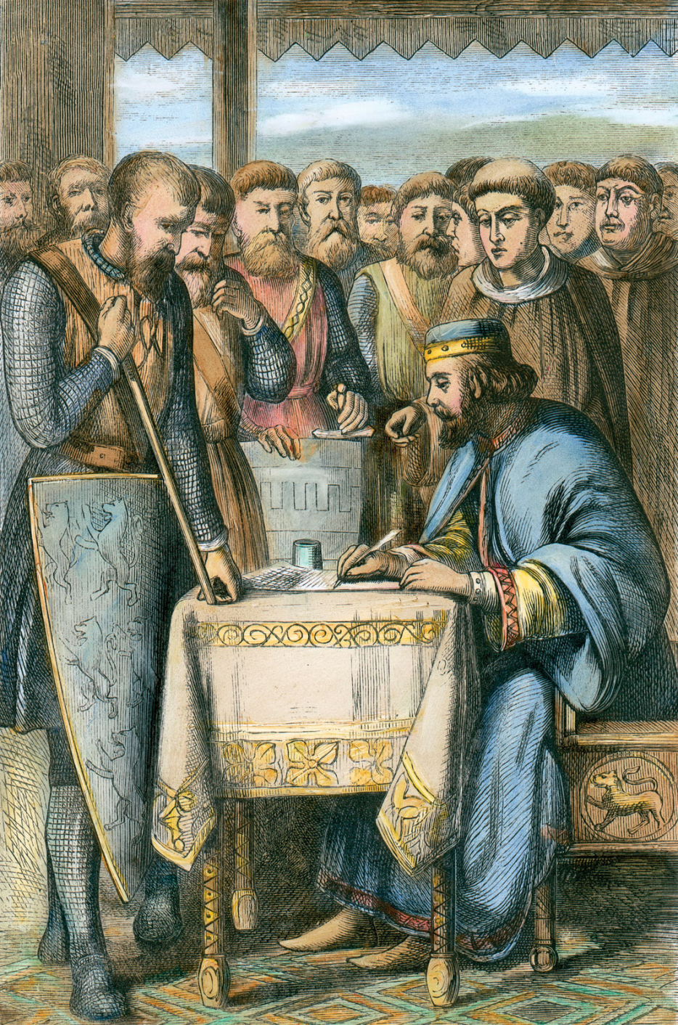
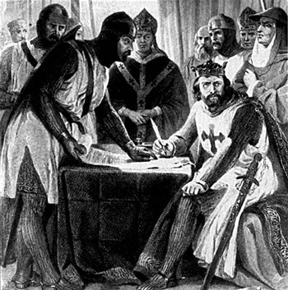

Slide 8
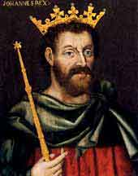
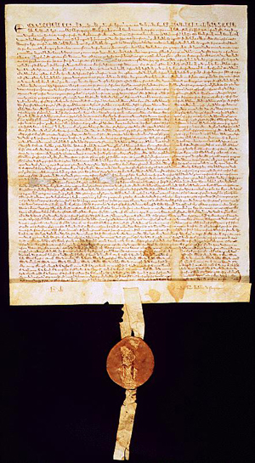
Magna Carta, 1215
King John I forced to accept it.
A list of demands made by the nobility.
Created a CONTRACT between the king and the aristocracy.
Established principles which limited the power of the king:
Not to imprison nobles without trial
That trials must be in courts: trial by jury with peers; not held in secret by King
To have fair taxation for the nobles
To let freemen travel wherever they like
Not to interfere in Church matters
Not to seize crops without paying for them

Slide 9
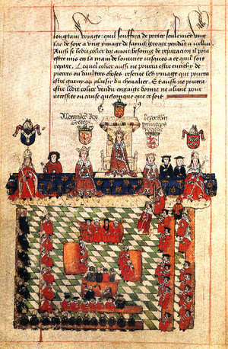
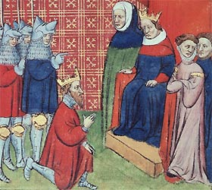
Model Parliament, 1295
King Edward I brought his military leaders and nobility together as a Parliament to ask their consent to new taxes.
Established the principle of parliamentary “power of the purse.”
A radical new idea for any monarch to ask for anything!

Slide 10
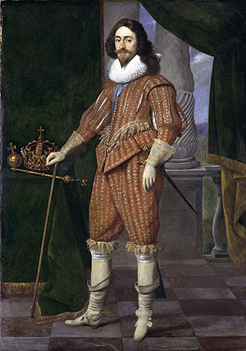
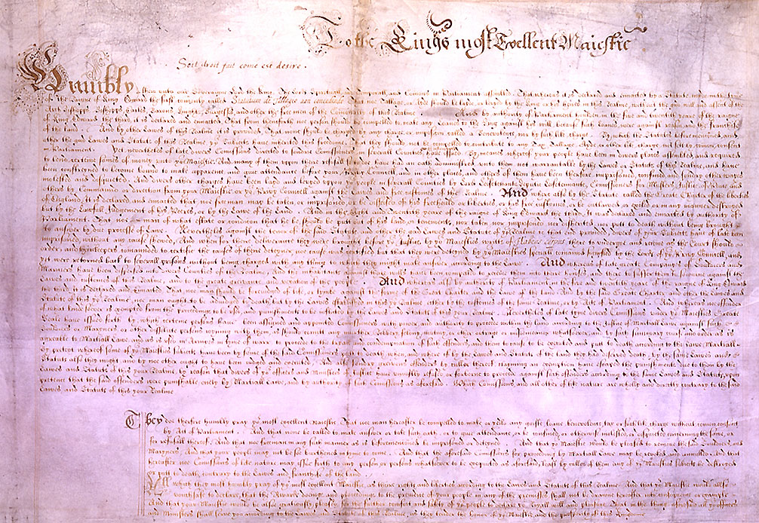
The Petition of Rights, 1628
In return for money to fund his wars, King Charles I agreed:
No imprisonment without due cause.
No taxation without Parliament’s consent.
No putting soldiers in private homes.
No martial law during peacetime.
Charles signed it, and then ignored it, dissolving Parliament!

Slide 11
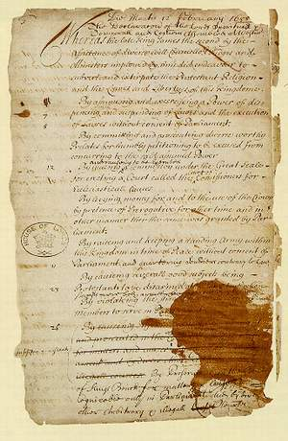
English Bill of Rights [1689]
It settled all of the major issues between King & Parliament.
It served as a model for the U. S. Bill of Rights.
It also formed a base for the steady expansion of civil liberties in the 18^{c} and early 19^{c} in England.

Slide 12
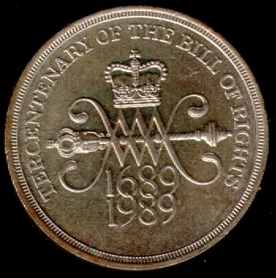
English Bill of Rights [1689]
Main provisions:
The King could not suspend the operation of laws.
The King could not interfere with the ordinary course of justice.
No taxes levied or standard army maintained in peacetime without Parliament’s consent.
Freedom of speech in Parliament.
Sessions of Parliament would be held frequently.
Subjects had the right of bail, petition, and freedom from excessive fines and cruel and unusual punishment.
The monarch must be a Protestant.
Freedom from arbitrary arrest.
Censorship of the press was dropped.
Religious toleration.

Slide 13
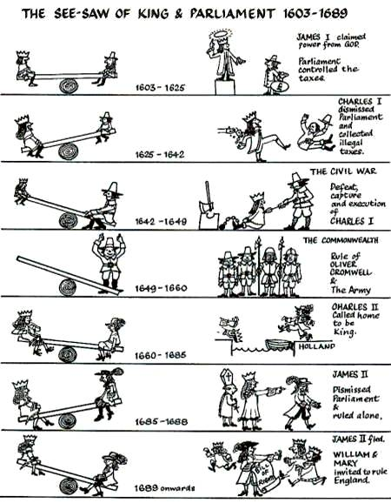
The Seesaw of King & Parliament: 1603-1689

