Slide 1
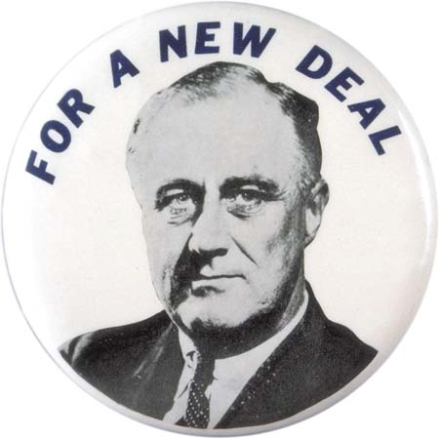
New Deal Review
Aim: What were the programs of the New Deal?

Slide 2
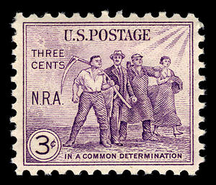

National Recovery Act (NRA)
Purpose: recovery of industry
Created a partnership of business, labor, and government to attack the depression with such measures as price controls, high wages, and codes of fair competition

Slide 3
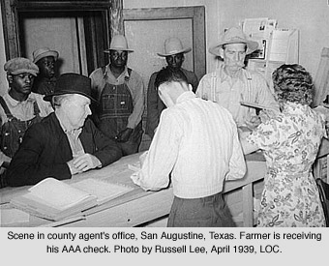
First Agricultural Adjustment Act (AAA)
Purpose: the recovery of agriculture
Paid farmers who agreed to reduce production of basic crops such as cotton, wheat, tobacco, hogs, and corn
Money came from a tax on processors such as flour millers and meat packers who passed the cost on to the consumer

Slide 4
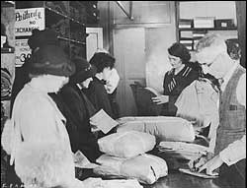
Federal Emergency Relief Admin (FERA)
Purpose: relief
Gave money to states and municipalities so they could distribute money, clothing, and food to the unemployed

Slide 5
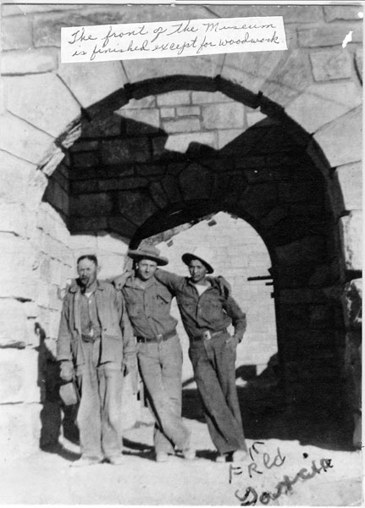
Civilian Conservation Corp (CCC)
Purpose: relief
Gave outdoor work to unemployed men between the ages of 17 and 29
They received $30 per month, but $22 went back to the family

Slide 6
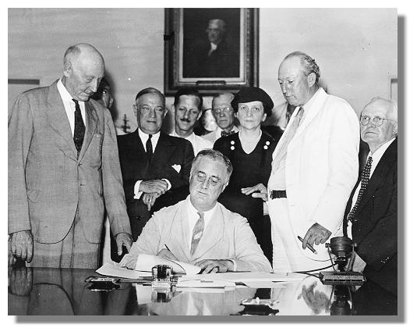
Second New Deal (1934-1941)
Emphasis: reform
Political Position: liberal
Primary aim: permanent reform
Philosophy: international economic cooperation and economic abundance
Objectives: increased purchasing power and social security for public
Beneficiaries: small farmers and labor

Slide 7
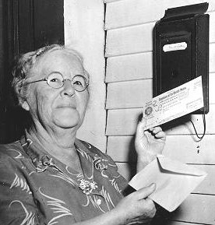
Social Security Act
Purpose: reform
Gave money to states for aid to dependent children, established unemployment insurance through payroll deduction, set up old-age pensions for retirees.

Slide 8
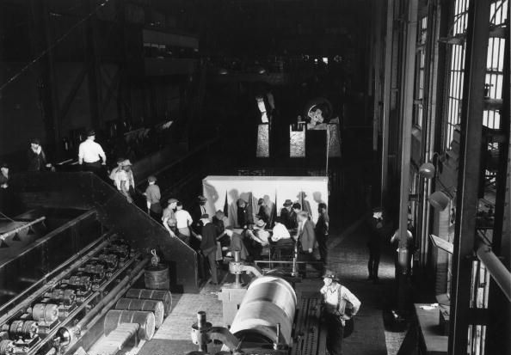
National Labor Relations Act
Purpose: reform
Put restraints on employers and set up a National Labor Relations Board to protect the rights of organized labor to bargain collectively with employers.

Slide 9
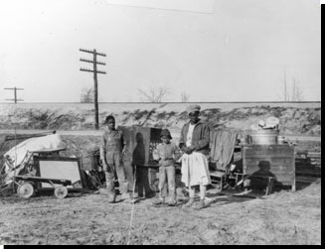
Second Agricultural Adjustment Act
Purpose: recovery for agriculture
Paid farmers for conservation practices, but only if they restricted production of staple crops.

Slide 10
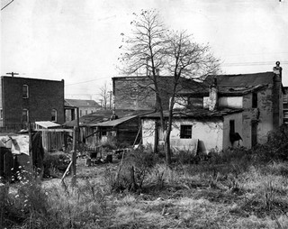
U.S. Housing Authority
Purpose: recovery and reform
Used federal funds to tear down slums and construct better housing.

Slide 11

The New Deal on Trial
By 1935, political disunity was evident. There were critics on the right and the left.
NEW DEAL

Slide 12

Criticisms of Conservative Opponents
Conservative opponents said the New Deal went too far:
  It was socialism (killed individualism)
  It added to the national debt ($35 billion)
  It wasted money on relief and encouraged idleness
  It violated the constitution & states rights
  It increased the power of the
  Presidency (FDR was reaching
  toward dictatorship, Congress a
  rubber stamp, independence
  of judiciary threatened,
  separation of powers shattered)

Slide 13
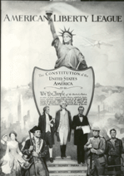
Anti-New Deal Organization
  Conservative opponents to the New Deal had an organization called the American Liberty League. They had money but were small in numbers, so FDR was not worried.

Slide 14

Criticisms of Radical Opponents
Radical opponents said the New Deal did not go far enough. They were demagogues (rabble-rousers) and had popular followings, so FDR was concerned.

Slide 15
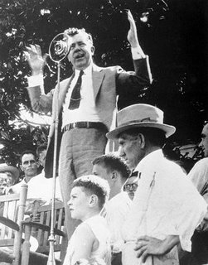
Senator Huey Long (LA)
Senator Huey Long said New Deal relief measures were mere crumbs and advocated a share the wealth plan (i.e., a guaranteed annual income of at least $5,000 for every American, financed by confiscating wealth of people who made over $5 million per year).

Slide 16
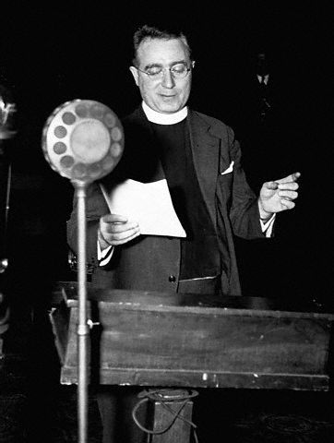
Father Charles E. Coughlin
Father Charles Coughlin was
a rabble-rousing radio priest from Detroit. His broadcasts were called the “Golden Hour of the Little Flower.” He claimed there was an international bankers conspiracy and Jews were responsible. He advocated nationalization of banking and currency and national resources and demanded a “living wage.”

Slide 17
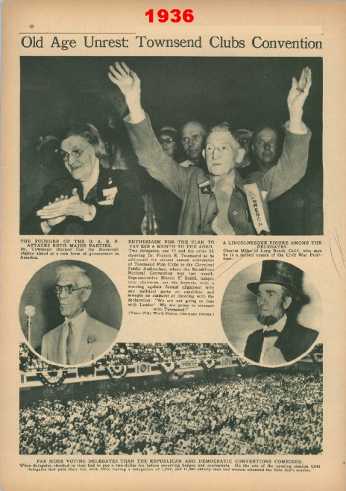
Dr. Francis E. Townsend
Dr. Francis E. Townsend was an elderly physician from CA. He had a plan for the federal government to pay $200 per month to unemployed people over 60. The program would be financed by a 2% national sales tax and each pensioner would be required to spend the money in 30 days. This would stimulate the economy.

Slide 18
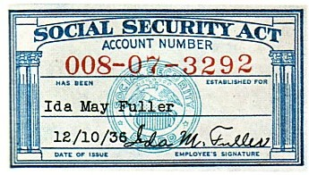
Moderate Legislation
FDR sponsored moderate legislation to silence radical opposition:
  Revenue Act of 1935 – Response to Huey Long. Increased taxes on large incomes and corporations.
  Banking Act of 1935 – Response to Coughlin. Extended federal control
  over private banking practices.
  Social Security Act of 1935
  Response to Townsend.
  Included provisions for
  unemployables (dependent children, the disabled, blind), unemployment insurance, and old-age pensions.

Slide 19
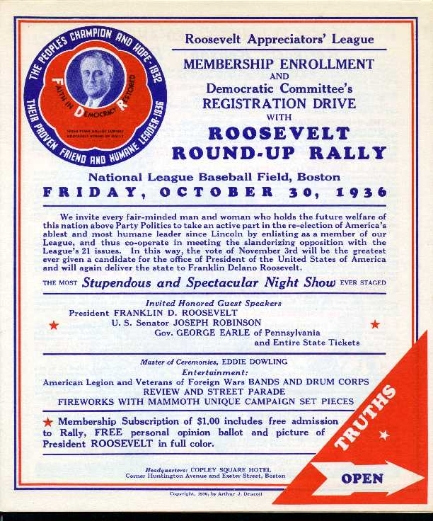
The Election of 1936
The Election of 1936:
  Made the Democratic party the majority party
  Created a new Democratic coalition composed of both traditional elements and new elements
  Showed that the American people rejected radical solutions to depression

Slide 20
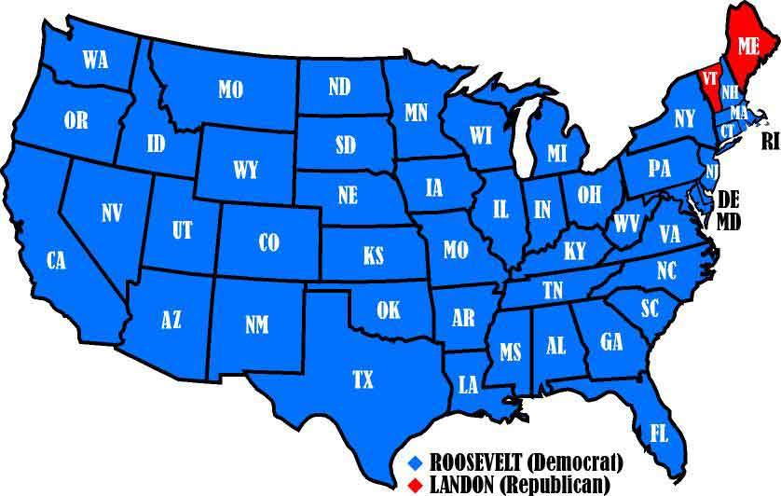

Slide 21
The Election of 1936
Candidate | Party | % Popular Vote | Electoral Votes
FDR | Democratic | 60.3% | 523
Alfred E. Landon | Republican | 36.56% | 8
William Lemke | Radical | 1.93%
Norman Thomas | Socialist | 0.41% (2.21 in 1932)
Earl Browder | Communist | 0.17 (0.25 in 1932)

Slide 22
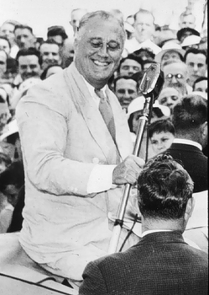
The Roosevelt Coalition
While Republicans were still relying on their traditional base of political support (big business, big farmers, and conservatives), Democrats broadened their constituency by appealing to small farmers in the Midwest, urban political bosses, ethnic blue collar workers, Jews, intellectuals, and African Americans.

Slide 23
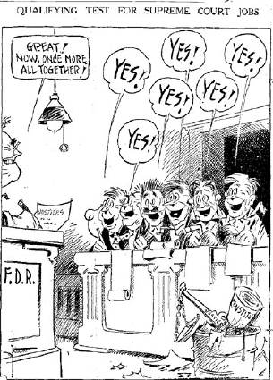
Protection of New Deal Accomplishments
Steps FDR took to protect New Deal accomplishments (both failed):
  Court-Packing Plan (proposed increasing Supreme Court from 9 to 15 members, caused in revolt in Dem. Party)
  Purge of the Democratic Party in the Election of 1938 (came out strongly in favor of liberal Dem. Candidates, evidence that he interfered in a state campaign, Republicans gained strength in both houses of Congress)

Slide 24
Decline of New Deal Reform after 1937
Reasons for decline of New Deal reform after 1937:
Court-packing plan made Congress irritable.
Recession of 1937-38 weakened confidence in New Deal measures. Republicans gained strength in both houses.
Attempted purge of Democratic party failed.
Conservative Democrats were elected to office. Resentful of attempted party purge, they joined ranks with Republicans to block New Deal legislation.
Increasing focus on foreign affairs.

Slide 25
The Significance of the New Deal

Slide 26
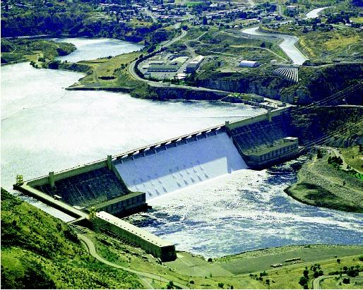
Physical Rehabilitation of Country
Attacked soil erosion
Built dams and planted trees to prevent floods
Reclaimed the grasslands of the Great Plains
Developed water power resources
Encouraged regional reconstruction projects like the TVA and Columbia River project

Slide 27
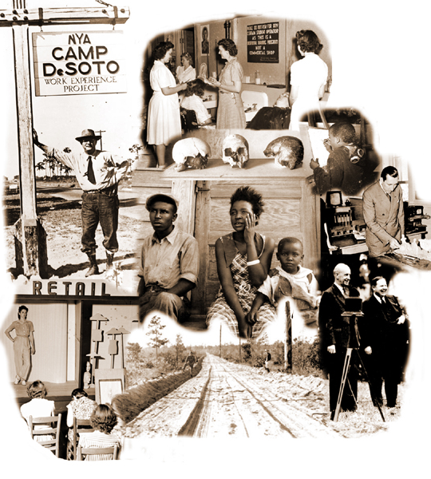
Human Rehabilitation
Established the principle that government has responsibility for the health, welfare, and security, as well as the protection and education of its citizens
Embraced social security, public health, housing
Entered the domain of agriculture and labor

Slide 28
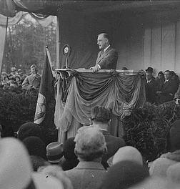
Revitalization of Politics
Strengthened executive branch
Reasserted presidential leadership
Revitalized political party as a vehicle for the popular will and as an instrument for effective action.

Slide 29
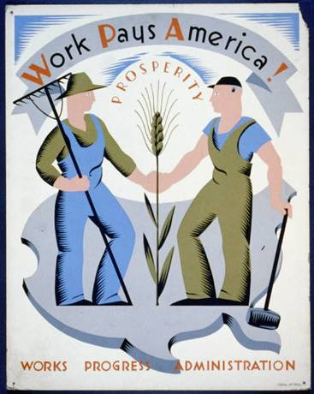
Extension of Democracy
Redefined the concept of democracy so that it included not only political rights but economic security and social justice as well.

Slide 30
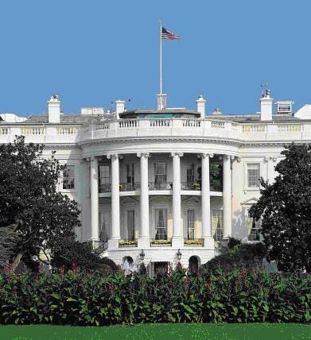
Maintenance of a Democratic System
The New Deal maintained a democratic system of government and society in a world threatened by totalitarianism.
  Increased size and scope of government to meet needs of the depression
  Provided the leadership that enabled Congress to put through the necessary relief, recovery, and reform measures.
  Sponsored moderate legislation to neutralize the popularity of radical opponents

Slide 31
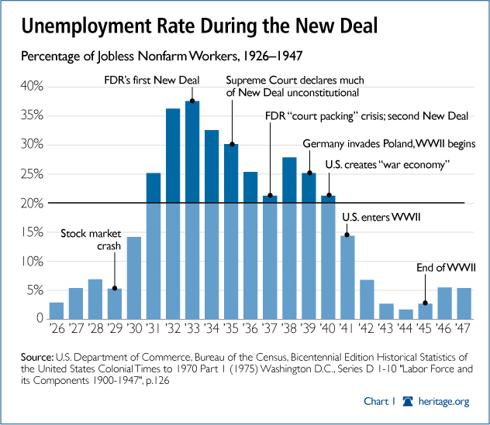

Slide 32
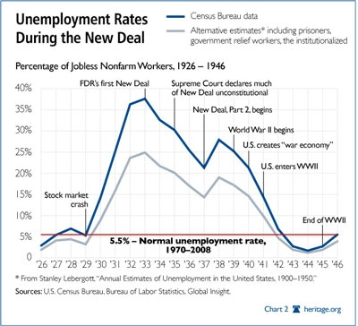

Slide 33
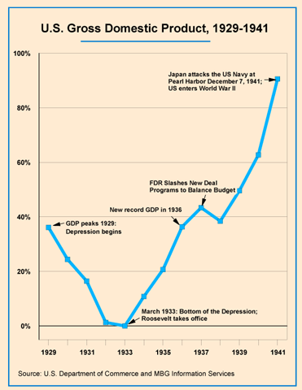

Slide 34
