Slide 1

APPARTS Document Technique
AP European History
Mr. Ott
Park East High School – 2015-16

Slide 2
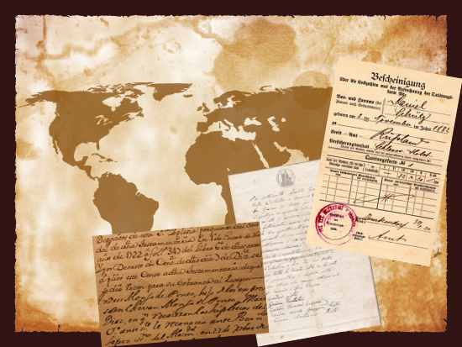
Primary Sources
What is a primary source?
Primary
Original Artworks
Diaries
Poems
Treaties
Photos
Videotapes of live events
Original Literature
Autobiographies

Slide 3
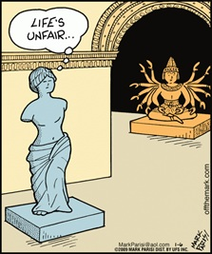
Secondary Sources
Secondary
Critique of the Art
Textbook
Articles about specific authors
Essays about a specific topic
Biographies
Wikipedia

Slide 4
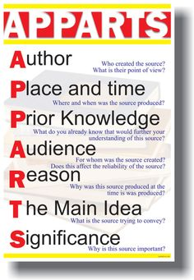
Examination of Primary Resources
APPARTS Technique
  Author
  Place and Time
  Prior Knowledge
  Audience
  Reason
  The Main Idea
  Significance

Slide 5
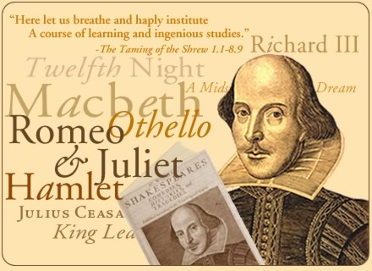
Author
Who created the source?
What do you know about the author?
What is the author’s point of view?
Does the author have anything in his/her past that could predict the POV?

Slide 6
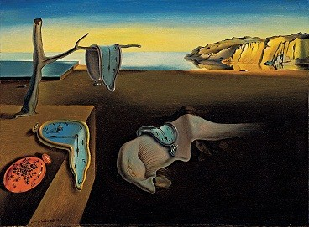
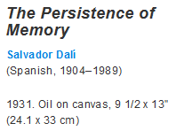
Place and Time
Where and when was the source produced?
How might this affect the meaning of the source?

Slide 7

Prior Knowledge
Beyond information about the author and the context of its creation, what do you know that would help you further understand the primary source? For example, do you recognize any symbols and recall what they represent?

Slide 8
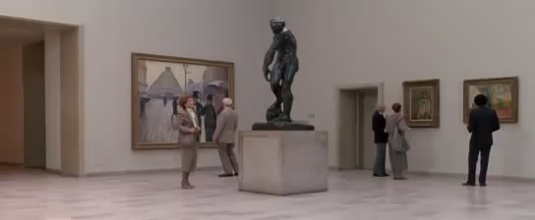
Audience
For whom was the source created and how might this affect the reliability of the source?
Can this source persuade the audience?

Slide 9

Reason
Why was this source produced at the time it was produced?

Slide 10
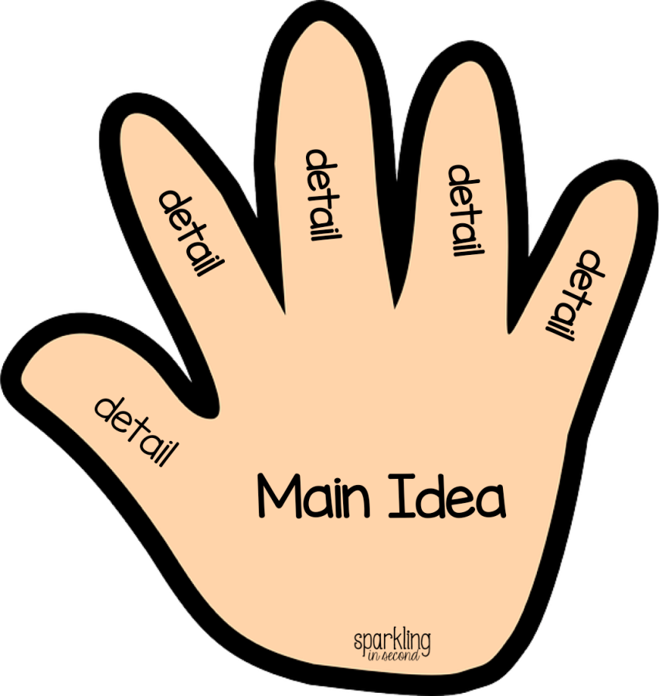
The Main Idea
What point is the source trying to convey?

Slide 11
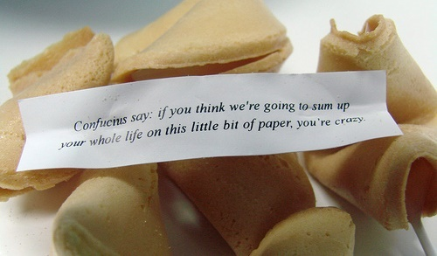
Significance
Why is this source important?
What inferences can you draw from this document?
Ask yourself, “So what?” in relation to the question asked.

Slide 12
Any questions???
APPARTS is not a test-taking strategy. Document-Based Questions on the Advanced Placement exams allow students only 15 minutes to read and analyze somewhere between eight to 12 documents. There is no time to go through the APPARTS process. Therefore, APPARTS must have become, in the words of the AP Social Studies Vertical Teams Guide, "a habit of mind." Student must have had enough practice so that it has become an intuitive part of examining documents.

