Slide 1

Research Skills
Aim: How do you conduct proper research for a paper or project?
Do Now: In your notebooks, Define:
* Argument
* Thesis (Topic Sentence)
Mr. Ott @ BETA 2012-13

Slide 2

What is Research?
The purpose of research is to gather reliable data that can be used to improve our knowledge and understanding of the world
 | Contents
Research Skills | Argument, Evidence and Reasoning
 | Deduction and Induction

Slide 3

Facts as evidence
Empirical research involves an investigation of facts, trying to gain a better understanding of some aspect of the world
But facts need to be interpreted and analyzed, not simply accumulated with the hope that the conclusions will appear!
This is what we mean by constructing an argument

Slide 4
What is an argument?
An argument involves a premise and a conclusion.
First, every argument involves one or more propositions.
Second, every argument has exactly one final conclusion. That final conclusion is one of the propositions.
Third, every argument represents one or more of the propositions as leading to the final conclusion.

Slide 5
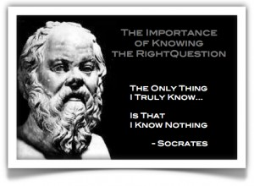
List of Propositions
Socrates is a person
all people are mortal
Socrates is mortal
all mortal things have parts
Socrates has parts
all things that have parts are made of particles
Socrates is made of particles

Slide 6
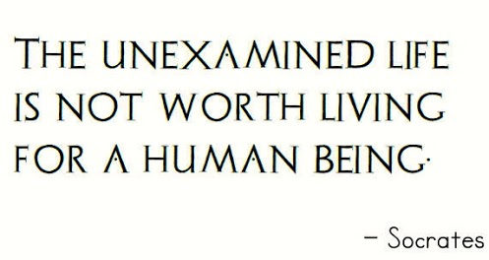
But, That is still not an Argument
You need to make one of those propositions the FINAL CONCLUSION
Socrates is a person
all people are mortal
Socrates is mortal
all mortal things have parts
Socrates has parts
all things that have parts are made of particles
Socrates is made of particles

Slide 7
We still do not have an Argument yet
Every argument represents one or more of the propositions as leading to the final conclusion.
Socrates is a person and all people are mortal together are meant to lead to Socrates is mortal
Socrates is mortal and all mortal things have parts together are meant to lead to Socrates has parts
Socrates has parts and all things that have parts are made of particles together are meant to lead to Socrates is made of particles

Slide 8
Let’s look at it numbered
Socrates is a person.
All people are mortal.
Therefore, Socrates is mortal. [1,2]
All mortal things have parts.
Therefore, Socrates has parts. [3,4]
All things that have parts are made of particles.
Therefore, Socrates is made of particles. [5,6]
Intermediate
Conclusion
Intermediate
Conclusion
Final
Conclusion

Slide 9
Evidence and reasoning
Good research requires both good evidence (facts) and good reasoning (analysis)
This means avoiding going beyond the evidence when drawing conclusions

Slide 10
Deductive reasoning
Deduction involves moving from the general to the specific
Theory
Hypothesis
Observation
Evidence

Slide 11
Inductive reasoning
Induction involves moving from the specific to the general
Observation
Analysis
Inference (logical guess)
Evidence to confirm

Slide 12
Activity
You will be assigned a group
Work on your Reasoning Puzzle as a group
Each member of the group needs to have a completed copy of their worksheet
Be prepared to discuss your outcomes.
Activity will start Wed and End Thursday

