Slide 1
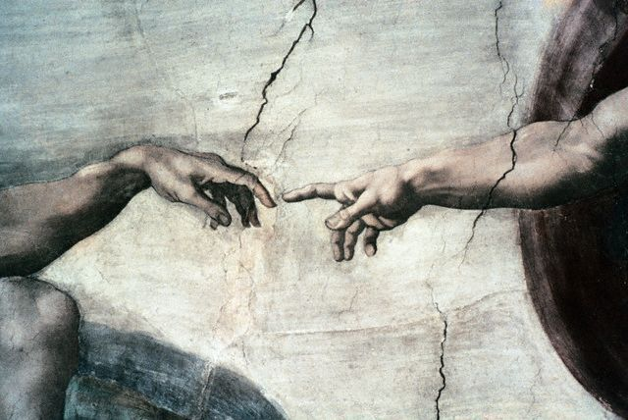

Michelangelo
Born in 1475 in a small town near Florence, is considered to be one of the
most inspired men who ever lived

Slide 2
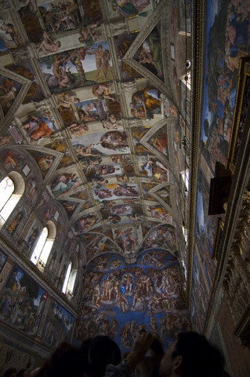
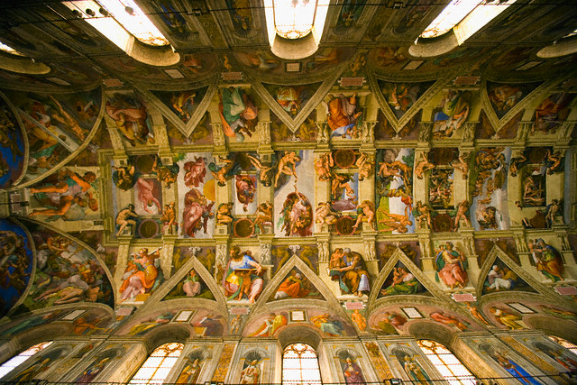
Sistine Chapel
About a year after creating David, Pope Julius II summoned Michelangelo to Rome to work on his most famous project, the ceiling of the Sistine Chapel.

Slide 3
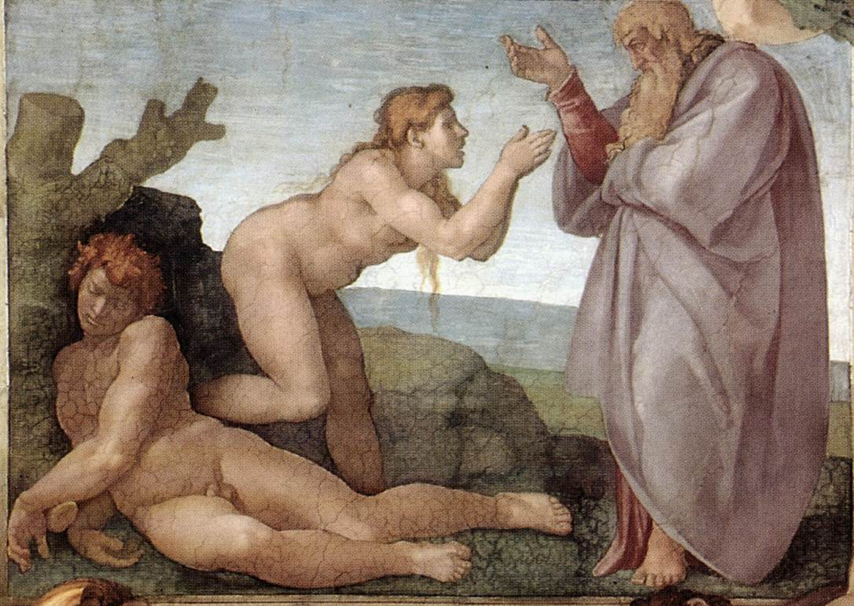
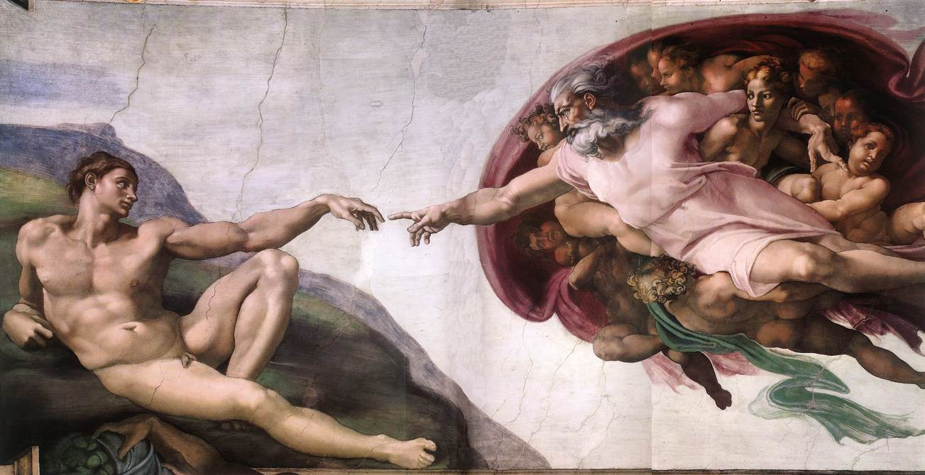
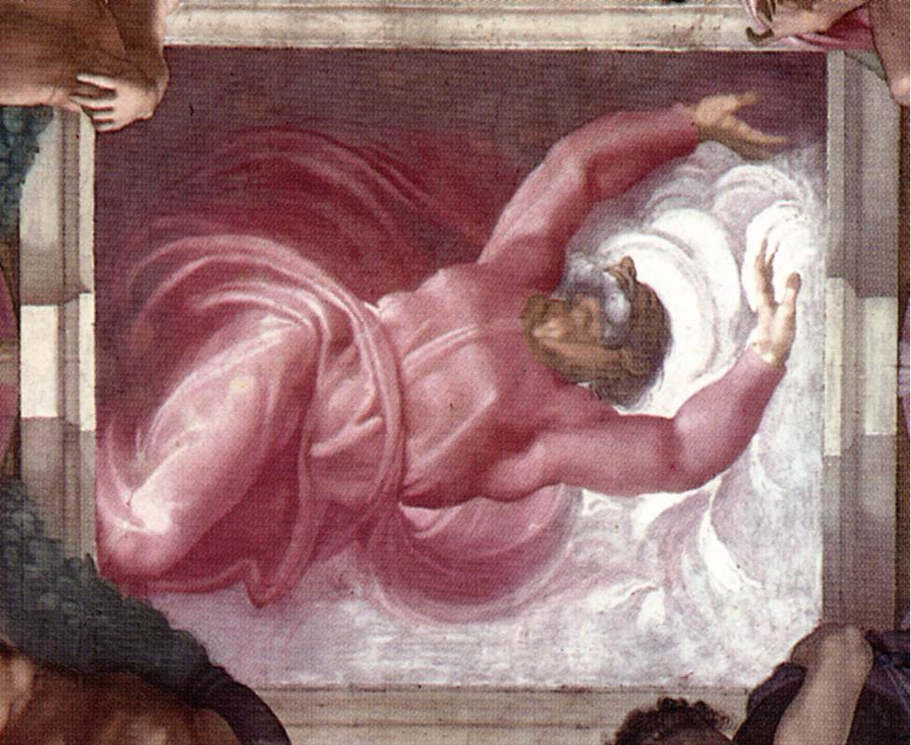
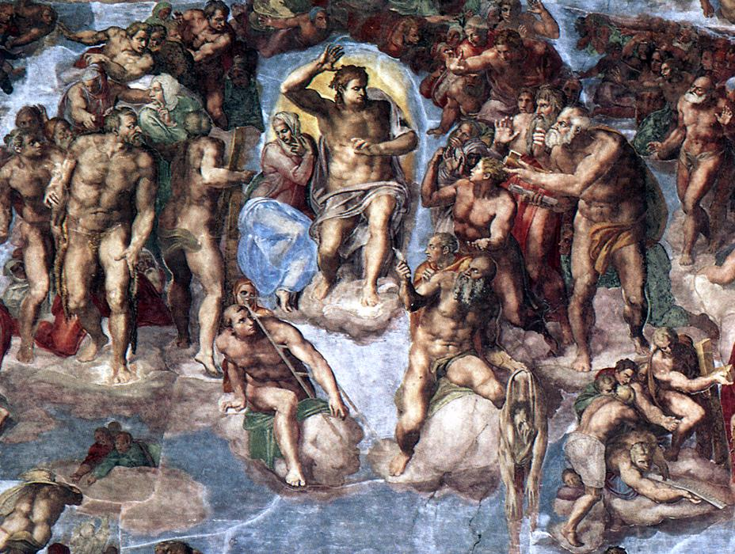
Michelangelo
Creation of Eve
Creation of Adam
Separation of Light and Darkness
The Last Judgment

Slide 4
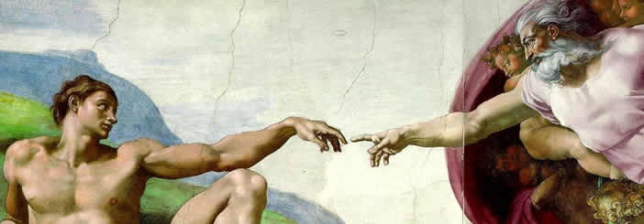
The ceiling of the Sistine Chapel is one of the world’s most famous paintings, but not everyone was happy with Michelangelo’s work. Cardinal Biagio de Cesena noted that the crowd of more than 300 human figures would be more appropriate in a wine shop than in a papal chapel. Michelangelo responded to this criticism by adding a portrait of Biagio among the figures of the damned in the scene of the Last Judgment.

Slide 5
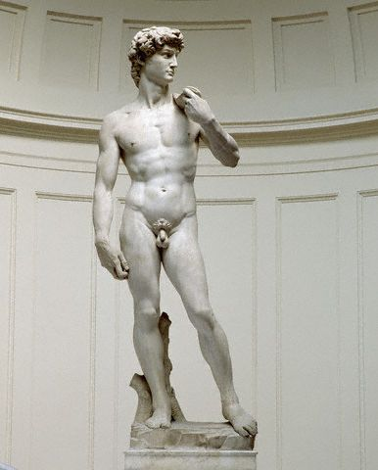
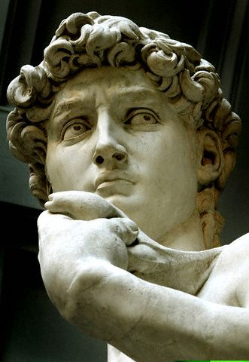
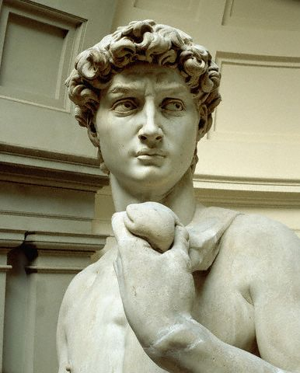
David
Michelangelo created his masterpiece David in 1504.

Slide 6
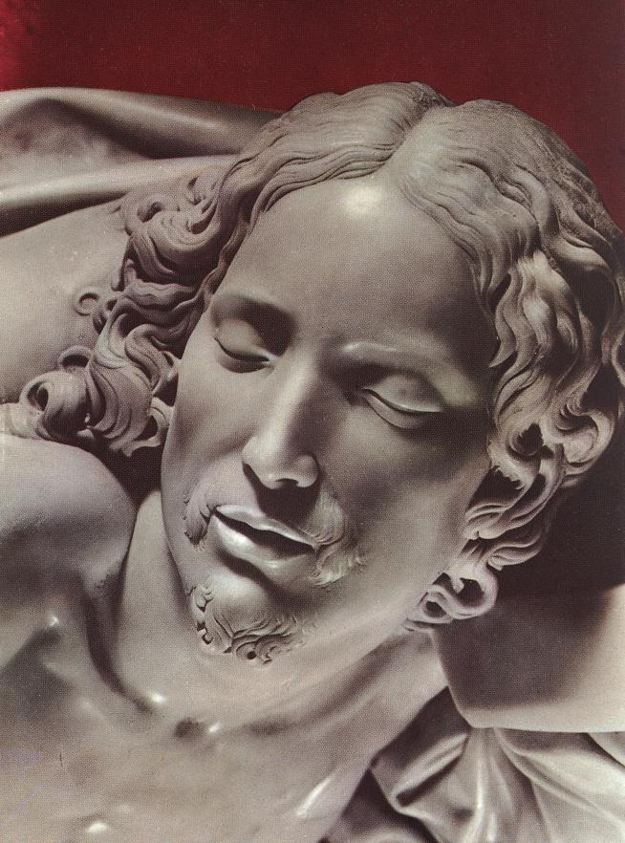
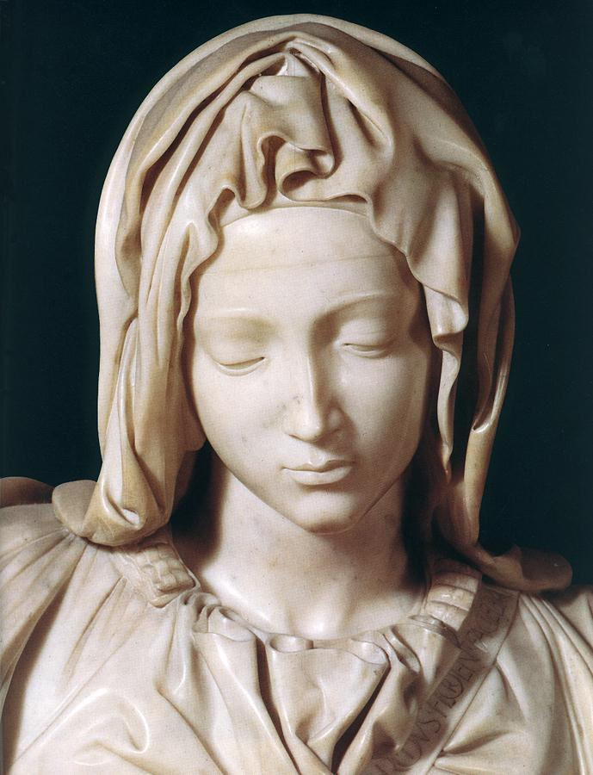
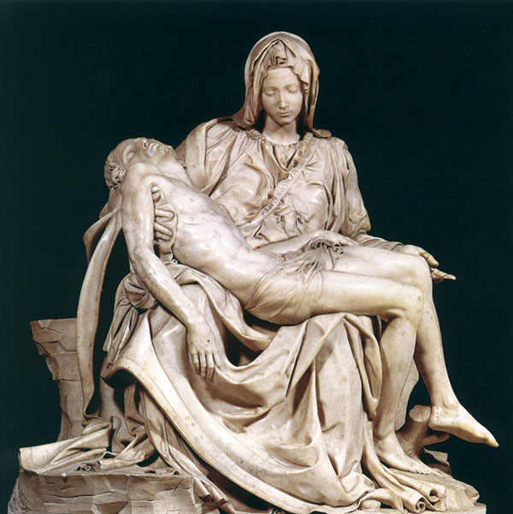
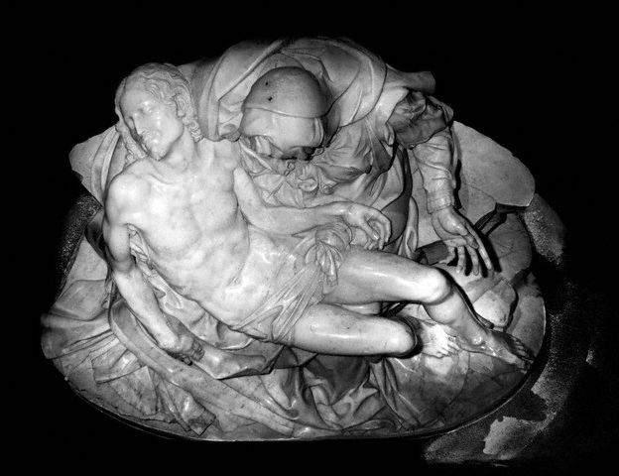
La Pieta 1499
Marble Sculpture

Slide 7
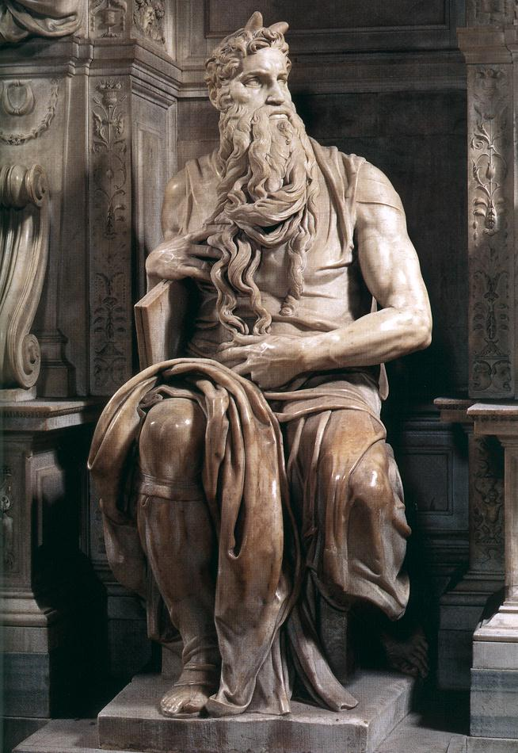
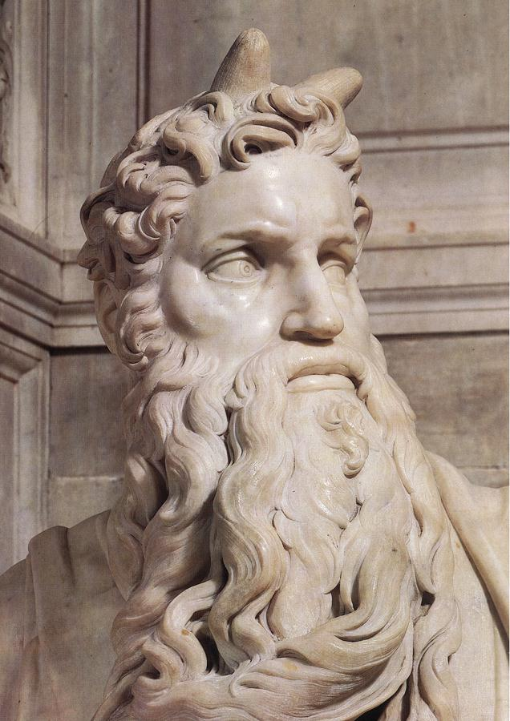
Moses
Michelangelo

Slide 8
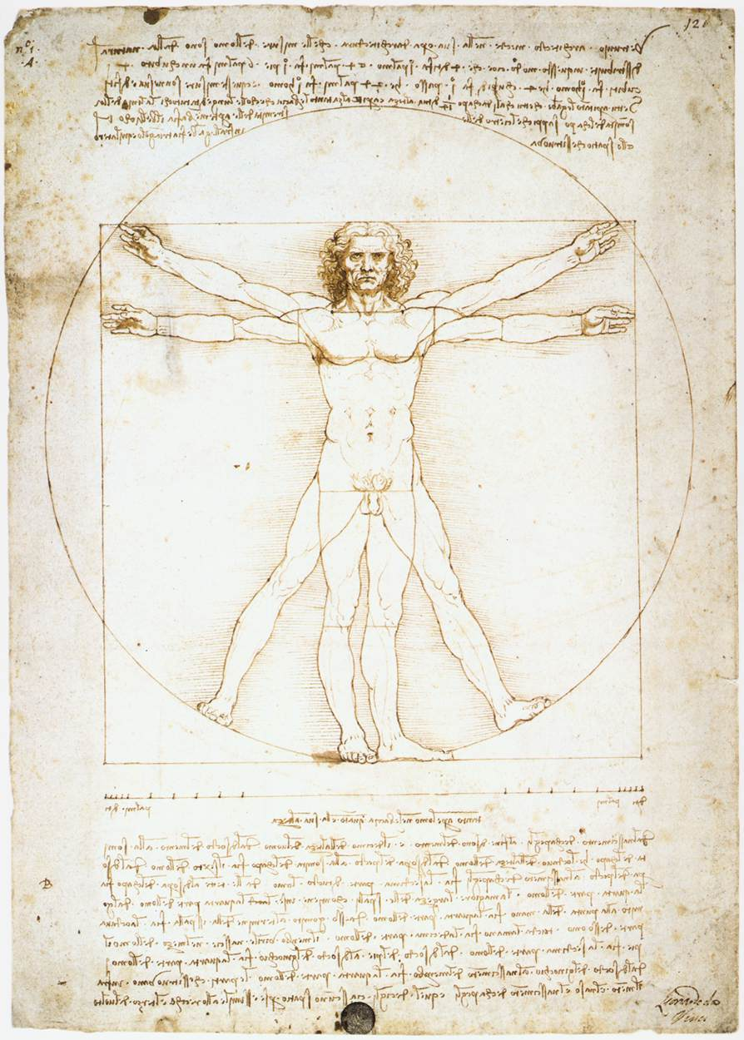
Leonardo Da Vinci
1452-1519
Painter, Sculptor, Architect, Engineer
Genius!

Slide 9
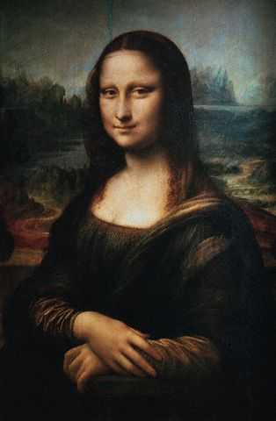
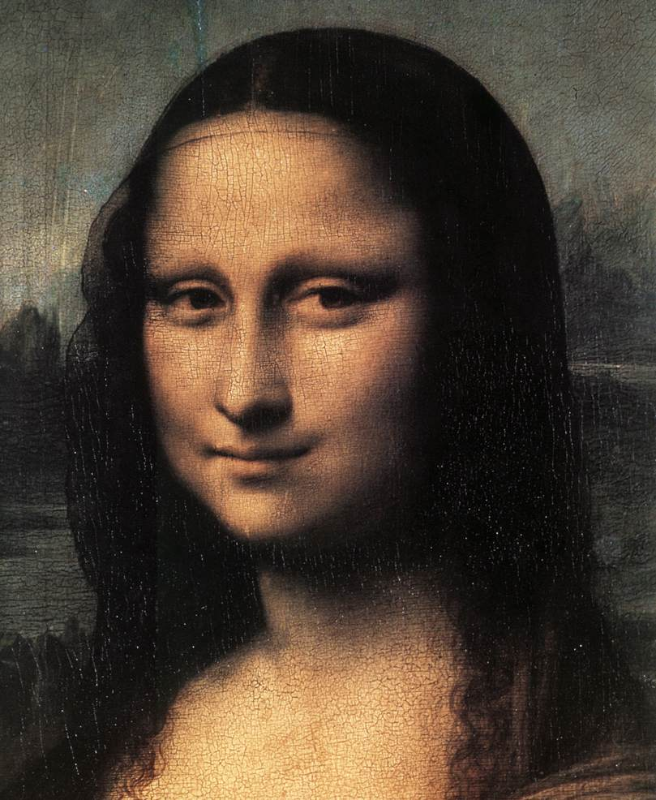
Mona Lisa or
La Giaconda
Leonardo Da Vinci

Slide 10
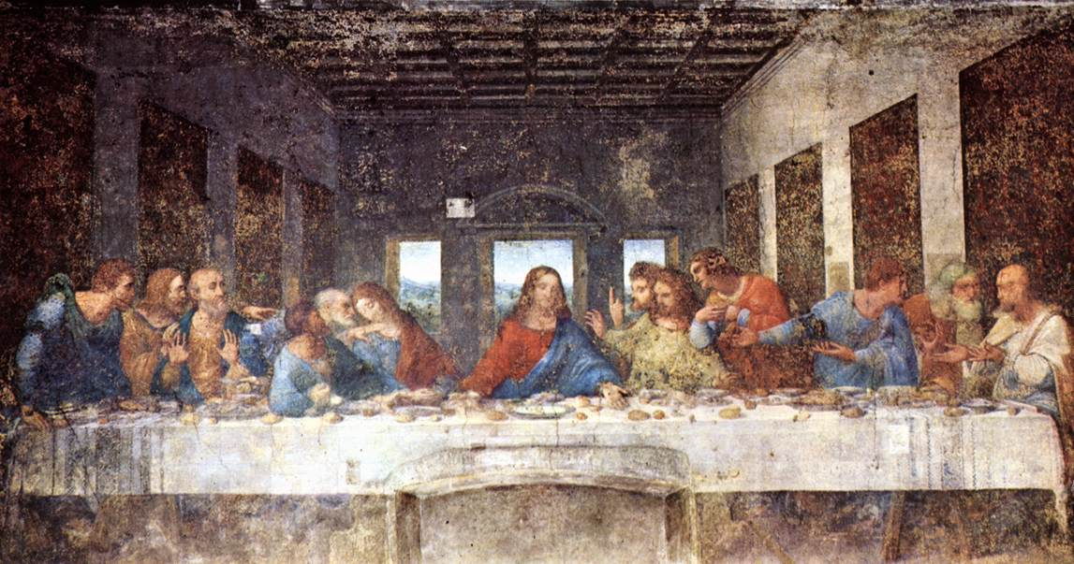
The Last Supper
Leonardo Da Vinci

Slide 11
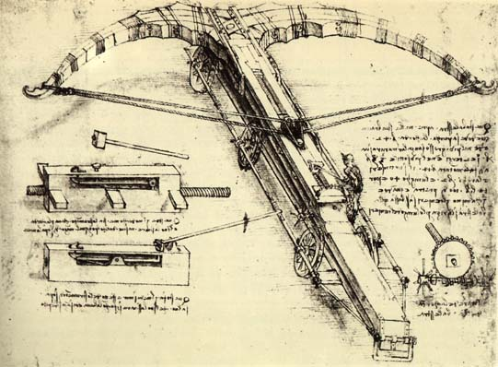
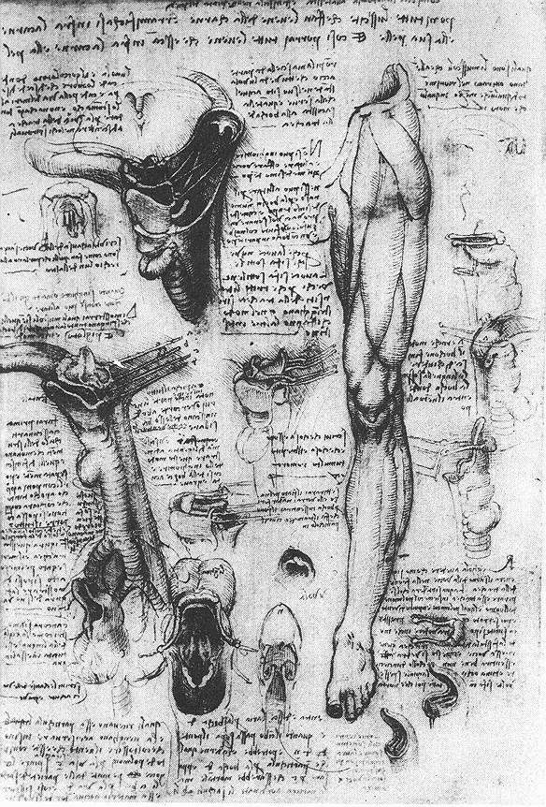
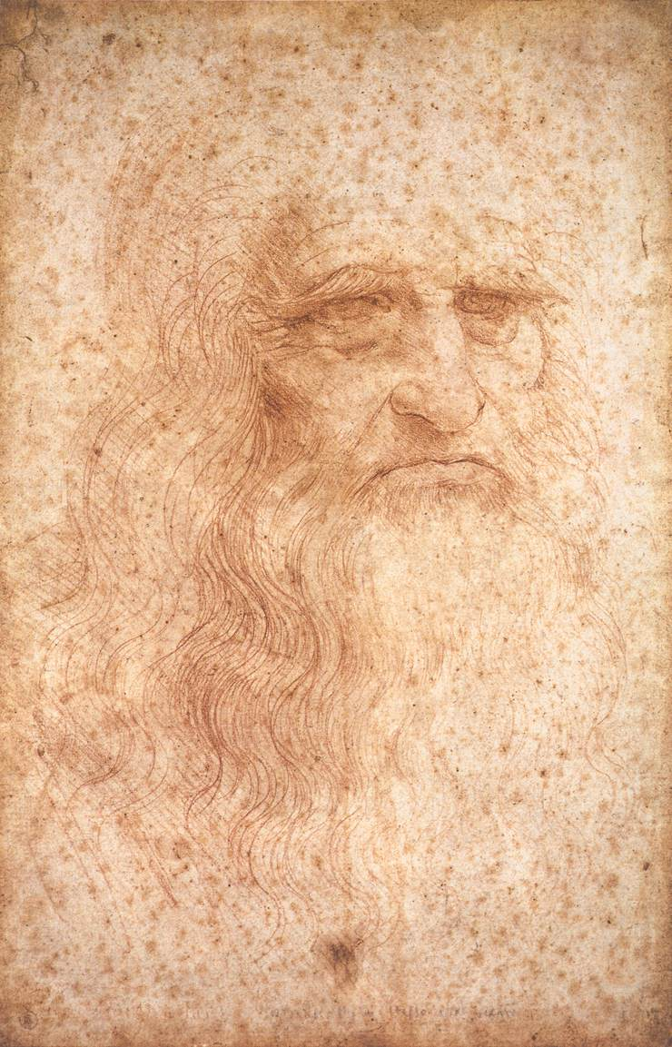
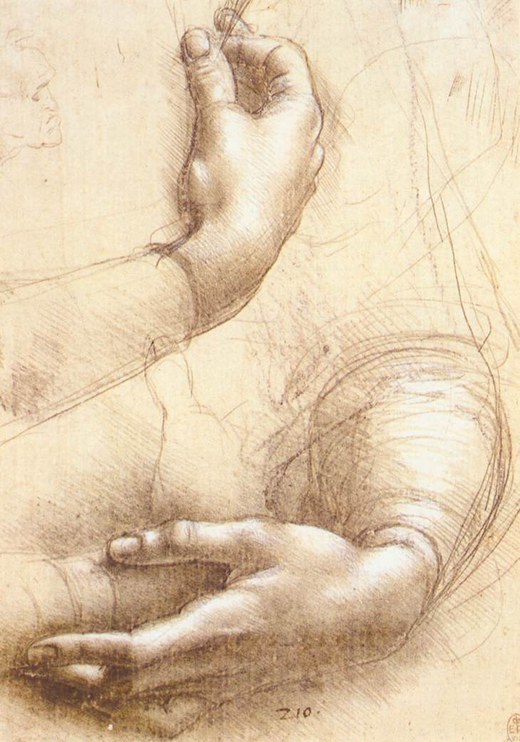
Notebooks
Leonardo Da Vinci

Slide 12
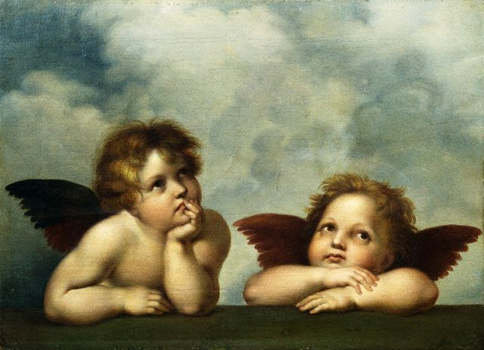
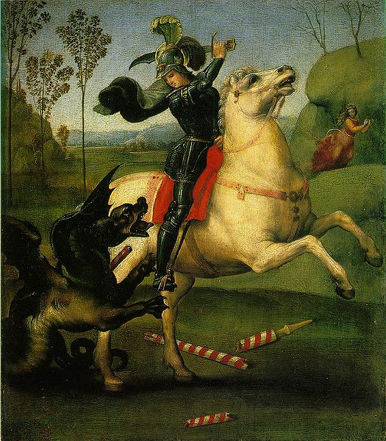
Raphael
Painter
1483-1520

Slide 13
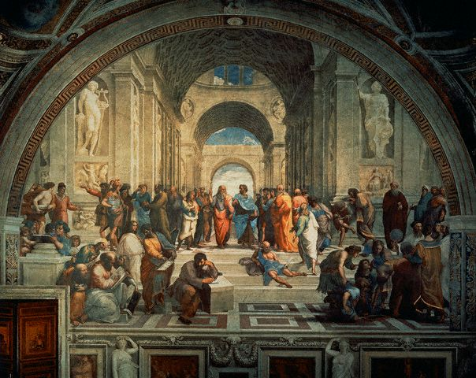
The School of Athens
Raphael

Slide 14
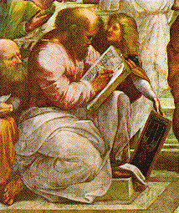
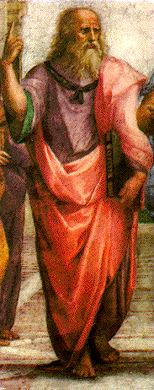
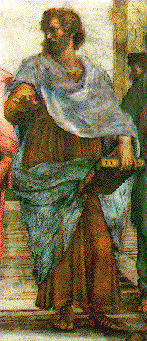
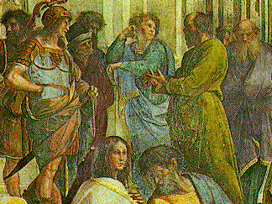
Pythagoras
Plato and Aristotle
Socrates

Slide 15
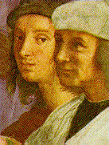
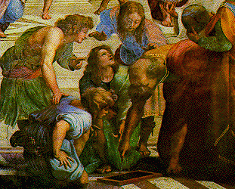
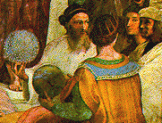
Raphael (back)→
Euclid
Zoroaster & Ptolemy

