Slide 1
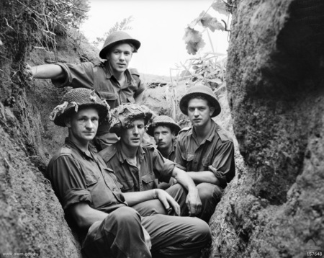
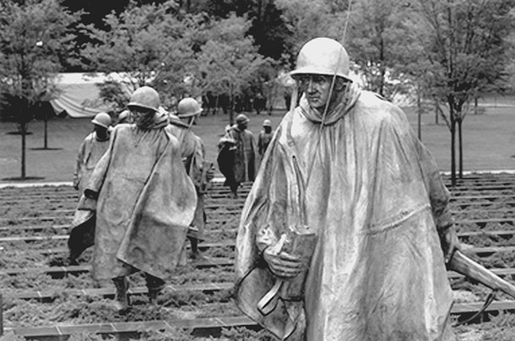
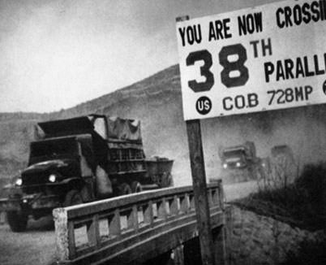
The Cold War 1945-1991
Aim: How does U.S. Government Foreign Policy affect American Society?

Slide 2
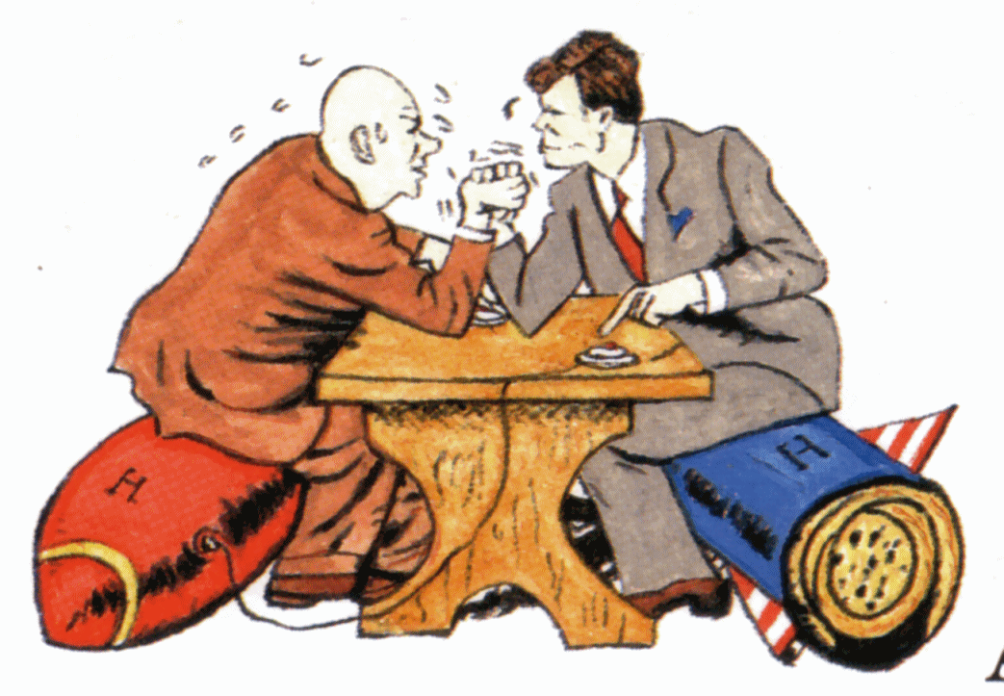
Cold War
The Cold War was a time after WWII when the USA and the Soviet Union were rivals for world influence.

Slide 3
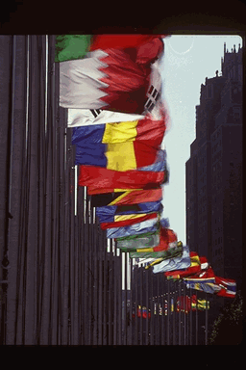
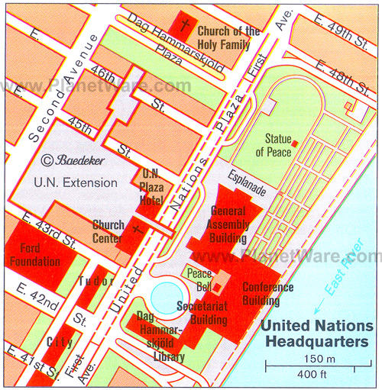
United Nations
International Organization where countries try to find peaceful solutions
Based in New York City!

Slide 4

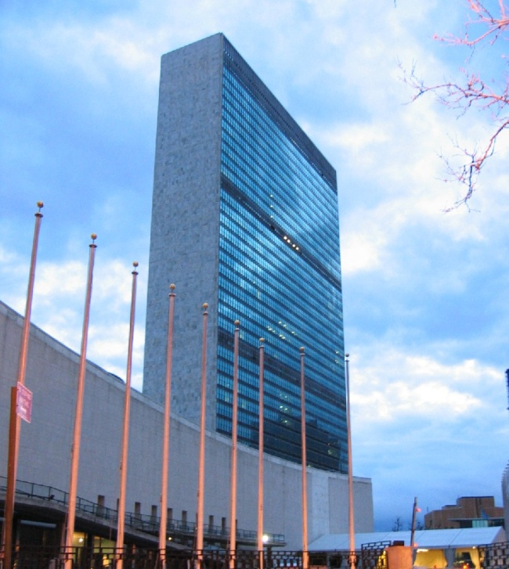
United Nations
It has no army but uses troops
from other countries.
193 countries (2012)
Except Vatican
Secretary-General which has
been held by Ban Ki-moon of
South Korea since 2007.
5 Permanent Member Security
Council (US, UK, Russia, China, France)
Uses Economic & Diplomatic pressure as tool

Slide 5
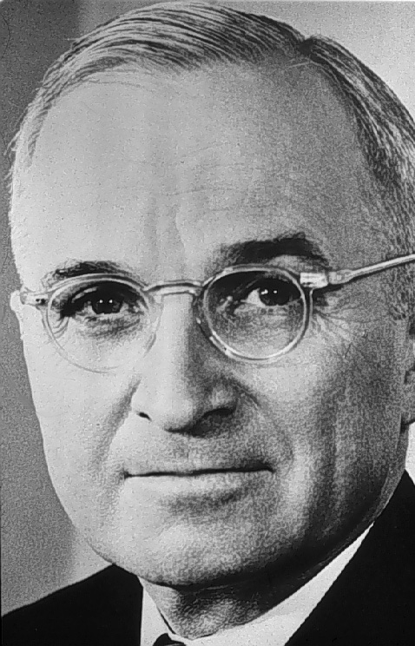
Truman Doctrine
The Truman Doctrine in March 1947 promised that the USA “would support free peoples who are resisting” communism.
This led to containment – policy of containing communism where it is.

Slide 6
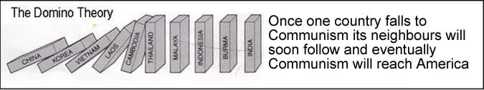
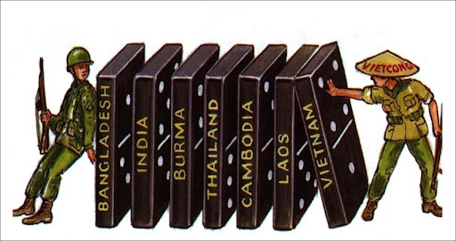
Domino Theory
Communism spreads like a disease

Slide 7
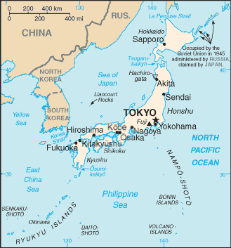
Korean Peninsula
USA tried to contain communism. Communist troops fought armies trained and funded by the USA.

Slide 8
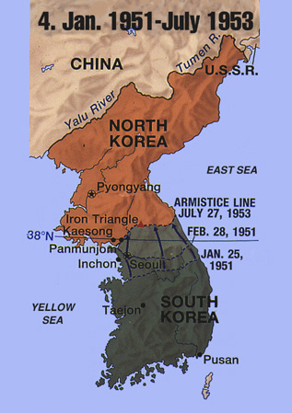
Communists invaded from the north. China sent a million troops to help the reds (Communists).

Slide 9
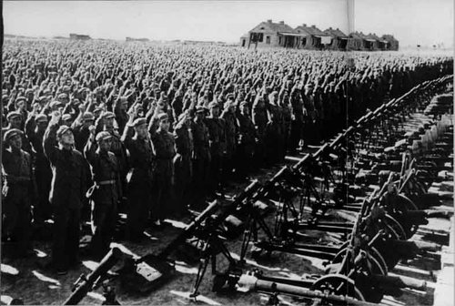
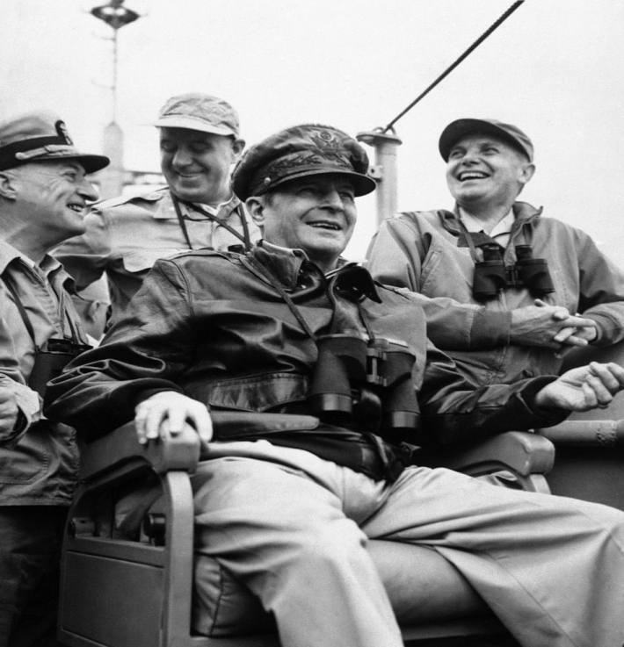
Korean War
After the failure of the promise of Korean independence by the Allied nations, on June 25, 1950, communist North Korean troops invaded South Korea.
Poorly armed, the South Koreans were no match for the North.
The United Nations ordered North Korea to withdraw its troops. General MacArthur was appointed to command all UN troops in Korea.
MacArthur was in command and due to a letter written against the President’s limited-war strategy toward Korea, he was removed from post in April 1951.

Slide 10
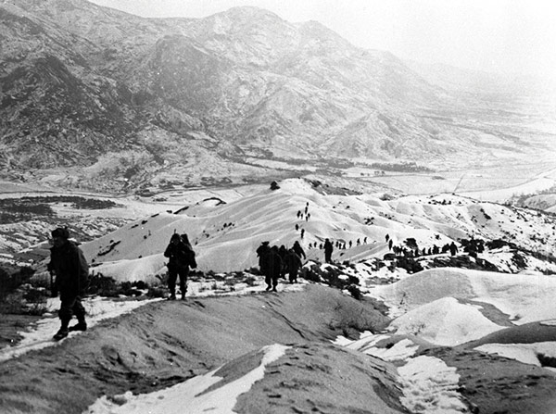
Korean War
War ended in a stalemate at the 38th parallel. We still have troops on boarder to this day!
More than 54,000 American troops perished.
No peace treaty was ever signed. Technically still at war!

Slide 11
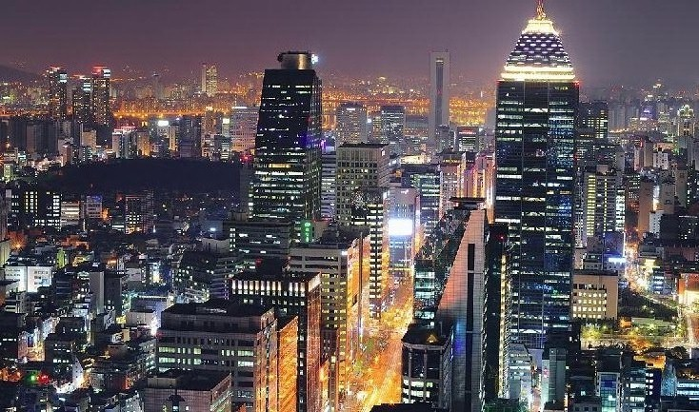
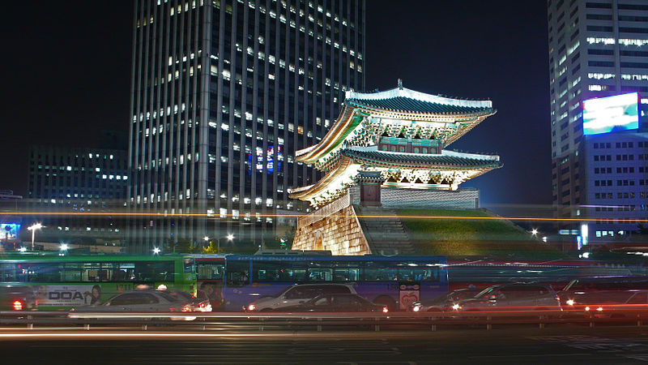
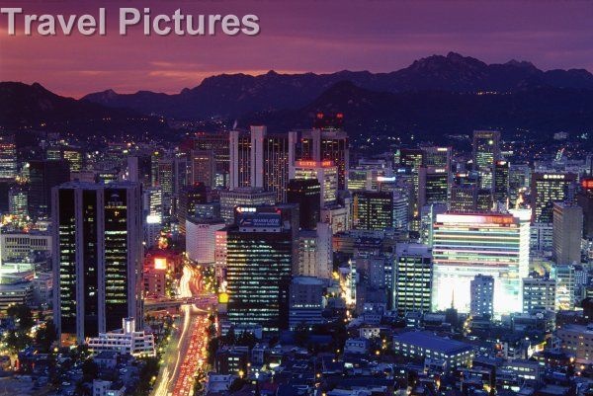
Korean War & Today
Results/Effects:
Cease Fire – Still no peace
treaty
U.S. still has troops on
border (38th parallel)
1st use of Jet aircraft
1st test of Truman Doctrine
US Gov’t allowed migration
of Koreans (1952 – Race eliminated as
a factor to immigration).
100,000 African American soldiers
in non-segregated army.
South Korea founded in 1948 as
Republic of South Korea
13th largest economy in the world
(Capitalism)

