Slide 1
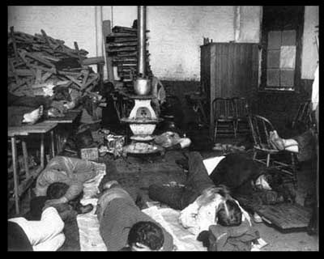
The Progressive Era
AIM: What were the social and economic reasons and remedies of change in the Progressive Era.
Do Now: Define the term progressive or progressivism in your notebook.
Social & Economic Issues & Results

Slide 2
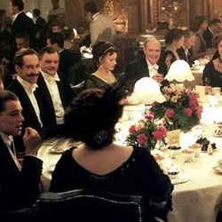
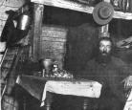
The Problems of the 1890’s
Reform shifts from the farm to the city and climbs the ladder of government from the local to the state and then to the national level.
Many Americans cried for reform.
The people claimed government and big business were taking advantage of them, rather than serving them.
Huge Gap between rich and poor.

Slide 3
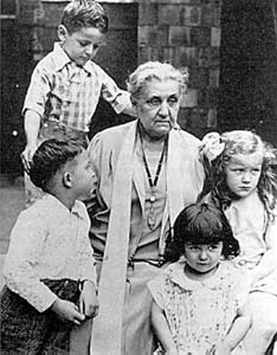
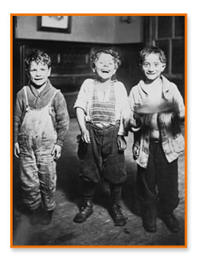
Reform Movements
Settlement House Workers
--Jane Addams, Hull House in Chicago (1889)
Young, socially-conscious lawyers
Investigative Journalists
-- “Muckrakers”
--Lincoln Steffens, Ida Tarbell, and Upton Sinclair
Small businessmen
Wanted reform not revolution
Desire to make businessmen more responsible for problems

Slide 4
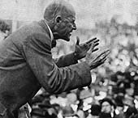
GOAL: CREATE ECONOMIC REFORM
The Panic of 1893 prompted some Americans to question the capitalist economic system
As a result some workers embraced socialism
Eugene Debs organized the American Socialist Party in 1901
Debs encouraged workers to reject American Capitalism

Slide 5
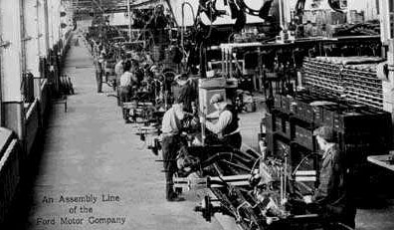
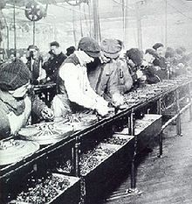
Modernization & Efficiency for Capitalism
• Many use experts, science to make society, workplace more efficient
• Louis D. Brandeis uses social scientists’ data in trial
• Scientific management—time and motion studies applied to workplace
• Assembly lines speed up production, make people work like machines
- cause high worker turnover

Slide 6

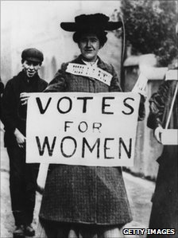
Features of Progressive Reform
Desire to make society more moral and more just
Desire to distribute income more equitably
Desire to broaden opportunities for individual advancement
Women were active in progressivism
--Suffragettes like Susan B. Anthony
The NCAA was founded in 1910 to protect young people from the dangerous and exploitive athletics practices of the time.

Slide 7
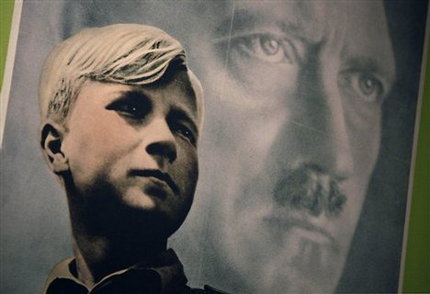
Social Reforms
Child labor laws
Ten-hour work days
Prohibition
Minimum safety standards on the job
Minimum standards for housing codes
“City Beautification” movement
Immigration Restriction
Eugenics
is the legal act of prohibiting the manufacture, transportation and sale of alcohol and alcoholic beverages
the bio-social movement which advocates the use of practices aimed at improving the genetic composition of a population

Slide 8
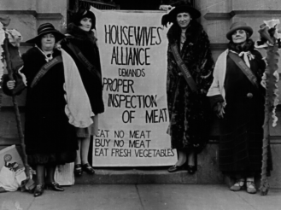
Results of Economic & Social Progressive Reform
Upton Sinclair’s book led to the Meat Inspection Act in 1906, along with the Pure Food and Drug Act, banning the sale of harmful food.
Laws Controlling Immigration were strengthened
Muckrakers—journalists who expose corruption in politics, business
Women as Public Leaders:
As a result of social and economic change, many women enter public life as workers and reformers.
Limit Working Hours (10hrs/day for men)
& Compensation for injured workers & safer working conditions

