Slide 1
Characteristics of a Civilization
Social / Political / Economic Factors
Specialization - Economic
Cities – Social/Political/Economic
A Social Hierarchy - Social
Organized Religion and Education – Social/Political
Trade - Economic
Development of New Technologies – Economic
Advanced development of the arts – Social
(This can include writing)
Notes:
Intensive agricultural techniques, such as the use of animal power, crop rotation, and irrigation. This enables farmers to produce a surplus of food that will not be needed for their own subsistence.
A significant portion of the population that does not devote most of its time to producing food. They can go into other occupations and trade for the food they need. This is called "specialization of labor." It is possible because of the food surplus described above.
The gathering of these non-food producers into permanent settlements, called cities.
A social hierarchy. This can be a chiefdom, in which the chieftain of one noble family or clan rules the people; or a state society, in which the ruling class is supported by a government or bureaucracy. Political power is concentrated in the cities.
The establishment of complex, formal social institutions such as organized religion and education, as opposed to the less formal traditions of other societies.
Development of complex forms of economic exchange. This includes the expansion of trade and may lead to the creation of money and markets.
The accumulation of more material possessions than in simpler societies.
Development of new technologies by people who are not busy producing food. In many early civilizations, metallurgy was an important advancement.
Advanced development of the arts by those who don't have to farm for a living. This can include writing.

Slide 2

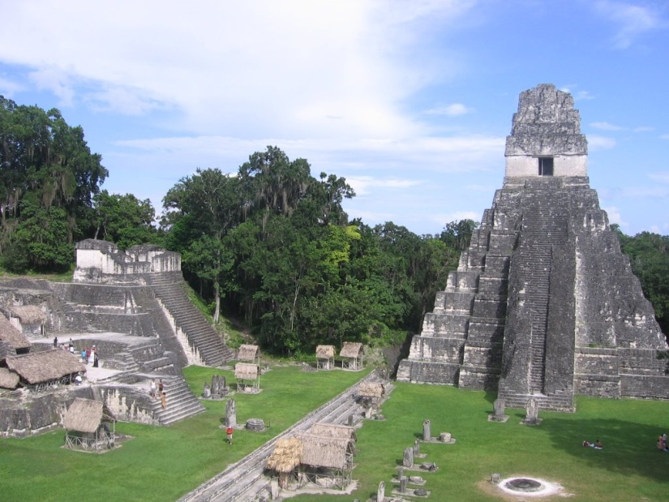
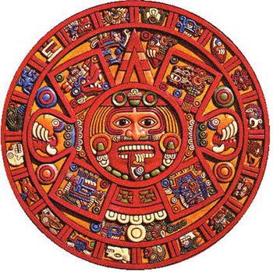
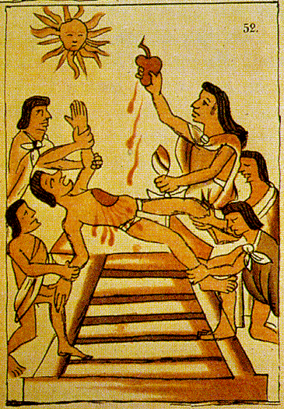
Do Now: Name a characteristic or trait of a civilization?
HW: Friday: Vocabulary Due & Quiz

Slide 3
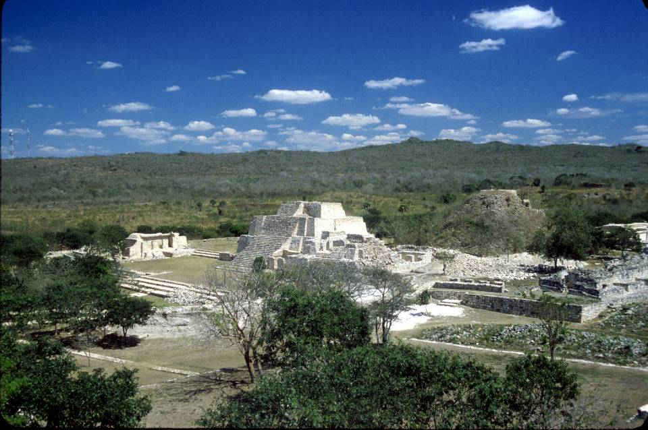
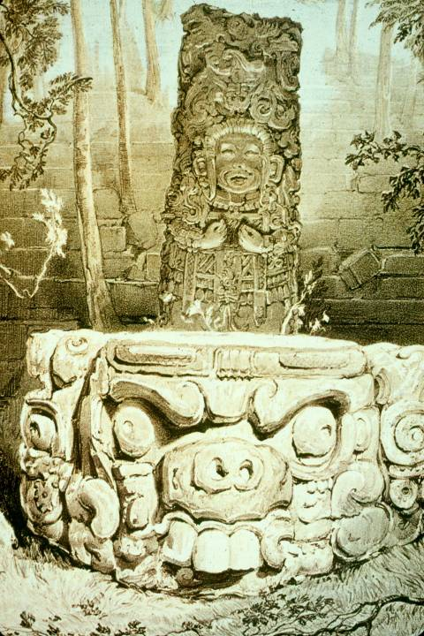
Civilizations of the America’s
Olmec & Mayan
AIM: How were the Olmec & Mayan Civilizations similar?

Slide 4
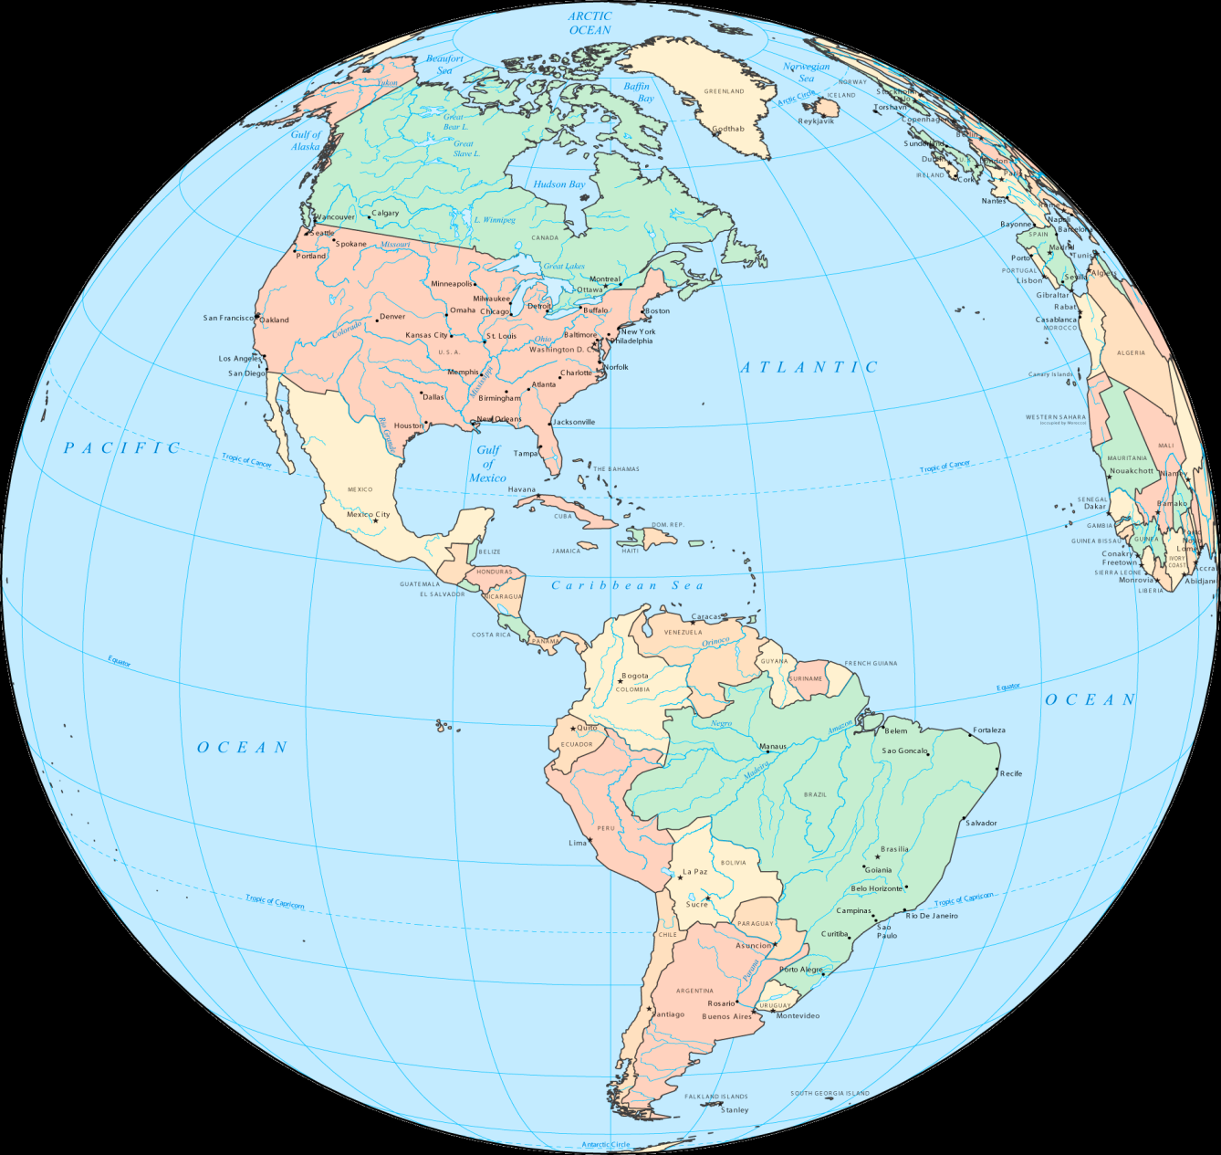
In between or on what two (2) continents
is Mesoamerica located?
A
North America
C
Mesoamerica
B
South America

Slide 5
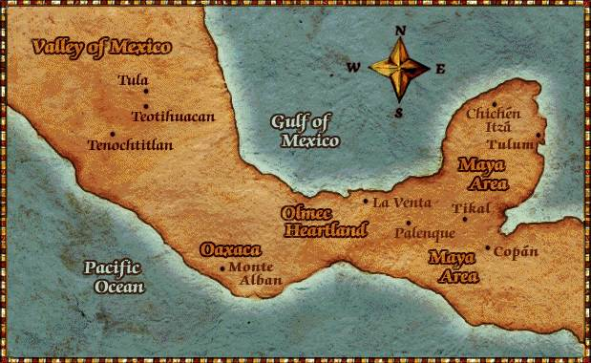
Olmec Civilization
Mexico & Central America

Slide 6
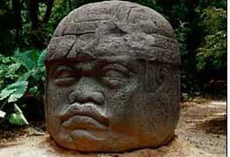
Olmec Head at La Venta

Slide 7
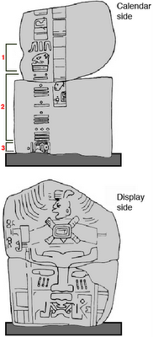
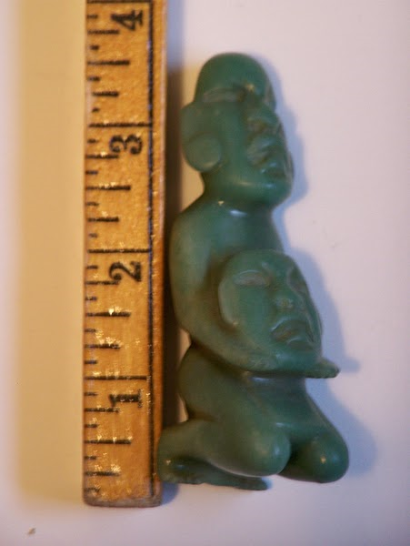
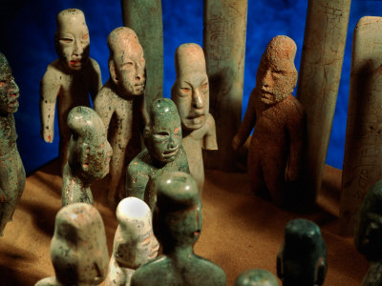
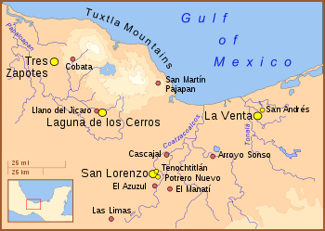
Olmecs – Important Achievements
1st COMPLEX SOCIETY in the Americas (1200BC)
Built elaborate CITIES with DRAINAGE SYSTEMS to divert waters that might otherwise have caused floods.
  Jade Craftsman - Imported jade and obsidian and exported small jade, basalt, and ceramic & created stone works of art. TRADE
  Math & Astronomy to create a CALENDAR.
Notes:
“Olmec” was not what the people called themselves
It means “rubber people” and comes from the rubber trees that flourish in the region

Slide 8
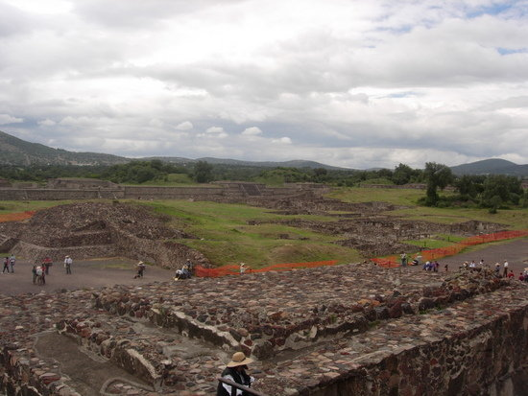
Decline of the Olmec
By about 400 B.C., Statues were broken and buried, monuments defaced, and capitals burned.
Other societies (Mayan) soon eclipsed it.
No one knows why, but some speculate reasons involving civil conflicts.

Slide 9
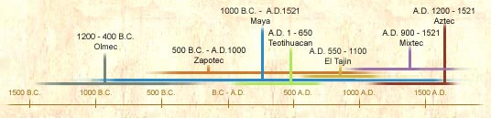
Activity: Early America’s Timeline

Slide 10
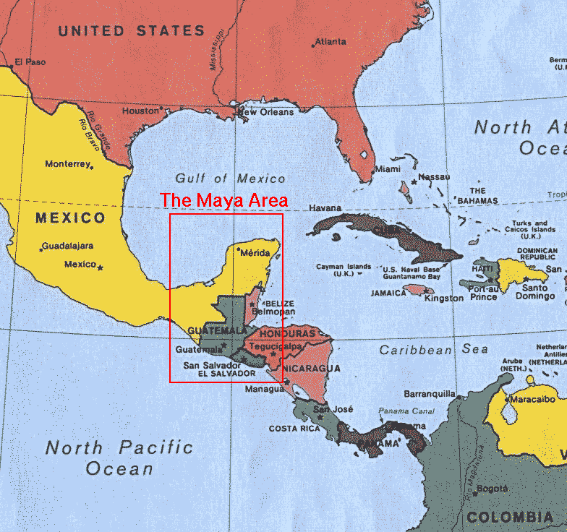
Mayan Civilization
Mexico &
Central America

Slide 11
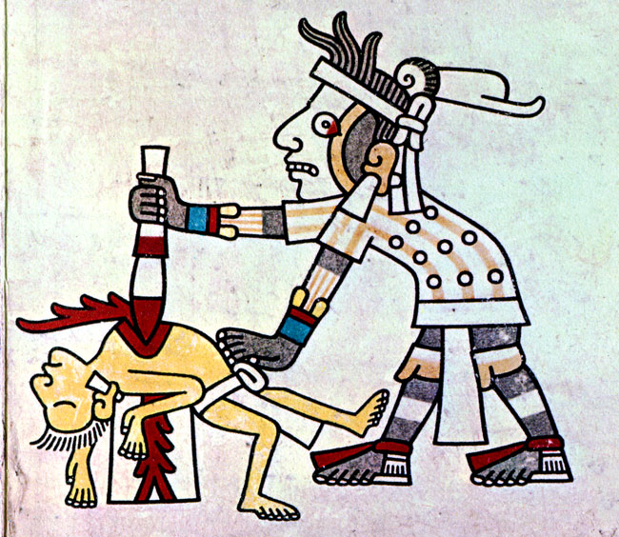
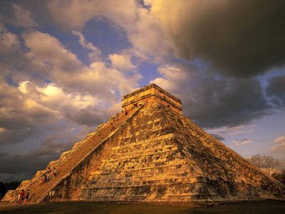
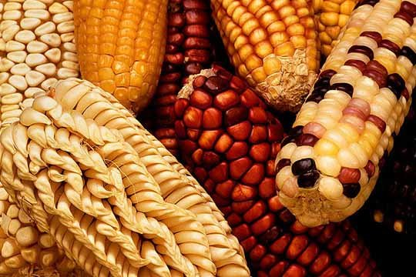
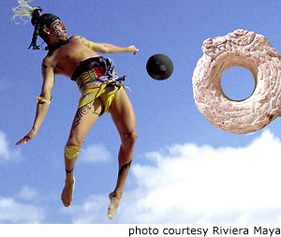
Olmec Influence on the Mayans
Maize
Ceremonial centers
with temple pyramids
Calendar based on
the Olmec calendar
Ball games
Rituals involving
human sacrifice

Slide 12
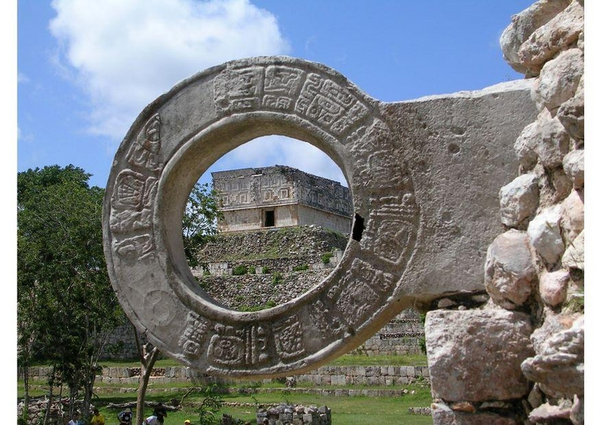
Mayan Ball Court Game – “No Hands, Please”

Slide 13
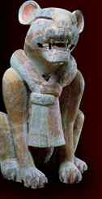
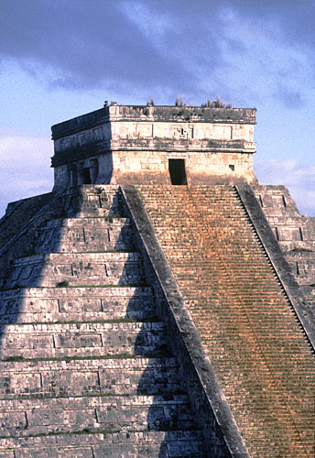
Mayans
Began to develop around 300 A.D. in what is now southern Mexico, Guatemala, Belize, Honduras, and El Salvador
Known as “The People of the Jaguar”

Slide 14
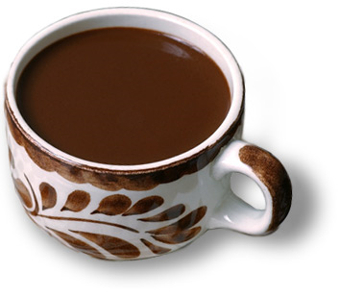
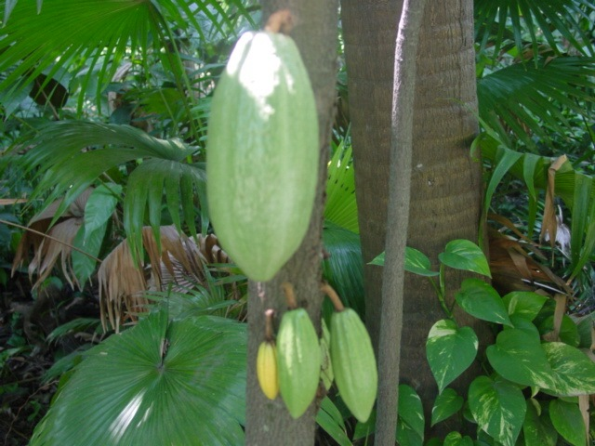
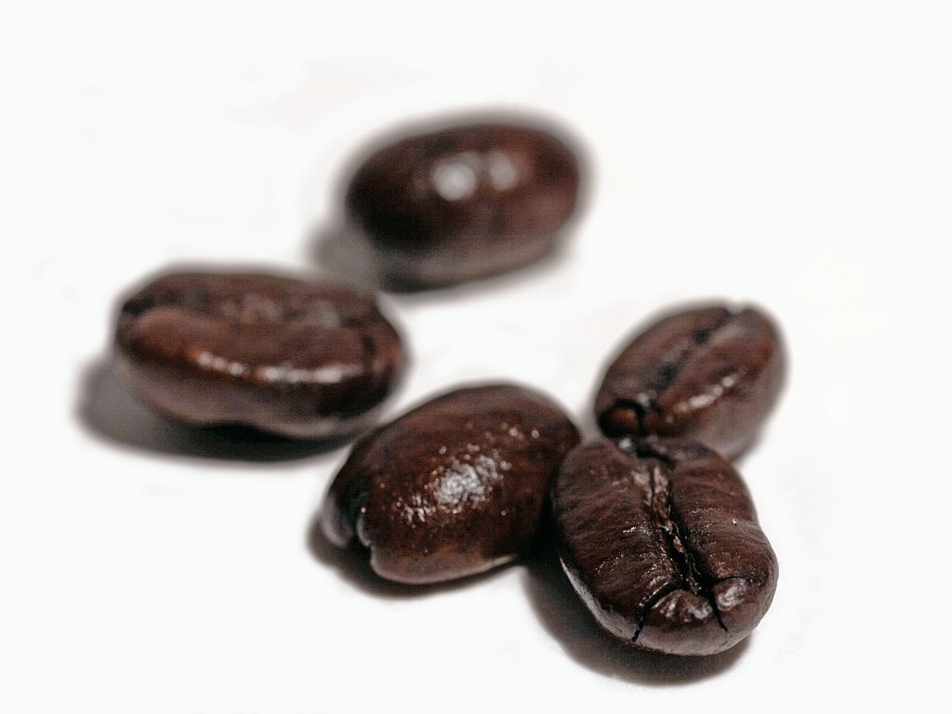

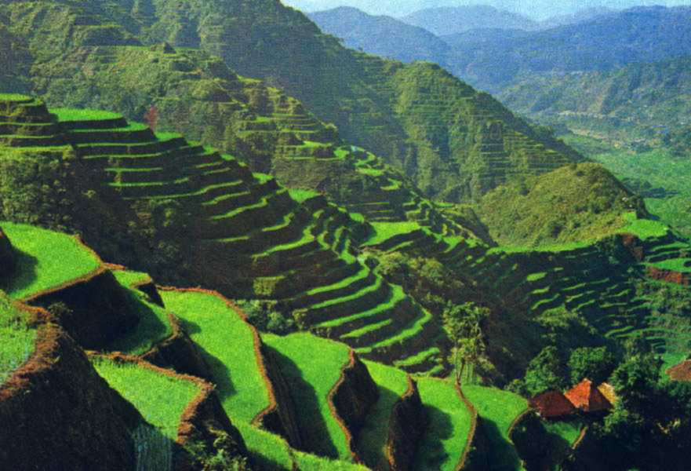
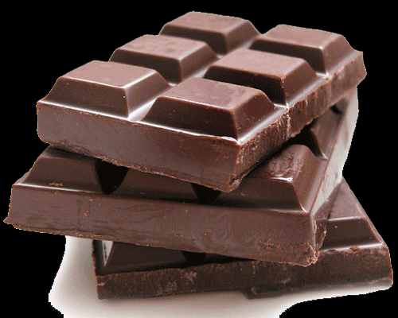
Agriculture
  Mayans built terraces to retain the silt and therefore greatly improved agricultural production
  Cacao was a precious commodity consumed mostly by nobles and even used as money
  What drinks/food can you make out of Cacao?
Cacao tree

Slide 15

New Technologies: Calendar
Interwove two kinds of year
  A solar year of 365 days governed the agricultural cycle
  A ritual year of 260 days governed daily affairs by organizing time into twenty “months” of thirteen days each
Mayan priests developed the most elaborate calendar
of the ancient Americas

Slide 16
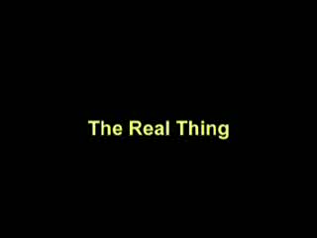
New Technologies: Astronomy1
Interwove two kinds of year
  A solar year of 365 days governed the agricultural cycle
  A ritual year of 260 days governed daily affairs by organizing time into twenty “months” of thirteen days each
Temple of the Serpent – Chitchen Itza

Slide 17
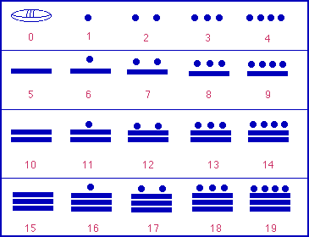
New Technologies
Excelled in astronomy and mathematics
  Could plot planetary cycles and predict eclipses of the sun and moon
  Invented the concept of zero and used a symbol to represent zero mathematically, which facilitated the manipulation of large numbers
  By combining astronomy and mathematics, calculated the length of the solar year at 365.242 days– about 17 seconds shorter than the figure reached by modern astronomers
Mayan numerical system

Slide 18
Mayan Decline
By about 800, most Mayan populations had begun to desert their cities
  Full scale decline followed everywhere but in the northern Yucatan
Possible causes include foreign invasion, internal dissension and civil war, failure of the water control system leading to agricultural disaster, ecological problems caused by destruction of the forests, epidemic diseases, and natural disasters

