Slide 1
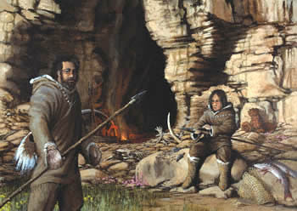
Aim: What are the characteristics of the Paleolithic Age?
People of the
Old Stone Age
Hunters &
Gatherers
Do Now: What does the word stem “Paleo” mean? Hint: It’s the opposite of “Neo”

Slide 2
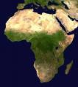
The earliest humans probably lived in Africa.
They spread to the rest of the world over the next tens of thousands of years as they hunted and gathered food to survive.

Slide 3
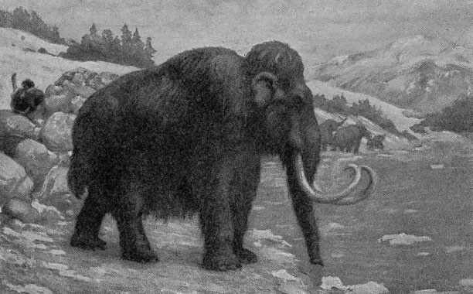
Getting Food

Slide 4


Without becoming food!

Slide 5
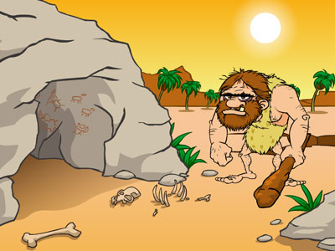
Ugh…Me so
Hungry!

Slide 6
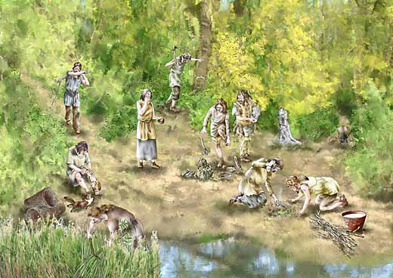
Groups of related families united in bands.
They collected roots, nuts, fruits, and seeds.
They also cooperated together for basic
needs such as for food and shelter
Hunted & Gathered for Food / Nomadic

Slide 7
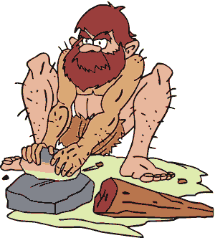

The animals
they killed
provided:
meat for food
bones for tools
hides for clothing

Slide 8
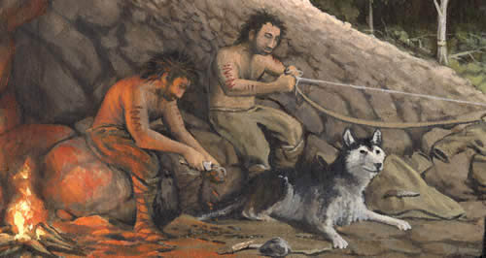
They set up seasonal camps in caves or rock shelters wherever the animals were plentiful.

Slide 9
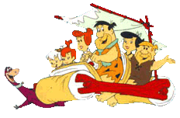

People (Bands) migrated when food (plants or animals) became scarce in one location.
We’re
outta here!
Yaba-daba-doo!

Slide 10
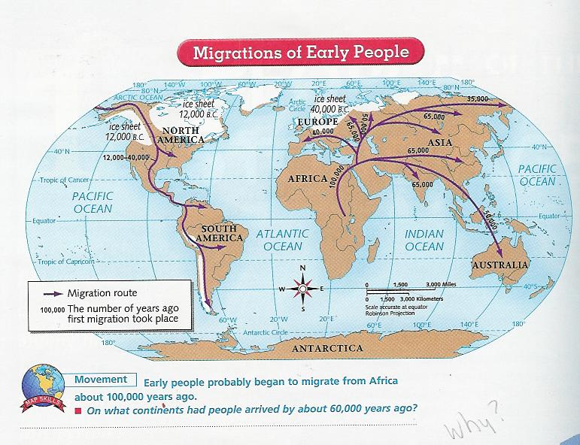
Spreading Through the World

Slide 11

Reasons for the Migrations
Couldn’t find enough food
Growing number of bands
Changing climate
Follow animals on the move (hunting)

Slide 12
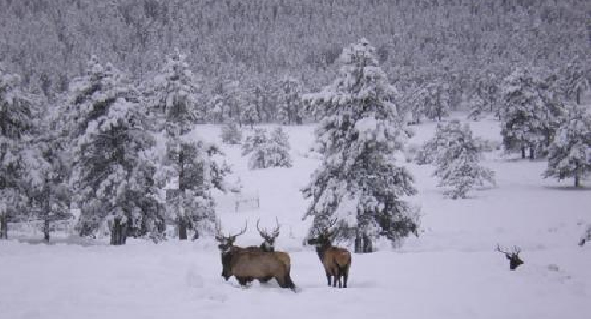
Ice Age
About 35,000 years ago
Ice sheets covered about 1/3 of the earth
Result…ocean level lower &
land bridges made migration to
various parts of world possible

Slide 13
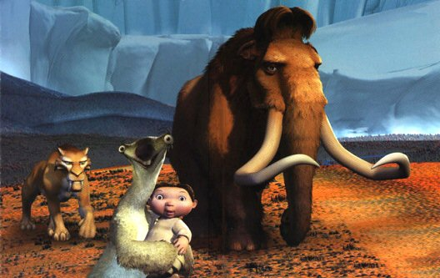
And it made a cool movie too…

Slide 14
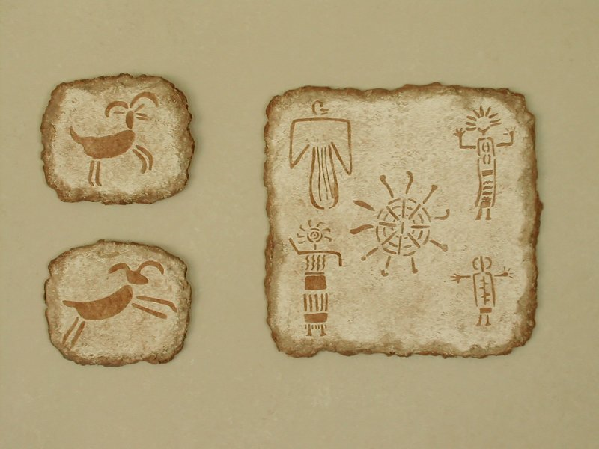
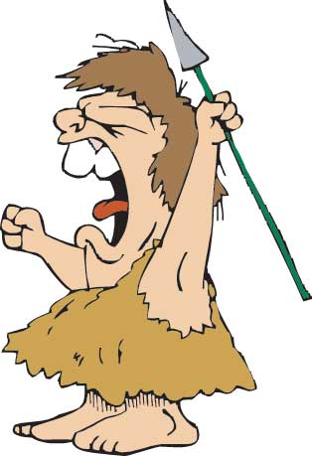
Cave Paintings are Artifacts too.

Slide 15
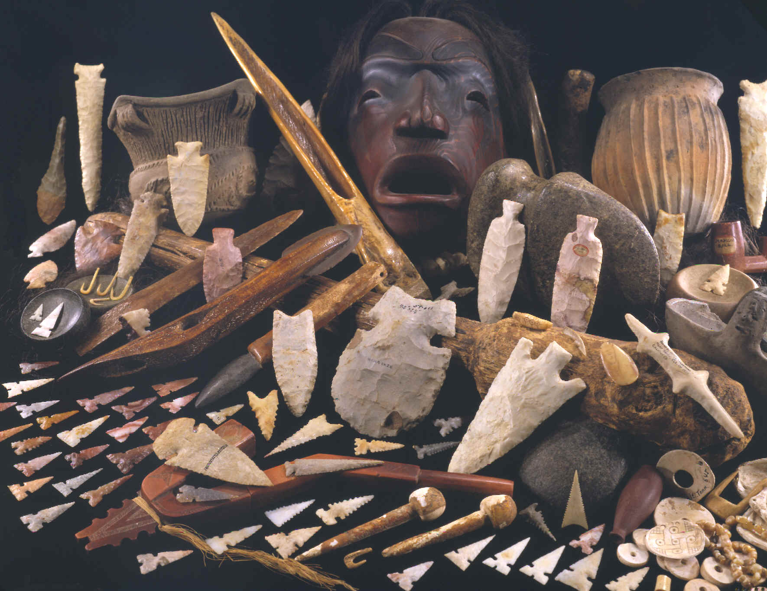
Stone Age Artifacts

Slide 16

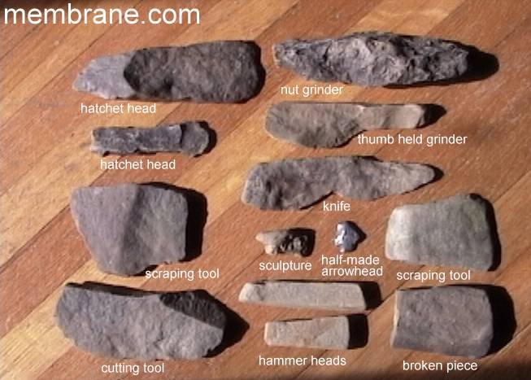
Stone Tools

Slide 17

Here we see our good friend, Ugamug, hard at work using his tools.
Watch out for your thumb!

Slide 18


Slide 19
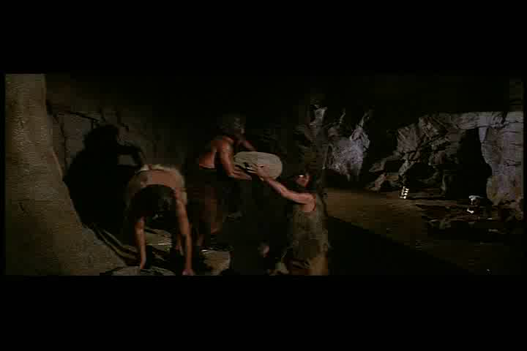

Slide 20
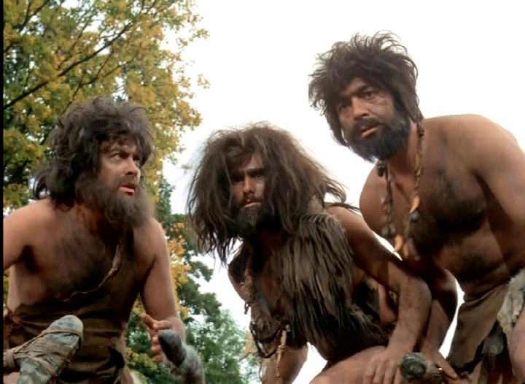
What have we learned?

Slide 21
How did early people get the food they needed to survive?

Slide 22
2. Why did early people work together?

Slide 23
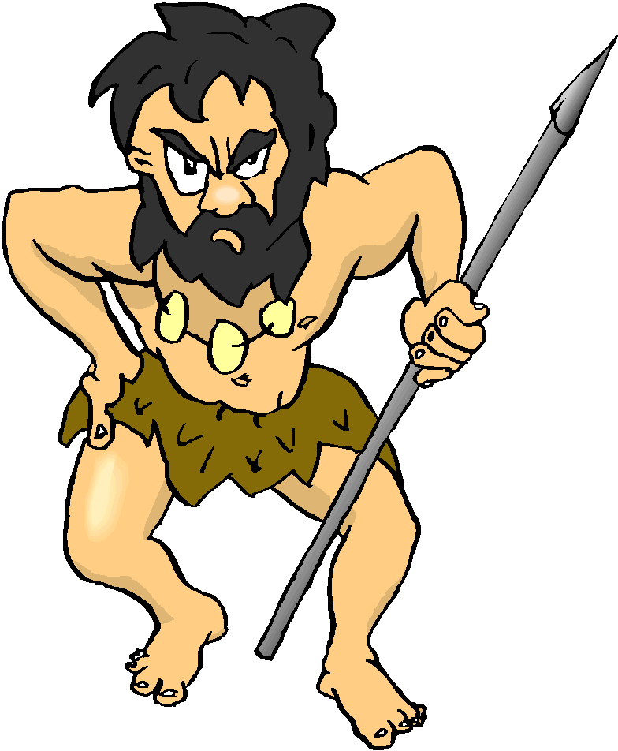
Paleolithic - Old Stone Age
Review
People hunted & gathered for food
People were nomadic (moved from place to place)
People made tools made of Stone
People expressed themselves with cave painting art
People worked together for survival

Slide 24
3. Besides food, for what purposes might early people have worked together?

