Slide 1
Essential Question:
How did the Roman Catholic Church respond to the Protestant Reformation?
Do Now: In a quick write, identify and explain at least two (2) causes of the Protestant Reformation.

Slide 2
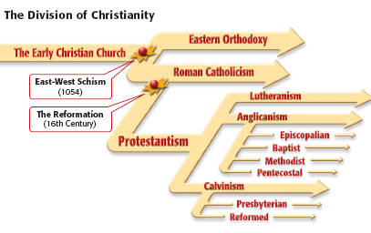
During the Protestant Reformation, religious reformers called protestants broke from the Catholic Church & started new Christian denominations

Slide 3
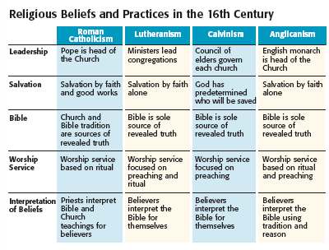
Protestant Reformation
Martin Luther began the Reformation & believed in Justification by Faith
John Calvin believed in predestination & a strict code of living
Henry VIII, not the Pope, was the head of the Anglican Church

Slide 4
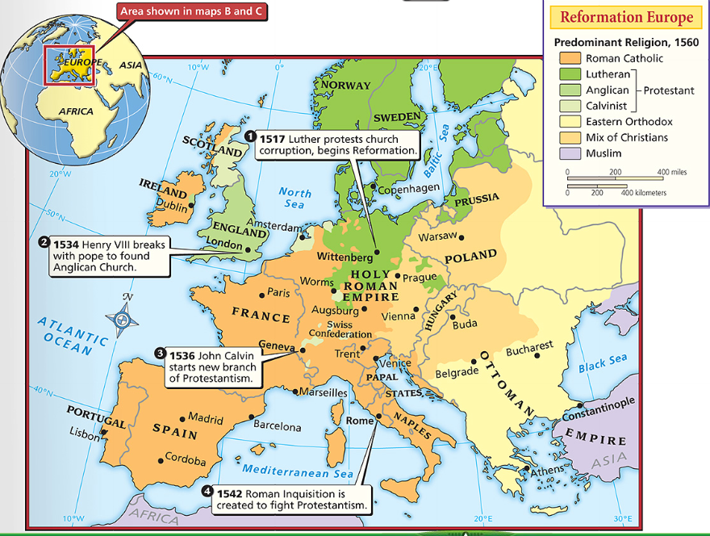
In the 1500s, the new protestant faiths spread, especially into northern Europe in areas away from the power of the Catholic Church
But, most Europeans, especially in Spain, France, Portugal, & Italy stayed with the Catholic Church which remained the largest religion in Europe but it had lost much of its power & influence

Slide 5
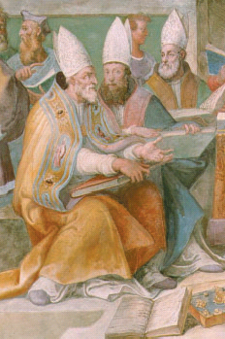
How did leaders of the Catholic Church respond to the Reformation?
Assume the role of a Catholic bishop attending the Council of Trent in 1545 & develop a response to the Reformation
Brainstorm solutions to this problem
Identify positive & negative consequences of each possible solution
Rank order your solutions
Be prepared to discuss

Slide 6
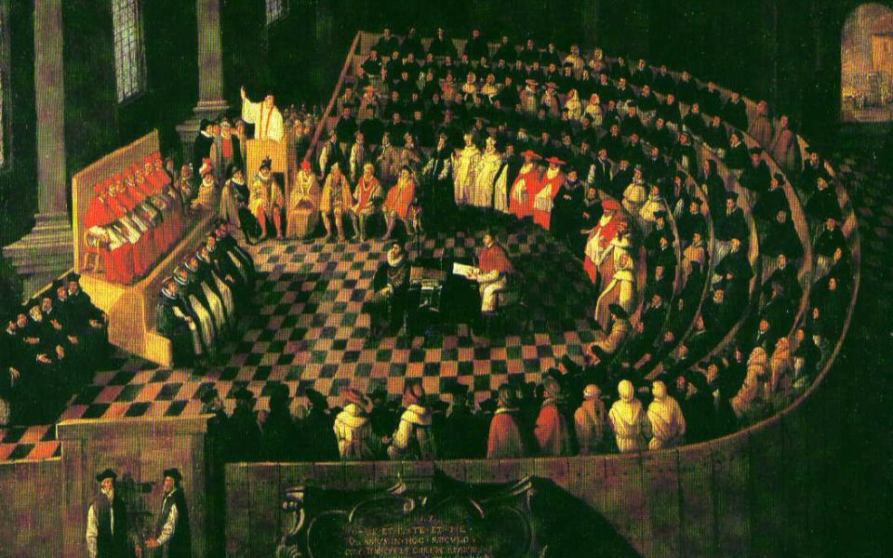
The Catholic Reformation
The response of the Catholic Church to the Protestant Reformation became known as the Counter-Reformation (or the Catholic Reformation)

Slide 7
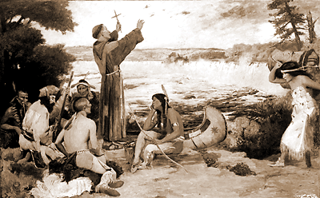
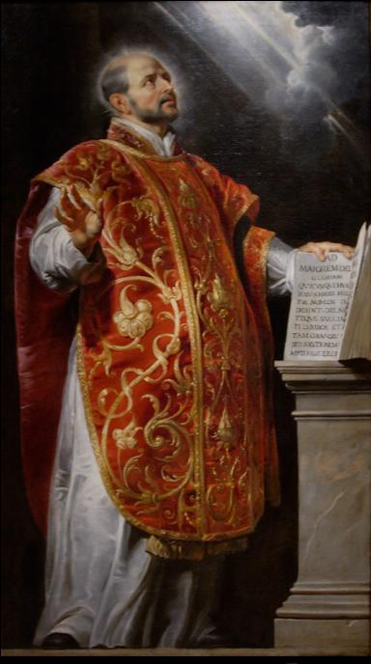
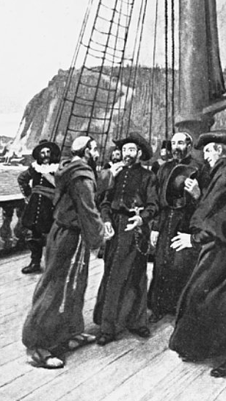
One of the first reformers in the Catholic Church was Ignatius of Loyola who formed the Society of Jesus in 1540
Members of the Society of Jesus were called Jesuits & focused on three goals:
Jesuits formed schools to better educate Catholic priests
Jesuits tried to stop the spread of Protestantism
Jesuits sent missionaries around the world to convert non-Christians to Catholicism
Notes:
For the next 18 years, Ignatius gathered followers. In 1540, the pope created a religious order for his followers called the Society of Jesus. Members were called Jesuits (JEHZH•u•ihts). The Jesuits focused on three activities. First, they founded superb schools throughout Europe. Jesuit teachers were well-trained in both classical studies and theology. The Jesuits’ second mission was to convert non-Christians to Catholicism. So, they sent out missionaries around the world. Their third goal was to stop the spread of Protestantism. The zeal of the Jesuits overcame the drift toward Protestantism in Poland and southern Germany.

Slide 8
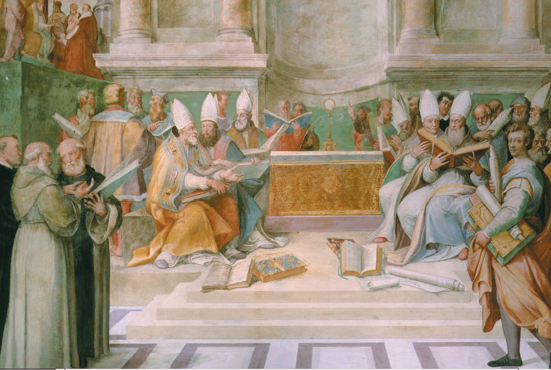
In 1545, Pope Paul III created a committee of Catholic leaders to review church practices, known as the Council of Trent
The Catholic Church stopped selling false indulgences
Over the next 18 years, the Council of Trent made a series of reforms
New schools were created to educate priests
Notes:
The nineteenth ecumenical council opened at Trent on 13 December, 1545, and closed there on 4 December, 1563. Its main object was the definitive determination of the doctrines of the Church in answer to the heresies of the Protestants; a further object was the execution of a thorough reform of the inner life of the Church by removing the numerous abuses that had developed in it.
Two popes took the lead in reforming the Catholic Church. Paul III, pope from 1534 to 1549, took four important steps. First, he directed a council of cardinals to investigate indulgence selling and other abuses in the Church. Second, he approved the Jesuit order. Third, he used the Inquisition to seek out heresy in papal territory. Fourth, and most important, he called a council of Church leaders to meet in Trent, in northern Italy. From 1545 to 1563, at the Council of Trent, Catholic bishops and cardinals agreed on several doctrines:
• The Church’s interpretation of the Bible was final. Any Christian who substituted his or her own interpretation was a heretic.
• Christians needed faith and good works for salvation. They were not saved by faith alone, as Luther argued.
• The Bible and Church tradition were equally powerful authorities for guiding Christian life.
• Indulgences were valid expressions of faith. But the false selling of indulgences was banned. The next pope, Paul IV, vigorously carried out the council’s decrees. In 1559, he had officials draw up a list of books considered dangerous to the Catholic faith. This list was known as the Index of Forbidden Books. Catholic bishops throughout Europe were ordered to gather up the offensive books (including Protestant Bibles) and burn them in bonfires. In Venice alone, followers burned 10,000 books in one day.

Slide 9
The Council of Trent also reaffirmed several core Catholic beliefs & practices
Salvation is gained through faith in God & good works
All seven Holy Sacraments are legitimate means to gain God’s grace
The Church’s interpretation of the Bible is final & all others who interpret the Bible are heretics (non-believers)
Notes:
Two popes took the lead in reforming the Catholic Church. Paul III, pope from 1534 to 1549, took four important steps. First, he directed a council of cardinals to investigate indulgence selling and other abuses in the Church. Second, he approved the Jesuit order. Third, he used the Inquisition to seek out heresy in papal territory. Fourth, and most important, he called a council of Church leaders to meet in Trent, in northern Italy. From 1545 to 1563, at the Council of Trent, Catholic bishops and cardinals agreed on several doctrines:
• The Church’s interpretation of the Bible was final. Any Christian who substituted his or her own interpretation was a heretic.
• Christians needed faith and good works for salvation. They were not saved by faith alone, as Luther argued.
• The Bible and Church tradition were equally powerful authorities for guiding Christian life.
• Indulgences were valid expressions of faith. But the false selling of indulgences was banned. The next pope, Paul IV, vigorously carried out the council’s decrees. In 1559, he had officials draw up a list of books considered dangerous to the Catholic faith. This list was known as the Index of Forbidden Books. Catholic bishops throughout Europe were ordered to gather up the offensive books (including Protestant Bibles) and burn them in bonfires. In Venice alone, followers burned 10,000 books in one day.

Slide 10
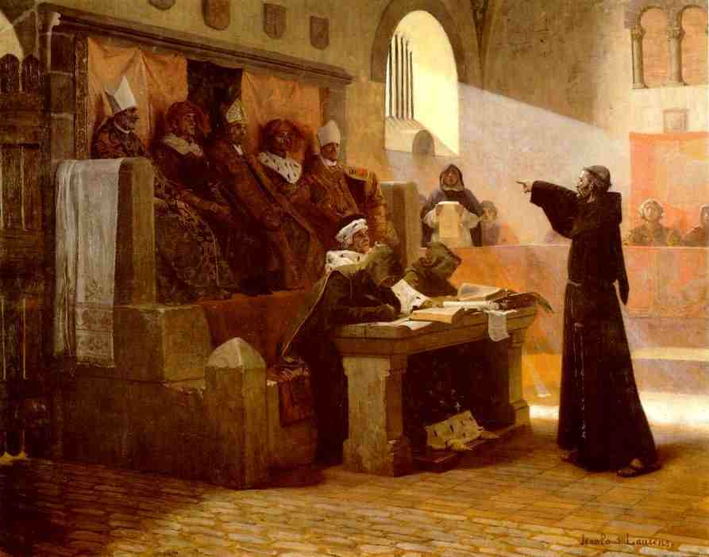
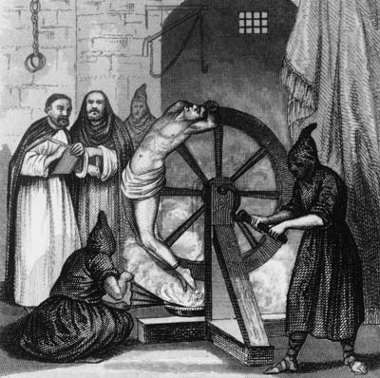
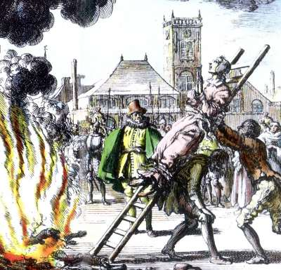
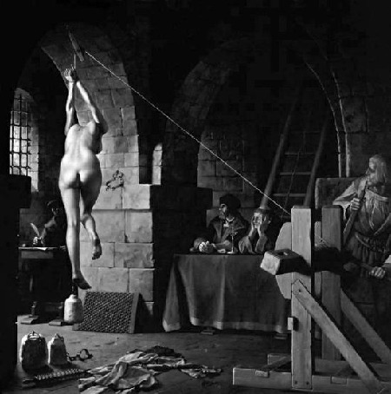
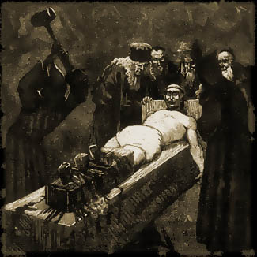
To enforce these beliefs, the Church used the Inquisition to accuse, hold trials, & punish heretics

Slide 11
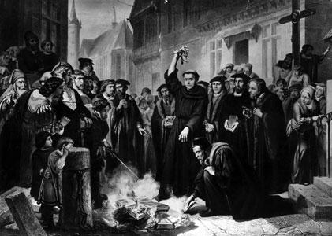
The Church banned & burned all offensive books, including Protestant bibles

Slide 12
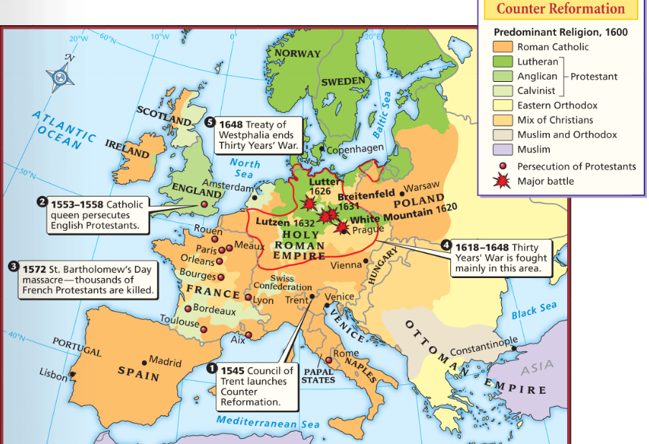
The Impact of the Reformation
The Protestant Reformation left Europe religiously divided
Numerous religious wars were fought between Catholics & Protestants
The weakened authority of the Pope helped kings gain power & form nations
Missionaries converted non-Christians throughout the world
The Reformation encouraged education & the questioning of long-held beliefs
Notes:
Religious and Social Effects of the Reformation Despite
religious wars and persecutions, Protestant churches flourished
and new denominations developed. The Roman Catholic Church itself became more unified as a result of the reforms started at the Council of Trent. Both Catholics and Protestants gave more emphasis to the role of education in promoting their beliefs. This led to the founding of parish schools and new colleges and universities throughout Europe. Some women reformers had hoped to see the status of women in the church and society improve as a result of the Reformation. But it remained much the same both under Protestantism and Roman Catholicism. Women were still mainly limited to the concerns of home and family.
Political Effects of the Reformation As the Catholic
Church’s moral and political authority declined, individual
monarchs and states gained power. This led to the development
of modern nation-states. In the 1600s, rulers of nation-states
would seek more power for themselves and their
countries through warfare, exploration, and expansion.
The Reformation’s questioning of beliefs and authority also
laid the groundwork for the Enlightenment. As you will read
in Chapter 22, this intellectual movement would sweep Europe
in the late 18th century. It led some to reject all religions and
others to call for the overthrow of existing governments.

